Slide 1
DR. JAYA BHARTI
ASSISTANT PROFESSOR
DEPARTMENT OF PSYCHOLOGY
A.N.D.N.N.M.M. (C.S.J.M. KANPUR)

Slide 2
CONCEPT OF LEARNING
Learning, in psychology, the process by which a relatively lasting change in potential behaviour occurs because of practice or experience. Learning is also a process of acquiring modifications in existing knowledge, skills, habits, or tendencies through experience, practice, or exercise.

Slide 3
“Learning is the process of progressive behaviour adaptation”.
-Skinner
“Learning is the acquisition of new behaviour or strengthening or weakening of old behaviour as a result of experience”.
-Henry, P Smith
“Learning is the process of progressive behaviour adaptation”.
- Skinner
“Learning is the acquisition of habits, knowledge and attitudes. It involves new ways of doing things, and it operates in an individual‘s attempt to overcome obstacles or to adjust to new situations”.
-Crow and Crow
“Learning is the modification of behaviour through experience”.
- Gates and others

Slide 4
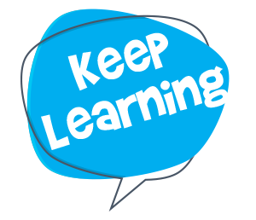
CHARACTERISTICS OF LEARNING
Learning is a continuous modification of behaviour which continues throughout life
Learning is pervasive. It reaches into all aspects of human life.
Learning involves the whole person, socially, emotionally & intellectually.
Learning is often a change in the organisation of behaviour.
Learning is development. Time is one of its dimensions.
Learning is responsive to incentives. In most cases positive incentives such as rewards are most effective than negative incentives such as punishments.
Learning is always concerned with goals. These goals can be expressed in terms of observable behaviour.
Interest & learning are positively related. The individual learns best those things, which he is interested in learning. Most boys find learning to play football easier than learning to add fractions.
Learning depends on maturation and motivation.

Slide 5
CLASSICAL CONDITIONING
Ivan Pavlov (1849-1936) .
Pavlov was a Russian physiologist who was doing research on digestion. His research was aimed at better understanding the digestive patterns in dogs.
Later on, the dogs began to salivate as soon as the person feeding them would enter the room. Then he moved his focus to Classical Conditioning.
Learning to associate an unconditioned stimulus that already brings about a particular response with a new stimulus, so that the new stimulus brings about the same response.
In simple terms two stimuli are linked together to produce a new learned response in a person or animal.
The first systematic study of basic laws of learning and or conditioning. Involves placing a neutral signal before a reflex .
Focuses on involuntary, automatic behaviours.

Slide 6
Classical conditioning is a form of learning whereby a conditioned stimulus (CS) becomes associated with an unrelated unconditioned stimulus (US), in order to produce a behavioral response known as a conditioned response (CR). The conditioned response is the learned response to the previously neutral stimulus.
The unconditioned stimulus is usually a biologically significant stimulus such as food or pain that elicits an unconditioned response (UR) from the start. The conditioned stimulus is usually neutral and produces no particular response at first, but after conditioning it elicits the conditioned response.

Slide 7
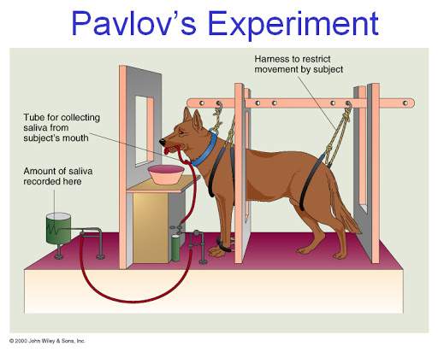
He inserted a small test tube into the cheek of each dog to measure saliva when the dogs were fed (with a powder made from meat).
Pavlov predicted the dogs would salivate in response to the food placed in front of them, but he noticed that his dogs would begin to salivate whenever they heard the footsteps of his assistant who was bringing them the food.
When Pavlov discovered that any object or event which the dogs learned to associate with food (such as the lab assistant) would trigger the same response, he realized that he had made an important scientific discovery. Accordingly, he devoted the rest of his career to studying this type of learning.

Slide 8
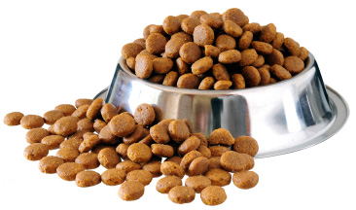
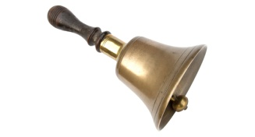
COMPONENTS OF CLASSICAL CONDITIONING
The Unconditioned Stimulus (UCS) :A stimulus that naturally, and automatically triggers a response.
The Unconditioned Response(UCR):The unlearned response that occurs naturally in response to the unconditioned stimulus.
The Conditioned Stimulus(CS):A previously neutral stimulus that when paired with an unconditioned stimulus triggers a conditioned response.
+
The Conditioned Response(CR):Learned response to the previously neutral stimulus.

Slide 9
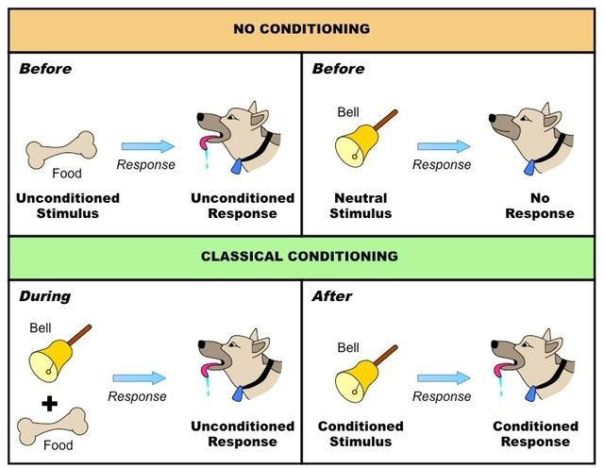

Slide 10
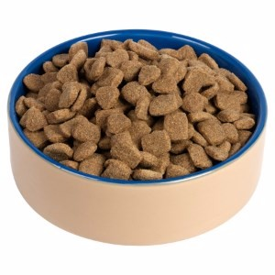
TYPES OF CONDITIONING
Forward Conditioning- Occurs when the neutral stimulus (NS) appears just before and during the presentation of the unconditioned stimulus (UCS).
There are 2 types:
Delayed conditioning (forward) - the CS is presented before the US and it (CS) stays on until the US is presented. This is generally the best, especially when the delay is short.
2. Trace conditioning - discrete event is presented, then the US occurs. Shorter the interval the better, but as you can tell, this approach is not very effective.
C.S.
UCS
C.S.
UCS

Slide 11
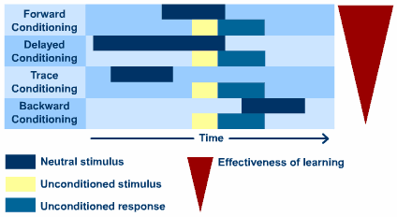
Backward conditioning – Backward conditioning occurs when a Conditioned stimulus immediately follows a Unconditioned stimulus.
Temporal conditioning a Unconditioned stimulus is presented at regular intervals, for instance every 10 minutes
Simultaneous conditioning - Both conditioned and unconditioned stimulus occurs and terminates at same time.
UCS
CS

Slide 12
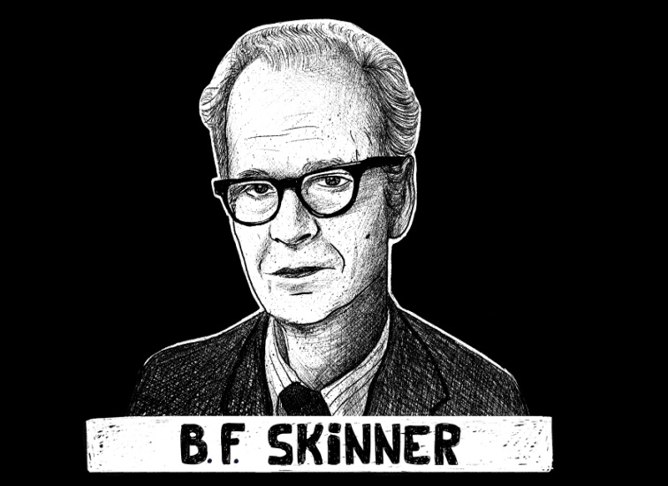
Instrumental conditioning is another term for Operant Conditioning, a learning process first described by B. F. Skinner. In instrumental conditioning, reinforcement or punishment are used to either increase or decrease the probability that a behaviour will occur again in the future.

Slide 13
A method of learning that occurs through reinforcements and punishments for behavior. We learn to perform certain behaviors more often because they result in rewards, and learn to avoid other behaviors because they result in punishment or adverse consequences.

Slide 14
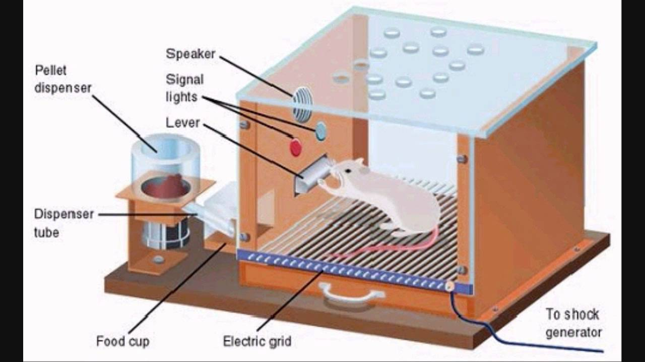
In a typical experiment, a rat or pigeon would be put into the Skinner box in which temperature, light and noise could be kept constant. On one wall of the box, there would be a lever and a hopper that could deliver a food pellet to the animal when the lever was pressed. Initially, the rat is likely to wander around the box aimlessly until it accidentally presses the lever and receives a food pellet. Skinner would leave the animal in the box and measure how frequently the animal pressed the lever over time. The frequency should indicate the strength of the conditioning of the behaviour. This would then be repeated with other animals.

Slide 15
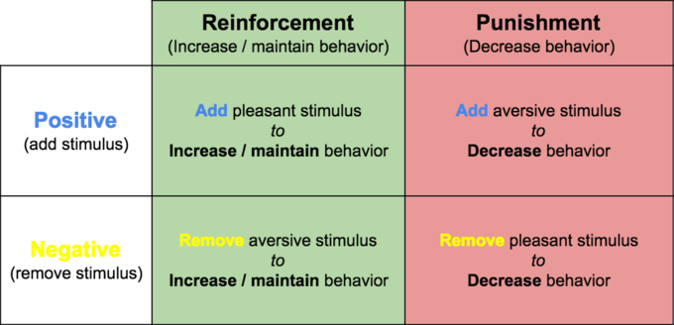
REINFORCEMENT IN INSTRUMENTAL CONDITIONING

Slide 16
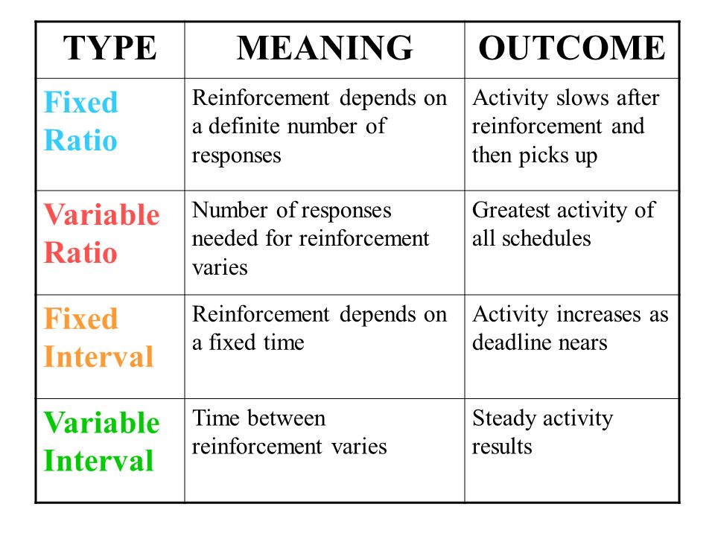
SCHEDULES OF REINFORCEMENT

Slide 17
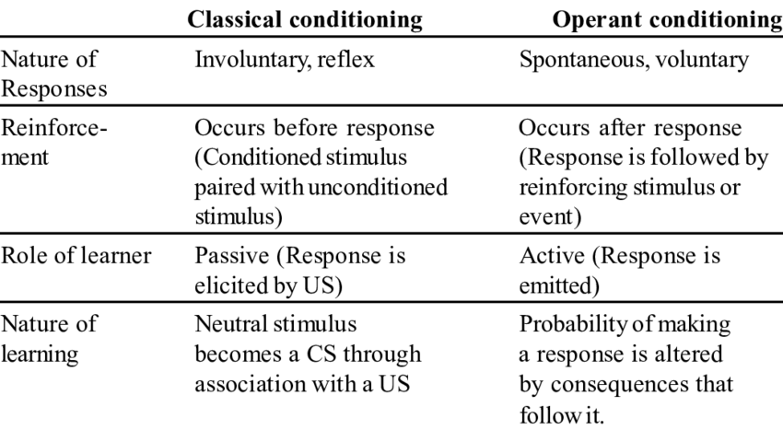
DIFFERENCES

