Slide 1
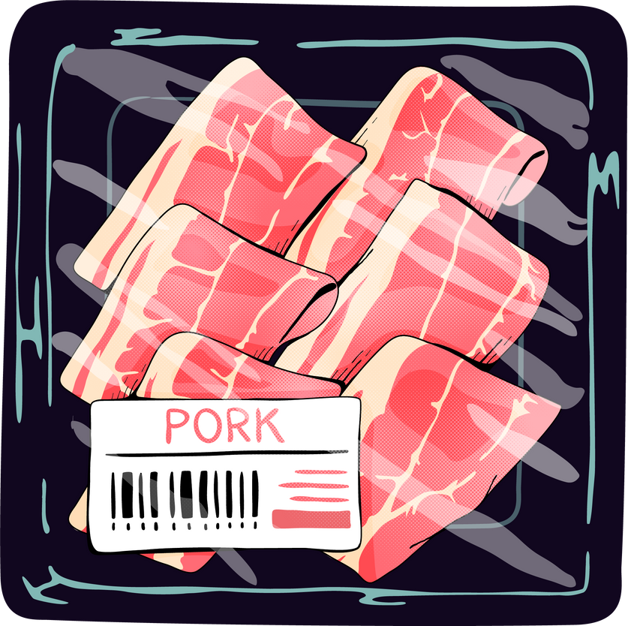
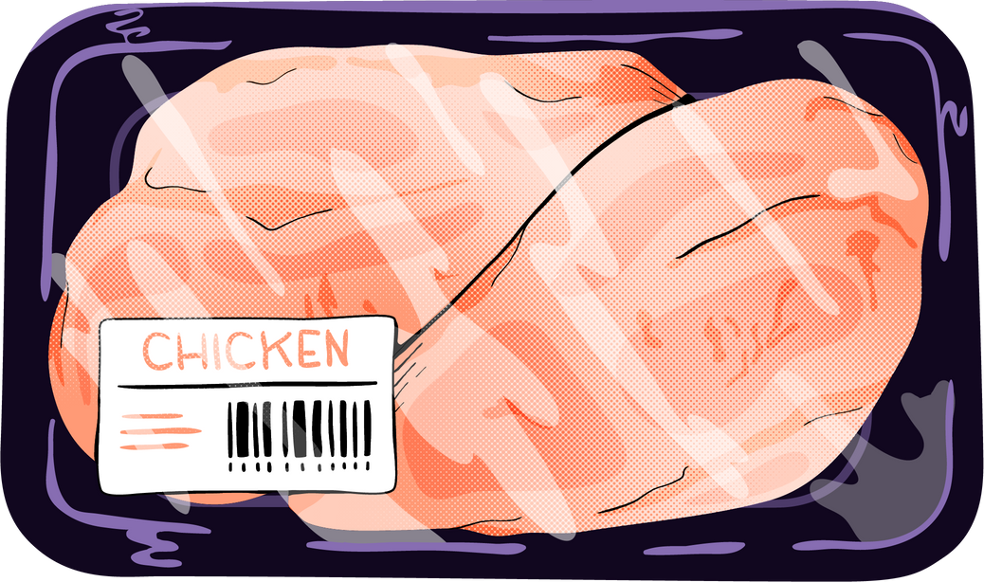
Proteins:
Sources, Classification, Functions and Deficiency Diseases
Dr. Archna Saxena
Associate Professor
Deptt. of Home Science
A.N.D. College, Kanpur

Slide 2
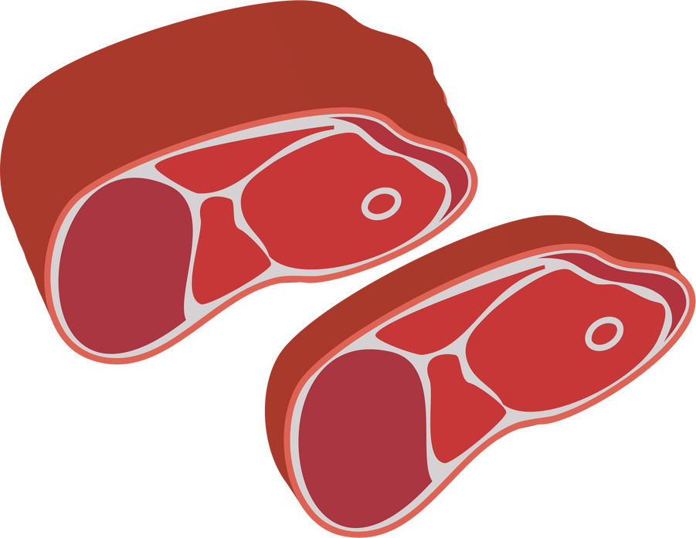
The term 'protein' was suggested by Berzelius to describe these complex organic nitrogenous substances found in animal and plant tissues.
Proteins form three-fourths of the animal body on a moisture-free basis. They are essential for life processes.

Slide 3
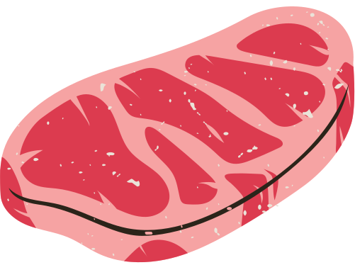
Proteins contain carbon, hydrogen, oxygen and nitrogen.
The basic building blocks of proteins are nitrogen-containing units called Amino acids.

Slide 4
Amino acids consist of a basic amino group (-NH2) and an acidic carboxyl group (-COOH) along with an organic R group (side chain) which is unique in each amino acid.

Slide 5
Food has a variety of proteins.
No two proteins have similar structures because amino acids are arranged in varying proportions and sequences.
Amino acids are of two types:
Essential Amino Acids
Non-essential Amino Acids

Slide 6
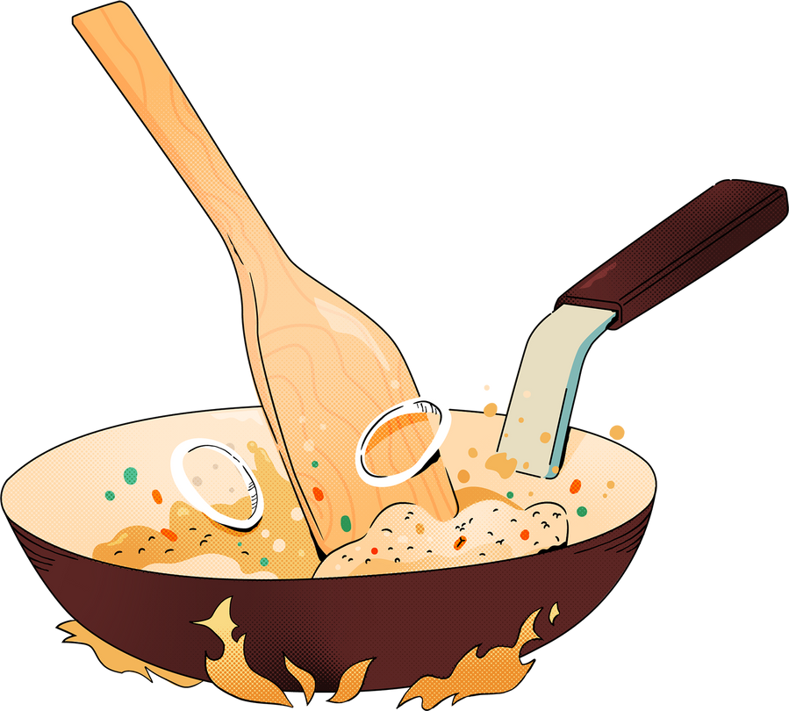
Our body doesn't produce essential amino acids.
We get them from food, and they're important for our growth.
Essential amino acids are of 10 types. Let's have a look at them.

Slide 7
L-arginine
L-histidine (only in infants)
L-isoleucine
L-leucine
L-lysine
L-methionine
L-phenylalanine
L-threonine
L-tryptophan
L-valine

Slide 8
Non-essential amino acids are synthesized in the body.
We don't source them from our food.
They only repair our cells, and don't assist the function of body-building.
Examples include Glutamic acid, Alanine, Proline, Glycine and others.

Slide 9
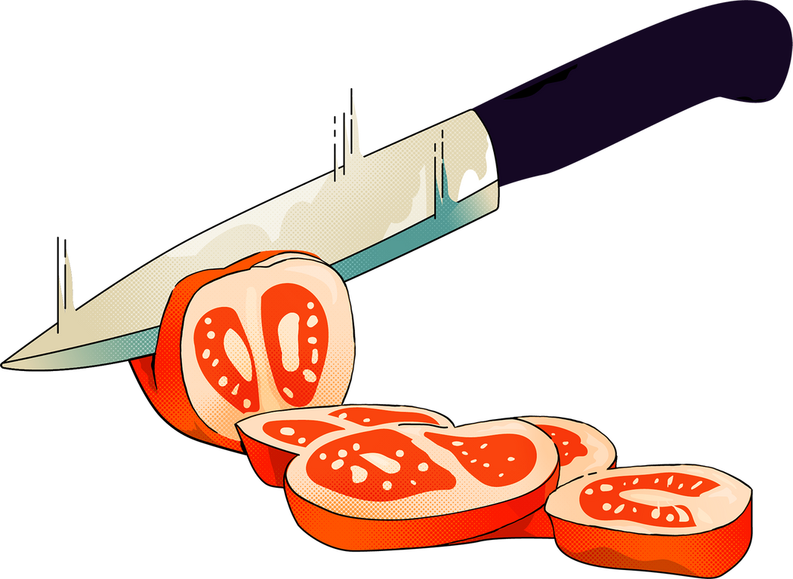
Proteins can be classified on the basis of their-
Quality
Source
Chemical nature

Slide 10
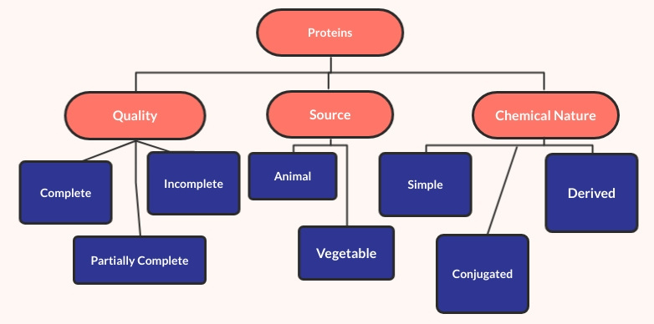
Classification of Proteins

Slide 11
Quality
Complete Proteins
Partially Complete Proteins
Incomplete Proteins

Slide 12
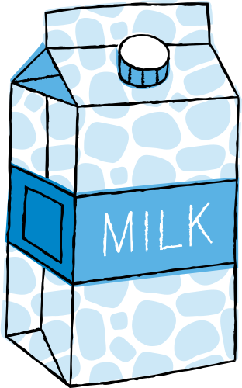
Complete proteins are of high biological value. They contain all the essential amino acids in appropriate amounts.
As they perform the function of body-building, they help in our growth and development.
Proteins from animal origin belong to this category, for example, lactalbumin in milk and ovalbumin in egg.

Slide 13
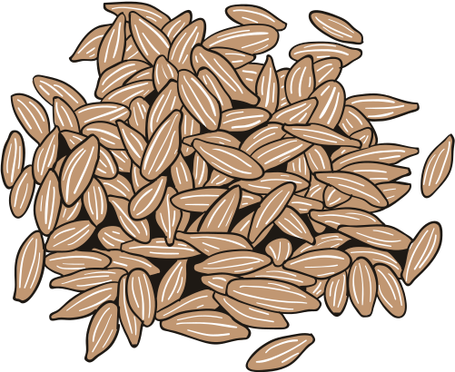
Partially complete proteins promote moderate growth and partially lack one or more essential amino acids. They cannot form new cells and tissues.
Examples include the proteins found in dal and cereals. Cereals lack essential amino acid lysine and dals lack methionine.

Slide 14
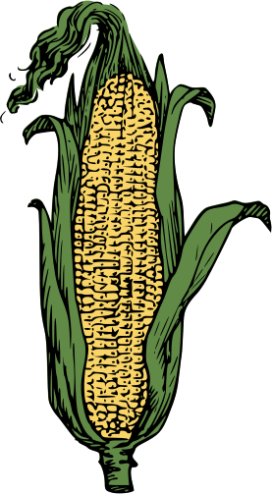
Incomplete proteins lack various kinds of essential amino acids. They do not promote growth.
They are found in corn (zein) and vegetables.

Slide 15
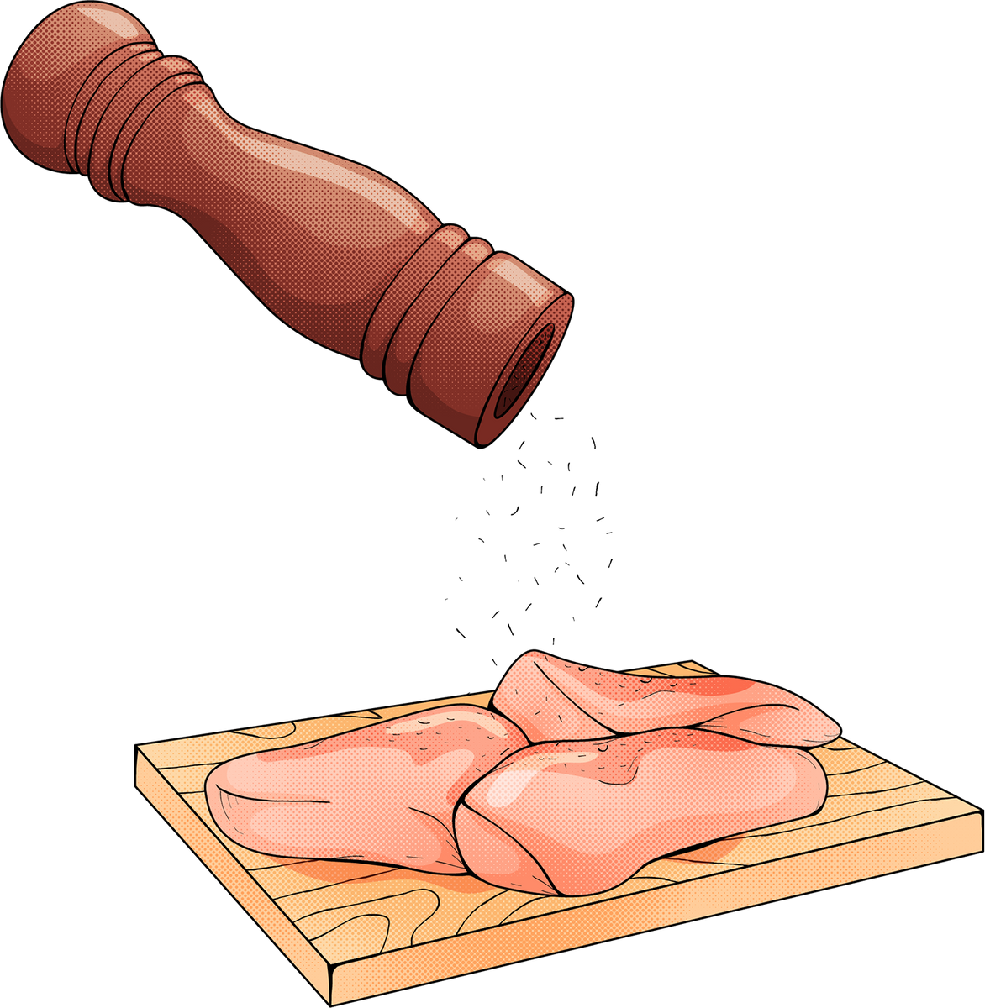
2. Sources
Animal Protein
Vegetable Protein

Slide 16
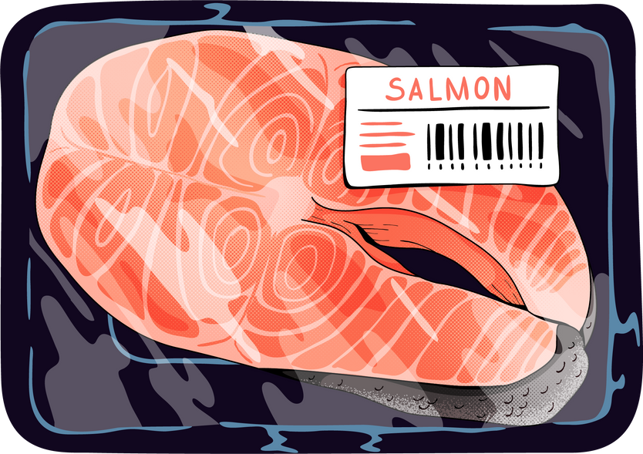
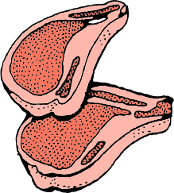
Animal proteins are obtained from animals. These are of high biological value and contain all the essential amino acids.
Milk and milk products, eggs, meat, fish, etc. belong to this category.

Slide 17
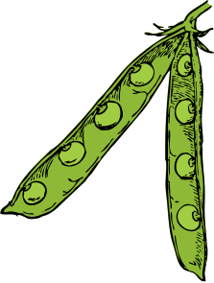
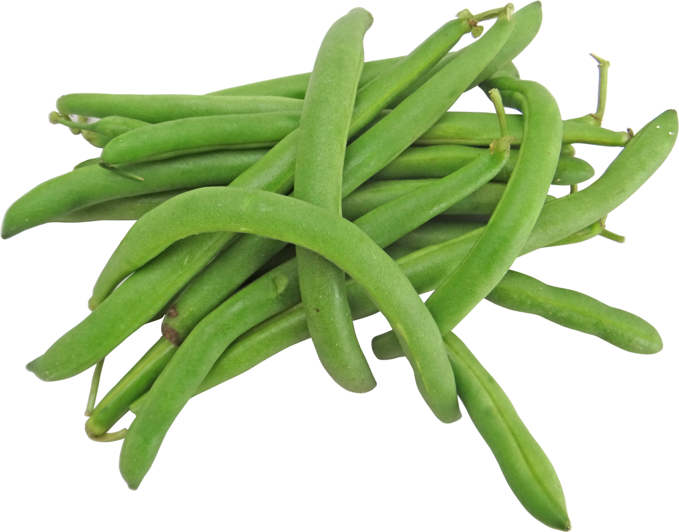
Vegetable proteins are obtained from plants. These are partially complete proteins and lack some essential amino acids.
Proteins of legumes and pulses, cereals and soya bean, peanuts, pea and dry fruits, for example, belong to this category.

Slide 18
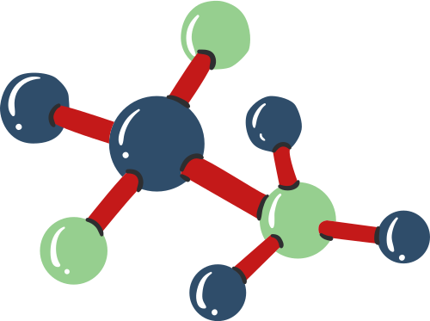
3. Chemical Nature
Simple Proteins
Conjugated Proteins
Derived Proteins

Slide 19
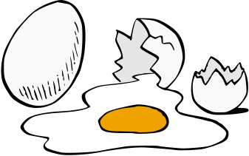
Simple proteins contain only amino acids. On hydrolysis, they yield only amino acids.
Albumin present in egg yolk and glutenin in wheat are examples.

Slide 20
Conjugated proteins contain some non-protein substances.
Examples include glycoproteins, lipoproteins, sulphoproteins, etc.

Slide 21
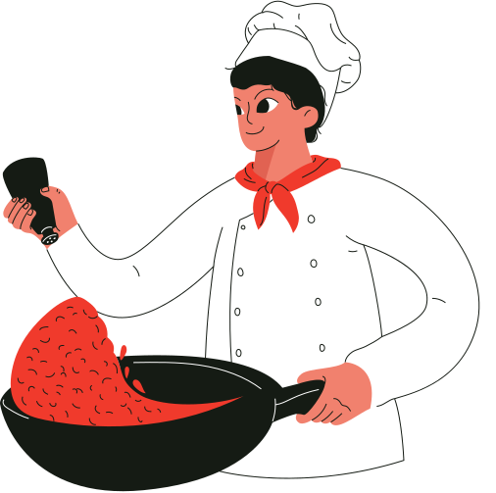
Derived proteins are derivates of the protein molecules formed by hydrolysis changes in the molecule.
In simpler words, we can say that derived proteins are formed by physical reactions, effect of temperature, or by the action of digestive juices.

Slide 22
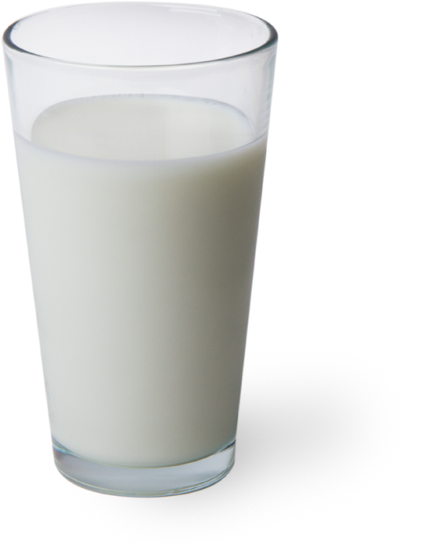
Let's have a look at the functions of proteins in our body.

Slide 23
Proteins aid in the growth and development of the body.
They also help in the maintenance and regeneration of tissues.

Slide 24
Proteins regulate the acid-base balance in the body.
Proteins help in the synthesis of hormones, enzymes and antibodies.
They maintain water balance.
They aid in muscle contraction.

Slide 25
Kwashiorkar is seen in children due to protein deficiency.
Deficiency of both protein and calories leads to Marasmus.
Protein deficiency diseases
Due to the deficiency of proteins,
growth is stunted.

Slide 26
Kwashiorkor is the disease the first child gets when the second baby is born. Essentially, it is the sickness of the deposed child.
The child is usually between 1-3 years and is weaned because the mother has given birth to another child or is pregnant.
Kwashiorkor

Slide 27
Growth failure
Edema
Moon face
Mental changes include irritability, laziness, indifference
Rashes and/or lesions
Rough, lusterless, brown, easily pluckable hair
Symptoms of Kwashiorkor

Slide 28
Muscle wasting
Enlarged liver
Loss of appetite, vomiting, diarrhoea
Anaemia
Vitamin deficiency (of Vitamin A), resulting in Xeropthalmia and Keratomalacia
Pot-belly

Slide 29
Marasmus occurs due to deficiency of protein and calories both.
Generally, children of around 1 year are affected. In developing countries, a common cause for Marasmus is the cessation of breast feeding.
Marasmus

Slide 30
Symptoms of Marasmus
Growth retardation
Wasting of muscles and subcutaneous fat
The skin becomes dry and atrophic
Lowering of serum albumin

Slide 31
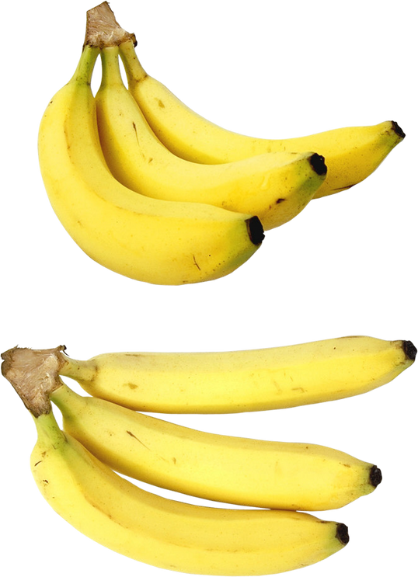
Treatment for Kwashiorkor and Marasmus (P.E.M.) requires care and caution. Diets must be soft, liquid and easily digestible and enriched with good quality proteins. Small amounts should be fed at frequent intervals. For example, skimmed milk and mashed banana make for an adequate meal.

Slide 32
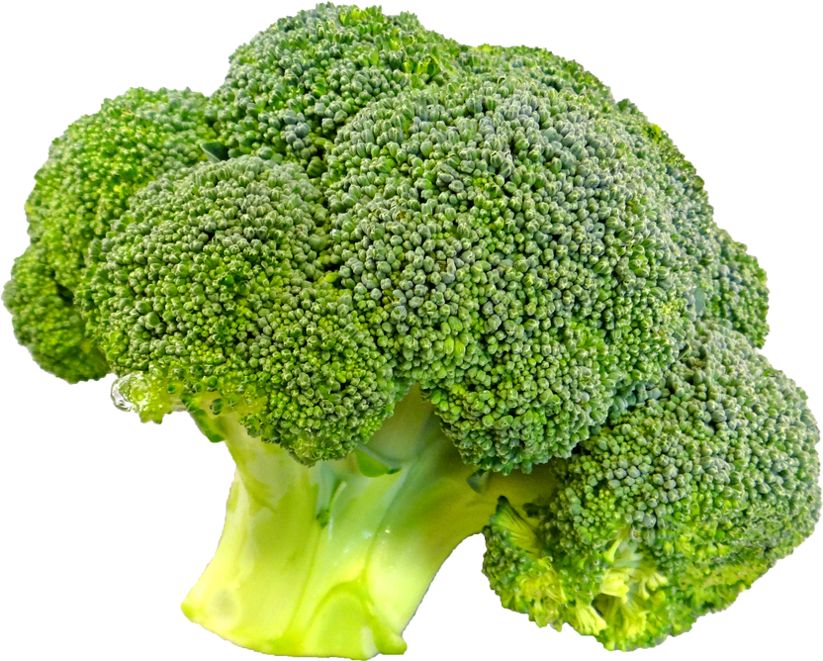
Thank you.

Slide 33
Bibliography
Antia, F.P. 1989. Clinical Dietetics and Nutrition, 3rd ed. Oxford University Press.
Guthrie, A.H. 1986, Introductory Nutrition, 6th ed. The C.V. Mosby Company.
Rajlakshmi, K. 1981, Applied Nutrition, 3rd ed. Oxford & IBH Publishing Company.
Robinson, C.H.; Lawler, M.N.; Chenoweth, L.W. and Garwick, E.A. 1986, Normal & Therapeutic Nutrition, 17th ed. Macmillan Publishing Company.
Swaminathan, M. 1985, Essentials of Food & Nutrition, 2nd ed. Bangalore Printing and Publishing Co. Ltd.
Williams, S.R. 1989, Essentials of Nutrition and Diet Therapy. 5th ed. Times Mirror/ Mosby College Publishing.
Sumati R. Mudami, "Fundamentals of Food Nutrition and Diet Therapy." New Age International Pvt. Ltd. New Delhi. 6th ed (2018).

Slide 34
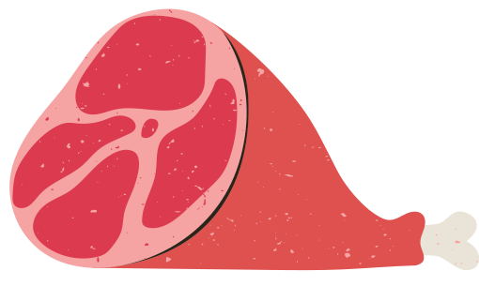
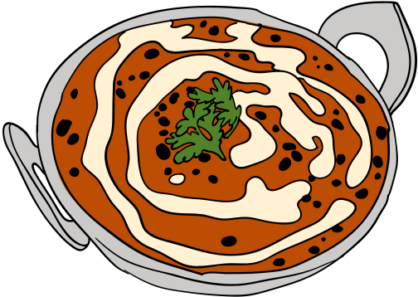
Questions for Practice
These will help you revise what we've learned. Let's check our progress!

Slide 35
1. The building blocks of Proteins are ________.
(a) Fatty Acids
(b) Amino Acids
(c) Citric Acids
(d) None of these

Slide 36
Answer-
(b) Amino Acids

Slide 37
2. 1 gm of protein gives ____ calories.
(a) 9 kcal
(b) 6 kcal
(c) 4 kcal
(d) 7 kcal

Slide 38
Answer-
(c) 4 kcal

Slide 39
3. Out of the following, which is the best source of protein?
(a) Legumes and Pulses
(b) Fruits
(c) Vegetables
(d) Eggs

Slide 40
Answer-
(d) Eggs

Slide 41
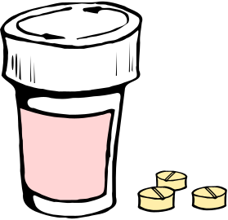
4. A disease that occurs due to deficiency of proteins is ________.
(a) Kwashiorkor
(b) Goiter
(c) Anemia
(d) Rickets

Slide 42
Answer-
(a) Kwashiorkor

Slide 43
5. The quality of Protein depends on _________.
(a) Origin
(b) Essential amino acids
(c) Chemical nature
(d) None of these

Slide 44
Answer-
(b) Essential amino acids

Slide 45
6. Deficiency of Protein and Calories both leads to _________.
(a) Beri Beri
(b) Kidney Stones
(c) Marasmus
(d) All of the above

Slide 46
Answer-
(c) Marasmus

Slide 47
7. The main function of protein in the body is ____________.
(a) To provide energy
(b) Growth and development
(c) To protect the body
(d) All of these

Slide 48
Answer-
(b) Growth and development

Slide 49
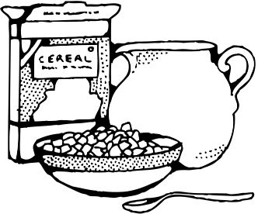
8. We can increase the biological value of protein by-
(a) Mixing cereals with legumes
(b) Including animal proteins in all main meals
(c) Both (a) and (b)
(d) Eating junk food

Slide 50
Answer-
(c) Both (a) and (b)

Slide 51
9. An average adult requires _____ gram of protein per kg of body weight in a day.
(a) 1
(b) 2
(c) 2.5
(d) None of the above

Slide 52
Answer-
(a) 1

Slide 53
10. Pot Belly and Moon Face are two prominent symptoms of which of the following diseases?
(a) Night blindness
(b) Anemia
(c) Kwashiorkor
(d) Scurvey

Slide 54
Answer-
(c) Kwashiorkor

Slide 55
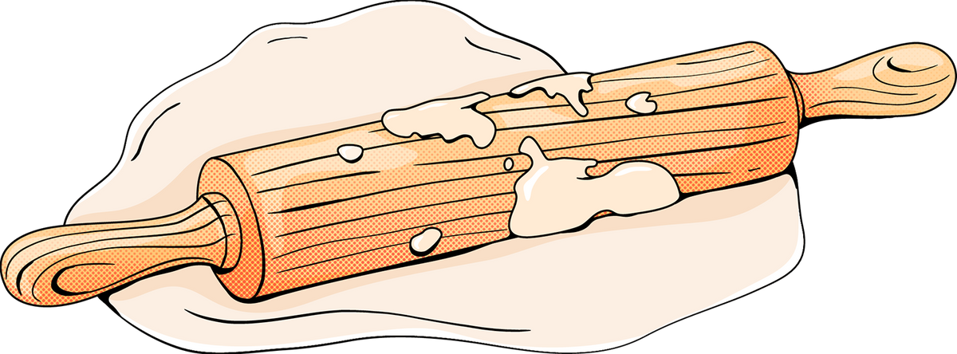
You're doing great!
For further reading, you can refer to the bibliography that has been provided in this presentation. Happy learning!

