Slide 1
Engineering Mechanics
Cylinder Problem
Course Faculty Name
Ranbir Mukhya

Slide 2

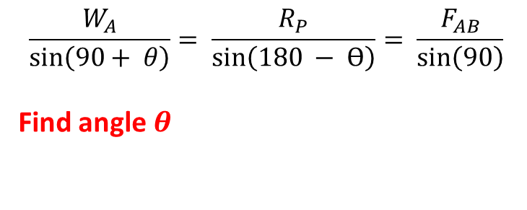
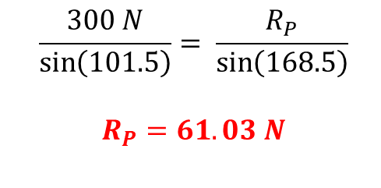

Cylinder Problem
Three uniform, homogeneous and smooth spheres A, B and C weighing 300 N, 600 N and 300 N, respectively and having
diameters 800 mm, 1200 mm and 800 mm, respectively, are placed in a trench. Determine the reaction at the contact
points P, Q, R and S
Free body diagram of Sphere -A
3
$$\frac{W_{A}}{\sin\left(90+ θ\right)}= \frac{R_{P}}{\sin\left(180 − Ɵ\right)}= \frac{F_{AB}}{\sin\left(90\right)}$$
Find angle $θ$
P
A
R_{P}
A
1
C
5
Q
S
Ɵ
$$\sin{Ɵ}= \frac{r_{B} − r_{A}}{r_{B}+ r_{A}} = \frac{600 −400}{600+400}= \frac{200}{1000}$$
$$θ={11.5}^{0}$$
B
W_{A}
F_{AB}
4
R
P
A
30⁰
F_{AB}
Ɵ
7
90 + Ɵ
R_{P}
2
180 - Ɵ
90
$$\frac{300 N}{\sin\left(101.5\right)}= \frac{R_{P}}{\sin\left(168.5\right)}$$
$$R_{P}=61.03 N$$
Q
P
B
AB = r_{A} + r_{B}
6
W_{A}
$$\frac{W_{A}}{\sin\left(90+11.5\right)}= \frac{R_{P}}{\sin\left(180 −11.5\right)}$$
BP = r_{B} - r_{A}

Slide 3
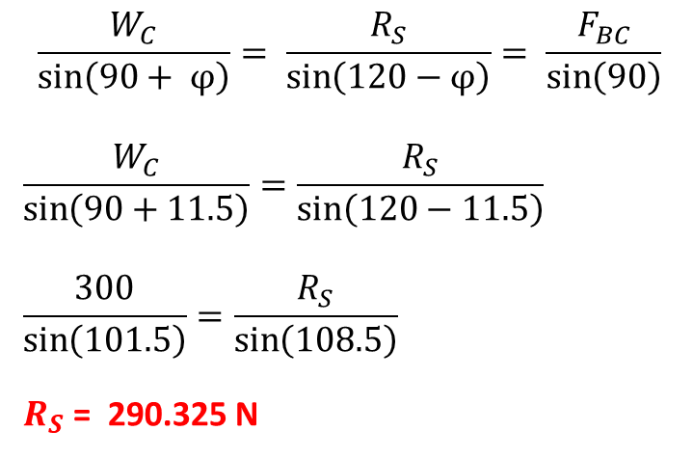
Cylinder Problem
Free body diagram of Sphere -C
$$\frac{W_{C}}{\sin\left(90+ φ\right)}= \frac{R_{S}}{\sin\left(120−φ\right)}= \frac{F_{BC}}{\sin\left(90\right)}$$
$$\frac{W_{C}}{\sin\left(90+11.5\right)}=\frac{R_{S}}{\sin\left(120−11.5\right)}$$
$$\frac{300}{\sin\left(101.5\right)}=\frac{R_{S}}{\sin\left(108.5\right)}$$
$R_{S}$ = 290.325 N
F_{BC}
30⁰
R_{S}
F_{AB}
60⁰ + φ
30⁰
R_{S}
W_{c}
W_{c}
C
R_{S}
F_{BC}
B
φ
90⁰ + φ
S
T
R
150⁰
120⁰ - φ
$$\sin{φ}=\frac{r_{B} − r_{C}}{r_{B}+ r_{C}}= \frac{600 −400}{600+400}$$
$$REST DO YourSELF$$
W_{c}
$$φ={11.5}^{0}$$

