Slide 1
ESC-S201
09-NOV
MON.

Slide 2
Area moment of inertia

Slide 3
Area moment of inertia
Axis
dA is area of element
r is perpendicular distance of elemental area to axis about which area moment of inertia is calculated
dA
Area moment of inertia ( I )
r
I = Area * r²
I = dA * r²

Slide 4
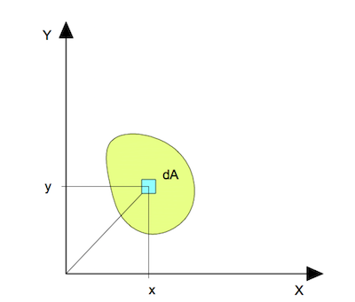
Area moment of inertia
Area moment of inertia about x-axis
i = n
I_{xx} = Σ dA_{i} * y²_{i}
i = 1
Area moment of inertia about x-axis
_{X}
i = n
I_{YY} = Σ dA_{i} * x²_{i}
i = 1
_{Y}
n tends to infinity.

Slide 5
Area moment of inertia
Mass moment of inertia
Area moment of inertia
L
L
M
G
A
G
Centroidal axis
Centroidal axis
I_{G} = M L²
I_{G} = A L²
12
12

Slide 6
Area moment of inertia
Mass moment of inertia
Area moment of inertia
G
A
G
M
Centroidal axis
Centroidal axis
I_{G} = M R²
I_{G} = A R²
4
4

Slide 7
Area moment of inertia
Determine the moment of inertia of the section about an axis passing through the centroid
and parallel to the top most fiber of the section.
140
10
140
10

Slide 8
Locate the centroid
Axis of symmetry
Locus of G
Centroid lie on axis of symmetry

Slide 9
Locate the centroid
Y- axis
Section-1
 | x_{G} | y_{G}
Section-1 | 0 | 70
140
G₁
70
O
X- axis
Centroid lie on axis of symmetry

Slide 10
Locate the centroid
Section-2
Y- axis
10
G₂
 | x_{G} | y_{G}
Section-2 | 0 | 145
140
O
X- axis
Centroid lie on axis of symmetry

Slide 11
Locate the centroid
Y- axis
G₂
Section | Area (mm²) | Centroid |  | A_{i} * x_{i} ( mm³ ) | A_{i} * y_{i} ( mm³ )
 |  | x_{c} (mm) | y_{c} (mm)
I | A₁ | x_{G1} | y_{G1} | A₁ * x_{G1} | A₁ * y_{G1}
 | 1400 | 0 | 70 | 0 | 9800
II | A₂ | x_{G2} | y_{G2} | A₂ * x_{G2} | A₂ * y_{G2}
 | 1400 | 0 | 145 | 0 | 203000
Section-1
X- axis
O
 | x_{G} | y_{G}
Section-1 | 0 | 70
 | x_{G} | y_{G}
Section-2 | 0 | 145
Centroid lie on axis of symmetry

Slide 12
Locate the centroid
Section | Area (mm²) | Centroid |  | A_{i} * x_{i} ( mm³ ) | A_{i} * y_{i} ( mm³ )
 |  | x_{c} (mm) | y_{c} (mm)
I | 1400 | 0 | 70 | 0 | 9800
II | 1400 | 0 | 145 | 0 | 203000
 | 2800 |  |  | 0 | 212800
Y- axis
6
G
G₁
Centroid of the Section
x_{G} | y_{G}
0 | 76
70
X- axis
O
212800
y_{G}
=
2800

Slide 13
Moment of inertia
Y- axis
G₂
d₂
G
I_{G}
6
d₁
I_{G1}
G₁
70
I_{G} = ( I_{G1} + A₁ d₁² ) + ( I_{G2} + A₂ d₂² )

Slide 14
G₂
d₂
I_{G}
G
G
I_{G}
I_{G1}
6
G₁
6
d₁
L₁ =140
I_{G1}
G₁
70
70
10
Section -1
Length | width | Area | L₁ | d₁ | I_{G1} | A₁d₁² | I_{G1} + A₁d₁²
140 mm | 10 mm | 1400 mm² | 140 mm | Y_{G} – Y_{G1} = 76 – 70 = 6 mm | (A₁L₁² )/12 = (1400* 140² )/12 = 163566.67 mm⁴ | = 1400 x 6 = 8400 mm⁴ | = 171966.67 mm⁴
I_{G} = ( I_{G1} + A₁ d₁² ) + ( I_{G2} + A₂ d₂² )

