Slide 1
Warming-up to ML, and Some Simple Supervised Learners (Distance-based “Local” Methods)
Warming-up to ML, and Some Simple Supervised Learners

Slide 2
Some Notation/Nomenclature/Convention
Supervised Learning requires training data given as a set of input-output pairs {
(x , y )}
N
n=1
n n
Unsupervised Learning requires training data given as a set of inputs {x }
N
n
n=1
Warming-up to ML, and Some Simple Supervised Learners
3

Slide 3
Some Notation/Nomenclature/Convention
Supervised Learning requires training data given as a set of input-output pairs {
(x , y )}
N
n=1
n n
Unsupervised Learning requires training data given as a set of inputs {x }
N
n
n=1
Each input x _{n} is (usually) a vector containing the values of the features or attributes or covariates that encode properties of the data it represents, e.g.,
Warming-up to ML, and Some Simple Supervised Learners
3

Slide 4
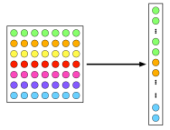
Some Notation/Nomenclature/Convention
Supervised Learning requires training data given as a set of input-output pairs {
(x , y )}
N
n=1
n n
Unsupervised Learning requires training data given as a set of inputs {x }
N
n
n=1
Each input x _{n} is (usually) a vector containing the values of the features or attributes or covariates that encode properties of the data it represents, e.g.,
Representing a 7 × 7 image: x n can be a 49 × 1 vector of pixel intensities
Warming-up to ML, and Some Simple Supervised Learners
3

Slide 5
Some Notation/Nomenclature/Convention
Supervised Learning requires training data given as a set of input-output pairs {
(x , y )}
N
n=1
n n
Unsupervised Learning requires training data given as a set of inputs {x }
N
n
n=1
Each input x _{n} is (usually) a vector containing the values of the features or attributes or covariates that encode properties of the data it represents, e.g.,
Representing a 7 × 7 image: x n can be a 49 × 1 vector of pixel intensities
Note: Good features can also be learned from data (feature learning) or extracted using hand-crafted rules defined by a domain expert.
Warming-up to ML, and Some Simple Supervised Learners
3

Slide 6
Some Notation/Nomenclature/Convention
Supervised Learning requires training data given as a set of input-output pairs {
(x , y )}
N
n=1
n n
Unsupervised Learning requires training data given as a set of inputs {x }
N
n
n=1
Each input x _{n} is (usually) a vector containing the values of the features or attributes or covariates that encode properties of the data it represents, e.g.,
Representing a 7 × 7 image: x n can be a 49 × 1 vector of pixel intensities
Note: Good features can also be learned from data (feature learning) or extracted using hand-crafted rules defined by a domain expert. Having a good set of features is half the battle won!
Warming-up to ML, and Some Simple Supervised Learners
3

Slide 7
Some Notation/Nomenclature/Convention
Supervised Learning requires training data given as a set of input-output pairs {
(x , y )}
N
n=1
n n
Unsupervised Learning requires training data given as a set of inputs {x }
N
n
n=1
Each input x _{n} is (usually) a vector containing the values of the features or attributes or covariates that encode properties of the data it represents, e.g.,
Representing a 7 × 7 image: x n can be a 49 × 1 vector of pixel intensities
Note: Good features can also be learned from data (feature learning) or extracted using hand-crafted rules defined by a domain expert. Having a good set of features is half the battle won!
Each y_{n} is the output or response or label associated with input x _{n}
Warming-up to ML, and Some Simple Supervised Learners
3

Slide 8
Some Notation/Nomenclature/Convention
Supervised Learning requires training data given as a set of input-output pairs {
(x , y )}
N
n=1
n n
Unsupervised Learning requires training data given as a set of inputs {x }
N
n
n=1
Each input x _{n} is (usually) a vector containing the values of the features or attributes or covariates that encode properties of the data it represents, e.g.,
Representing a 7 × 7 image: x n can be a 49 × 1 vector of pixel intensities
Note: Good features can also be learned from data (feature learning) or extracted using hand-crafted rules defined by a domain expert. Having a good set of features is half the battle won!
Each y_{n} is the output or response or label associated with input x _{n}
The output yn can be a scalar, a vector of numbers, or a structured object
Warming-up to ML, and Some Simple Supervised Learners
3

Slide 9
Some Notation/Nomenclature/Convention
Will assume each input x _{n} to be a D × 1 column vector (its transpose x ^{T}_{n} will be row vector)
x_{nd} will denote the d -th feature of the n-th input
We will use X (N × D feature matrix) to collectively denote all the N inputs
We will use y (N × 1 output/response/label vector) to collectively denote all the N outputs
A feature
 |  | D
x n1 | x n2 |  |  | x nD
 |  |  | X
y n
y
Input n
Output for input n
_{x}T
n
N
Feature Matrix
Outputs
Warming-up to ML, and Some Simple Supervised Learners
4

Slide 10
Some Notation/Nomenclature/Convention
Will assume each input x _{n} to be a D × 1 column vector (its transpose x ^{T}_{n} will be row vector)
x_{nd} will denote the d -th feature of the n-th input
We will use X (N × D feature matrix) to collectively denote all the N inputs
We will use y (N × 1 output/response/label vector) to collectively denote all the N outputs
A feature
 |  | D
x n1 | x n2 |  |  | x nD
 |  |  | X
y n
y
Input n
Output for input n
_{x}T
n
N
Feature Matrix Outputs
Note: If each y_{n} itself is a vector (we will see such cases later) then we will use a matrix Y to collectively denote all the N outputs (with row n containing y_{n} ) and also use boldfaced y _{n}
Warming-up to ML, and Some Simple Supervised Learners
4

Slide 11
Getting Features from Raw Data: A Simple Example
Consider the feature representation for some text data consisting of the following sentences:
John likes to watch movies Mary likes movies too John also likes football
Our feature “vocabulary” consists of 8 unique words
Warming-up to ML, and Some Simple Supervised Learners
5

Slide 12
Getting Features from Raw Data: A Simple Example
Consider the feature representation for some text data consisting of the following sentences:
John likes to watch movies Mary likes movies too John also likes football
Our feature “vocabulary” consists of 8 unique words
Here is the bag-of-words feature vector representation of these 3 sentences
Warming-up to ML, and Some Simple Supervised Learners
5

Slide 13
Getting Features from Raw Data: A Simple Example
Consider the feature representation for some text data consisting of the following sentences:
John likes to watch movies Mary likes movies too John also likes football
Our feature “vocabulary” consists of 8 unique words
Here is the bag-of-words feature vector representation of these 3 sentences
Here the features are binary (presence/absence of each word)
Warming-up to ML, and Some Simple Supervised Learners
5

Slide 14
Getting Features from Raw Data: A Simple Example
Consider the feature representation for some text data consisting of the following sentences:
John likes to watch movies Mary likes movies too John also likes football
Our feature “vocabulary” consists of 8 unique words
Here is the bag-of-words feature vector representation of these 3 sentences
Here the features are binary (presence/absence of each word)
Again, note that this may not necessarily be the best “feature” representation for a given task (which is why other techniques or feature learning may be needed)
Warming-up to ML, and Some Simple Supervised Learners
5

Slide 15
Types of Features and Types of Outputs
Features (in vector x _{n} ) as well as outputs y_{n} can be real-valued, binary, categorical, ordinal, etc.
Warming-up to ML, and Some Simple Supervised Learners
6

Slide 16
Types of Features and Types of Outputs
Features (in vector x _{n} ) as well as outputs y_{n} can be real-valued, binary, categorical, ordinal, etc.
Real-valued: Pixel intensity, house area, house price, rainfall amount, temperature, etc
Warming-up to ML, and Some Simple Supervised Learners
6

Slide 17
Types of Features and Types of Outputs
Features (in vector x _{n} ) as well as outputs y_{n} can be real-valued, binary, categorical, ordinal, etc.
Real-valued: Pixel intensity, house area, house price, rainfall amount, temperature, etc Binary: Male/female, adult/non-adult, or any yes/no or present/absent type values
Warming-up to ML, and Some Simple Supervised Learners
6

Slide 18
Types of Features and Types of Outputs
Features (in vector x _{n} ) as well as outputs y_{n} can be real-valued, binary, categorical, ordinal, etc.
Real-valued: Pixel intensity, house area, house price, rainfall amount, temperature, etc Binary: Male/female, adult/non-adult, or any yes/no or present/absent type values
Categorical/Discrete: Pincode, bloodgroup, or any “which one from this finite set” type values
Warming-up to ML, and Some Simple Supervised Learners
6

Slide 19
Types of Features and Types of Outputs
Features (in vector x _{n} ) as well as outputs y_{n} can be real-valued, binary, categorical, ordinal, etc.
Real-valued: Pixel intensity, house area, house price, rainfall amount, temperature, etc Binary: Male/female, adult/non-adult, or any yes/no or present/absent type values
Categorical/Discrete: Pincode, bloodgroup, or any “which one from this finite set” type values Ordinal: Grade (A/B/C etc.) in a course, or any other type where relative values matters
Warming-up to ML, and Some Simple Supervised Learners
6

Slide 20
Types of Features and Types of Outputs
Features (in vector x _{n} ) as well as outputs y_{n} can be real-valued, binary, categorical, ordinal, etc.
Real-valued: Pixel intensity, house area, house price, rainfall amount, temperature, etc Binary: Male/female, adult/non-adult, or any yes/no or present/absent type values
Categorical/Discrete: Pincode, bloodgroup, or any “which one from this finite set” type values Ordinal: Grade (A/B/C etc.) in a course, or any other type where relative values matters Often, the features can be of mixed types (some real, some categorical, some ordinal, etc.)
Warming-up to ML, and Some Simple Supervised Learners
6

Slide 21
Types of Features and Types of Outputs
Features (in vector x _{n} ) as well as outputs y_{n} can be real-valued, binary, categorical, ordinal, etc.
Real-valued: Pixel intensity, house area, house price, rainfall amount, temperature, etc Binary: Male/female, adult/non-adult, or any yes/no or present/absent type values
Categorical/Discrete: Pincode, bloodgroup, or any “which one from this finite set” type values Ordinal: Grade (A/B/C etc.) in a course, or any other type where relative values matters Often, the features can be of mixed types (some real, some categorical, some ordinal, etc.)
Appropriate handling of different types of features may be very important (even if you algorithm is designed to “learn” good features, given a set of heterogeneous features)
Warming-up to ML, and Some Simple Supervised Learners
6

Slide 22
Types of Features and Types of Outputs
Features (in vector x _{n} ) as well as outputs y_{n} can be real-valued, binary, categorical, ordinal, etc.
Real-valued: Pixel intensity, house area, house price, rainfall amount, temperature, etc Binary: Male/female, adult/non-adult, or any yes/no or present/absent type values
Categorical/Discrete: Pincode, bloodgroup, or any “which one from this finite set” type values Ordinal: Grade (A/B/C etc.) in a course, or any other type where relative values matters Often, the features can be of mixed types (some real, some categorical, some ordinal, etc.)
Appropriate handling of different types of features may be very important (even if you algorithm is designed to “learn” good features, given a set of heterogeneous features)
In Sup. Learning, different types of outputs may require different type of learning models
Warming-up to ML, and Some Simple Supervised Learners
6

Slide 23
Supervised Learning
Warming-up to ML, and Some Simple Supervised Learners

Slide 24
Supervised Learning
Supervised Learning comes in many flavors. The flavor depends on the type of each output y_{n}
Warming-up to ML, and Some Simple Supervised Learners
8

Slide 25
Supervised Learning
Supervised Learning comes in many flavors. The flavor depends on the type of each output y_{n}
Regression: y_{n} ∈ R (real-valued scalar)
Warming-up to ML, and Some Simple Supervised Learners
8

Slide 26
Supervised Learning
Supervised Learning comes in many flavors. The flavor depends on the type of each output y_{n}
Regression: y_{n} ∈ R (real-valued scalar)
Multi-Output Regression: y _{n} ∈ R^{M} (real-valued vector containing M outputs)
Warming-up to ML, and Some Simple Supervised Learners
8

Slide 27
Supervised Learning
Supervised Learning comes in many flavors. The flavor depends on the type of each output y_{n}
Regression: y_{n} ∈ R (real-valued scalar)
Multi-Output Regression: y _{n} ∈ R^{M} (real-valued vector containing M outputs)
0.3 | 0.1 | 0.2 | 0.8 | 0.4
Illustration of a 5-dim output vector for a multi-output regression problem
Warming-up to ML, and Some Simple Supervised Learners
8

Slide 28
Supervised Learning
Supervised Learning comes in many flavors. The flavor depends on the type of each output y_{n}
Regression: y_{n} ∈ R (real-valued scalar)
Multi-Output Regression: y _{n} ∈ R^{M} (real-valued vector containing M outputs)
0.3 | 0.1 | 0.2 | 0.8 | 0.4
Illustration of a 5-dim output vector for a multi-output regression problem
Binary Classification: y_{n} ∈ {−1, +1} or {0, 1} (output in classification is also called “label”)
Warming-up to ML, and Some Simple Supervised Learners
8

Slide 29
Supervised Learning
Supervised Learning comes in many flavors. The flavor depends on the type of each output y_{n}
Regression: y_{n} ∈ R (real-valued scalar)
Multi-Output Regression: y _{n} ∈ R^{M} (real-valued vector containing M outputs)
0.3 | 0.1 | 0.2 | 0.8 | 0.4
Illustration of a 5-dim output vector for a multi-output regression problem
Binary Classification: y_{n} ∈ {−1, +1} or {0, 1} (output in classification is also called “label”)
Multi-class Classification: y_{n} ∈ {1, 2, . . . , M} or {0, 1, . . . , M − 1} (one of M classes is correct label)
0 | 0 | 0 | 1 | 0
Illustration of a 5-dim one-hot label vector for a multi-class classification problem
Warming-up to ML, and Some Simple Supervised Learners
8

Slide 30
Supervised Learning
Supervised Learning comes in many flavors. The flavor depends on the type of each output y_{n}
Regression: y_{n} ∈ R (real-valued scalar)
Multi-Output Regression: y _{n} ∈ R^{M} (real-valued vector containing M outputs)
0.3 | 0.1 | 0.2 | 0.8 | 0.4
Illustration of a 5-dim output vector for a multi-output regression problem
Binary Classification: y_{n} ∈ {−1, +1} or {0, 1} (output in classification is also called “label”)
Multi-class Classification: y_{n} ∈ {1, 2, . . . , M} or {0, 1, . . . , M − 1} (one of M classes is correct label)
0 | 0 | 0 | 1 | 0
Illustration of a 5-dim one-hot label vector for a multi-class classification problem
Multi-label Classification: y_{n} ∈ {−1, +1}^{M} or {0, 1}^{M} (a subset of M labels are correct)
1 | 0 | 1 | 0 | 0
Illustration of a 5-dim binary label vector for a multi-label classification problem (unlike one-hot, there can be multiple 1s)
Warming-up to ML, and Some Simple Supervised Learners
8

Slide 31
Supervised Learning
Supervised Learning comes in many flavors. The flavor depends on the type of each output y_{n}
Regression: y_{n} ∈ R (real-valued scalar)
Multi-Output Regression: y _{n} ∈ R^{M} (real-valued vector containing M outputs)
0.3 | 0.1 | 0.2 | 0.8 | 0.4
Illustration of a 5-dim output vector for a multi-output regression problem
Binary Classification: y_{n} ∈ {−1, +1} or {0, 1} (output in classification is also called “label”)
Multi-class Classification: y_{n} ∈ {1, 2, . . . , M} or {0, 1, . . . , M − 1} (one of M classes is correct label)
0 | 0 | 0 | 1 | 0
Illustration of a 5-dim one-hot label vector for a multi-class classification problem
Multi-label Classification: y_{n} ∈ {−1, +1}^{M} or {0, 1}^{M} (a subset of M labels are correct)
1 | 0 | 1 | 0 | 0
Illustration of a 5-dim binary label vector for a multi-label classification problem (unlike one-hot, there can be multiple 1s)
Note: Multi-label classification is also informally called “tagging” (especially in Computer Vision)
Warming-up to ML, and Some Simple Supervised Learners
8

Slide 32
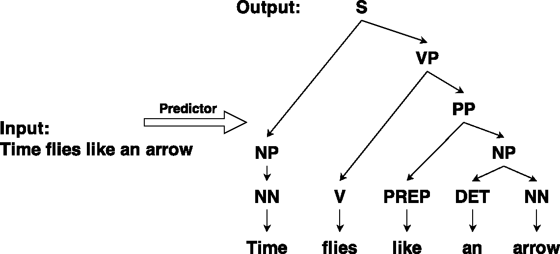
Supervised Learning (Contd.)
Structured-Prediction (a.k.a. Structured Output Learning): Each y_{n} is a structured object
Warming-up to ML, and Some Simple Supervised Learners
9

Slide 33
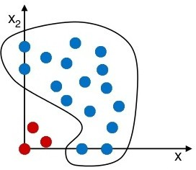
Supervised Learning (Contd.)
Structured-Prediction (a.k.a. Structured Output Learning): Each y_{n} is a structured object
One-Class Classification (a.k.a. outlier/anomaly/novelty detection): y_{n} is “1” or “everything else”
Examples from the class being modeled (e.g., animals)
All other examples (“outliers”, e.g., humans, vehicles, etc)
Warming-up to ML, and Some Simple Supervised Learners
9

Slide 34
Supervised Learning (Contd.)
Structured-Prediction (a.k.a. Structured Output Learning): Each y_{n} is a structured object
One-Class Classification (a.k.a. outlier/anomaly/novelty detection): y_{n} is “1” or “everything else”
Examples from the class being modeled (e.g., animals)
All other examples (“outliers”, e.g., humans, vehicles, etc)
Ranking: Each y_{n} is a ranked list of relevant stuff for a given input/query x
Warming-up to ML, and Some Simple Supervised Learners
9

Slide 35
Computing Distances/Similarities
Assuming all real-valued features, an input x _{n} ∈ R^{D×1} is a point in a D dim. vector space of reals
Warming-up to ML, and Some Simple Supervised Learners
10

Slide 36
Our First (Supervised) Learning Algorithm
Warming-up to ML, and Some Simple Supervised Learners
11

Slide 37
Our First (Supervised) Learning Algorithm (need to know nothing except how to
compute distances/similarities between points!)
Warming-up to ML, and Some Simple Supervised Learners
11

Slide 38
Prototype based Classification
N
Given: N labeled training examples {x , y } from two classes
n n
n=1
Assume green is positive and red is negative class
N+ exampes from positive class, N− examples from negative class
Our goal: Learn a model to predict label (class) y for a new test example x
Warming-up to ML, and Some Simple Supervised Learners
12

Slide 39
Prototype based Classification
N
Given: N labeled training examples {x , y } from two classes
n n
n=1
Assume green is positive and red is negative class
N+ exampes from positive class, N− examples from negative class
Our goal: Learn a model to predict label (class) y for a new test example x
A simple “distance from means” model: predict the class that has a closer mean
Warming-up to ML, and Some Simple Supervised Learners
12

Slide 40
Prototype based Classification
N
Given: N labeled training examples {x , y } from two classes
n n
n=1
Assume green is positive and red is negative class
N+ exampes from positive class, N− examples from negative class
Our goal: Learn a model to predict label (class) y for a new test example x
A simple “distance from means” model: predict the class that has a closer mean Note: The basic idea easily generalizes to more than 2 classes as well
Warming-up to ML, and Some Simple Supervised Learners

Slide 41
Prototype based Classification: More Formally
What does the decision rule look like, mathematically ?
Warming-up to ML, and Some Simple Supervised Learners
13

Slide 42
Prototype based Classification: More Formally
What does the decision rule look like, mathematically ?
The mean of each class is given by
1
1
N₊
µ =
Σ
x and µ =
Σ
x
−
N₋
n
+
n
yn =−1
yn =+1
Warming-up to ML, and Some Simple Supervised Learners
13

Slide 43
Prototype based Classification: More Formally
What does the decision rule look like, mathematically ?
The mean of each class is given by
1
1
N₊
Σ
Σ
µ = x
n
and µ =
x
n
−
N₋
+
yn =−1
yn =+1
Euclidean Distances from each mean are given by
2
2
2
||µ₋ − x ||
= ||µ₋|| + ||x || − 2⟨µ₋, x ⟩
2
2
2
||µ₊ − x ||
= ||µ || + ||
x || − 2⟨µ , x ⟩
+
+
Warming-up to ML, and Some Simple Supervised Learners
13

Slide 44
Prototype based Classification: More Formally
What does the decision rule look like, mathematically ?
The mean of each class is given by
1
Σ
1
N₊
Σ
µ = x
n
and µ =
x
n
−
N₋
+
yn =−1
yn =+1
Euclidean Distances from each mean are given by
2
2
2
||µ₋ − x ||
= ||µ₋|| + ||x || − 2⟨µ₋, x ⟩
2 2
2
||µ₊ − x || = ||µ || + ||
x || − 2⟨µ , x ⟩
+ +
Decision Rule: If f (x ) := ||µ₋ − x ||² − ||µ₊ − x ||² > 0 then predict +1, otherwise predict -1
Warming-up to ML, and Some Simple Supervised Learners
13

Slide 45
Prototype based Classification: The Decision Rule
We saw that our decision rule was
f (x ) := ||µ₋ − x ||² − ||µ₊ − x ||²
Warming-up to ML, and Some Simple Supervised Learners
14

Slide 46
Prototype based Classification: The Decision Rule
We saw that our decision rule was
f (x ) := ||µ₋ − x ||² − ||µ₊ − x ||² = 2⟨µ₊ − µ₋, x ⟩ + ||µ₋||² − ||µ₊||²
Warming-up to ML, and Some Simple Supervised Learners
14

Slide 47
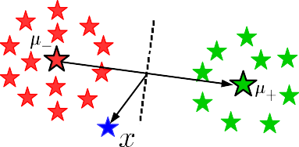
Prototype based Classification: The Decision Rule
We saw that our decision rule was
f (x ) := ||µ₋ − x ||² − ||µ₊ − x ||² = 2⟨µ₊ − µ₋, x ⟩ + ||µ₋||² − ||µ₊||²
Imp.: f (x ) effectively denotes a hyperplane based classification rule f (x ) = w ^{T}x + b with the vector w = µ₊ − µ₋ representing the direction normal to the hyperplane
Warming-up to ML, and Some Simple Supervised Learners
14

Slide 48
Prototype based Classification: The Decision Rule
We saw that our decision rule was
f (x ) := ||µ₋ − x ||² − ||µ₊ − x ||² = 2⟨µ₊ − µ₋, x ⟩ + ||µ₋||² − ||µ₊||²
Imp.: f (x ) effectively denotes a hyperplane based classification rule f (x ) = w ^{T}x + b with the vector w = µ₊ − µ₋ representing the direction normal to the hyperplane
Imp.: Can show that the rule is equivalent to f (x ) =
Σ
N
n=1
α_{n} ⟨x _{n}, x ⟩ + b, where α’s and b can be
estimated from training data (try this as an exercise)
Warming-up to ML, and Some Simple Supervised Learners
14

Slide 49
Prototype based Classification: The Decision Rule
We saw that our decision rule was
f (x ) := ||µ₋ − x ||² − ||µ₊ − x ||² = 2⟨µ₊ − µ₋, x ⟩ + ||µ₋||² − ||µ₊||²
Imp.: f (x ) effectively denotes a hyperplane based classification rule f (x ) = w ^{T}x + b with the vector w = µ₊ − µ₋ representing the direction normal to the hyperplane
Imp.: Can show that the rule is equivalent to f (x ) =
Σ
N
n=1
α_{n} ⟨x _{n}, x ⟩ + b, where α’s and b can be
estimated from training data (try this as an exercise)
This form of the decision rule is very important. Decision rules for many (in fact most) supervised learning algorithms can be written like this (weighted sum of similarities with all the training inputs)
Warming-up to ML, and Some Simple Supervised Learners
14

Slide 50
Be Careful when Computing Distances
¹Distance Metric Learning. See “A Survey on Metric Learning for Feature Vectors and Structured Data” by Ballet et al
Warming-up to ML, and Some Simple Supervised Learners
15

Slide 51
Prototype based Classification: Some Comments
A very simple supervised learner. Works for any number of classes. Trivial to implement. :-)
Warming-up to ML, and Some Simple Supervised Learners
16

Slide 52
Prototype based Classification: Some Comments
A very simple supervised learner. Works for any number of classes. Trivial to implement. :-) This simple approach, if using Euclidean distances, can only learn linear decision boundaries
Warming-up to ML, and Some Simple Supervised Learners
16

Slide 53
Prototype based Classification: Some Comments
A very simple supervised learner. Works for any number of classes. Trivial to implement. :-) This simple approach, if using Euclidean distances, can only learn linear decision boundaries
A reason: The basic approach implicitly assumes that classes are roughly spherical and equi-sized
Warming-up to ML, and Some Simple Supervised Learners
16

Slide 54
Prototype based Classification: Some Comments
A very simple supervised learner. Works for any number of classes. Trivial to implement. :-) This simple approach, if using Euclidean distances, can only learn linear decision boundaries
A reason: The basic approach implicitly assumes that classes are roughly spherical and equi-sized
Several nice improvements/generalizations possible
Warming-up to ML, and Some Simple Supervised Learners
16

Slide 55
Prototype based Classification: Some Comments
A very simple supervised learner. Works for any number of classes. Trivial to implement. :-) This simple approach, if using Euclidean distances, can only learn linear decision boundaries
A reason: The basic approach implicitly assumes that classes are roughly spherical and equi-sized
Several nice improvements/generalizations possible
Instead of a point (mean), model classes by prob. distributions (to account for class shapes/sizes)
Warming-up to ML, and Some Simple Supervised Learners
16

Slide 56
Prototype based Classification: Some Comments
A very simple supervised learner. Works for any number of classes. Trivial to implement. :-) This simple approach, if using Euclidean distances, can only learn linear decision boundaries
A reason: The basic approach implicitly assumes that classes are roughly spherical and equi-sized
Several nice improvements/generalizations possible
Instead of a point (mean), model classes by prob. distributions (to account for class shapes/sizes) Instead of Euclidean distances, can use non-Euclidean distances, distance metric learning, or “kernels”
Warming-up to ML, and Some Simple Supervised Learners
16

Slide 57
Prototype based Classification: Some Comments
A very simple supervised learner. Works for any number of classes. Trivial to implement. :-) This simple approach, if using Euclidean distances, can only learn linear decision boundaries
A reason: The basic approach implicitly assumes that classes are roughly spherical and equi-sized
Several nice improvements/generalizations possible
Instead of a point (mean), model classes by prob. distributions (to account for class shapes/sizes) Instead of Euclidean distances, can use non-Euclidean distances, distance metric learning, or “kernels”
Another limitation: Needs plenty of training data from each class to reliably estimate the means
Warming-up to ML, and Some Simple Supervised Learners
16

Slide 58
Prototype based Classification: Some Comments
A very simple supervised learner. Works for any number of classes. Trivial to implement. :-) This simple approach, if using Euclidean distances, can only learn linear decision boundaries
A reason: The basic approach implicitly assumes that classes are roughly spherical and equi-sized
Several nice improvements/generalizations possible
Instead of a point (mean), model classes by prob. distributions (to account for class shapes/sizes) Instead of Euclidean distances, can use non-Euclidean distances, distance metric learning, or “kernels”
Another limitation: Needs plenty of training data from each class to reliably estimate the means
But with a good feature learner, even ONE (or very few) example per class may be enough (a state-of-the-art “Few-Shot Learning” model actually uses Prototype based classification)
Warming-up to ML, and Some Simple Supervised Learners
16

Slide 59
Another Simple Supervised Learner: Nearest Neighbors
Warming-up to ML, and Some Simple Supervised Learners

Slide 60
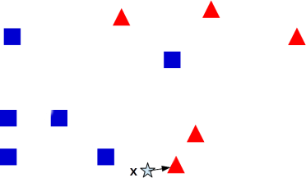
Nearest Neighbor
Another classic distance-based supervised learning method
The label y for x ∈ R^{D} will be the label of its nearest neighbor in training data. Also known as
one-nearest-neighbor (1-NN)
Euclidean/Mahalanobis distance can be used to find the nearest neighbor (or can use a learned distance metric)
Warming-up to ML, and Some Simple Supervised Learners
18

Slide 61
Nearest Neighbor
Another classic distance-based supervised learning method
The label y for x ∈ R^{D} will be the label of its nearest neighbor in training data. Also known as
one-nearest-neighbor (1-NN)
Euclidean/Mahalanobis distance can be used to find the nearest neighbor (or can use a learned distance metric)
We typically use more (K > 1) neighbors in practice
Warming-up to ML, and Some Simple Supervised Learners
18

Slide 62
Nearest Neighbor
Another classic distance-based supervised learning method
The label y for x ∈ R^{D} will be the label of its nearest neighbor in training data. Also known as
one-nearest-neighbor (1-NN)
Euclidean/Mahalanobis distance can be used to find the nearest neighbor (or can use a learned distance metric)
We typically use more (K > 1) neighbors in practice
Note: The method is widely applicable - works for both classification and regression problems
Warming-up to ML, and Some Simple Supervised Learners
18

Slide 63
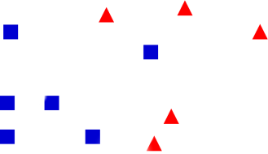
K -Nearest Neighbors (K -NN)
Makes one-nearest-neighbor more robust by using more than one neighbor
Test time simply does a majority vote (or average) of the labels of K closest training inputs
Warming-up to ML, and Some Simple Supervised Learners
19

Slide 64
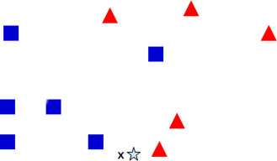
K -Nearest Neighbors (K -NN)
Makes one-nearest-neighbor more robust by using more than one neighbor
Test time simply does a majority vote (or average) of the labels of K closest training inputs
Warming-up to ML, and Some Simple Supervised Learners
19

Slide 65
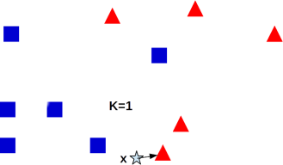
K -Nearest Neighbors (K -NN)
Makes one-nearest-neighbor more robust by using more than one neighbor
Test time simply does a majority vote (or average) of the labels of K closest training inputs
Warming-up to ML, and Some Simple Supervised Learners
19

Slide 66
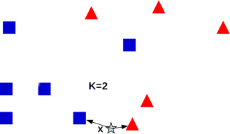
K -Nearest Neighbors (K -NN)
Makes one-nearest-neighbor more robust by using more than one neighbor
Test time simply does a majority vote (or average) of the labels of K closest training inputs
Warming-up to ML, and Some Simple Supervised Learners
19

Slide 67
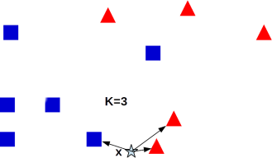
K -Nearest Neighbors (K -NN)
Makes one-nearest-neighbor more robust by using more than one neighbor
Test time simply does a majority vote (or average) of the labels of K closest training inputs
Warming-up to ML, and Some Simple Supervised Learners
19

Slide 68
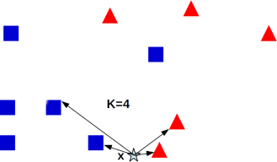
K -Nearest Neighbors (K -NN)
Makes one-nearest-neighbor more robust by using more than one neighbor
Test time simply does a majority vote (or average) of the labels of K closest training inputs
Warming-up to ML, and Some Simple Supervised Learners
19

Slide 69
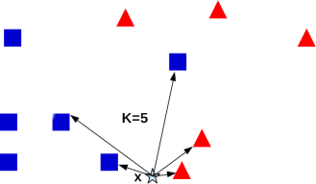
K -Nearest Neighbors (K -NN)
Makes one-nearest-neighbor more robust by using more than one neighbor
Test time simply does a majority vote (or average) of the labels of K closest training inputs
Warming-up to ML, and Some Simple Supervised Learners
19

Slide 70
K -Nearest Neighbors (K -NN)
Makes one-nearest-neighbor more robust by using more than one neighbor
Test time simply does a majority vote (or average) of the labels of K closest training inputs
For a test input x , the averaging version of the prediction rule for K -nearest neighbors
_{y =} 1
Σ
y
K
n
n∈N_{K} (x )
.. where N_{K} (x ) is the set of K closest training inputs for x
Warming-up to ML, and Some Simple Supervised Learners
19

Slide 71
K -Nearest Neighbors (K -NN)
Makes one-nearest-neighbor more robust by using more than one neighbor
Test time simply does a majority vote (or average) of the labels of K closest training inputs
For a test input x , the averaging version of the prediction rule for K -nearest neighbors
_{y =} 1
Σ
y
K
n
n∈N_{K} (x )
.. where N_{K} (x ) is the set of K closest training inputs for x
Above assumes the K neighbors have equal (1/K ) weights. Can also use distance-based weights
Warming-up to ML, and Some Simple Supervised Learners
19

Slide 72
K -Nearest Neighbors (K -NN)
Makes one-nearest-neighbor more robust by using more than one neighbor
Test time simply does a majority vote (or average) of the labels of K closest training inputs
For a test input x , the averaging version of the prediction rule for K -nearest neighbors
_{y =} 1
Σ
y
K
n
n∈N_{K} (x )
.. where N_{K} (x ) is the set of K closest training inputs for x
Above assumes the K neighbors have equal (1/K ) weights. Can also use distance-based weights Note: The rule works for multi-label classification too where each y _{n} ∈ {0, 1}^{M} is a binary vector
Warming-up to ML, and Some Simple Supervised Learners
19

Slide 73
K -Nearest Neighbors (K -NN)
Makes one-nearest-neighbor more robust by using more than one neighbor
Test time simply does a majority vote (or average) of the labels of K closest training inputs
For a test input x , the averaging version of the prediction rule for K -nearest neighbors
_{y =} 1
Σ
y
K
n
n∈N_{K} (x )
.. where N_{K} (x ) is the set of K closest training inputs for x
Above assumes the K neighbors have equal (1/K ) weights. Can also use distance-based weights Note: The rule works for multi-label classification too where each y _{n} ∈ {0, 1}^{M} is a binary vector
Averaging will give a real-valued “label score vector” y ∈ R^{M} using which we can find the best label(s)
Warming-up to ML, and Some Simple Supervised Learners
19

Slide 74
K -NN for Multi-Label Learning: Pictorial Illustration
Suppose K = 3. The label averaging for a multi-label learning problem will look like
*
+
1 | 0 | 0 | 1 | 0
y =
1 | 0 | 1 | 1 | 0
=
1 | 0 | 0.33 | 0.66 | 0.33
*
+
*
#1 label #4 label #3 label #2 label #3 label
1 | 0 | 0 | 0 | 1
Warming-up to ML, and Some Simple Supervised Learners
20

Slide 75
K -NN for Multi-Label Learning: Pictorial Illustration
Suppose K = 3. The label averaging for a multi-label learning problem will look like
*
+
1 | 0 | 0 | 1 | 0
y =
1 | 0 | 1 | 1 | 0
=
1 | 0 | 0.33 | 0.66 | 0.33
*
#1 label #4 label #3 label #2 label #3 label
+
*
Note that we can use the final y to rank the labels based on the real-valued scores
Can use it to predict the best, best-2, best-3, and so on..
Note: This is why multi-label learning is often used in some ranking problems where we wish to predict a ranking of the possible labels an input can have
1 | 0 | 0 | 0 | 1
Warming-up to ML, and Some Simple Supervised Learners
20

Slide 76
How to Select K : Cross-Validation
We can use cross-validation to select the “optimal” value of K
Warming-up to ML, and Some Simple Supervised Learners
21

Slide 77
How to Select K : Cross-Validation
We can use cross-validation to select the “optimal” value of K
Cross-validation - Divide the training data into two parts: actual training set and a validation set
(Actual) Training Set
Training Data
Validation Set
Test Data
Test Data
Never Ever Touch While Training
Warming-up to ML, and Some Simple Supervised Learners
21

Slide 78
How to Select K : Cross-Validation
We can use cross-validation to select the “optimal” value of K
Cross-validation - Divide the training data into two parts: actual training set and a validation set
(Actual) Training Set
Training Data
Validation Set
Test Data
Test Data
Never Ever Touch While Training
Try different values of K and look at the accuracies on the validation set
Warming-up to ML, and Some Simple Supervised Learners
21

Slide 79
How to Select K : Cross-Validation
We can use cross-validation to select the “optimal” value of K
Cross-validation - Divide the training data into two parts: actual training set and a validation set
(Actual) Training Set
Training Data
Validation Set
Test Data
Test Data
Never Ever Touch While Training
Try different values of K and look at the accuracies on the validation set
Note: For each K , we typically try multiple splits of train and validation sets
Warming-up to ML, and Some Simple Supervised Learners
21

Slide 80
How to Select K : Cross-Validation
We can use cross-validation to select the “optimal” value of K
Cross-validation - Divide the training data into two parts: actual training set and a validation set
(Actual) Training Set
Training Data
Validation Set
Test Data
Test Data
Never Ever Touch While Training
Try different values of K and look at the accuracies on the validation set
Note: For each K , we typically try multiple splits of train and validation sets
Select the K that gives the best accuracy on the validation set
Warming-up to ML, and Some Simple Supervised Learners
21

Slide 81
How to Select K : Cross-Validation
We can use cross-validation to select the “optimal” value of K
Cross-validation - Divide the training data into two parts: actual training set and a validation set
(Actual) Training Set
Training Data
Validation Set
Test Data
Test Data
Never Ever Touch While Training
Try different values of K and look at the accuracies on the validation set
Note: For each K , we typically try multiple splits of train and validation sets
Select the K that gives the best accuracy on the validation set
Never touch the test set (even if you have access to it) during training to choose the best K
Warming-up to ML, and Some Simple Supervised Learners
21

Slide 82
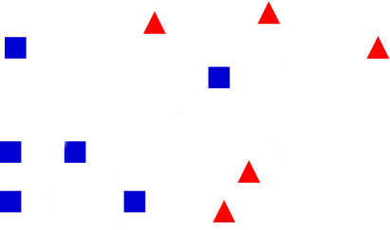
ϵ-Ball Nearest Neighbors
Instead of K nearest neighbors, can instead consider an ϵ-radius ball centered at the test point
x
Ball of radius
Just like selecting K , we can select the optimal ϵ via cross-validation
Have to be careful to choose ϵ so as to not get zero neighbors within ϵ-ball :-)
Warming-up to ML, and Some Simple Supervised Learners

Slide 83
Some Aspects about Nearest Neighbor
A simple yet very effective method in practice (if given lots of training data)
Provably has an error-rate that is no worse than twice of the “Bayes optimal” classifier which assumes knowledge of the true data distribution for each class
Warming-up to ML, and Some Simple Supervised Learners
23

Slide 84
Some Aspects about Nearest Neighbor
A simple yet very effective method in practice (if given lots of training data)
Provably has an error-rate that is no worse than twice of the “Bayes optimal” classifier which assumes knowledge of the true data distribution for each class
Also called a memory-based or instance-based or non-parametric method
Warming-up to ML, and Some Simple Supervised Learners
23

Slide 85
Some Aspects about Nearest Neighbor
A simple yet very effective method in practice (if given lots of training data)
Provably has an error-rate that is no worse than twice of the “Bayes optimal” classifier which assumes knowledge of the true data distribution for each class
Also called a memory-based or instance-based or non-parametric method No “model” is learned here. Prediction step uses all the training data
Warming-up to ML, and Some Simple Supervised Learners
23

Slide 86
Some Aspects about Nearest Neighbor
A simple yet very effective method in practice (if given lots of training data)
Provably has an error-rate that is no worse than twice of the “Bayes optimal” classifier which assumes knowledge of the true data distribution for each class
Also called a memory-based or instance-based or non-parametric method No “model” is learned here. Prediction step uses all the training data Requires lots of storage (need to keep all the training data at test time)
Warming-up to ML, and Some Simple Supervised Learners
23

Slide 87
Some Aspects about Nearest Neighbor
A simple yet very effective method in practice (if given lots of training data)
Provably has an error-rate that is no worse than twice of the “Bayes optimal” classifier which assumes knowledge of the true data distribution for each class
Also called a memory-based or instance-based or non-parametric method No “model” is learned here. Prediction step uses all the training data Requires lots of storage (need to keep all the training data at test time) Predction can be slow at test time
Warming-up to ML, and Some Simple Supervised Learners
23

Slide 88
Some Aspects about Nearest Neighbor
A simple yet very effective method in practice (if given lots of training data)
Provably has an error-rate that is no worse than twice of the “Bayes optimal” classifier which assumes knowledge of the true data distribution for each class
Also called a memory-based or instance-based or non-parametric method No “model” is learned here. Prediction step uses all the training data Requires lots of storage (need to keep all the training data at test time) Predction can be slow at test time
For each test point, need to compute its distance from all the training points
Warming-up to ML, and Some Simple Supervised Learners
23

Slide 89
Some Aspects about Nearest Neighbor
A simple yet very effective method in practice (if given lots of training data)
Provably has an error-rate that is no worse than twice of the “Bayes optimal” classifier which assumes knowledge of the true data distribution for each class
Also called a memory-based or instance-based or non-parametric method No “model” is learned here. Prediction step uses all the training data Requires lots of storage (need to keep all the training data at test time) Predction can be slow at test time
For each test point, need to compute its distance from all the training points Clever data-structures or data-summarization techniques can provide speed-ups
Warming-up to ML, and Some Simple Supervised Learners
23

Slide 90
Some Aspects about Nearest Neighbor
A simple yet very effective method in practice (if given lots of training data)
Provably has an error-rate that is no worse than twice of the “Bayes optimal” classifier which assumes knowledge of the true data distribution for each class
Also called a memory-based or instance-based or non-parametric method No “model” is learned here. Prediction step uses all the training data Requires lots of storage (need to keep all the training data at test time) Predction can be slow at test time
For each test point, need to compute its distance from all the training points Clever data-structures or data-summarization techniques can provide speed-ups
Need to be careful in choosing the distance function to compute distances (especially when the data dimension D is very large)
Warming-up to ML, and Some Simple Supervised Learners
23

Slide 91
Some Aspects about Nearest Neighbor
A simple yet very effective method in practice (if given lots of training data)
Provably has an error-rate that is no worse than twice of the “Bayes optimal” classifier which assumes knowledge of the true data distribution for each class
Also called a memory-based or instance-based or non-parametric method No “model” is learned here. Prediction step uses all the training data Requires lots of storage (need to keep all the training data at test time) Predction can be slow at test time
For each test point, need to compute its distance from all the training points Clever data-structures or data-summarization techniques can provide speed-ups
Need to be careful in choosing the distance function to compute distances (especially when the data dimension D is very large)
The 1-NN can suffer if data contains outliers (we will soon see a geometric illustration), or if amount of training data is small. Using more neighbors (K > 1) is usually more robust
Warming-up to ML, and Some Simple Supervised Learners
23

Slide 92
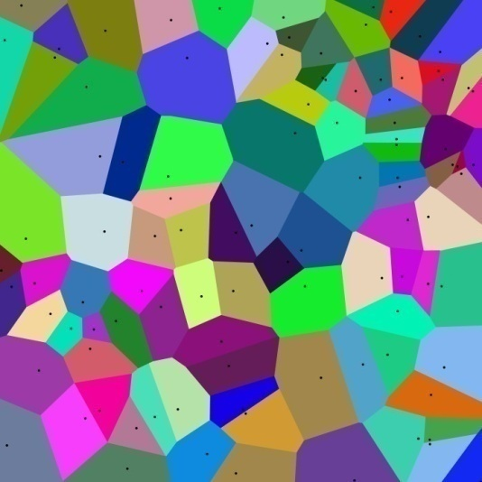
1-NN induces a Voronoi tessellation of the input space
Geometry of 1-NN
Warming-up to ML, and Some Simple Supervised Learners

Slide 93
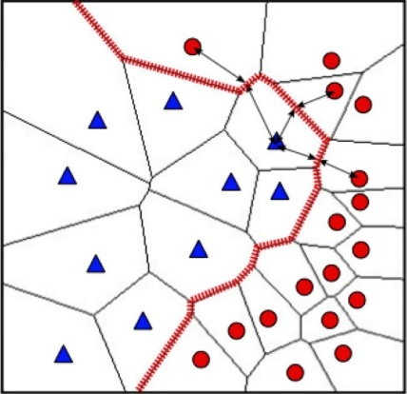
The Decision Boundary of 1-NN (for binary classification)
The decision boundary is composed of hyperplanes that form perpendicular bisectors of pairs of points from different classes
Warming-up to ML, and Some Simple Supervised Learners

Slide 94
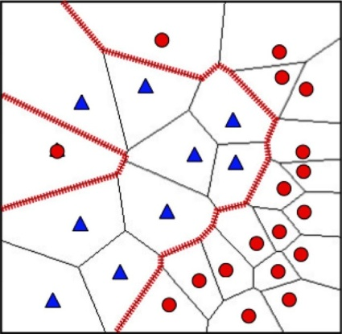
Effect of Outliers on 1-NN
How the decision boundary can drastically change when the data contains some outliers
Warming-up to ML, and Some Simple Supervised Learners

Slide 95
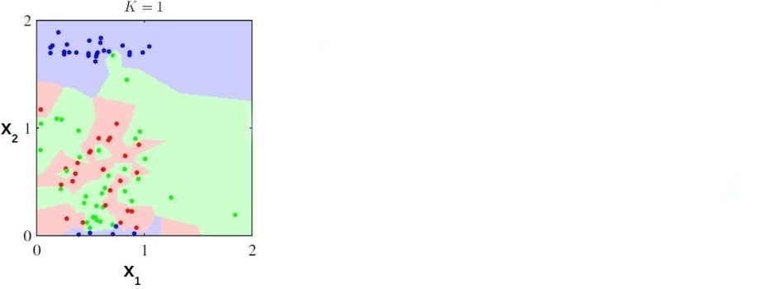
Effect of Varying K
Larger K leads to smoother decision boundaries
Too small K (e.g., K = 1) can lead to overfitting, too large K can lead to underfitting
Warming-up to ML, and Some Simple Supervised Learners
27

Slide 96
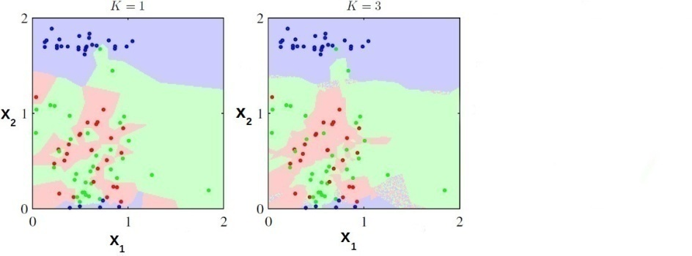
Effect of Varying K
Larger K leads to smoother decision boundaries
Too small K (e.g., K = 1) can lead to overfitting, too large K can lead to underfitting
Warming-up to ML, and Some Simple Supervised Learners
27

Slide 97
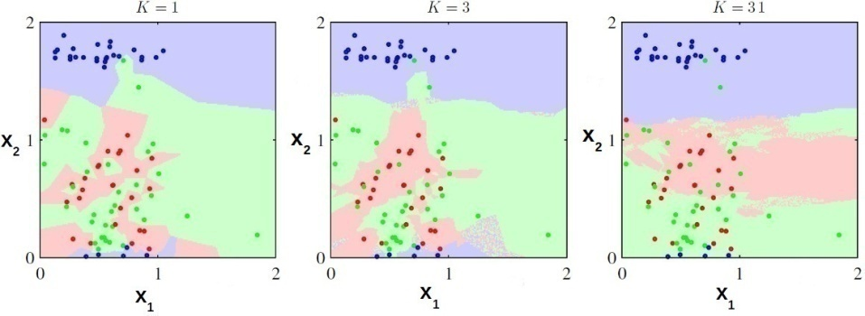
Effect of Varying K
Larger K leads to smoother decision boundaries
Too small K (e.g., K = 1) can lead to overfitting, too large K can lead to underfitting
Warming-up to ML, and Some Simple Supervised Learners
27

Slide 98
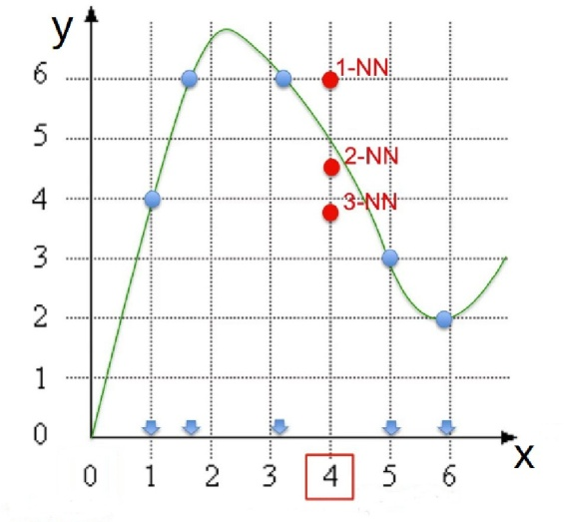
K -NN Behavior for Regression
Pic credit: Victor Lavrenko
Warming-up to ML, and Some Simple Supervised Learners
28

Slide 99
K -NN Behavior for Regression
Pic credit: Alex Smola and Vishy Vishwanathan
Warming-up to ML, and Some Simple Supervised Learners

Slide 100
Summary
Looked at two distance-based methods for classification/regression
A “Distance from Means” Method Nearest Neighbors Method
Warming-up to ML, and Some Simple Supervised Learners
30

Slide 101
Summary
Looked at two distance-based methods for classification/regression
A “Distance from Means” Method Nearest Neighbors Method
Both are essentially “local” methods (look at local neighborhood of the test point)
Warming-up to ML, and Some Simple Supervised Learners
30

Slide 102
Summary
Looked at two distance-based methods for classification/regression
A “Distance from Means” Method Nearest Neighbors Method
Both are essentially “local” methods (look at local neighborhood of the test point) Both are simple to understand and only require knowledge of basic geometry
Warming-up to ML, and Some Simple Supervised Learners
30

Slide 103
Summary
Looked at two distance-based methods for classification/regression
A “Distance from Means” Method Nearest Neighbors Method
Both are essentially “local” methods (look at local neighborhood of the test point) Both are simple to understand and only require knowledge of basic geometry
Have connections to other more advanced methods (as we will see)
Warming-up to ML, and Some Simple Supervised Learners
30

Slide 104
Summary
Looked at two distance-based methods for classification/regression
A “Distance from Means” Method Nearest Neighbors Method
Both are essentially “local” methods (look at local neighborhood of the test point) Both are simple to understand and only require knowledge of basic geometry
Have connections to other more advanced methods (as we will see)
Need to be careful when computing the distances (learned Mahalanobis distance metrics, or “learned features” + Euclidean distance can often do wonders!)
Warming-up to ML, and Some Simple Supervised Learners
30

