Slide 1
Gel Electrophoresis
Dr. NISHA SHARMA, ASSOCIATE PROFESSOR, C.S.J.M. UNIVERSITY, KANPUR

Slide 2
TYPES OF ELECTROPHORESIS
Zone Electrophoresis
Paper E
Gel E
Moving Boundary Electrophoresis
Iso tacho-phoresis
Cellulose Acetate E
Capillary E
Isoelectric
Focussing
Immuno E
Migration of charged particles on supporting media
Migration of charged particles in solution. No supporting media

Slide 3
GEL ELECTROPHORESIS
Gel Electrophoresis
1-D
SDS-PAGE
Isoelectric focusing
2 D
Separates proteins by isoelectric point in the first dimension and by mass in the second dimension.
Native PAGE
Based on mol. Wt. & iso electric pt
Sep. Of proteins Based on molecular wt only
Moving

Slide 4
Gel Electrophoresis
Electrophoresis: Tech. – separation of DNA, RNA, protein mol. – based on size & electrical charge- applying electrical current- on gel matrix
Gel? – Cross linked polymer, colloid in solid form (99%water)
It is support media, acts like molecular sieve, should be electrically neutral
Gel porosity, compositions- depends on sp. Wt. & composition of target molecule
Porous gel- sieve- retards bigger molecules, while allows smaller to pass freely depending upon size of mol.
Ex: Agar and Agarose gel, starch, sephadex, Polyacrylamide gel,

Slide 5
A porous gel acts as a sieve by retarding or, in some cases, by completely obstructing the movement of macromolecules while allowing smaller molecules to migrate freely.
Agar gel is used for separation of different types of protein mixtures as well as nucleic acids
Polyacrylamide is most suitable for separation of nucleic acids. It is also frequently used in separating proteins, peptides and amino acids from microgram quantities of mixed samples
Carried by two methods
A) Horizontal
B) Vertical

Slide 6
Horizontal gel Electrophoresis
In this technique the gel bed is placed in horizontal position
Both the ends of gel bed are connected with the electrophoresis buffer solution separately.
The gel acts as the pocket in which the components with the smaller molecular size are trapped & it become easy to separate some of specific components.
When potential difference is applied across the two ends, components of the mixture get separated on the basis of their electrophoretic ability.

Slide 8
Vertical Gel Electrophoresis
The technique employed here is also as similar as the Horizontal gel electrophoresis technique in case of principle, but the arrangement of the experiment is differing in these case.
In this the sample is kept in the midpoint of the separation plate which is at 90 degrees with the ground.
The separation is aided by the gravity and the efficiency of the separation is enhanced.

Slide 10
Gel types
Agarose Gel | Polyacrylamide Gel
Polysaccharide extracted from sea weed | Cross linked polymer of acrylamide
Gel casted horizontally | Gel casted vertically
Non toxic | Potent neuro toxic
Separate large molecules | Separate small molecules
Commonly used for DNA separations | For DNA or proteins
Staining can be done before pouring the gel | Staining can be done after pouring the gel

Slide 11
Agarose Gel
Commonly used support medium
Less expensive than cellulose acetate
Equally good separation
Agar is a complex acidic polysaccharide containing monomers of sulfated galactose
Agarose is a sulfate free fraction of Agar
Gel is prepared in buffer and spread over a microscopic slide
A small sample of serum or biological fluid is applied by cutting in to the gel with a sharp edge
The electrophoretic run takes about 90 minutes

Slide 12
Agarose and Agar Gel
Agar is a mixture of poly saccharides extracted from sea weeds.
Agarose is a highly purified uncharged polysaccharide derived from agar.
Agarose is chemically basic disaccharide repeating units of 3,6-anhydro-L-galactose.
Agarose dissolves when added to boiling liquid. It remains in a liquid state until the temperature is lowered to about 40° C at which point it gels.

Slide 13
The pore size may be predetermined by adjusting the concentration of agarose in the gel.
Agarose gels are fragile. They are actually hydrocolloids, and they are held together by the formation of weak hydrogen and hydrophobic bonds.
The pores of an agarose gel are large, agarose is used to separate macromolecules such as nucleic acids, large proteins and protein complexes.

Slide 14
ADVANTAGES
Easy to prepare and small concentration of agar is required.
Resolution is superior to that of filter paper.
Large quantities of proteins can be separated and recovered.
Adsorption of negatively charged protein molecule is negligible.
It adsorbs proteins relatively less when compared to other medium.
Sharp zones are obtained due to less adsorption.
Recovery of protein is good, good method for preparative purpose.

Slide 15
DISADVANTAGES
Electro osmosis is high.
Resolution is less compared to polyacrylamide gels.
Different sources and batches of agar tend to give different results and purification is often necessary.
APPLICATION:
Widely used in Immuno electrophoresis.
To separate different types of protein mixtures as well as nucleic acids.

Slide 16
Gel Structure of Agarose

Slide 17
PAGE: Polyacrylamide Gel Electrophoresis
It is prepared by polymerizing acryl amide monomers in the presence of methylene-bis- acrylamide to cross link the monomers.
Structure of acrylamide (CH₂=CH-CO-NH₂)
Polyacrylamide gel structure held together by covalent cross-links.
Polyacrylamide gels are tougher than agarose gels.
It is thermostable, transparent, strong and relatively chemically inert.
Gels are uncharged and are prepared in a variety of pore sizes.
Proteins are separated on the basis of charge to mass ratio and molecular size, a phenomenon called Molecular sieving.

Slide 18
Types of PAGE
PAGE can be classified according the separation conditions into:
NATIVE-PAGE: Native gels are run in non-denaturing conditions, so that the analyte's natural structure is maintained.
Separation is based upon charge, size, and shape of macromolecules.
Useful for separation or purification of mixture of proteins.
This was the original mode of electrophoresis.
DENATURED-PAGE OR SDS-PAGE:
Separation is based upon the molecular weight of proteins.
The common method for determining MW of proteins.
Very useful for checking purity of protein samples.

Slide 19
PAGE-Procedure
The gel of different pore sizes is cast into a column inside a vertical tube, often with large pore gel at the top and small pore gel at the bottom.
Microgram quantity of the sample is placed over the top of the gel column and covered by a buffer solution having such a pH so as to change sample components into anions.
The foot of the gel column is made to dip in the same buffer in the bottom reservoir.
Cathode and anode are kept above and below the column to impose an electric field through the column.

Slide 20
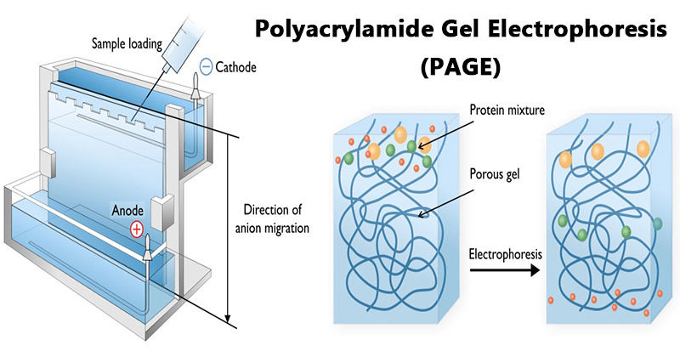

Slide 21
PAGE-Procedure
Macromolecular anions move towards the anode down the gel column.
There is no external solvent space, all the migratory particles have to pass through the gel pores.
Rate of migration depends on the charge to mass ratio.
Different sample components get separated into discrete migratory bands along the gel column on the basis of electrophoretic mobility and gel filtration effect.
a) The gel is poured vertically between two glass plates.
b.) Protein bands are separated on the basis of relative molecular weight and visualized with stains.

Slide 22
PROCEDURE

Slide 23
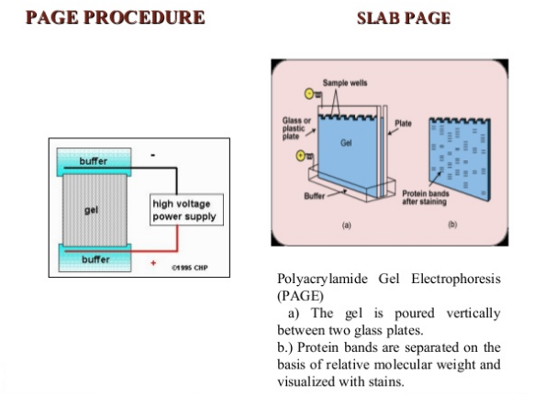

Slide 24
Visualization
After the electrophoresis is complete, the molecules in the gel can be stained to make them visible.
Ethidium bromide, silver, or coomassie blue dye may be used for this process.
Other methods may also be used to visualize the separation of the mixture's components on the gel.
If the analyte molecules fluoresce under ultraviolet light, a photograph can be taken of the gel under ultraviolet lighting conditions. If the molecules to be separated contain radioactivity added for visibility, an autoradiogram can be recorded of the gel.

Slide 25
Types of PAGE

Slide 26
SDS-PAGE
SDS-PAGE, sodium dodecyl sulfate polyacrylamide gel electrophoresis, is a technique widely used in biochemistry, forensics, genetics and molecular biology to separate proteins according to their electrophoretic mobility.
When a detergent SDS added to PAGE the combined procedure is termed as SDS PAGE.
SDS coats protein molecules giving all proteins a constant charge- mass ratio.
Due to masking of charges of proteins by the large negative charge on SDS binding with them, the proteins migrate along the gel in order of increasing sizes or molecular weights.

Slide 27
SDS PAGE
SDS is an anionic detergent which denatures secondary and non– disulfide–linked tertiary structures by wrapping around the polypeptide backbone. In doing so, SDS confers a net negative charge to the polypeptide in proportion to its length.
Molecules in solution with SDS have a net negative charge within a wide pH range.
A polypeptide chain binds amounts of SDS in proportion to its relative molecular mass.
The negative charges on SDS destroy most of the complex structure of proteins, and are strongly attracted toward an anode in an electric field

Slide 32
DIFFERENCES

Slide 33
ADVANTAGES
Chemically inert
Hydrophillic & electrically neutral
Transparent to light
Stable over a wide range of pH, temperature, & ionic strength
Never bind to proteins
Available in wide range of pore sizes
Superior resolution

Slide 34
APPLICATIONS
Used for estimation of molecular weight of proteins and nucleic acids.
Determination of subunit structure of proteins.
Purification of isolated proteins.
Monitoring changes of protein content in body fluids.
Identifying disulfide bonds between protein
Quantifying proteins
Blotting applications

Slide 35
STARCH GEL ELECTROPHORESIS
A suspension of granular starch should be boiled in a buffer to give a clear colloidal suspension.
The suspension on cooling sets as a semisolid gel due to intertwining of the branched chains of amylopectin.
In order to avoid swelling and shrinking petroleum jelly is used.

Slide 36
ADVANTAGES
High resolving power and sharp zones are obtained.
The components resolved can be recovered in reasonable yield especially proteins.
Can be used for analytical as well as preparative electrophoresis.
DISADVANTAGES:
Electro osmotic effect.
Variation in pore size from batch to batch.

Slide 37
1-D Gel electrophoresis
Protein sample + SDS (Na Dodecyl SO₄), anionic surfactant → breaks R-S-S-R’ disulphide bond, provides –ve charge to each protein molecule based on its mol. Wt.→ Thus denatures proteins
If not treated with SDS, the different proteins having same Mol. Wt. would move differently based on difference in folding→ due to folding patterns of proteins, some gets better fit in gel matrix than others

Slide 38
1-D Gel electrophoresis
SDS- linearizes protein- separation- Mol. Wt. only
Tracking dye- bromophenol blue+ protein solution- to track progress of migration of protein on gel
Gel- SDS-PAGE-acrylamide-forms cross linked polymers – polyacrylamide
Standard gels: 2 layers-
Top layer- stacking gel- ↓ % of acrylamide, ↓ pH
Lower layer- separating gel- conc. of acrylamide varies as per sample run, ↑ pH

Slide 39
1-D Gel electrophoresis
Difference in pH & conc. acrylamide in stacking & separating gel – better resolution, & sharp bands in separating gel
Gel can withstand ↑ Voltage, staining, detaining procedures, digested to extract material, dried for autoradiography, recording

Slide 40
2-D Gel electrophoresis
1st introduced- O Farrell, Klose- 1975
Mix. of proteins -separated by 2 properties- & in 2 dimensions on 2 D gels
Begins with 1 D, then separates by 2nd prop. in direction 90° to 1st
Effective b’cos- any 2 mol. Will not be same in 2 prop.
Separated using iso-electric point & protein mass

Slide 41
REQUIREMENTS
Equipment: Electrophoresis unit, power supply, Gel casting trays of U.V. transparent plastic
For casting Gel- open ends of trays- closed with tape
Removed before performing electrophoresis
For sample well- In sample combs- molten agarose – poured
Buffers: TAE/TBE- Tris acetate EDTA/Tris borate EDTA

Slide 42
REQUIREMENTS
Loading buffer: contains Glycerol- sample falls in wells + tracking dyes- to track the migration
Nucleic acid staining: Ethidium bromide- (mutagenic chemical)
Transilluminator (U.V. light chamber)- to visualize DNA stained with Eth-Br

Slide 43
PROCEDURE
Gel powder (ex. agarose) + buffer solution + heat → melted + Eth-Br 0.5µg/ml→ cool to 6°C
Pour – casting tray with sample combs- allow solidification at RT
Remove comb carefully
Casted Gel with tray – moved horizontally to electrophoresis chamber + cover with Buffer solution

Slide 44
PROCEDURE
Samples in loading buffer- added to wells
Lid, power cables- attached, Apply current
Bubbles generate as I flows
Sample start migrating to opposite charged electrodes
Migration is visualized by tracking dyes
After separation- gel may be stained with dye- kept in U.V. transilluminator to visualize

Slide 45
Advantages
Easy
Better resolution than Paper electrophoresis
Variety of proteins can be separated & recovered
-vely charged proteins- negligible adsorption
Sharp zones are obtained as of less adsorption
Recovery of proteins – Good

