Slide 1
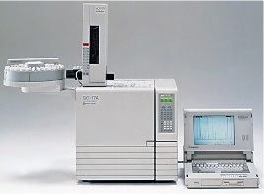
7th Semester
Unit –IV Gas Chromatography
Introduction, theory, instrumentation, derivatization,
Temperature programming, advantages, disadvantages and applications
Dr. Nisha Sharma, Associate Professor, Pharmacy, C.S.J.M. University

Slide 2
DERIVATIZATION
Process of modifying chemically a compd. to generate a new one so as to enable the analysis
Chemical structure remains same, only sp. fn. grp. of reacting compd. is modified to changes in chemical & physical prop. for easy analysis.
Why derivatization?
For compds. that cannot be directly analyzed due to improper stability & volatility, imparts volatility to non volatile compds.
To improve chromatographic behaviour/ detection

Slide 3
DERIVATZATION
↑ses detectability ex. Steroids
↑ses stability- thermo-sentitivity
↑ses sensitivity to detector: ECD- halogenated acyl grp. when introduced – allows detection
↑ses volatility- ex. sugars;- eliminates polar grps- OH, NH, SH
↓ses adsorption of polar samples on active surfaces of column walls & solid support
Derivatization agent must be- stable,
DA & its products- must not be detectable, must be separable, Analyte – reactive with DA, Non toxic

Slide 4
DERIVATIZATION: Types
Silylation: easily volatilizes sample,
silyl derivatives- more volatile, thermal stable, replaces active H with TMS (tri methyl silyl gr)
Silylation- SN2 grps- better leaving grp- better silylation
Alkylation: reduces mol. Polarity, replaces active H with alkyl grp. They modify acidic H containing compd.-carboxylic acids, phenols
They make- esters, ethers, alkyl amines, alkyl amides, throu mech - nucleophilic displacement
Ex: BCl₃ in MeOH, BF₃ in MeOH, MeOH in acid

Slide 5
DERIVATZATION
Acylation: reduces polarity of amino, -OH, thiol grps. Adds halogenated fnc. for ECD
Targets are high polar, multifunctional compds., carbohydrates, amino acids
It converts- active H to esters, thioesters, amides
Formed with acyl halide, anhydride, acyl amide
Carried out in pyridine, THF capable of accepting acid by product
Used for increasing retention times
Ex. Acetic anhydride, TFAA Anhydride

Slide 6
Effects of Derivation
1. Time consumption
2. Side reaction
3. Loss of sample

Slide 7
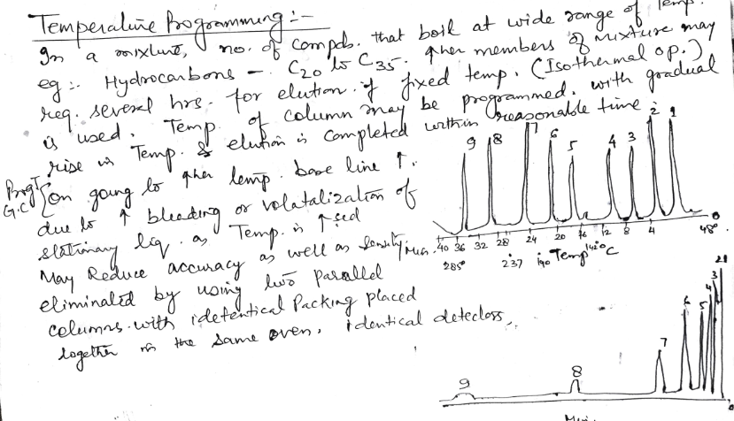
Temperature Programming

Slide 8
Temperature programming
Complete & efficient separation
T high enough to evaporate sample components
Effects partition coefficient of analytes
↑ T ↓ retention vice versa
Isothermal analysis
Sample with components close similar B.P.
Isothermal separation- short time at a single Temp.- obtained

Slide 9
Temperature programming
But with compounds having wide B.P. – efficient sep.- not possible in short time- Go for Temp-prog.- allows efficient & complete separation of both components with early & late elution in less time.
Initial Temp: nearly below the B.P. of lowest boiling component
Final Temp.: near to B.P. of highest boiling of component in sample
Temp. rate: linear/multi linear etc

Slide 10
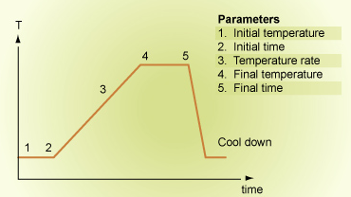
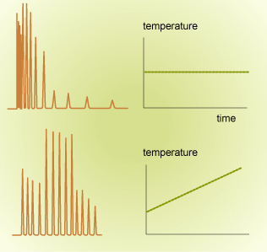
Linear Temp. programmimg
Isothermal vs Temperature Gradient

Slide 11
Chromatographic behaviour of solutes
Described in no. of ways
Retention Vol. V_{R} , Retention time: tR
Partition coefficient K’
By varying stationary mobile phase combinations & operating parameters, degrees of retention can be varied from total retention to free migration

Slide 12
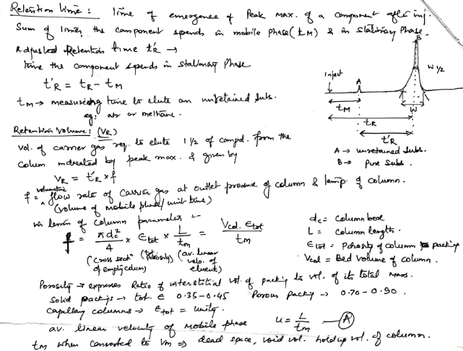

Slide 13
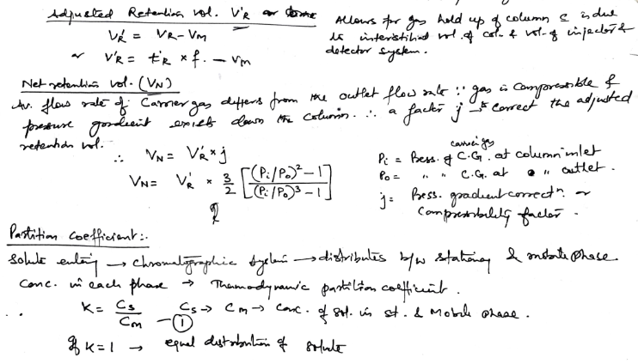

Slide 14
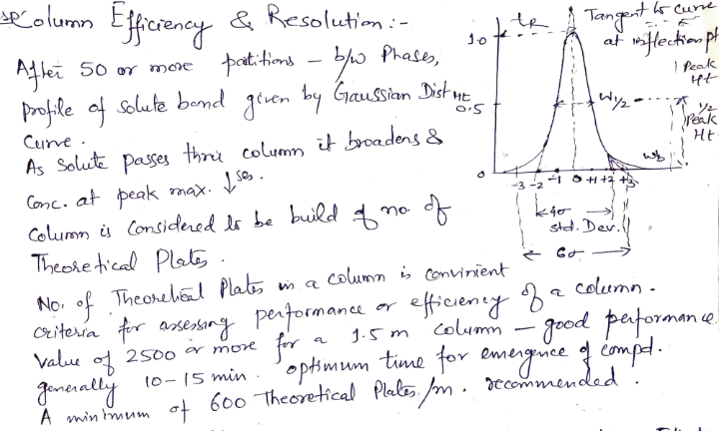
Column Efficiency

Slide 15
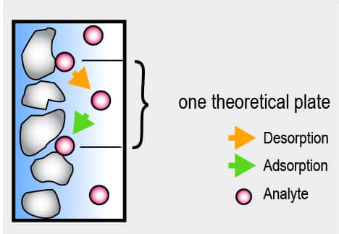

Slide 16
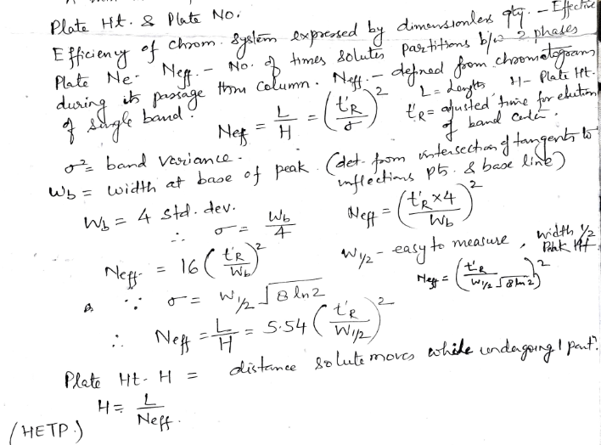
Plate Ht. Plate No.

Slide 17
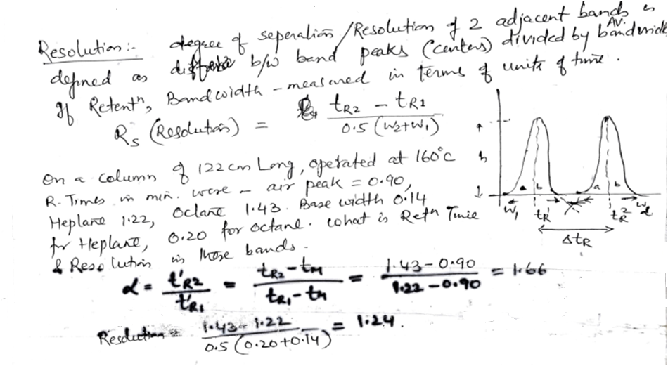

Slide 18
GLC ADVANTAGES
1.Very good separation
2.Time (analysis is short)
3.Small sample is needed - μl
4.Good detection system available
5. Quantitatively analysis
6. Universal detectors for organic
Carrier gases can’t be detected

Slide 19
GLC DISADVANTAGES
Less application- fixed Gas analysis
Low column efficiency
Sample must be volatile
Not good for thermolabile
Carrier gas must be pure
Does not respond to common inorganic comp
Mobile phase impurities cant be detected

Slide 20
DISADVANTAGES OF GAS CHROMATOGRAPHY
Material has to be volatilized at 250°C without decomposition.

Slide 21
Applications
As a tool for doing separations- complex organic, metal organic, & Biochemical systems
For providing means for completion of an analysis
Quanlitative identification: carried by using t_{R}, V_{R} , quantitative information- by using peak ht. or area
For elemental analysis of organic compounds-C,H,N

Slide 22
Applications
In petroleum Industry- for analysis of crude petroleum products, gasoline, waxes, LPG, S, N compounds & unsaturation etc.
In food industry: For color, flavour, detectors based on ECD.
To determine residual solvents in spices, oleoresins, for pesticides in foods.
In Biochemical & clinical fields: Blood gases, estrogens, vanilimandelic acid, Hydroxy cortico steroids etc. determined & analysed in medicine

Slide 23
Applications
In cosmetic & perfumery: To determine composition of various cosmetics, quality of ingredients,
Determination of styrene monomer, vinyl toulene, latex toulene di-isocyanate in paint, varnish, lacquer etc.
In plastic Industry: To identify plastics, determination of esters in acrylic co-polymers, styrene monomers in styrene plastics, vinyl acetate in its co-polymers etc.

Slide 24
Applications
For analysis of coal tar products
For analysis of Alcoholic beverages
For analysis of Fertilizers
For determination of water in butane, gas, creams, emulsions, ointments, pastes etc.
Pesticides in water, aquatic herbicide.

