Slide 1
Decision Trees for Classification and Regression
Decision Trees for Classification and Regression

Slide 2
Decision tree
Decision tree is a type of supervised learning algorithm (having a pre-defined target variable) that is mostly used in classification problems.
 It works for both categorical and continuous input and output variables.
 In this technique, we split the population or sample into two or more homogeneous sets (or sub-populations) based on most significant splitter / differentiator in input variables.

Slide 3
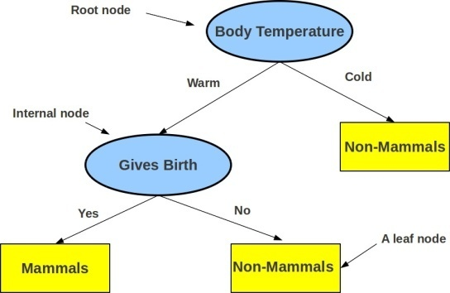
Decision Tree
Defines a tree-structured hierarchy of rules
Consists of a root node, internal nodes, and leaf nodes
Root and internal nodes contain the rules Leaf nodes define the predictions
Decision Tree (DT) learning is about learning such a tree from labeled training data
Decision Trees for Classification and Regression

Slide 4
A Classification Problem
Consider binary classification. Assume training data with each input having 2 features (x₁, x₂)
5
4
3
2
1
0
0
1
2
3
4
5
6
Decision Trees for Classification and Regression

Slide 5
The “expected” decision boundary given this training data.
A Classification Problem
5
4
3
2
1
0
0
1
2
3
4
5
6
Decision Trees for Classification and Regression
6

Slide 6
A Classification Problem
The “expected” decision boundary given this training data. Let’s learn this!
5
4
3
2
1
0
0
1
2
3
4
5
6
Decision Trees for Classification and Regression
6

Slide 7
Learning by Asking Questions!
Is x₁ (feature 1) greater than 3 ?
5
4
3
2
1
0
0
1
2
3
4
5
6
Decision Trees for Classification and Regression

Slide 8
Learning by Asking Questions!
Given x₁ > 3, is feature 2 (x₂) greater than 3?
5
4
3
2
1
0
0
1
2
3
4
5
6
Decision Trees for Classification and Regression

Slide 9
Learning by Asking Questions!
Given x₁ < 3, is feature 2 (x₂) greater than 1?
5
4
3
2
1
0
0
1
2
3
4
5
6
Decision Trees for Classification and Regression

Slide 10
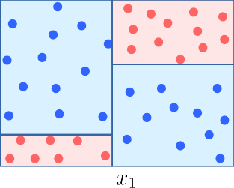
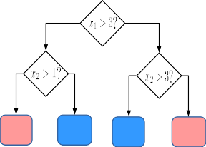
What We Learned
A Decision Tree (DT) consisting of a set of rules learned from training data
5
4
NO
YES
3
NO
YES
NO
YES
2
1
Predict Red
Predict Blue
Predict Blue
Predict Red
0
0
1
2
3
4
5
6
Decision Trees for Classification and Regression
10

Slide 11
What We Learned
A Decision Tree (DT) consisting of a set of rules learned from training data
5
4
NO
YES
3
NO
YES
NO
YES
2
1
Predict Red
Predict Blue
Predict Blue
Predict Red
0
0
1
2
3
4
5
6
These rules perform a recursive partitioning of the training data into “homogeneous” regions
Decision Trees for Classification and Regression
10

Slide 12
What We Learned
A Decision Tree (DT) consisting of a set of rules learned from training data
5
4
NO
YES
3
NO
YES
NO
YES
2
1
Predict Red
Predict Blue
Predict Blue
Predict Red
0
0
1
2
3
4
5
6
These rules perform a recursive partitioning of the training data into “homogeneous” regions
Homogeneous means that the outputs are same/similar for all inputs in that region
Decision Trees for Classification and Regression
10

Slide 13
What We Learned
A Decision Tree (DT) consisting of a set of rules learned from training data
5
4
NO
YES
3
NO
YES
NO
YES
2
1
Predict Red
Predict Blue
Predict Blue
Predict Red
0
0
1
2
3
4
5
6
These rules perform a recursive partitioning of the training data into “homogeneous” regions
Homogeneous means that the outputs are same/similar for all inputs in that region
Given a new test input, we can use the DT to predict its label
Decision Trees for Classification and Regression
10

Slide 14
What We Learned
A Decision Tree (DT) consisting of a set of rules learned from training data
5
4
NO
YES
3
NO
YES
NO
YES
2
1
Predict Red
Predict Blue
Predict Blue
Predict Red
0
0
1
2
3
4
5
6
These rules perform a recursive partitioning of the training data into “homogeneous” regions
Homogeneous means that the outputs are same/similar for all inputs in that region
Given a new test input, we can use the DT to predict its label
A key benefit of DT: Prediction at test time is very fast (just testing a few conditions)
Decision Trees for Classification and Regression
10

Slide 15
Decision Tree for Classification: Another Example
Deciding whether to play or not to play Tennis on a Saturday
Each input (a Saturday) has 4 categorical features: Outlook, Temp., Humidity, Wind A binary classification problem (play vs no-play)
Example credit: Tom Mitchell
Decision Trees for Classification and Regression
11

Slide 16
Decision Tree for Classification: Another Example
Deciding whether to play or not to play Tennis on a Saturday
Each input (a Saturday) has 4 categorical features: Outlook, Temp., Humidity, Wind A binary classification problem (play vs no-play)
Left: Training data, Right: A decision tree constructed using this data
Example credit: Tom Mitchell
Decision Trees for Classification and Regression
11

Slide 17
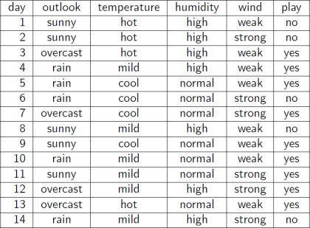
Decision Tree for Classification: Another Example
Deciding whether to play or not to play Tennis on a Saturday
Each input (a Saturday) has 4 categorical features: Outlook, Temp., Humidity, Wind A binary classification problem (play vs no-play)
Left: Training data, Right: A decision tree constructed using this data
Example credit: Tom Mitchell
Decision Trees for Classification and Regression
11

Slide 18
Decision Tree for Classification: Another Example
Deciding whether to play or not to play Tennis on a Saturday
Each input (a Saturday) has 4 categorical features: Outlook, Temp., Humidity, Wind A binary classification problem (play vs no-play)
Left: Training data, Right: A decision tree constructed using this data
Outlook
Rain
Sunny
Overcast
Humidity
Yes
Wind
High
Normal
Strong
Weak
No
Yes
No
Yes
Example credit: Tom Mitchell
Decision Trees for Classification and Regression
11

Slide 19
Decision Trees can also be used for regression problems
A Decision Tree for Regression
4
3
y 2
1
0
 | 0 1 2 3 4 x 5 | 6 | 7 | 8
Decision Trees for Classification and Regression
12

Slide 20
A Decision Tree for Regression
Decision Trees can also be used for regression problems
NO
YES
NO
YES
Predict y=3.5
4
3
y
2
1
Predict y=2.5
Predict y=0.5
₀
0 1 2 3 4 x 5 6
7 8
Decision Trees for Classification and Regression
12

Slide 21
A Decision Tree for Regression
Decision Trees can also be used for regression problems
NO
YES
NO
YES
Predict y=3.5
4
4
3
y
2
3
y
2
1
Predict y=2.5
Predict y=0.5
1
0
0 1 2 3 4 x 5
6
7
8
0
0 1 2 3 4 x 5
6
7
8
Decision Trees for Classification and Regression
12

Slide 22
A Decision Tree for Regression
Decision Trees can also be used for regression problems
NO
YES
NO
YES
Predict y=3.5
4
4
3
y
2
3
y
2
1
Predict y=2.5
Predict y=0.5
1
₀
0
0 1 2 3 4 x 5 6
7 8
0 1 2 3 4 x 5
6
7
8
Here too, the DT partitions the training data into homogeneous regions (inputs with similar outputs)
Decision Trees for Classification and Regression
12

Slide 23
Some Considerations: Shape/Size of DT
What should be the size/shape of the DT?
Number of internal and leaf nodes Branching factor of internal nodes Depth of the tree
Decision Trees for Classification and Regression
13

Slide 24
Some Considerations: Shape/Size of DT
What should be the size/shape of the DT?
Number of internal and leaf nodes Branching factor of internal nodes Depth of the tree
Decision Trees for Classification and Regression
13

Slide 25
Some Considerations: Shape/Size of DT
What should be the size/shape of the DT?
Number of internal and leaf nodes Branching factor of internal nodes Depth of the tree
Decision Trees for Classification and Regression
13

Slide 26
Some Considerations: Leaf Nodes
What to do at each leaf node (the goal: make predictions)? Some options:
Make a constant prediction (majority/average) for every test input reaching that leaf node? Use a nearest neighbors based prediction using all training inputs on that leaf node?
Decision Trees for Classification and Regression
14

Slide 27
Some Considerations: Leaf Nodes
What to do at each leaf node (the goal: make predictions)? Some options:
Make a constant prediction (majority/average) for every test input reaching that leaf node? Use a nearest neighbors based prediction using all training inputs on that leaf node?
NO
YES
4
Test Input
3
y
2
NO
YES
Predict y=?
1
0
0 1 2 3
4 x 5
6
7
8
Predict y=?
Predict y=?
Decision Trees for Classification and Regression
14

Slide 28
Some Considerations: Leaf Nodes
What to do at each leaf node (the goal: make predictions)? Some options:
Make a constant prediction (majority/average) for every test input reaching that leaf node? Use a nearest neighbors based prediction using all training inputs on that leaf node?
NO
YES
4
Test Input
3
y
2
NO
YES
Predict y=?
1
0
0 1 2 3
4 x 5
6
7
8
Predict y=?
Predict y=?
(Less common) Predict using an ML model learned using training inputs that belong to that leaf node?
Decision Trees for Classification and Regression
14

Slide 29
Some Considerations: Leaf Nodes
What to do at each leaf node (the goal: make predictions)? Some options:
Make a constant prediction (majority/average) for every test input reaching that leaf node? Use a nearest neighbors based prediction using all training inputs on that leaf node?
NO
YES
4
Test Input
3
y
2
NO
YES
Predict y=?
1
0
0 1 2 3
4 x 5
6
7
8
Predict y=?
Predict y=?
(Less common) Predict using an ML model learned using training inputs that belong to that leaf node?
Constant prediction is the fastest at test time (and gives a piece-wise constant prediction rule)
Decision Trees for Classification and Regression
14

Slide 30
Some Considerations: Internal Nodes
How to split at each internal node (the goal: split the training data received at that node)?
Decision Trees for Classification and Regression
15

Slide 31
Some Considerations: Internal Nodes
How to split at each internal node (the goal: split the training data received at that node)?
No matter how we split, the goal should be to have splits that result in groups as “pure” as possible
vs
A good split
A not-so-good split
Uniform Label Distributions (High entropy)
Non-uniform Label Distributions (Low entropy)
Decision Trees for Classification and Regression
15

Slide 32
Some Considerations: Internal Nodes
How to split at each internal node (the goal: split the training data received at that node)?
No matter how we split, the goal should be to have splits that result in groups as “pure” as possible
vs
A good split
A not-so-good split
Uniform Label Distributions (High entropy)
Non-uniform Label Distributions (Low entropy)
For classification problems, entropy of the label distribution is a measure of purity
Decision Trees for Classification and Regression
15

Slide 33
Some Considerations: Internal Nodes
How to split at each internal node (the goal: split the training data received at that node)?
No matter how we split, the goal should be to have splits that result in groups as “pure” as possible
vs
A good split
A not-so-good split
Uniform Label Distributions (High entropy)
Non-uniform Label Distributions (Low entropy)
For classification problems, entropy of the label distribution is a measure of purity
Low entropy ⇒ high purity (less uniform label distribution)
Decision Trees for Classification and Regression
15

Slide 34
Some Considerations: Internal Nodes
How to split at each internal node (the goal: split the training data received at that node)?
No matter how we split, the goal should be to have splits that result in groups as “pure” as possible
vs
A good split
A not-so-good split
Uniform Label Distributions (High entropy)
Non-uniform Label Distributions (Low entropy)
For classification problems, entropy of the label distribution is a measure of purity
Low entropy ⇒ high purity (less uniform label distribution)
Splits that give the largest reduction (before split vs after split) in entropy are preferred (this reduction is also known as “information gain”)
Decision Trees for Classification and Regression
15

Slide 35
Some Considerations: Internal Nodes
How to split at each internal node (the goal: split the training data received at that node)?
No matter how we split, the goal should be to have splits that result in groups as “pure” as possible
vs
A good split
A not-so-good split
Uniform Label Distributions (High entropy)
Non-uniform Label Distributions (Low entropy)
For classification problems, entropy of the label distribution is a measure of purity
Low entropy ⇒ high purity (less uniform label distribution)
Splits that give the largest reduction (before split vs after split) in entropy are preferred (this reduction is also known as “information gain”)
For regression, entropy doesn’t make sense (outputs are real-valued). Typically variance is used.
Decision Trees for Classification and Regression
15

Slide 36
Some Considerations: Internal Nodes (Contd.)
Note that splitting at internal node itself is like a classification problem
Data received at the internal node has to be routed along its outgoing branches
Decision Trees for Classification and Regression
16

Slide 37
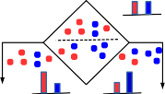
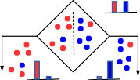
Some Considerations: Internal Nodes (Contd.)
Note that splitting at internal node itself is like a classification problem
Data received at the internal node has to be routed along its outgoing branches
Some common techniques for splitting an internal node
Splitting by testing a single feature (simplest/fastest; used in ID3, C4.5 DT algos). For example:
A horizontal split A Vertical split
Label distribution (before split)
Label distribution (before split)
Label distribution ^{Label distribution} (after split: upper group) ^{(after split: lower group)}
Label distribution Label distribution (after split: left group) (after split: right group)
Decision Trees for Classification and Regression
16

Slide 38
Some Considerations: Internal Nodes (Contd.)
Note that splitting at internal node itself is like a classification problem
Data received at the internal node has to be routed along its outgoing branches
Some common techniques for splitting an internal node
Splitting by testing a single feature (simplest/fastest; used in ID3, C4.5 DT algos). For example:
A horizontal split A Vertical split
Label distribution (before split)
Label distribution (before split)
Label distribution ^{Label distribution} (after split: upper group) ^{(after split: lower group)}
Label distribution Label distribution (after split: left group) (after split: right group)
Splitting using a classifier learned using data on that node. For example, prototype based classifier
Prototype-based node splitter
Decision Trees for Classification and Regression
16

Slide 39
Some Considerations: Internal Nodes (Contd.)
Note that splitting at internal node itself is like a classification problem
Data received at the internal node has to be routed along its outgoing branches
Some common techniques for splitting an internal node
Splitting by testing a single feature (simplest/fastest; used in ID3, C4.5 DT algos). For example:
A horizontal split A Vertical split
Label distribution (before split)
Label distribution (before split)
Label distribution ^{Label distribution} (after split: upper group) ^{(after split: lower group)}
Label distribution Label distribution (after split: left group) (after split: right group)
Splitting using a classifier learned using data on that node. For example, prototype based classifier
Prototype-based node splitter
The same splitting rule will be applied to route a test input that reaches this internal node
Decision Trees for Classification and Regression
16

Slide 40
Decision Tree Construction
As an illustration, let’s look at one way of constructing a decision tree for some given data We will use the entropy/information-gain based splitting criterion for this illustration
Decision Trees for Classification and Regression
17

Slide 41
Example:
Let’s say we have a sample of 30 students with three variables
Gender (Boy/ Girl)
Class( IX/ X)
Height (5 to 6 ft)
15 out of these 30 plays cricket in leisure time.
Now, we want to create a model to predict who will play cricket during leisure period?
In this problem, we need to segregate students who play cricket in their leisure time based on highly significant input variable among all three.
In such situations, decision tree helps.
It will segregate the students based on all values of three variable and identify
the variable, which creates the best homogeneous sets of students (which are heterogeneous to each other).
In the snapshot below, you can see that variable Gender is able to identify best homogeneous sets compared to the other two variables.

Slide 42
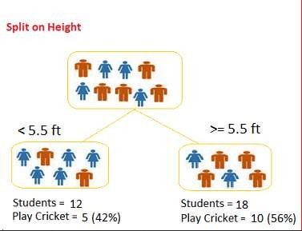
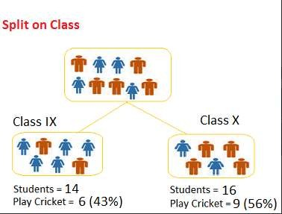

Slide 43
Decision on splitting the tree
The decision of making strategic splits heavily affects a tree’s accuracy.
Decision trees use multiple algorithms to decide to split a node in two or more sub-nodes.
The creation of sub-nodes increases the homogeneity of resultant sub-nodes.
In other words, we can say that purity of the node increases with respect to the target variable.
Decision tree splits the nodes on all available variables and then selects the split which results in most homogeneous sub-nodes.
The algorithm selection is also based on type of target variables.
Let’s look at the most commonly used algorithms in decision tree:
Gini
Information Gain

Slide 44
Gini Index
It works with categorical target variable “Success” or “Failure”.
It performs only Binary splits
Higher the value of Gini higher the homogeneity.
Steps to Calculate Gini for a split
Calculate Gini for sub-nodes, using formula sum of square of probability for success and failure (p^2+q^2).
Calculate Gini for split using weighted Gini score of each node of that split
Example:
Consider the previous example of students playing cricket.
Compute Gini for sub-trees of three attributes – Gender, Height and Class.
Compute the weighted Gini for these three attributes.
Choose the highest weighted-Gini and proceed further.

Slide 45
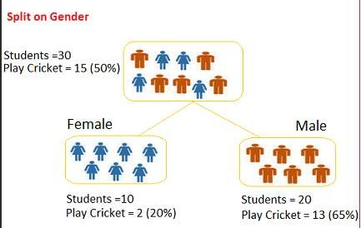
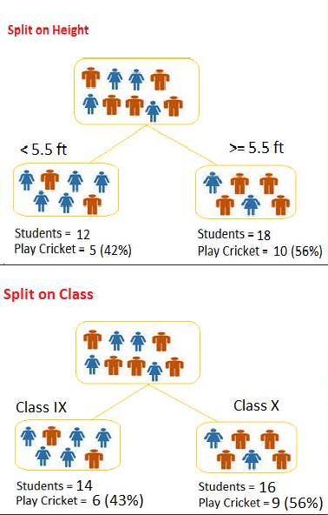
Split on Gender:
Gini for sub-node Female =(0.2)*(0.2)+(0.8)*(0.8)=0.68
Gini for sub-node Male = (0.65)*(0.65)+(0.35)*(0.35)=0.55
Weighted Gini for Gender = (10/30)*0.68+(20/30)*0.55 = 0.59
Split on Height:
Gini for sub-node <5.5 ft =(0.42)*(0.42)+(0.58)*(0.58)=0.5128
Gini for sub-node >=5.5 ft = (0.56)*(0.56)+(0.44)*(0.44)=0.5072
Weighted Gini for Height = (12/30)*0.5128+(18/30)*0.5072 = 0.5094
Split on Class:
Gini for sub-node IX =(0.43)*(0.43)+(0.57)*(0.57)=0.5098
Gini for sub-node X = (0.56)*(0.56)+(0.44)*(0.44)=0.5072
Weighted Gini for Class = (14/30)*0.5098+(16/30)*0.5072 = 0.5084

Slide 46
Gini score for Split on Gender is highest, hence, the node split will take place on Gender.
Sometimes, we use the term ‘Gini Impurity’ which is determined by subtracting the gini value from 1.
So mathematically we can say,
Gini Impurity = 1 - Gini
Datascience.manipal.edu | 40

Slide 47
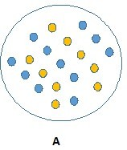
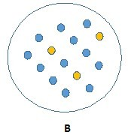
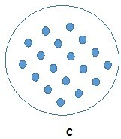
Information Gain
A node which has maximum information is used to split.
Observe the images A, B and C.
We can easily say that C is more pure, as it requires less information as all values are similar.
On the other hand, B requires more information to describe it and A requires the maximum information.
In other words, we can say that C is a Pure node, B is less Impure and A is more impure.
We conclude that less impure node requires less information to describe it and vice-versa.
Information theory is a measure to define this degree of disorganization in a system known as Entropy.
If the sample is completely homogeneous, then the entropy is zero.
If the sample is an equally divided (50% – 50%), it has entropy of one.

Slide 49
We need to split the node which has lowest entropy compared to parent node and other splits.
The lesser the entropy, the better it is.
In other words, we need to consider a node which has highest information gain.
Steps to calculate entropy for a split:
Calculate entropy of parent node
Calculate entropy of each individual node of split and calculate weighted average of all sub-nodes available in split.

Slide 50
Consider example of students playing cricket:
Out of 30 students, 15 play cricket and 15 do not.
So, probability of playing cricket, p⁺ = 15/30.
Hence, probability of not playing cricket, p⁻ = 15/30.
Entropy for sample =
-(15/30) log₂ (15/30) – (15/30) log₂ (15/30) = 1.
Here 1 shows that it is a impure node.

Slide 54
4.1 DECISION TREE ID3 AND CART NOTES.pdf

