Slide 1
Convolution
School of Engineering,
Department of Electronics & Communication Engg.,
C S J M University, Kanpur.

Slide 9
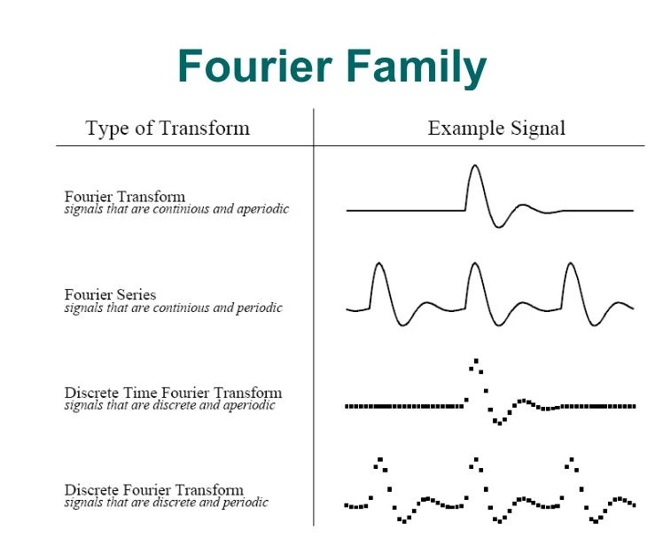

Slide 10
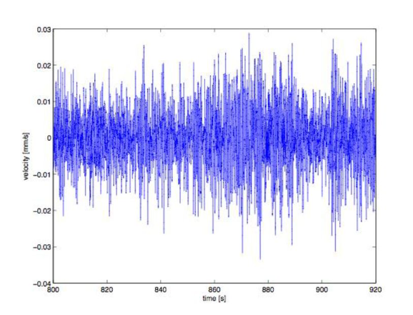
Time Domain audio Signal

Slide 11
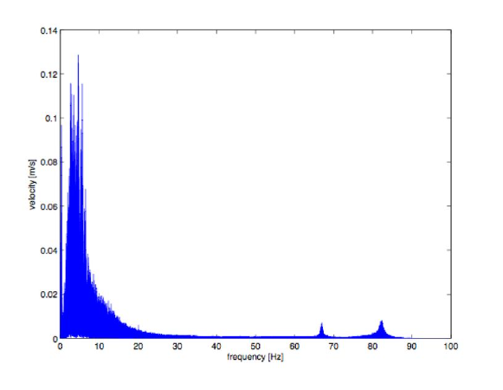
Frequency Spectrum of given signal

