Slide 1
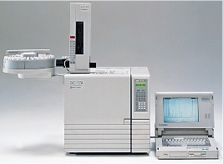
Gas Chromatography
Derivatization,
Temperature programming
Dr. Nisha Sharma, Associate Professor, Pharmacy, C.S.J.M. University

Slide 2
DERIVATIZATION
Process of modifying chemically a compd. to generate a new one so as to enable the analysis
Chemical structure remains same, only sp. fn. grp. of reacting compd. is modified to changes in chemical & physical prop. for easy analysis.
Why derivatization?
For compds. that cannot be directly analyzed due to improper stability & volatility, imparts volatility to non volatile compds.
To improve chromatographic behaviour/ detection

Slide 3
DERIVATZATION
↑ses detectability ex. Steroids
↑ses stability- thermo-sentitivity
↑ses sensitivity to detector: ECD- halogenated acyl grp. when introduced – allows detection
↑ses volatility- ex. sugars;- eliminates polar grps- OH, NH, SH
↓ces adsorption of polar samples on active surfaces of column walls & solid support
Derivatization agent must be- stable, Deriv Ag & its products- must not be detectable, must be separable, Analyte – reactive with DA, Non toxic,

Slide 4
DERIVATIZATION: Types
Silylation: easily volatilizes sample, silyl derivatives- more volatile, thermal stable, replaces active H with TMS (tri methyl silyl gr)
Silylation- SN2 grps- better the leaving grp- better silylation
Alkylation: reduces mol. Polarity, replaces active H with alkyl grp. They modify acidic H containing compd.-carboxylic acids, phenols
They make- esters, ethers, alkyl amines, alkyl amides, mech - nucleophilic displacement
Ex: BCl₃ in MeOH, BF₃ in MeOH, MeOH in acid

Slide 5
DERIVATZATION
Acylation: reduces polarity of amino, -OH, thiol grps. Adds halogenated fnc. for ECD
Targets are high polar, multifunctional compds., carbohydrates, amino acids
It converts- active H to esters, thioesters, amides
Formed with acyl halide, anhydride, acyl amide
Carried out in pyridine, THF capable of accepting acid by product
Used for increasing retention times
Ex. Acetic anhydride, TFAA Anhydride

Slide 6
Effects of Derivitization
1. Time consumption
2. Side reaction
3. Loss of sample

Slide 7
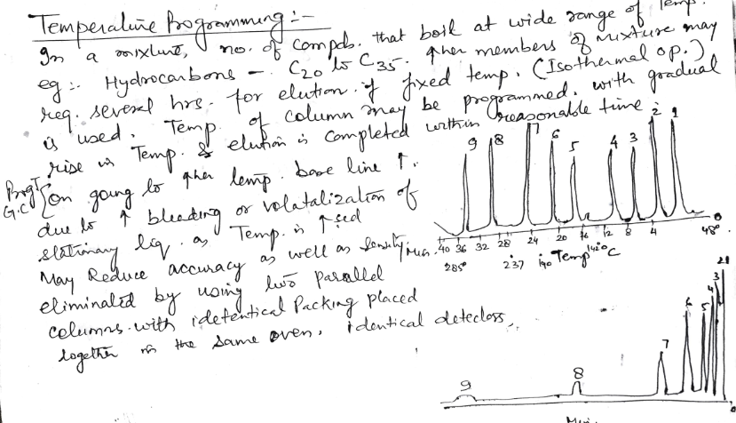
Temperature Programming

Slide 8
Temperature programming
Complete & efficient separation
T high enough to evaporate sample components
Effects partition coefficient of analytes
↑ T ↓ retention vice versa
Sample with components close similar B.P.- Isothermal separation- short time at a single Temp.- obtained

Slide 9
Temperature programming
But with compounds having wide B.P. – efficient sep.- not possible in short time
Go for Temp-prog.- allows efficient & complete separation of both components with early & late elution in less time.
Initial Temp: nearly below the B.P. of lowest boiling component
Final Temp.: near to B.P. of highest boiling of component in sample
Temp. rate: linear/multi linear etc

Slide 10
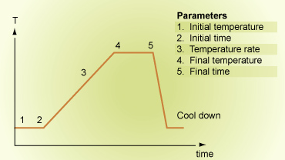
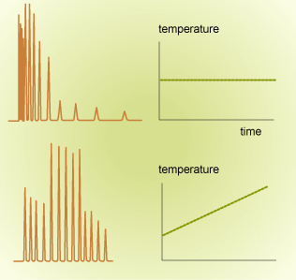
Linear Temp. programmimg
Isothermal vs Temperature Gradient

