Slide 1
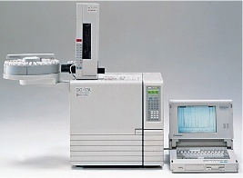
Gas Chromatography
Chromatographic behavior of Solute, Advantages, disadvantages and applications
Dr. Nisha Sharma, Associate Professor, Pharmacy, C.S.J.M. University

Slide 2
Chromatographic behaviour of solutes
Described in no. of ways
Retention Vol. V_{R} , Retention time: tR
Partition coefficient K’
By varying stationary mobile phase combinations & operating parameters, degrees of retention can be varied from total retention to free migration

Slide 3
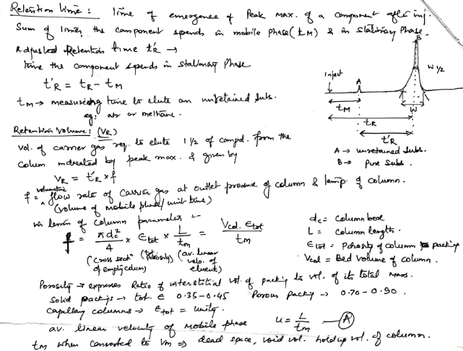

Slide 4
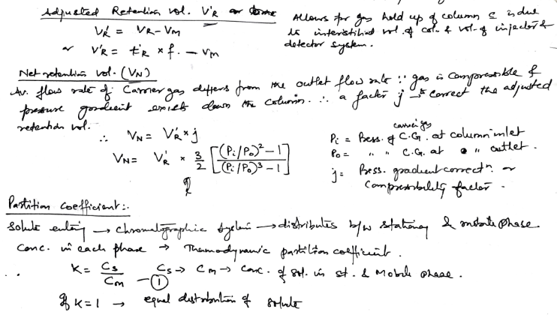

Slide 5
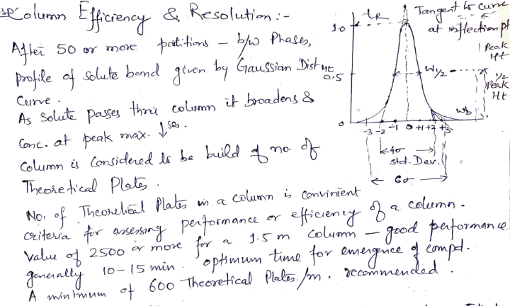
Column Efficiency

Slide 6
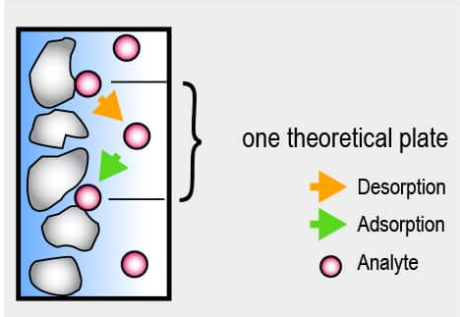

Slide 7
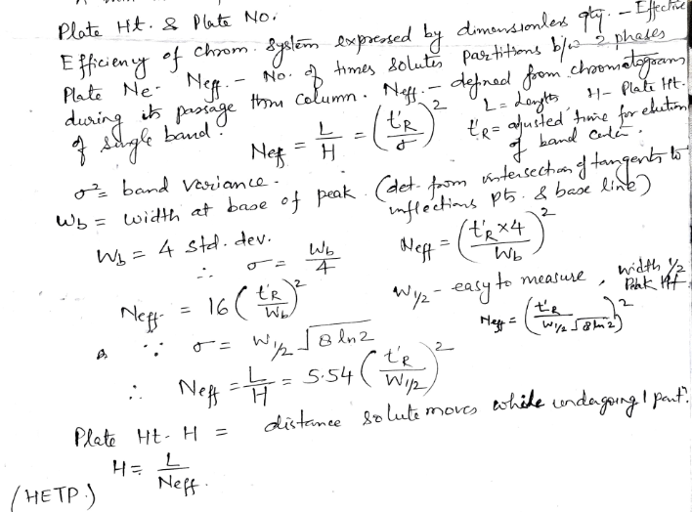
Plate Ht. Plate No.

Slide 8
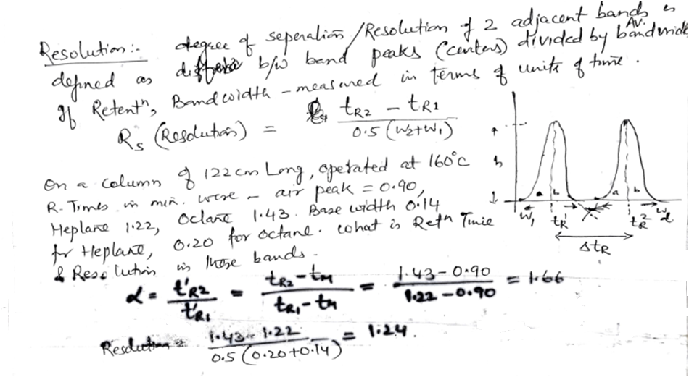

Slide 9
GLC ADVANTAGES
1.Very good separation
2.Time (analysis is short)
3.Small sample is needed - μl
4.Good detection system available
5. Quantitatively analysis
6. Universal detectors for organic
7. Carrier gases can’t be detected

Slide 10
GLC DISADVANTAGES
Less application- fixed Gas analysis
Low column efficiency
Sample must be volatile
Not good for thermolabile
Carrier gas must be pure
Does not respond to common inorganic comp
Mobile phase impurities can’t be detected

Slide 11
DISADVANTAGES OF GAS CHROMATOGRAPHY
Material has to be volatilized at 250°C without decomposition.

Slide 12
Applications
As a tool for doing separations- complex organic, metal organic, & Biochemical systems
For providing means for completion of an analysis
Quanlitative identification: carried by using t_{R}, V_{R} , quantitative information- by using peak ht. or area

Slide 13
Applications
In petroleum Industry- for analysis of crude petroleum products, gasoline, waxes, LPG, S, N compounds & unsaturation etc.
In food industry: For color, flavour, detectors based on ECD.
To determine residual solvents in spices, oleoresins, for pesticides in foods.
In Biochemical & clinical fields: Blood gases, estrogens, vanilimandelic acid, Hydroxy cortico steroids etc. determined & analysed in medicine

Slide 14
Applications
In cosmetic & perfumery: To determine composition of various cosmetics, quality of ingredients,
Determination of styrene monomer, vinyl toulene, latex toulene di-isocyanate in paint, varnish, lacquer etc.
In plastic Industry: To identify plastics, determination of esters in acrylic co-polymers, styrene monomers in styrene plastics, vinyl acetate in its co-polymers etc.

Slide 15
Applications
For analysis of coal tar products
For analysis of Alcoholic beverages
For analysis of Fertilizers
For determination of water in butane, gas, creams, emulsions, ointments, pastes etc.
Pesticides in water, aquatic herbicide.

