Slide 1
Logistic Regression

Slide 2
What is logistic regression?

Slide 3
Logistic regression applications

Slide 4
When is logistic regression suitable

Slide 5
Question
Which of the following sentences are TRUE about Logistic Regression?
Logistic regression is analogous to linear regression but takes a categorical/discrete target field instead of a numeric one.
Logistic Regression measures the probability of a case belonging to a specific class.
Logistic Regression can be used to understand the impact of a feature on a dependent variable.

Slide 6
Email: Spam / Not Spam?
Online Transactions: Fraudulent (Yes / No)?
Tumor: Malignant / Benign ?
0: “Negative Class” (e.g., benign tumor)
1: “Positive Class” (e.g., malignant tumor)

Slide 7
Logistic Regression
Logistic regression is another supervised learning algorithm which is used to solve the classification problems. In classification problems, we have dependent variables in a binary or discrete format such as 0 or 1.
o Logistic regression algorithm works with the categorical variable such as 0 or 1, Yes or No, True or False, Spam or not spam, etc.
o It is a predictive analysis algorithm which works on the concept of probability.
o Logistic regression is a type of regression, but it is different from the linear regression algorithm in the term how they are used.
o Logistic regression uses sigmoid function or logistic function which is a complex cost function. This sigmoid function is used to model the data in logistic regression. The function can be represented as:

Slide 8
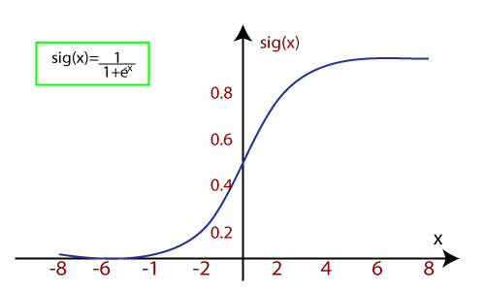
o f(x)= Output between the 0 and 1 value.
o x= input to the function
o e= base of natural logarithm.
When we provide the input values (data) to the function, it gives the S-curve as follows:

Slide 9
It uses the concept of threshold levels, values above the threshold level are rounded up to 1, and values below the threshold level are rounded up to 0.
There are three types of logistic regression:
o Binary(0/1, pass/fail)
o Multi(cats, dogs, lions)
o Ordinal(low, medium, high)

