Slide 1
BP701T. INSTRUMENTAL METHODS OF ANALYSIS (Theory) Unit 3
Syllabus
Paper chromatography
Introduction, methodology, development techniques, advantages, disadvantages and applications
PART-1
Dr. NISHA SHARMA, ASSOCIATE PROFESSOR, C.S.J.M. UNIVERSITY, KANPUR

Slide 2
CHROMATOGRAPHY
Chromatography: Greek: Chroma – color
Graphein: writing
M. Tsvet: Russian botanist: Father of Chrom.
Chromatography: It is Group of techniques for the separation & identification of components from their mixtures by distributing continuously between two phases.
One phase-- moving & other --- stationary

Slide 3
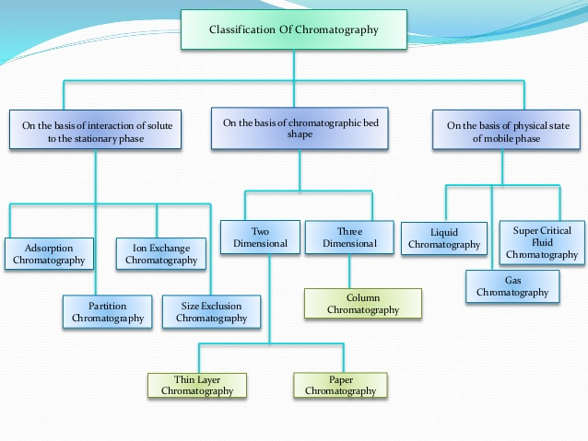
https://www.slideshare.net/khadeejaikram56/classification-of-chromatography-49733015

Slide 4
PRINCIPLES OF CHROMATOGRAPHY
Adsorption chromatography- stationary phase – Solid & mobile phase ---liquid or gaseous– separation based on adsorption/affinity for adsorbent
Partition Chromatography: stationary phase –Liquid & mobile phase -- liquid or gaseous- separation based on partition

Slide 5
Principle of Separation Partition
The components in a mixture get distributed in two liquid phases because of difference in partition coefficient
Liquid-Liquid partition: Liquid is held in place by one physical adsorption (Paper chromatography)
Liquid bonded phase column: liquid is attached by chemical bonding, stable packing, insoluble in mobile phase (HPLC)

Slide 6
PAPER CHROMATOGRAPHY
Introduction : Developed by AH Gorden AJP Martin. (1941), For separation of amino acids
AJP Martin & RYL Synge : Shared Nobel prize in 1952
Paper is used as support/ adsorbent
Partition plays imp. Role in separation of components than adsorption
Because: Cellulose fibers – have film of moisture surrounding them in air dried state also

Slide 7
PAPER CHROMATOGRAPHY
Movement of components on paper- depends on amt. & nature of stationary phase compared with the amt. of mobile phase in same part of paper & on partition coefficient of components
It offers means of tentative identification of components
Factors Responsible : Temp., Stationary phase, Size of spot, Quality of paper, equilibrium times

Slide 8
PAPER CHROMATOGRAPHY
To eliminate or to minimize the effect of variables, Rf values are related to std. subst.
Eg: Rx= Dist. sub. moves from origin / Dist. reference sub. moves from origin
Where x is reference compound
Rf values= Dist. travelled by component / Dist. travelled by solvent front

Slide 9
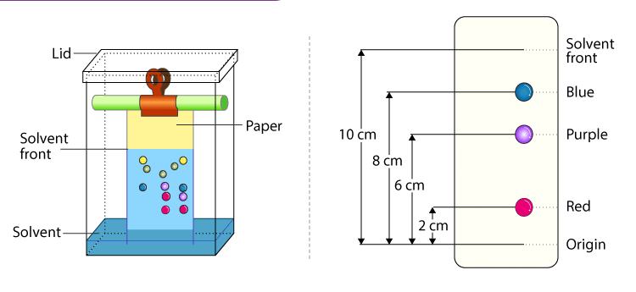
Methodology
Basic apparatus required
Closed chamber: to avoid loss of mobile phase

