Slide 1
BP701T. INSTRUMENTAL METHODS OF ANALYSIS (Theory) Unit 3
Syllabus
Paper chromatography
Introduction, methodology, development techniques, advantages, disadvantages and applications
PART-2
Dr. NISHA SHARMA, ASSOCIATE PROFESSOR, C.S.J.M. UNIVERSITY, KANPUR

Slide 2
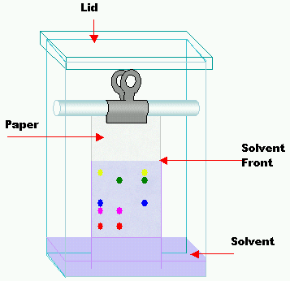
Development techniques: 1. Ascending Tech.
Draw a line with pencil
from one end of paper
Apply 2.5µl vol. (sample & ref.) at about 2 cm interval on line
Tank: Mobile phase to a depth of 1 cm,
Line tank with paper
Equilibrium time: 2-3 hr
Suitable ht. 15-20 cm
Remove the paper, Dry, locate the components
Components
sample

Slide 3
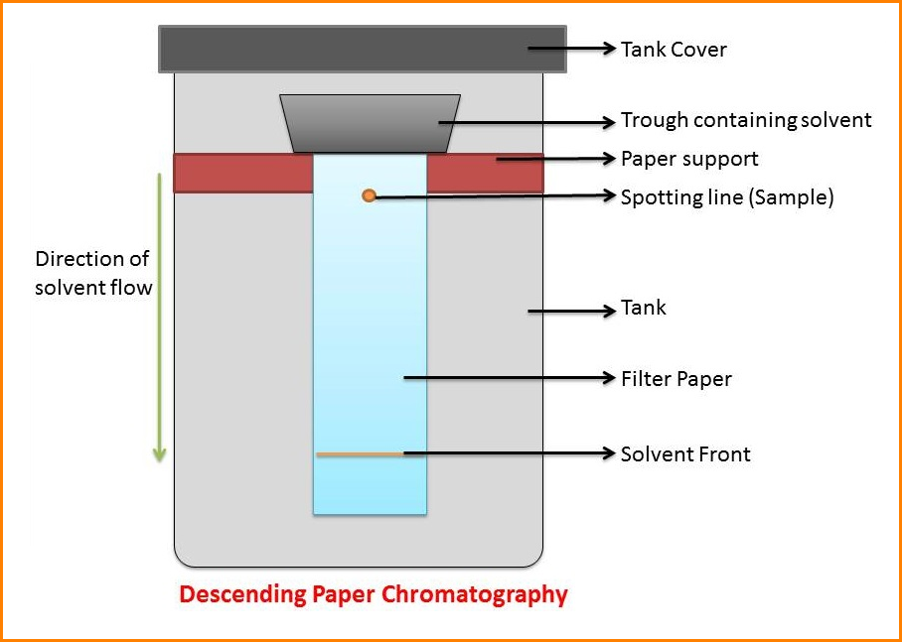
2. Descending Tech.

Slide 4
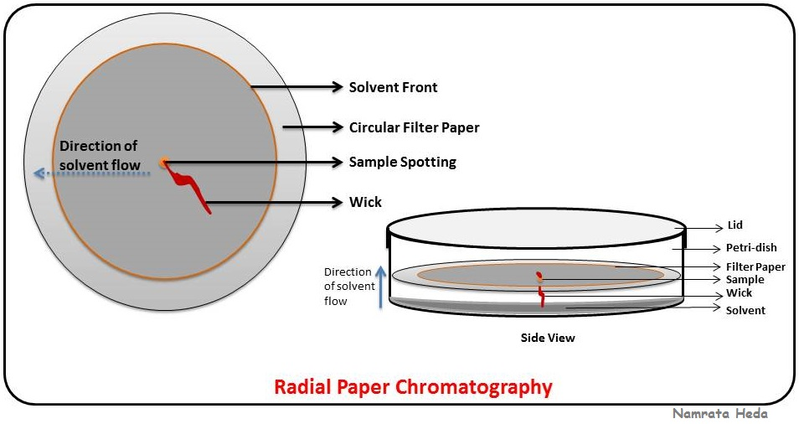
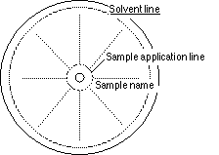
3. Radial Paper chromatography
Solvent spreads radially by capillary action

Slide 5
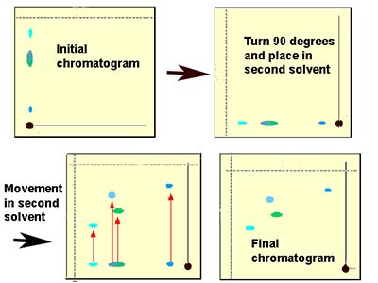
4. 2D PAPER CHROMATOGRAPHY
1st development in one solvent by ascending.
Then at perpendicular to 1st in 2nd solvent
Done for Complex mixtures

Slide 6
METHODOLGY (STEPS INVOLVED)
Choice of technique: Depends on nature of substance to be separated
Choice of paper: Depends on qualitative or quantitative analysis, for analytical or preparative chrom. or subs. used is hydrophylic or lipophilic, neutral or charged species

Slide 7
METHODOLOGY (Choice of paper)
Whatman chromatographic papers : depends on type of separation
Coarser or faster papers: Whatman 31ET: used when the components have Rf values wide apart
Slow paper: rarely used, but facilitate better resolution of subs with close Rf values
Slow papers: whatman 20, Schleicher & schull 2045, Macherey nogel 261, Edrol 208
Heavy papers- W 3MM, preparative purpose

Slide 8
METHODOLOGY (Choice of paper)
Paper is composed of 99% α-cellulose & mineral content
Modifications to paper can be done
For separation of polar subs. efficiently– exchange capacity of paper can be ↑sed by ↑sing carbonyl content (1.4%) by partial oxidation
By partial hydrolysis- soaking paper for 24 hrs. in 7% HCl & washing with H₂O & ethanol successively- capillarity of paper is ↑sed
Rigidity of paper: ↑sed by acetylation, esterification & other chemical methods

Slide 9
3. METHODOLOGY (selection of solvent)
3. Selection of Mobile phase: depends on the fact that the Rf values should be different for different constituents present in a mixture.
Generally solvent mixture which give Rf between 0.2-0.8 for a sample is selected
From the DEC, the polarity of solvent can be obtained

Slide 10
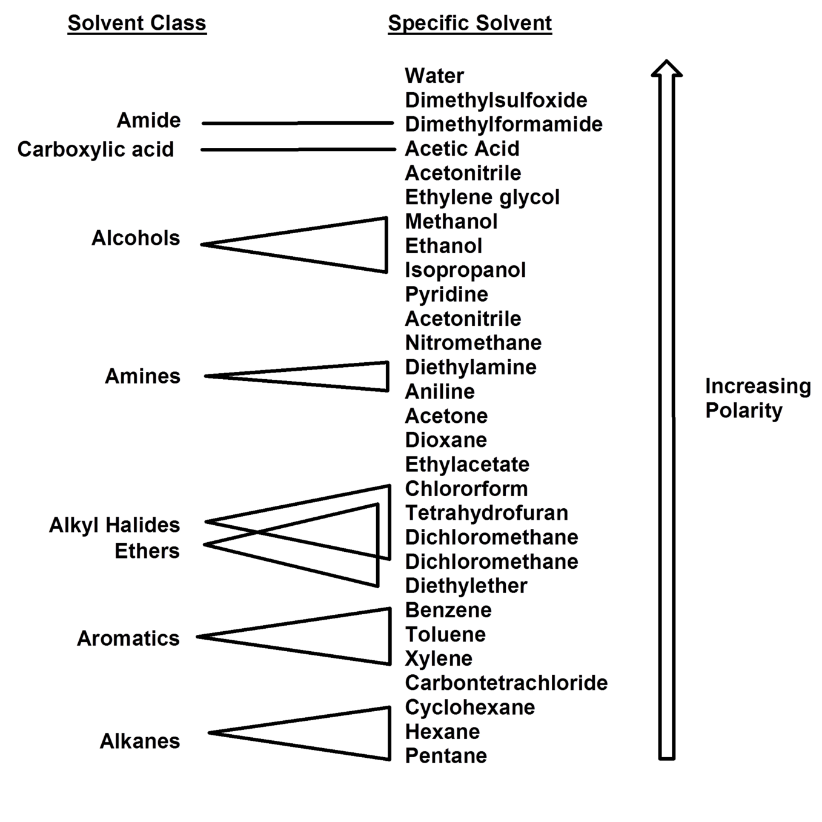
DEVELOPMENT (selection of solvent)

