Slide 1
BP701T. INSTRUMENTAL METHODS OF ANALYSIS (Theory) Unit 3
Syllabus
Paper chromatography
Introduction, methodology, development techniques, advantages, disadvantages and applications
PART-3
Dr. NISHA SHARMA, ASSOCIATE PROFESSOR, C.S.J.M. UNIVERSITY, KANPUR

Slide 2
4. DEVELOPMENT (Preparation of samples)
No standard procedure
Because of presence of variety of components like fats, salts, proteins etc.
Sample volume of 10-20µl containing few µg of sample is ideal sample

Slide 3
5. DEVELOPMENT (Spotting)
For ascending technique : 24cm x7cm whatman paper
Graduated micro pipette for sampling the spots
Drying by stream of hot or cold air
6. Preparing the tank/ chamber
The chamber is loaded with selected solvent mixture and poured in to the chamber such that the level of solvent is about 1 cm from bottom.

Slide 4
7. Saturation of tank: After placing solvent system, hang a blotting paper by the sides of tank and allow the solvent to rise to top.
8. Placing the paper in to the chamber: With the help of clips/holder hang the paper in to chamber such that the edge of the paper just touches the edge of solvent layer.
8. Allow to run the solvent onto paper till top but before the other edge.

Slide 5
9. Drying the chromatogram: Oven, drying cabinets with temp. control
10. Visualization/Detection: Done by
Chemical : Chromogenic / visualizing /locating agent: By dipping or fine spray atomizer or
I₂ vapours used in cupboard

Slide 6
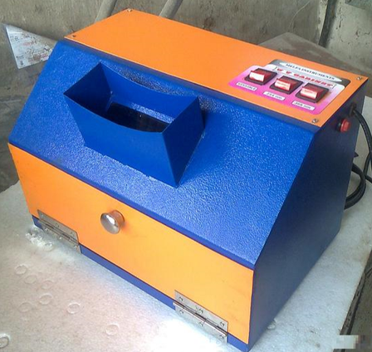
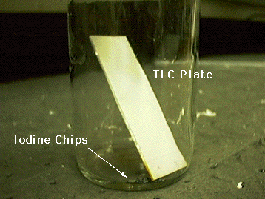
Detection
Physical method: colorless spots- under U.V. lamp- fluorescence reveals the presence
Irradiation with light of 254nm for compounds that absorbs in U.V. range
365nm : the fluorescence before and after irradiation with shorter wavelength light

Slide 7
11. Calculation of R_{f}
12. Estimation : After extraction from paper
Isolation of separated components from paper
Cut the spot part of paper, soak in min. qty. of solvent
Semi micro extractor (soxhlet), Eluation

Slide 8
Estimation After extraction from paper
Determine by U.V. spec., colorimetry, Flourimetry, Flame photometry, conductometry etc.
Factors: Nature of subs., equipment avail., senstivity of method, time etc.
In situ methods for estimation
By visual assessment: By human eye- not quantitative

Slide 9
b. Measurement of areas: Size of spot: Det. Qty. of subs., Linera relation obtained b/w spot area & amt. of subs. Present
Random errors: spot shape, vol. applied, speed of application must be identical
3. By densitometer: Intensity of color of subs. Measured directly on chromatogram
4. Potentiometry: changes in potential of metal electrode in contact with filter paper

Slide 10
ADVANTAGES
Low cost
Requires less quantitative material
Very efficient for polar substances
Easy to handle
Both inorganic and organic compounds can be identified
Simple
Various modes are available
Quantitation is possible

Slide 11
DISADVANTAGES
Cannot separate complex mixtures
Quantification is not efficient
Takes more time- 2-3 hr.
Accuracy is less
Results on paper cant be stored for long time
Separation is not sharp
Corrosive chemicals destroy paper
U.V. chamber can be used for florescent compounds only

Slide 12
APPLICATIONS
To monitor the reaction
To check purity of pharmaceuticals
In fermentation and ripening
Analysis of reaction mix. in biochemical labs
Forensic testing
Beverages and food industry
Analysis of Cosmetics
Drug testing
Separation of carbohydrates, antibiotics, amino acids, vitamins, mix. of drugs etc.

