Slide 1
ILO ( INTERNATIONAL LABOUR ORGANIZATION)

Slide 2
The International Labour Organization (ILO) is a United Nations agency dealing with labour issues, particularly international labour standards and decent work for all.
After the First World War, it was recognized that problems of industry, like disease, know no frontiers. In 1919, the International Labour Organization (I.LO.) was established as an affiliate of the League of Nations to improve the working and living conditions of the working population all over the world.

Slide 3
185 of the 193 UN member states are members of the ILO In 1969, the organization received the Nobel Peace Prize for improving peace among classes, pursuing justice for workers, and providing technical assistance to other developing nations.
The headquarters of ILO is in Geneva, Switzerland.

Slide 4
HISTORY
The ILO was founded in April 1919 primarily in response to humanitarian concern over the condition of workers who were being exploited with no consideration for their health, their family lives or their professional and social advancement.

Slide 5
THE ILO CONSTITUTION
“WHEREAS UNIVERSAL AND LASTING PEACE CAN BE ESTABLISHED ONLY IF IT IS BASED UPON SOCIAL JUSTICE…”

Slide 6
OBJECTIVES OF ILO
Full employment and raising of living.
Protection for the life and health of workers in all occupation.
Provision for child welfare and maternity protection.
Assurance of quality education.

Slide 7
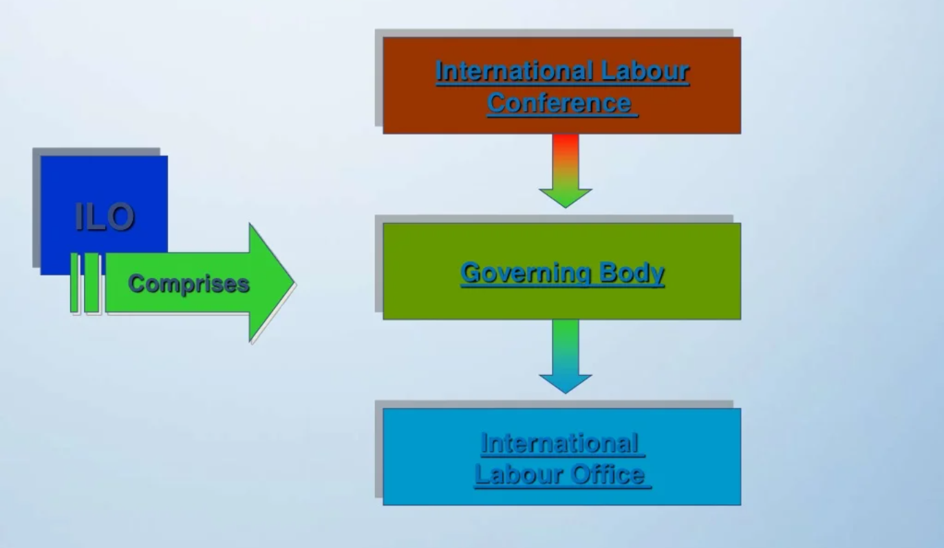
STRUCTURE: HOW THE ILO WORKS

Slide 8
PURPOSES OF ILO
to contribute to the establishment of lasting peace by promoting social justice
to improve, through international action, labour conditions, and living standards and
to promote economic and social stability.

Slide 9
The International Labour Code is a collection of international minimum standards related to health, welfare, living and working conditions of workers all over the world.
The ILO also provides assistance to organizations interested in the betterment of living and employment standards.
There is a close collaboration between ILO and WHO in the field of health and labour.

Slide 10
THANK YOU

