Slide 1
ANTIHYPERTENSIVE AGENTS Drugs used in the treatment of Hypertension. (The normal BP range is 120-=80MM Hg)
Classification of Official Drugs = 15
Beta blockers: Timolol
Centrally acting: Methyl Dopa, clonidine
catecholamine depletors: Reserpine
Ganglionic blockers: Guanethidine; Quanabenz acetate,
ACEI: Captopril, Lisinopril, Enalapril, Quinapril benazepril,
Vasodilators: Sodium nitroprusside, Minoxidil, Hydralazine Hcl, Diazoxide

Slide 2
RENIN ANGITENSION SYSTEM.

Slide 3
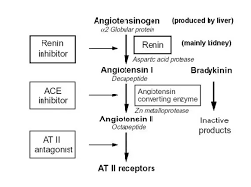
ACEI: Angiotensin-Converting-Enzyme Inhibitors ACEIs are a class of Drugs used primarily for the treatment of High Blood Pressure and Heart Failure. They work by causing relaxation of blood vessels as well as a decrease in blood volume, which leads to lower blood pressure and decreased oxygen demand from the Heart
Official ACEI & their
mechanism
1.Benazepril
2.Captopril,
3. Enalapril
4. Lisinopril,
5. Quinapril,
NOTE:
RENIN INHIBITORS: Aliskiren, Enalkiren, Remkiren
AT2 ANTAGONISTS: Alisartan, Irbisartan, losartan, Telmisartan
BRADYKININ: an active peptide of kinin, that causes inflammation and potent vasodilator, mild diuretic

Slide 4
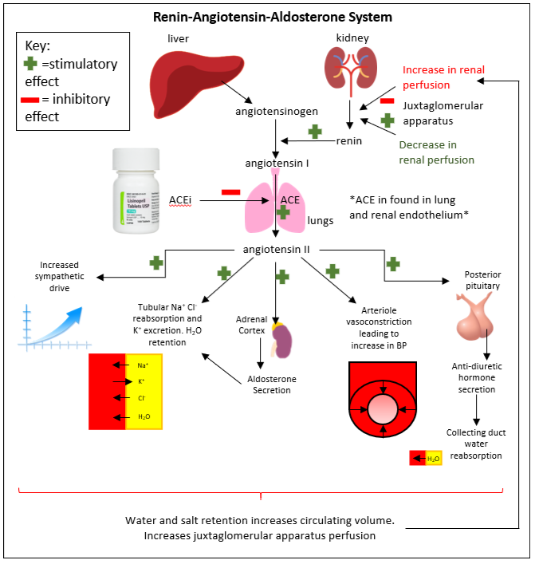
RAAS MECHANISM

Slide 5
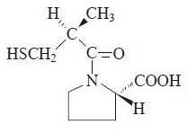
CAPTOPRIL (Capotan)
CATEGORY: Antihypertensive(ACEI)
NOMENCLATURE:
1-[(2s)-3-mercapto-2-methylpropionyl]- L-Proline
PROPERTIES : White to off-white, crystalline powder; odour characteristic, sulphide like. It is freely soluble in water; methanol, ethanol and in chloroform. It should be kept in airtight container. MP: Melts between 104-110⁰
MOA: It is Captopril is the prototype-first orally active ACE Inhibitor. It act by competitively inhibit angiotensin-I (an inactive decapeptide) in to angiotensin-II (an active octa-peptide) by binding to angiotensin converting enzyme (ACE). It’s Oral bioavailability is 60-75%, (to be taken 1 Hr. before meal due to food interference the absorption of drug)
USES: Used in hypertension, heart failure, left ventricular dysfunction and diabetic nephropathy DOSE: Orally, 25-150 mg bid or tid
PREPARATIONS: Captopril tablets (12.5, 25, 50 and 100 mg)

Slide 6
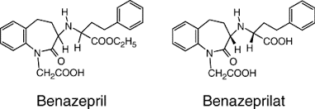
BENAZEPRIL Hcl (Lotensin)
CATEGORY: Antihypertensive agent
NOMENCLATURE: 3-[[1-(ethoxycarbonyl)-3-phenylprpyl]-amino]-tetrahydro-2-oxo-1H-1-Benzaepine-1-acetic acid
PROPERTIES :White crystalline powder; soluble in water, ethanol, methanol.
MOA: An ACE Inhibitor. A prodrug rapidly absorbed and converted to active drug benazeprilat
USES: Benazepril is used to treat hypertension , CHF
DOSE: Orally, 80 mg daily/Max
PREPARATIONS: Benazepril Hcl 5 mg, 10 mg, 20 mg, 40 mg tablets

Slide 7
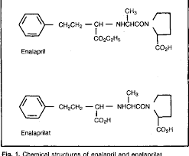
ENALAPRIL (Vasotec)
CATEGORY: Antihypertensive agent
NOMENCLATURE: It is a (2S)-1-[(2S)-2-[(1S)-1-(ethoxycarbonyl)-3-phenylpropyl)amino]- propanyl]-pyrrolidine-2-carboxylic acid-(Z)-butanedioate
PROPERTIES :white crystalline powder, sparingly soluble in water. stored, protected from light
MOA: An ACE Inhibitor. Enolapril (Prodrug) owes its activity to Enalaprilat(Drug) to which it is converted after biotransformation. ITS ORAL BA: 60%
USES Asymptomatic left ventricular dysfunction (LVF), heart failure
DOSE: Orally, 5-20 mg/day (40 mg maximum)
PREPARATIONS: ENALAPRIL maleate 2.5 mg, 5 mg, 10 mg, 20 mg Tablets IP; 1 mg/ml Oral Solution

Slide 8
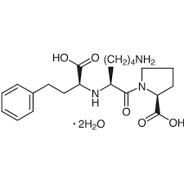
LISINOPRIL (Prinivil; Zestril)
CATEGORY: Antihypertensive agent
NOMENCLATURE: It is 2S-1-[(2S)-6-amino-2-[[(1s)-1-Carboxy-3-phenylpropyl]amino]hexonyl-pyrrolidine-2-carboxylic acid dehydrate
PROPERTIES: It is a white crystalline powder, soluble in water, stored protected from moisture temperature not exceeding 25 degree C
MOA: An ACE Inhibitor. It is a lysine analog of Enalaprilate (unlike enalapril it is already an active diacid), and has slowly, incompletely absorbed orally (30% only)
USES: Lisinopril is used to treat of Hypertension, Heart failure , acute myocardial infarction and in Diabetic nephropathy
DOSE: Orally, 10 mg-20mg /day
PREPARATIONS: Lisinopril 5 mg, 10 mg, 20 mg, 40 mg tablets IP, BP

Slide 9
QUINAPRIL (Accupril)
CATEGORY: Antihypertensive agent
NOMENCLATURE: It is white crystals
PROPERTIES : 2-[2-[[1-ethoxy carbonyl)-3-phenyl propyl]amino]-1-oxopropyl-tetrahydro-3-isoquinoline carboxylic acid
MOA: An ACE Inhibitor; a prodrug readily absorbed and rabidly hydrolyzed to active form Quinaprilat
USES: Quinapril is used to treat congestive heart failure (CHF) and hypertension
DOSE: Orally, 40 mg/day
PREPARATIONS: Quinapril 5 mg, 10 mg, 20 mg, 40 mg tablets

