Slide 1
Anti Hypertensive drugs-B
1. Methyl Dopa Hcl
2. Clonidine Hcl
3. Guanethidine sulphate
4. Guanabenz acetate
5. Timolol
6. Diazoxide
7. Hydralazine Hcl
8. Minoxidil
9. Sodium nitroprusside
10. Reserpine

Slide 2
1.METHYL DOPA HCL (Aldomet)
CATEGORY: Centrally acting-Antihypertensive
NOMENCLATURE: 3-(3, 4-dihydroxyphenyl)-2-methyl-L-alanine sesquehydrate
L-Tyrosine, 3-hydroxy-a-methyl sesquehydrate
PROPERTIES: white to yellowish white, odorless, almost tasteless, fine powder, which may contain friable lumps, relatively stable in light and air.
It is slightly soluble in water; very soluble in dilute HCl;
MOA: Methyl Dopa acts centrally by stimulating a-adrenergic receptors. It is converted to methyl norepinephrine in brain which displaces norepinephrine from storage site
USES: It is used in the treatment moderate to severe hypertension.
DOSE: Orally, equalent of 0.5 to 3 gram of anhydrous Methyldopa, daily in divided dose.
PREPARATIONS: Methyl Dopa Tablet ; injection IP, BP

Slide 3
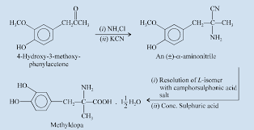
METHYL DOPA SYNTHESIS: It is synthesized from 4-hydroxy-3-methoxy-phenyl acetone with ammonium chloride and pot. cyanide, the intermediate racemic compound obtained is resolved to L-enantiomer which is converted to methyl Dopa.

Slide 4
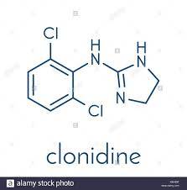
2. CLONIDINE Hcl (Catapress)
CATEGORY: Centrally acting-Antihypertensive
NOMENCLATURE: It is an Anilino-imidazoline
2-[(2,6-dichlorophenyl) amino]-imidazoline Hcl
PROPERTIES: White crystalline powder, It is freely soluble in water;
MOA: clonidine acts centrally by stimulating alpha-2-adrenergic receptors. It is converted to methyl norepinephrine in brain which displaces norepinephrine from storage site
USES: It is used in the treatment moderate to severe hypertension. (Given along with thiazide diuretics)
DOSE: Orally, 50-100mg Clonidine Hcl, daily in divided dose. Also given slow iv route in crisis 150-300mcg
PREPARATIONS: Clonidine Hcl Tablet, Injections IP; B P

Slide 5
3.GUANETHIDINE SULPHATE (Ismeline)
CATEGORY: antihypertensive, adrenergic neuron blocker
NOMENCLATURE: 2-[(2-azocan-1-yl) ethyl] guanidine
1-[2-(perhydroazocin-1-yl) ethyl] guanidine
PROPERTIES: White to off-white, crystalline powder; very soluble in water.
MP: Melts between 276-281⁰C
MOA: Guanethidine acts by selectively inhibiting transmission in post ganglionic adrenergic nerves.( displacing NE from Its storage sites in the neuronal granules)
USES: Guanethidine is used in the treatment of moderate to severe hypertension. It can be used either alone or in combination with other drugs. It is also used in the treatment of renal hypertension.
DOSE 10 to-20 mg (initially) and 30 to 100 mg daily (maintenance dose)
PREPARATIONS: Guanethidine sulfate 10 mg and 25 mg Tablets BP

Slide 6
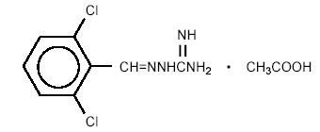
4.GUANABENZ ACETATE (Wytensin)
CATEGORY: antihypertensive, adrenergic neuron blocker
NOMENCLATURE:
[2,6-dichlorobenzylidene)amino]guanidine mone acetate
PROPERTIES: White to off-white, crystalline powder; very soluble in water.
MOA: Guanabenz acts by selectively inhibiting transmission in post ganglionic adrenergic nerves (alpha 2a- agonist) and there by reduces the release of NE from the neuron
USES: Guanabenz is used in the treatment of moderate to severe hypertension. It can be used either alone or in combination with other drugs. It is also used in the treatment of renal hypertension.
DOSE: 4-8mg daily in divided dose
PREPARATIONS: Guanabenz acetate Tablets

Slide 7
5. TIMOLOL Biocarden;Timoptic
CATEGORY: antihypertensive, beta adrenergic blocker
NOMENCLATURE: (-)-1-(tert. butyl amino)-3-[(4-morpholino-1,2,5-thiazol-3-yl)oxy]2-propanol malate (1: 1)
PROPERTIES: White crystals; freely soluble in water, alcohol; sparingly soluble in chloroform; practically insoluble in ether; protected from light and moisture; MP: Melts at 202⁰C
MOA: TIMOLOL acts by short acting, potent non selective beta blocker with moderate lipid solubility
USES: TIMOLOL is used in the treatment of open-angle glaucoma; Treatment of hypertension, angina pectoris, and myocardial infarction
DOSE: 10-60mg daily in divided doses
PREPARATIONS: TIMOLOL Maleate Eye dopes (0.25-0.5%) IP; BP and Tablets IP;BP

Slide 8
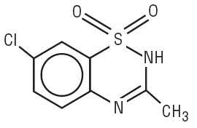
6. DIAZOXIDE (Eudemine)
It is Structurally related to diuretics, chlothiazide
CATEGORY: vasodilators,
NOMENCLATURE: 7-Chloro-3-methyl-2H-1,2,4-Benzothiadiazine-1,1-oxide
PROPERTIES: White fine or crystalline powders; practically in soluble in water; very soluble in alkali hydroxides
MOA: Diazoxide acts by directly on the arteriolar wall (a potent vasodilators) ;
USES: Diazoxide is used in the treatment of hypertension, crisis, (not recommended for long term therapy); it can be given orally in the treatment of hypoglycemia
DOSE: 1-3 mg/kg/body wt. daily in divided doses
PREPARATIONS: Diazoxide Injection BP and Tablets BP

Slide 9
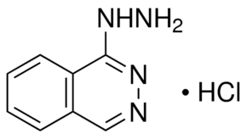
7. Hydralazine Hcl (Nepresol, Apresoline)
CATEGORY: Direct acting Vasodilarors,
NOMENCLATURE: 1-hydrazinophthalazine Hcl
PROPERTIES: White crystalline powder, soluble in water, alcohol; protected from light and moisture; the solution for injection deteriorate on storage and should be used immediately after preparation
MOA: Hydralazine acts by Direct relaxation of the arteriolar wall (vasodilation)
USES: Hydralazine is used in the Treatment of hypertension.
DOSE: 40-50 mg daily in divided doses. it can be always given with other drugs such as thiazide diuretics and beta blockers; 5-10mg as given slow iv injection in emergencies
PREPARATIONS: Hydralazine Hcl 10,25, 50 mg Tablets BP, injection ampoule ((1 ml containing 20mg) IP, BP

Slide 10
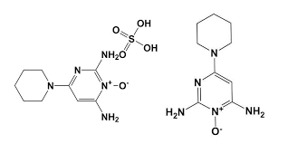
8.Minoxidil(Loniten)
CATEGORY: Vasodilator,
NOMENCLATURE: 6-(piperadin-1-yl)pyrimidine-2,4-diamine-3-oxide
PROPERTIES: White crystalline powder; slightly soluble in water, ; stored protected from light and moisture;
MOA: Minoxidil acts similarly to those of hydrallazine. It is more rapid more potent and more toxic than hydrallazine
USES: Minoxidil is used in the treatment of severe hypertension,(given in combination with beta blockers to prevent tachycardia); it can be used in alopecia, as it stimulate hair growth to a limited extent
DOSE: Initially 5mg daily , increased up to 50mg
PREPARATIONS: Minoxidil Scalp application BP and Tablets IP

Slide 11
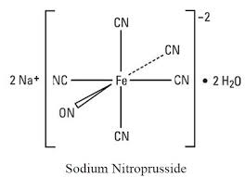
9.Sodium Nitroprusside (Nitropress)
CATEGORY: Vasodilator,
NOMENCLATURE: sodium penta cyanonitrosyl ferrate III- Dihydrate
PROPERTIES: Reddish brown powder or crystals; freely soluble in water, the aqueous solution decompose on exposure to light therefore, protected from light and moisture;
MOA: Sodium nitroprusside acts by rapid and short acting (1-10 minutes), potent vasodilator on both arteriolar as well as venous smooth muscles
USES: Sodium nitroprusside is used in emergency treatment of hypertension, angina pectoris, and myocardial infarction
DOSE: Given as slow intravenous injection, in the dose of 0.5- 5mcg/kg/min doses
PREPARATIONS: Sodium nitroprusside infusion BP, supplied as 50mg dissolved in 500ml of 5% dextrose in water

Slide 12
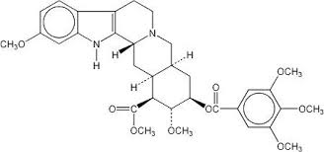
10. Reserpine Hcl (Serpasil)
Reserpine is an principal indole- alkaloid obtained from Rawolfia Serpentina
CATEGORY: antihypertensive,
NOMENCLATURE: methyl-11,17-dimethoxy-18b-(3,4,5-trimethoxy benzoyloxy)-3b,20a-yohimbane-16b-carboxylate
PROPERTIES: White or yellow crystalline powder which darken on exposure to light ; practically insoluble in water, protected from light;
MOA: Reserpine act by depletion of NE in peripheral sympathetic nerve terminal and depletion of Serotonin ( 5HT)in the brain, there by reduction of blood pressure, bradycardia and CNS depression
USES: Reserpine is used in the treatment of Hypertension, and used in major Psychosis (tranquilizer)
DOSE: 1 mg daily (for psychosis); 0.5mg (for hypertension)
PREPARATIONS: Reserpine Injection and Tablets IP

