Slide 1
SUBJECT:INTRODUCTION TO DBMS CODE: BCA501N UNIT:I
BY
Dr MAYUR RAHUL
(E762)
DEPARTMENT OF COMPUTER APPLICATION
UIET,CSJM UNIVERSITY, KANPUR

Slide 2
INTRODUCTION
Database is a collection of inter-related data which helps in efficient retrieval, insertion and deletion
DBMS stands for Database Management System.
DBMS = Database + Management System.
Database is a collection of data and Management System is a set of programs to store and retrieve those data.
DBMS is a collection of inter-related data and set of programs to store & access those data in an easy and effective manner.

Slide 3
WHY WE NEED DBMS?
Two things that require optimization: Storage of data and retrieval of data.
Storage:
The data is stored in such a way that it acquires lot less space as the redundant data (duplicate data) has been removed before storage.
Fast Retrieval of Data:
We retrieve the data quickly when needed. Database systems ensure that the data is retrieved as quickly as possible.

Slide 4
CHARACTERISTICS OF DATABASE APPROACH
Real-world entity
A modern DBMS is more realistic and uses real-world entities to design its architecture. It uses the behavior and attributes too.
Relation-based tables
DBMS allows entities and relations among them to form tables. A user can understand the architecture of a database just by looking at the table names.
Isolation of data and application
A database system is entirely different than its data. A database is an active entity, whereas data is said to be passive, on which the database works and organizes. DBMS also stores metadata, which is data about data, to ease its own process.

Slide 5
CHARACTERISTICS OF DATABASE APPROACH CONTD.
Less redundancy
DBMS follows the rules of normalization, which splits a relation when any of its attributes is having redundancy in values.
Consistency
Consistency is a state where every relation in a database remains consistent. There exist methods and techniques, which can detect attempt of leaving database in inconsistent state.
Query Language
DBMS is equipped with query language, which makes it more efficient to retrieve and manipulate data.

Slide 6
CHARACTERISTICS OF DATABASE APPROACH CONTD.
ACID Properties
DBMS follows the concepts of Atomicity, Consistency, Isolation, and Durability (normally shortened as ACID). These concepts are applied on transactions, which manipulate data in a database.
Multiuser and Concurrent Access
DBMS supports multi-user environment and allows them to access and manipulate data in parallel. Though there are restrictions on transactions when users attempt to handle the same data item, but users are always unaware of them.
Multiple views
DBMS offers multiple views for different users. A user who is in the Sales department will have a different view of database than a person working in the Production department.

Slide 7
CHARACTERISTICS OF DATABASE APPROACH CONTD.
Security
Features like multiple views offer security to some extent where users are unable to access data of other users and departments. DBMS offers methods to impose constraints while entering data into the database and retrieving the same at a later stage.

Slide 8
ACTORS ON THE SCENE
Administrators
Administrators maintain the DBMS and are responsible for administrating the database. They are responsible to look after its usage and by whom it should be used. They create access profiles for users and apply limitations to maintain isolation and force security. Administrators also look after DBMS resources like system license, required tools, and other software and hardware related maintenance.
Designers
Designers are the group of people who actually work on the designing part of the database. They keep a close watch on what data should be kept and in what format. They identify and design the whole set of entities, relations, constraints, and views.
End Users
End users are those who actually reap the benefits of having a DBMS. End users can range from simple viewers who pay attention to the logs or market rates to sophisticated users such as business analysts.

Slide 9
Data Models
A Database model defines the logical design and structure of a database and defines how data will be stored, accessed and updated in a database management system.
Hierarchical Model
Network Model
Entity-relationship Model
Relational Model

Slide 10
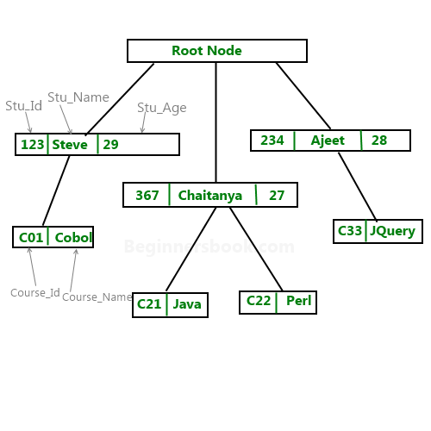
Hierarchical Model
A hierarchical database model is a data model in which the data are organized into a tree-like structure.
The data are stored as records which are connected to one another through links.
A record is a collection of fields, with each field containing only one value.
The type of a record defines which fields the record contains.
The hierarchical database model mandates that each child record has only one parent, whereas each parent record can have one or more child records.
In order to retrieve data from a hierarchical database, the whole tree needs to be traversed starting from the root node.

Slide 11
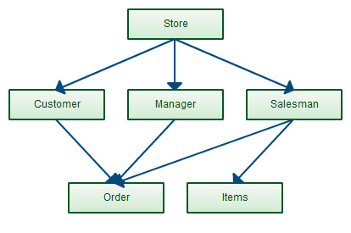
Network Model
The network model is a database model conceived as a flexible way of representing objects and their relationships.
Its distinguishing feature is that the schema, viewed as a graph in which object types are nodes and relationship types are arcs.

Slide 12
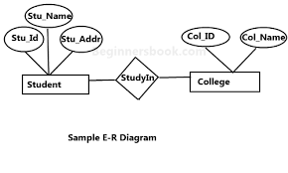
Entity-relationship Model
ER model stands for an Entity-Relationship model. It is a high-level data model.
This model is used to define the data elements and relationship for a specified system.
It develops a conceptual design for the database.
It also develops a very simple and easy to design view of data.
In ER modeling, the database structure is portrayed as a diagram called an entity-relationship diagram.

Slide 13
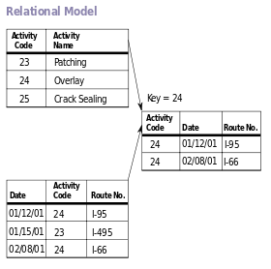
RELATIONAL MODEL
In relational model, the data and relationships are represented by collection of inter-related tables.
Each table is a group of column and rows, where column represents attribute of an entity and rows represents records.
The table name and column names are helpful to interpret the meaning of values in each row.
In the formal relational model terminology, a row is called a tuple, a column header is called an attribute, and the table is called a relation.
The data type describing the types of values that can appear in each column is represented by a domain of possible values.

Slide 14
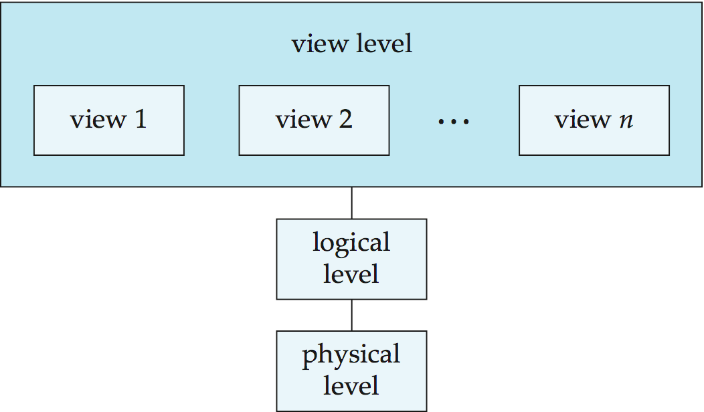
3-tier Architecture
The physical level has an internal schema,which describes the physical storage structure of the database.
The logical level has a conceptual schema, which describes the structure of the whole database for a community of users. The logical schema concentrates on describing entities, data types, relationships, user operations, and constraints.
The external or view level includes a number of external schemas or user views. Each external schema describes the part of the database that a particular user group is interested in .

Slide 15
DATA INDEPENDENCE
LOGICAL DATA INDEPENDENCE
Logical data independence is the capacity to change the conceptual schema without having to change external schemas or application programs. We may change the conceptual schema to expand the database, to change constraints, or to reduce the database.
PHYSICAL DATA INDEPENDENCE
Physical data independence is the capacity to change the internal schemawithout having to change the conceptual schema. Hence, the external schemas need not be changed as well. Changes to the internal schema may be needed because some physical files were reorganized

Slide 16
DATABASE LANGUAGES
Data control language (DCL) – controls access to data;
Data definition language (DDL) – defines data types such as creating, altering, or dropping tables and the relationships among them;
Data manipulation language (DML) – performs tasks such as inserting, updating, or deleting data occurrences;
Data query language (DQL) – allows searching for information and computing derived information.
Database languages are specific to a particular data model. Notable examples include:
SQL combines the roles of data definition, data manipulation, and query in a single language.

Slide 17
REFERENCES
https://www.tutorialspoint.com/dbms/dbms_overview.htm
https://www.studytonight.com/dbms/database-model.php
https://en.wikipedia.org/wiki/DBMS

