Slide 1
Entity Relationship Diagram BCA 501N(Unit-II)
Dr Mayur Rahul
E762
Assistant Professor
UIET,CSJM University,Kanpur

Slide 2
Unit-II Entity-Relationship Model
Entity Sets
Relationship Sets
Design Issues
Mapping Constraints
Keys
E-R Diagram
Extended E-R Features
Design of an E-R Database Schema
Reduction of an E-R Schema to Tables

Slide 3
Entity Sets
A database can “model” a “world” which is seen as:
a collection of entities,
relationships among entities.
An entity(-instance) is an individual “object” that exists and is distinguishable from other individuals.
Example: specific person, company, event, plant
Entities have attributes Example: people have names and addresses
An entity set (also entity type) is a set of entities of the same type that share the same properties.
Example: set of all persons, companies, trees, holidays

Slide 4
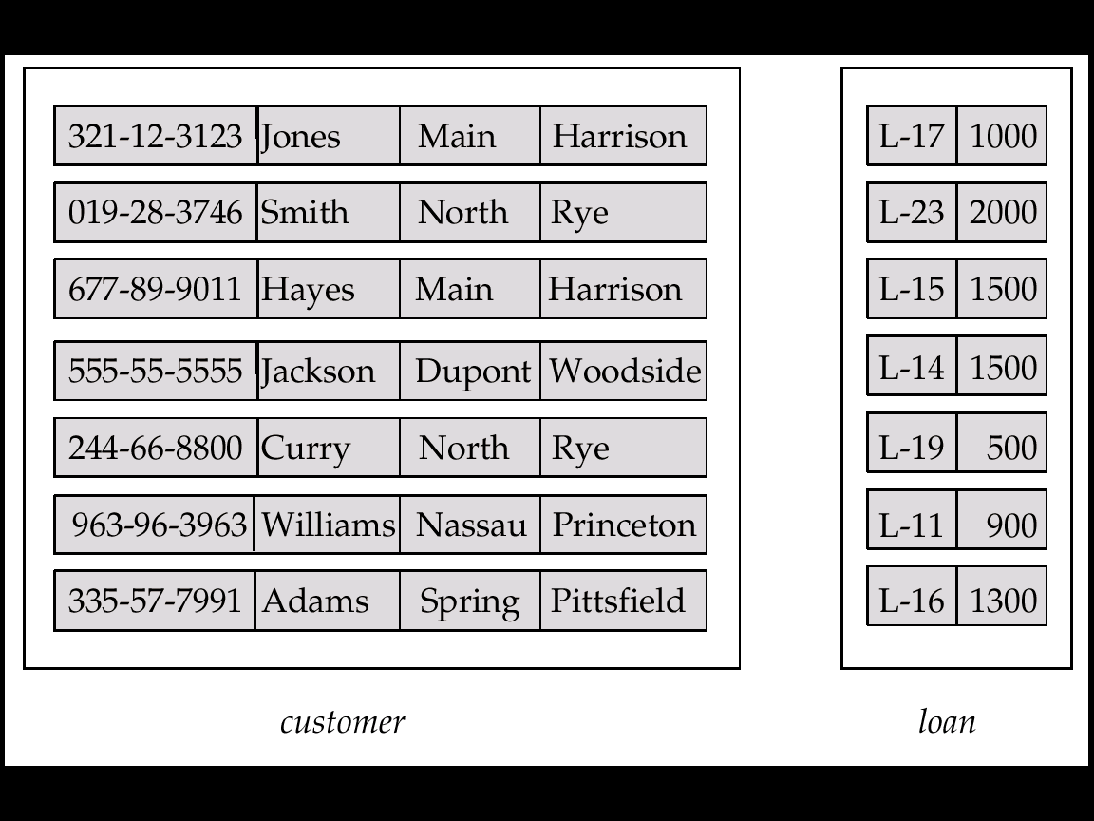
Entity Sets customer and loan
customer-id customer- customer- customer- loan- amount name street city number

Slide 5
Attributes
An entity is represented by a set of attributes, i.e. descriptive properties possessed by all members of an entity set.
Example:
customer = (customer-id, customer-name, customer-street, customer-city) loan = (loan-number, amount)
Domain – the set of permitted values for each attribute
Attribute types:
Simple and composite attributes.
Single-valued and multi-valued attributes
E.g. multivalued attribute: phone-numbers
Derived attributes
Can be computed from other attributes
E.g. age, given date of birth

Slide 6
Composite Attributes

Slide 7
Relationship Sets
A relationship (-instance) is an association among several entities Example: Hayes depositor A-102 customer entity relationship [set] account entity
A relationship set is a mathematical relation among n ≥ 2 entities, each taken from entity sets {(e₁, e₂, … e_{n}) | e₁ ∈ E₁, e₂ ∈ E₂, …, e_{n} ∈ E_{n}} where (e₁, e₂, …, e_{n}) is a relationship
Example:
(Hayes, A-102) ∈ depositor

Slide 8
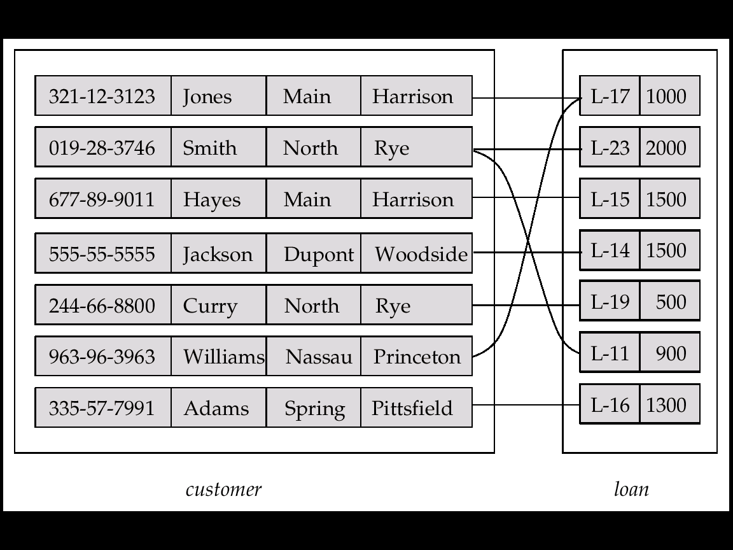
Relationship Set borrower

Slide 9
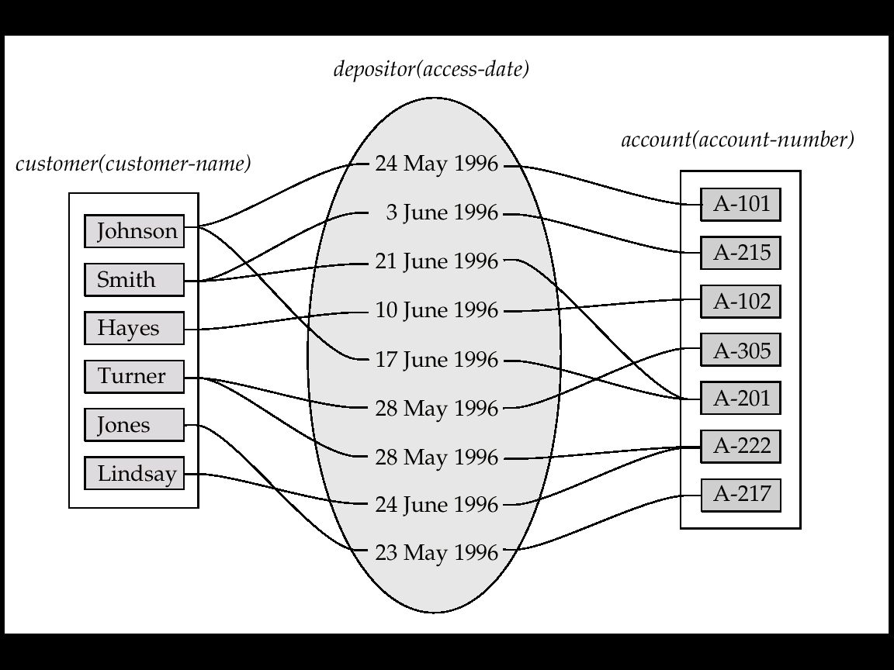
Relationship Sets (Cont.)
An attribute can also be property of a relationship set.
For instance, the depositor relationship set between entity sets customer and account may have the attribute access-date

Slide 10
Degree of a Relationship Set
Refers to number of entity sets that participate in a relationship set.
Relationship sets that involve two entity sets are binary (or degree two). Generally, most relationship sets in an E-R schema are binary.
Relationship sets may involve more than two entity sets.
E.g. Suppose employees of a bank may have jobs (responsibilities) at multiple branches, with different jobs at different branches. Then there is a ternary relationship set between entity sets employee, job and branch
Relationships between more than two entity sets are relatively rare. Most relationships are binary. (More on this later.)

Slide 11
Mapping Cardinalities
Express the number of entities to which another entity can be associated via a relationship set.
Most useful in describing binary relationship sets.
For a binary relationship set the mapping cardinality must be one of the following types:
One-to-one
One-to-many
Many-to-one
Many-to-many

Slide 12
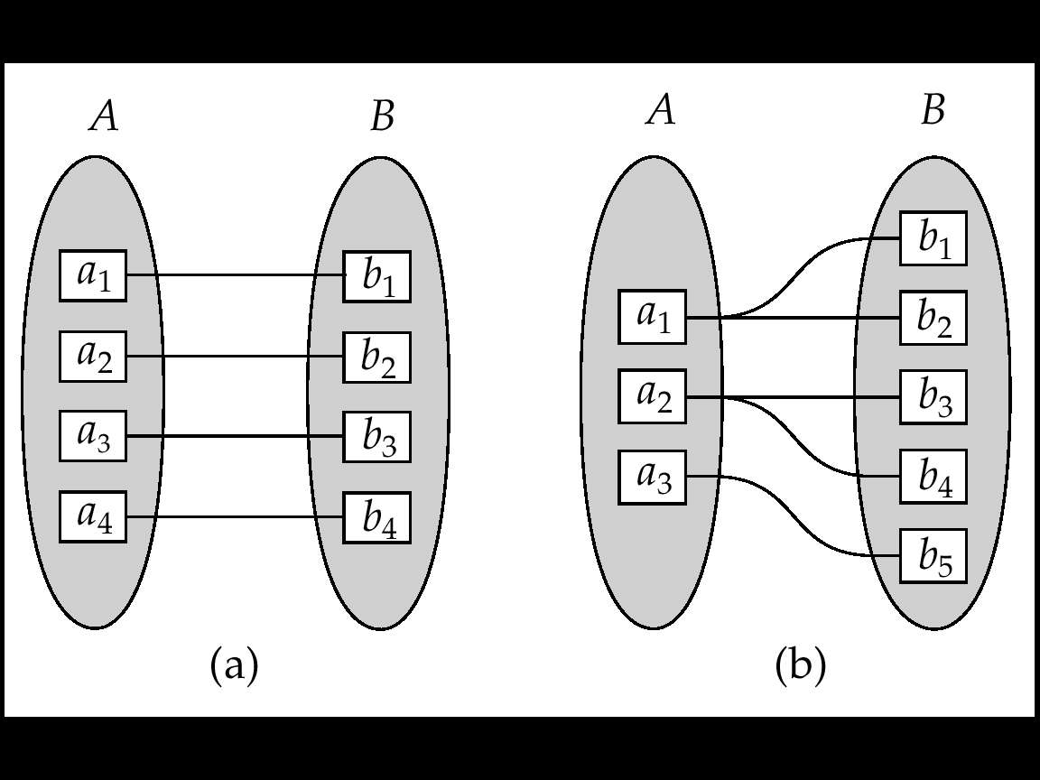
Mapping Cardinalities
one-to-one one-to-many
Note: Some elements in A and B may not be mapped to any elements in the other set

Slide 13
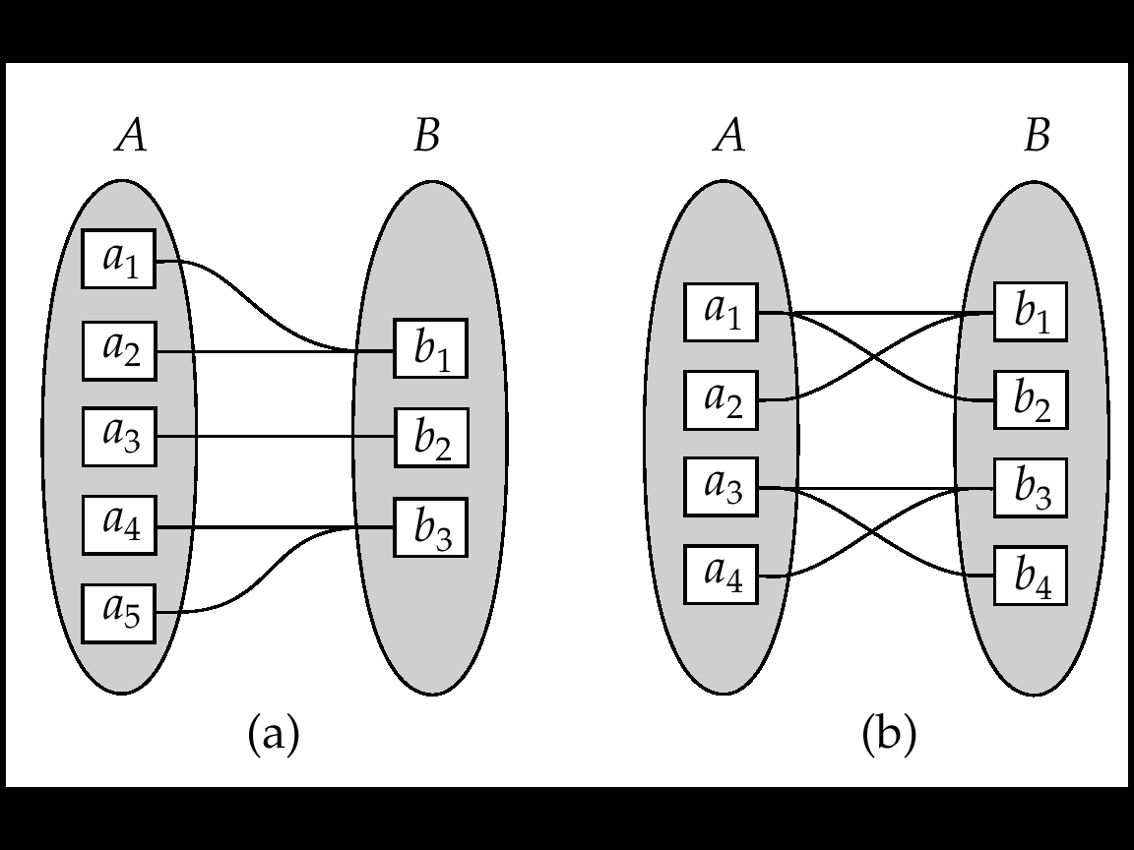
Mapping Cardinalities
many-to-one many-to-many
Note: Some elements in A and B may not be mapped to any elements in the other set

Slide 14
E-R Diagrams
Rectangles represent entity sets.
Diamonds represent relationship sets.
Lines link attributes to entity sets and entity sets to relationship sets.
Ellipses represent attributes
Double ellipses represent multivalued attributes.
Dashed ellipses denote derived attributes.
Underline indicates primary key attributes

Slide 15
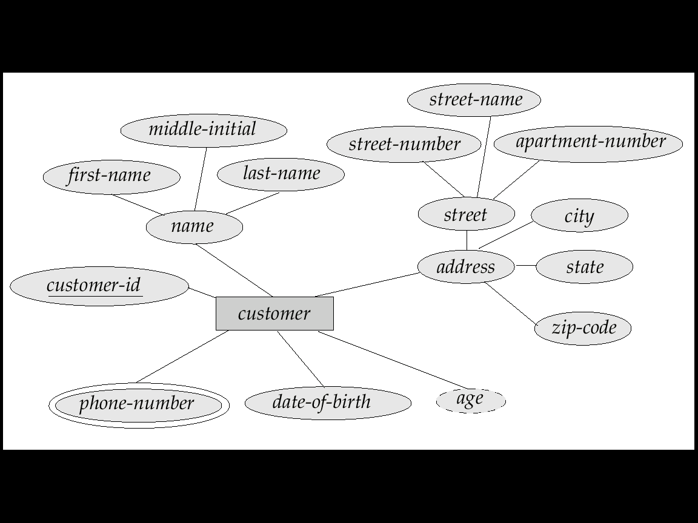
E-R Diagram With Composite, Multivalued, and Derived Attributes

Slide 16
Relationship Sets with Attributes

Slide 17
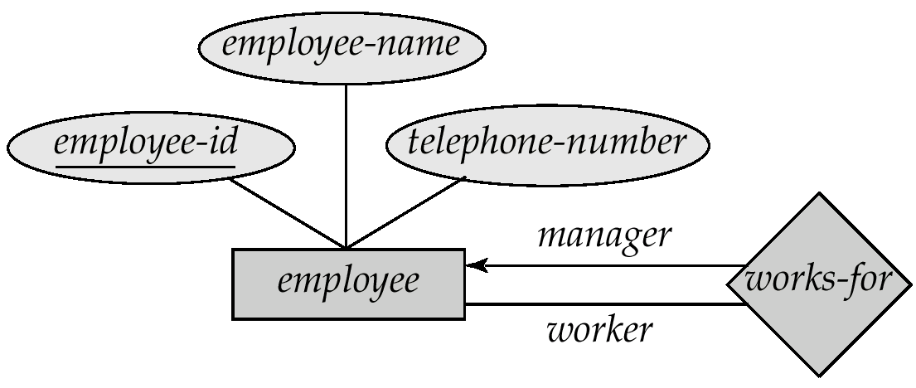
Roles
Entity sets of a relationship need not be distinct
The labels “manager” and “worker” are called roles; they specify how employee entities interact via the works-for relationship set.
Roles are indicated in E-R diagrams by labeling the lines that connect diamonds to rectangles.
Role labels are optional, and are used to clarify semantics of the relationship

Slide 18
Cardinality Constraints
We express cardinality constraints by drawing either a directed line (→), signifying “one,” or an undirected line (—), signifying “many,” between the relationship set and the entity set.
E.g.: One-to-one relationship:
A customer is associated with at most one loan via the relationship borrower
A loan is associated with at most one customer via borrower

Slide 19
One-To-Many Relationship
In the one-to-many relationship a loan is associated with at most one customer via borrower, a customer is associated with several (>= 0) loans via borrower

Slide 20
Many-To-One Relationships
In a many-to-one relationship a loan is associated with several (including 0) customers via borrower, a customer is associated with at most one loan via borrower

Slide 21
Many-To-Many Relationship
A customer is associated with several (possibly 0) loans via borrower
A loan is associated with several (possibly 0) customers via borrower

Slide 22
Participation of an Entity Set in a Relationship Set
Total participation (indicated by double line): every entity in the entity set participates in at least one relationship in the relationship set
E.g. participation of loan in borrower is total
every loan must have a customer associated to it via borrower
Partial participation: some entities may not participate in any relationship in the relationship set
E.g. participation of customer in borrower is partial

Slide 23
Keys
A super key of an entity set is a set of one or more attributes whose values uniquely determine each entity.
A candidate key of an entity set is a minimal super key
Customer-id is candidate key of customer
account-number is candidate key of account
Although several candidate keys may exist, one of the candidate keys is selected to be the primary key.

Slide 24
Specialization
Top-down design process; we designate subgroupings within an entity set that are distinctive from (= more specialized than) other entities in the set.
These subgroupings become lower-level entity sets that have attributes or participate in relationships that do not apply to the higher-level entity set.
Depicted by a triangle symbol labeled ISA (E.g. customer “is a” person).
Attribute inheritance – a lower-level entity set inherits all the attributes and relationship participation of the higher-level entity set to which it is linked.
Different hierarchy from “weak-identifying” hierarchy

Slide 25
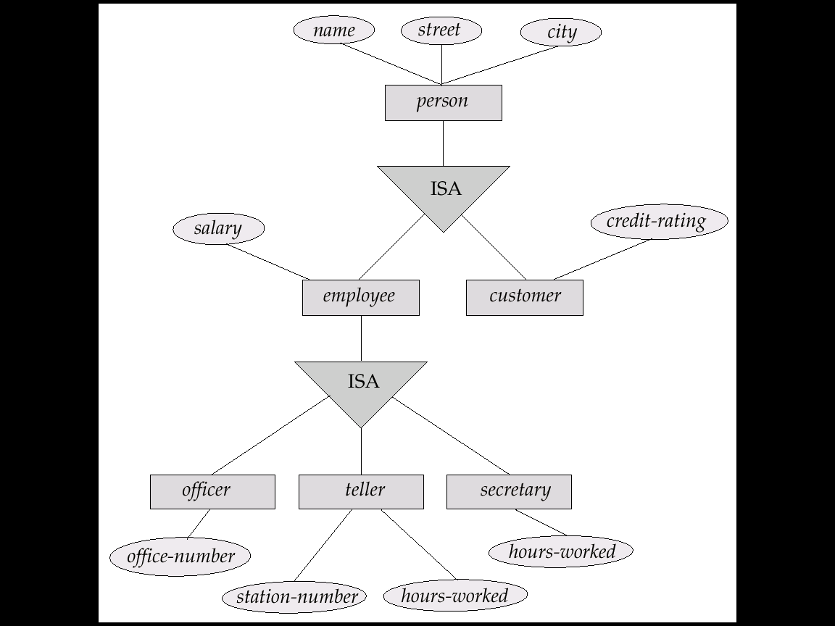
Specialization Example

Slide 26
Generalization
A bottom-up design process – combine a number of entity sets that share the same features into a higher-level entity set.
Specialization and generalization are simple inversions of each other; they are represented in an E-R diagram in the same way.

Slide 27
Specialization and Generalization (Cont.d)
Can have multiple overlapping specializations of an entity set based on different features.
E.g. permanent-employee vs. temporary-employee, in addition to officer vs. secretary vs. teller
Each particular employee would be
a member of one of permanent-employee or temporary-employee,
and also a member of one of officer, secretary, or teller
The ISA relationship also referred to as superclass - subclass relationship

Slide 28
Reference
ELMASRI, R., & NAVATHE, S. (2007). Fundamentals of database systems. Boston, Pearson/Addison Wesley.

