Slide 1
Business Communication
Unit-1
Means of Communication

Slide 2
Definition of Communication
A process by which information is exchanged between individuals through a common system of symbols, signs, or behavior
The act or process of using words, sounds, signs, or behaviors to express or exchange information or to express your ideas, thoughts, feelings, etc., to someone else
Communication is the sending and receiving of information and can be one-on-one or between groups of people, and can be face-to-face or through communication devices

Slide 3
Communication requires
a sender, the person who initiates communication, to transfer their thoughts or encode a message.
This message is sent to the receiver, a person who receives the message.
Finally, the receiver must decode, or interpret the message.

Slide 4
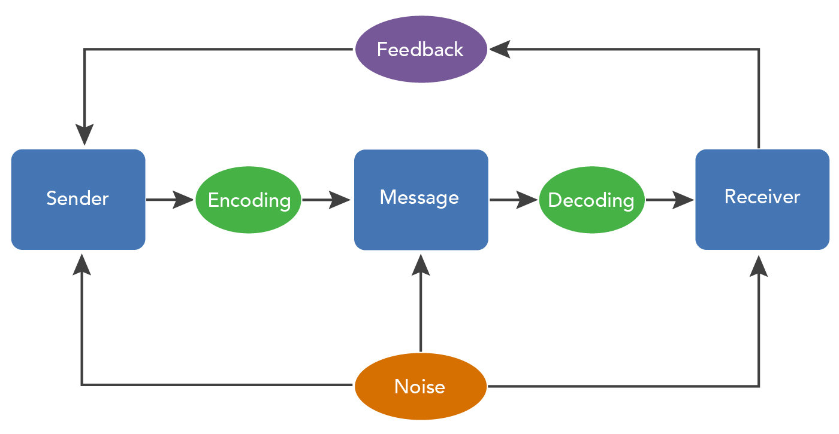
Process of Communication

Slide 5
Process of Communication
The sender develops an idea to be sent.
The sender encodes the message.
The sender selects the channel of communication that will be used.
The message travels over the channel of communication.
The receiver receives the message.
The receiver decodes the message.

Slide 6
Elements of Communication
Seven major elements of communication process are:
(1) sender
(2) ideas
(3) encoding
(4) communication channel
(5) receiver
(6) decoding and
(7) feedback.

Slide 7
Functions of Communication
Information
Function
Command and Instructive Function
Influence and Persuasive Function
Integrative Function

Slide 8
Objectives of Communication
Building Awareness.
Providing Information or Educating.
Creating Interest.
Motivating People/Audiences.
Promoting the brand, product or service.
Organizing Resources.
Offering better Coordination.
Increasing Efficiency.
Harmonious Relationship b/w Management & Workers

Slide 9
Importance of Communication
Acts as a base of action
Anticipate problems
Coordinate workflow
Better organizational image
Better decision making
Promotes cooperation and peace
Boosts morale and motivation
Establishes effective leadership
Ensures order and discipline
Better control

Slide 10
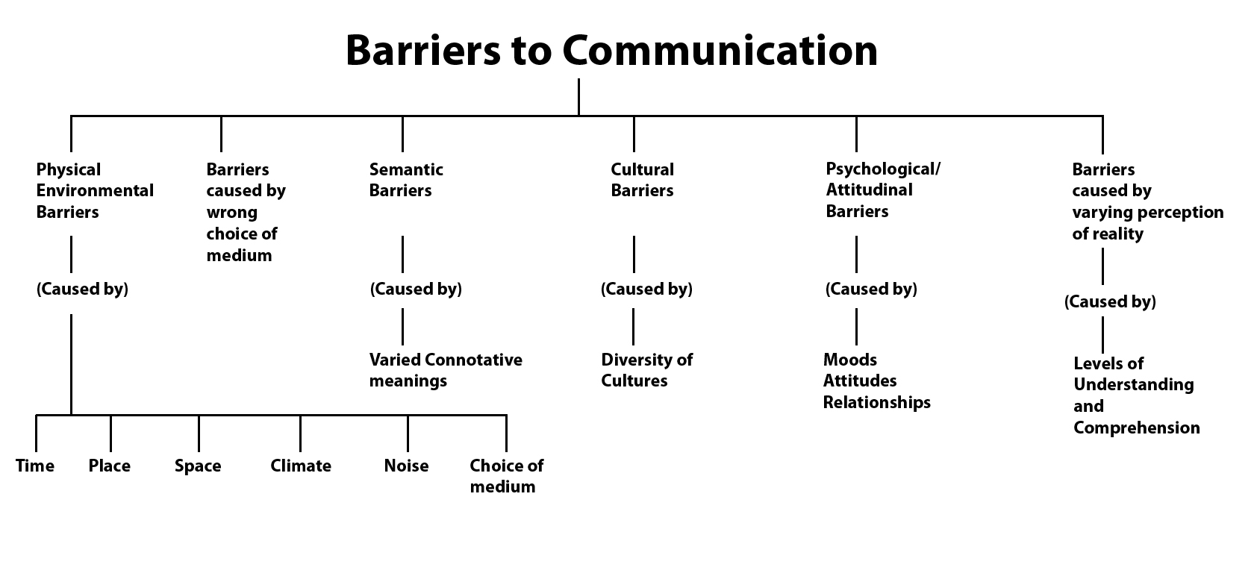
Barriers to Communication

Slide 11
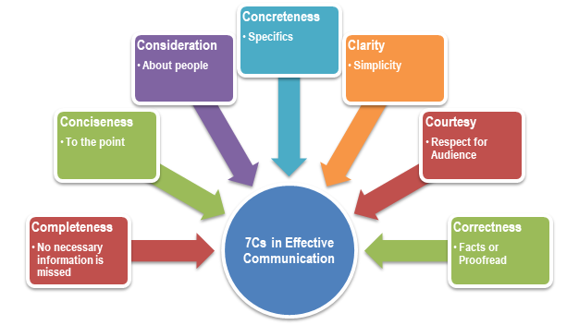
7 C’s of Communication

Slide 12
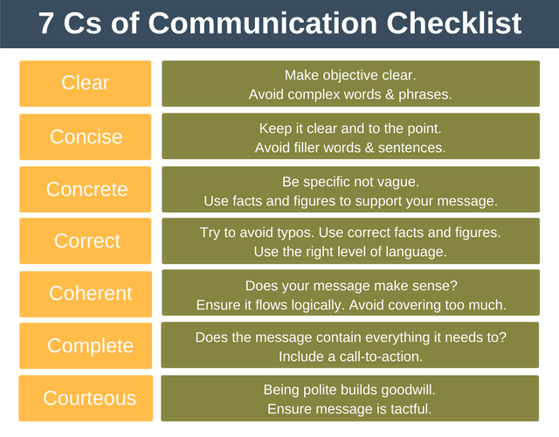
7 C’s of Communication

Slide 13
Thank You!!

