Slide 1
C Loops
The looping can be defined as repeating the same process multiple times until a specific condition satisfies. There are three types of loops used in the C language. In this part of the tutorial, we are going to learn all the aspects of C loops.
Why use loops in C language?
The looping simplifies the complex problems into the easy ones. It enables us to alter the flow of the program so that instead of writing the same code again and again, we can repeat the same code for a finite number of times. For example, if we need to print the first 10 natural numbers then, instead of using the printf statement 10 times, we can print inside a loop which runs up to 10 iterations.
Advantage of loops in C
1) It provides code reusability.
2) Using loops, we do not need to write the same code again and again.
3) Using loops, we can traverse over the elements of data structures (array or linked lists).

Slide 2
Types of C Loops
There are three types of loops in C language that is given below:
do while
while
for
do-while loop in C
The do-while loop continues until a given condition satisfies. It is also called post tested loop. It is used when it is necessary to execute the loop at least once (mostly menu driven programs).
The syntax of do-while loop in c language is given below:
do{
//code to be executed
}while(condition);

Slide 3
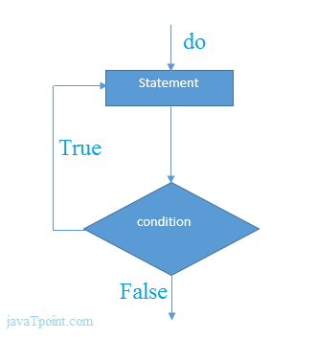
do while example
There is given the simple program of c language do while loop where we are printing the table of 1.
#include<stdio.h>
int main(){
int i=1;
do{
printf("%d \n",i);
i++;
}while(i<=10);
return 0;
}

Slide 4
while loop in C
While loop is also known as a pre-tested loop. In general, a while loop allows a part of the code to be executed multiple times depending upon a given boolean condition. It can be viewed as a repeating if statement. The while loop is mostly used in the case where the number of iterations is not known in advance.
Syntax of while loop in C language
The syntax of while loop in c language is given below:
while(condition){
//code to be executed
}

Slide 5
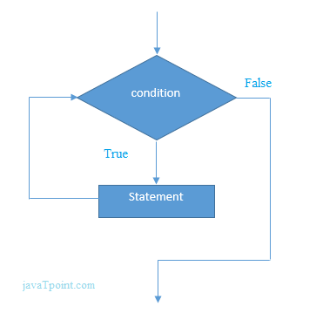
Example of the while loop in C language
Let's see the simple program of while loop that prints table of 1.
#include<stdio.h>
int main()
{
int i=1;
while(i<=10)
{
printf("%d \n",i);
i++;
}
return 0;
}

Slide 6
Properties of while loop
A conditional expression is used to check the condition. The statements defined inside the while loop will repeatedly execute until the given condition fails.
The condition will be true if it returns 0. The condition will be false if it returns any non-zero number.
In while loop, the condition expression is compulsory.
Running a while loop without a body is possible.
We can have more than one conditional expression in while loop.
If the loop body contains only one statement, then the braces are optional.

Slide 7
Example 1
#include<stdio.h>
void main ()
{
int j = 1;
while(j+=2,j<=10)
{
printf("%d ",j);
}
printf("%d",j);
} Output
3 5 7 9 11

Slide 8
for loop in C
The for loop in C language is used to iterate the statements or a part of the program several times. It is frequently used to traverse the data structures like the array and linked list.
Syntax of for loop in C
The syntax of for loop in c language is given below:
for(Expression 1; Expression 2; Expression 3){
//code to be executed
}

Slide 9
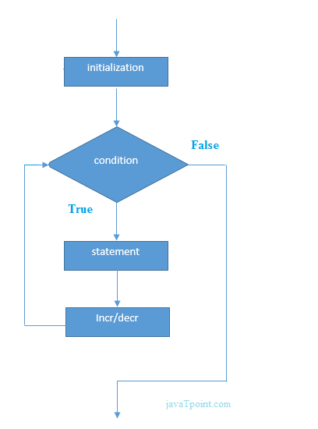
C for loop Examples
Let's see the simple program of for loop that prints table of 1.
#include<stdio.h>
int main()
{
int i=0;
for(i=1;i<=10;i++)
{
printf("%d \n",i);
}
return 0;
}

Slide 10
C Program: Print table for the given number using C for loop
#include<stdio.h>
int main(){
int i=1,number=0;
printf("Enter a number: ");
scanf("%d",&number);
for(i=1;i<=10;i++){
printf("%d \n",(number*i));
}
return 0;
}

Slide 11
Nested Loops in C
C supports nesting of loops in C. Nesting of loops is the feature in C that allows the looping of statements inside another loop. Let's observe an example of nesting loops in C.
Any number of loops can be defined inside another loop, i.e., there is no restriction for defining any number of loops. The nesting level can be defined at n times. You can define any type of loop inside another loop; for example, you can define 'while' loop inside a 'for' loop.
Syntax of Nested loop
Outer_loop
{
Inner_loop
{
// inner loop statements.
}
// outer loop statements.
}

Slide 12
Outer_loop and Inner_loop are the valid loops that can be a 'for' loop, 'while' loop or 'do-while' loop.
Nested for loop
The nested for loop means any type of loop which is defined inside the 'for' loop.
for (initialization; condition; update)
{
for(initialization; condition; update)
{
// inner loop statements.
}
// outer loop statements.
}

Slide 13
Example of nested for loop
#include <stdio.h>
int main()
{
int n;// variable declaration
printf("Enter the value of n :");
// Displaying the n tables.
for(int i=1;i<=n;i++) // outer loop
{
for(int j=1;j<=10;j++) // inner loop
{
printf("%d\t",(i*j)); // printing the value.
}
printf("\n");
}

Slide 14
Explanation of the above code
First, the 'i' variable is initialized to 1 and then program control passes to the i<=n.
The program control checks whether the condition 'i<=n' is true or not.
If the condition is true, then the program control passes to the inner loop.
The inner loop will get executed until the condition is true.
After the execution of the inner loop, the control moves back to the update of the outer loop, i.e., i++.
After incrementing the value of the loop counter, the condition is checked again, i.e., i<=n.
If the condition is true, then the inner loop will be executed again.
This process will continue until the condition of the outer loop is true.

