Slide 1
CALIPERS
BY:
Dr. Digvijay Sharma
Director & Professor
School of Health Sciences, CSJM University

Slide 2
Introduction
These are the orthosis prescribed for lower extremity.
There are various considerations before providing orthosis especially in the foot like positioning of limb, straps, suspensions, nature of the orthosis, need of the patients, strength of patients, ability of patients and number of joints and their integrity.
A lower extremity orthosis tends to be taut and comfortable at the time of rest, while moving, while performing any activity or while checking the alignment.
There are four major types of lower extremity orthosis namely Foot orthosis, Ankle- Foot orthosis, Knee- Ankle- Foot orthosis and Hip- Knee- Ankle- Foot orthosis.
These orthosis which are designed to bear weight and help locomote are termed as Calipers.

Slide 3
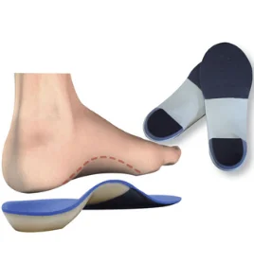
Foot Orthosis
An orthosis fitted to provide functions, support and protection to the foot structures are called Foot Orthosis.
The basic modifications include Boots, Shoes, etc.
A simple foot orthosis is divided into two parts upper and lower.
Components of a lower part of FO include Sole, Ball, Shank, Toe spring and Heel.
Components of an upper part of FO include Quarter, Heel counter, Vamp, Throat, Toe box, Tongue and Stirrup.

Slide 4
Indications
Limb shortening
Arthritis of the subtalar joints
Pes equinus
Pes cavus
Calcaneal spurs
Metatarsalgia
Hallux valgus
Hammer toes
Foot fractures

Slide 5
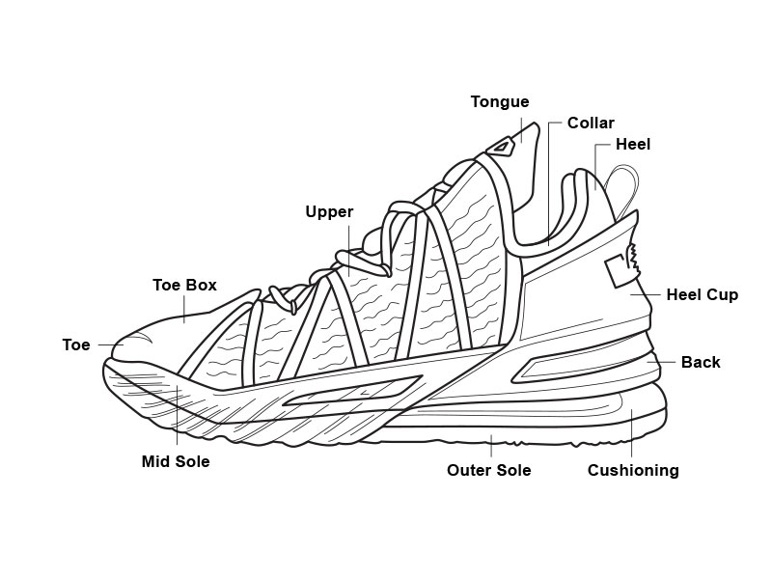
Extends down in front of throat.
Consists of the quarter part. High quarter shoes in Runners.
Prevents toe from trauma.
Especially in football players.
Weight bearing part of shoe.
Elevated for short limbs, cushion attached for spurs
Widest part.
At metatarsal heads.
Metatersal pads used in metatarsalgia cases.
Attached to ground. Elevated for short limbs.

Slide 6
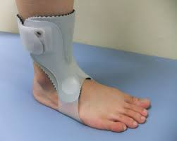
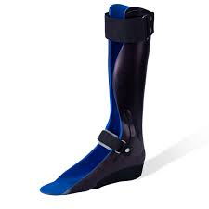
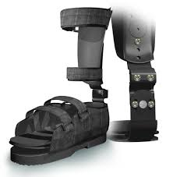
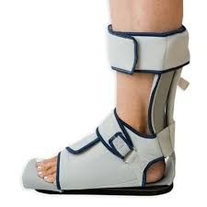
Ankle Foot Orthosis
It is a form of boot which an ankle is fixed through the stirrup.
Metal uprights ascend to the calf bilaterally.
Components include calf bands with leather straps, medial lateral bars controlling PF and DF.

Slide 7
Indications
Muscle weakness affecting the ankle and subtalar joint
Dorsiflexor muscle paralysis; AT contracture
Ankle and foot paralysis; mediolateral stability
Spasticity; children with CP
Limited weight bearing; Fracture calcaneus

Slide 8
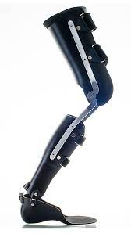
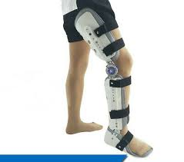
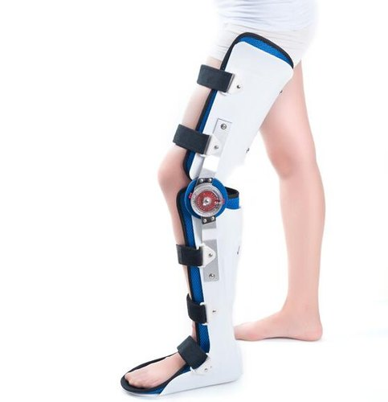
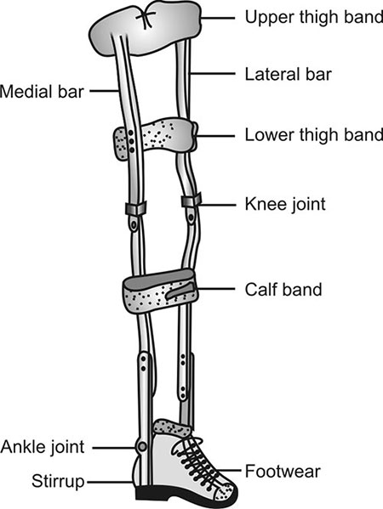
Knee- Ankle- Foot Orthosis
Provides stability to the knee ankle and foot
Uprights are extended to the knee joint and lower thigh bands are also attached.
Consists of types of artificial knee joints, stance control and various knee locks.
Knee joints include straight set knee, polycentric knee and posterior offset knee joint.
The knee locks include drop lock, spring loaded lock, cam lock, ball lock, dial lock and plunger type lock.

Slide 9
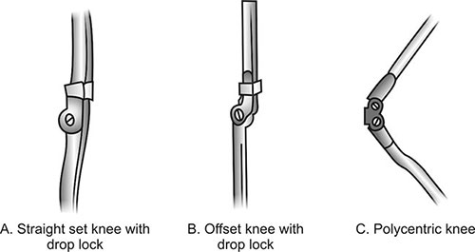
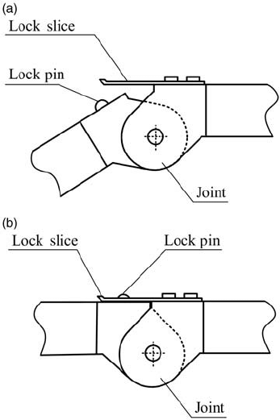
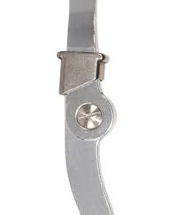
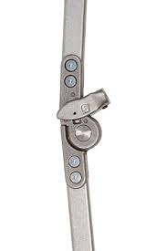
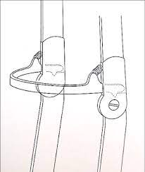
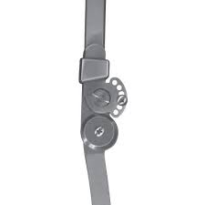
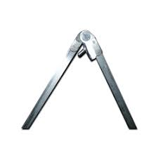
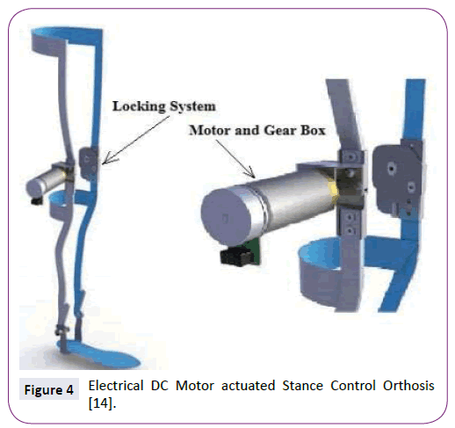
SPRING LOADED LOCK
DROP LOCK
BALL LOCK
DIAL LOCK
CAM LOCK
PLUNGER TYPE LOCK

Slide 10
Indications
Weakness of the Quadriceps and hip extensors
Poliomyelitis
Spinal cord injury
Upper motor neuron lesion
Septic arthritis of knee joint
Osteoarthritis of knee
Genu varus/ valgum
Femoral fracture
Joint replacement or non-union

Slide 11
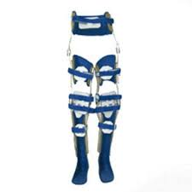
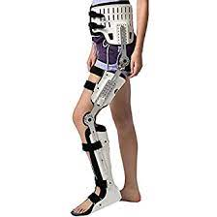
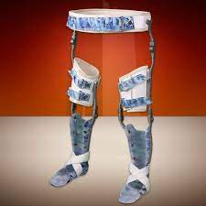
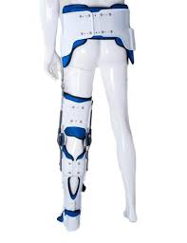
Hip- Knee- Ankle- Foot Orthosis
Consider an extension of KAFO
The extension at the hip joint allows the movement of flexion and extension.
Rotational movement at the hip joint is controlled by the padded rigid steel band placed between the iliac crest and greater trochanter.
Improves posture, balance and controlled stance and swing phases.
Ideal in patients with weak hip musculature and abnormal forward leg swing.
Since hip motions are controlled enhanced movements are seen at the lumbar spine.
Abnormal rotations at hip in children with CP is a common indication.

