Slide 1
Chapter 1. Introduction

Slide 2
Introduction
In 1987, Robert M. Solow, an economist at the Massachusetts Institute of Technology,
Nobel Prize in economics for his work in determining the sources of economic growth
Economy’s growth is the result of technological advances
more complex processes: higher pressure, more reactive chemicals, and exotic chemistry
more complex safety technology

Slide 3
As chemical engineers will need a more detailed and fundamental understanding of safety.
safety is equal in importance to production and has developed into a scientific discipline
Examples of the technology of safety include
  Hydrodynamic models representing two-phase flow
  Dispersion models representing the spread of toxic vapor
  Mathematical techniques to determine the various ways that processes can fail and the probability of failure
highly technical and complex theories and practices.

Slide 4
Chemical plant safety emphasize:
use of appropriate technological tools to provide information for making safety decisions with respect to plant design and operation.
  safety: Accident prevention (older strategy) worker safety through the use of hard hats, safety shoes,
  and a variety of rules and regulations
Loss prevention includes hazard identification, technical evaluation, and the design of new engineering features to prevent loss.

Slide 5
Safety, Hazard, and Risk
Frequently used terms in chemical process safety
Safety or loss prevention: Technologies to identify the hazards of a chemical plant and eliminate them before an accident occurs
Hazard: a chemical or physical condition that has the potential to cause damage to people, property, or the environment.
Risk: measure of human injury, environmental damage, or economic loss (incident likelihood, magnitude of the loss )

Slide 6
Chemical plants
Large variety of hazard
Mechanical hazards: Worker injuries from tripping, falling, or moving equipment
Chemical hazards: Fire and explosion hazards, reactivity hazards, and toxic hazards
Safety Programs: (For participants)
A successful safety program ingredients are
System
Attitude
Fundamentals
Experience
Time
You

Slide 7
Safety Programs
System
(1) to record what needs to be done
(2) to do what needs to be done
(3) to record that the required tasks are done
Attitude: Participants must have a positive attitude.
willingness to do some of the thankless work that is required for success.
Fundamentals: Must understand and use the fundamentals of chemical process safety.

Slide 8
Experience: Learn from the experience of history
(1) read and understand case histories of past accidents and
(2) ask people in their own and other organizations for their experience and advice
Time: Safety takes time.
This includes time to study
time to do the work
time to record results (for history)
time to share experiences
time to train or be trained.
You: everyone (you) should take the responsibility to contribute to the safety program.

Slide 9
Safety Programs
Distinction between a good and an outstanding safety program.
Good safety program: identifies and eliminates existing safety hazards.
Outstanding safety program: has management systems that prevent the existence of safety hazards.
prevents the existence of a hazard in the first place
include
Safety reviews,
Safety audits,
Hazard identification techniques,
Checklists,
Proper application of technical knowledge

Slide 10
Engineering Ethics
Engineers are responsible for minimizing losses and providing a safe and secure environment for the company’s employees
Responsibility to themselves, fellow workers
Family, community, and the engineering profession.
Part of this responsibility is described
  by the American Institute of Chemical Engineers

Slide 11
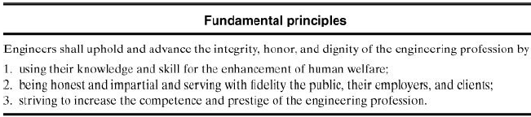
American Institute of Chemical Engineers Code of Professional Ethics

Slide 12
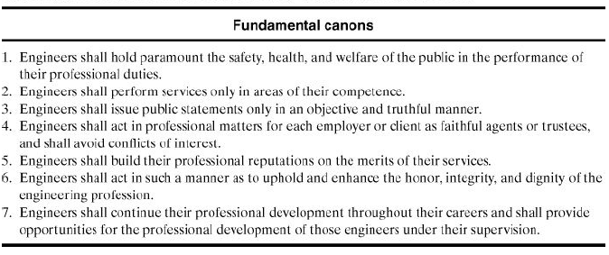
American Institute of Chemical Engineers Code of Professional Ethics

Slide 13
20/8/2020
END of The Lecture
Thanks

Slide 14
Accident and Loss Statistics
Accident and loss statistics are important measures of the effectiveness of safety programs
process is safe or safety procedure is working effectively
No single method is capable of measuring all required aspects
Many statistical methods are available
Three systems considered here are
• OSHA incidence rate,
• Fatal accident rate (FAR)
• Fatality rate, or deaths per person per year
All three methods report the number of accidents and/or fatalities for a fixed number of workers during a specified period.

Slide 15
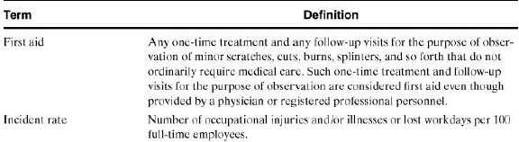


OSHA
Occupational Safety and Health Administration of the United States government.
OSHA is responsible for ensuring that workers are provided with a safe working environment
OSHA definitions applicable to accident statistics references
Injury Facts, 1999 ed. (Chicago: National Safety Council, 1999), p. 151. OSHA regulations, 29 CFR 1904.12.

Slide 16
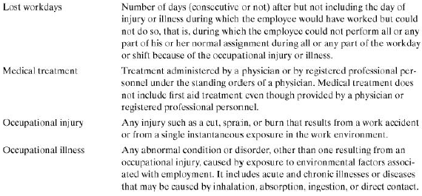



Accident and Loss Statistics

Slide 17
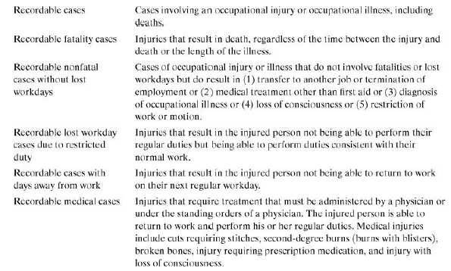




Accident and Loss Statistics

Slide 18
OSHA incidence rate
Based on cases per 100 worker/years.
A worker 2000 hours
(50 work weeks/year × 40 hours/week)
The OSHA incidence rate is therefore based on 20,0000 hours of worker exposure to a hazard.
Provides information on all types of work-related injuries and illnesses, including fatalities
Better representation of worker accidents than systems based on fatalities alone
For instance, a plant might experience many small accidents with resulting injuries but no fatalities

Slide 19
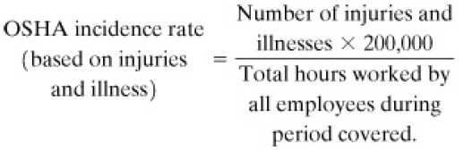
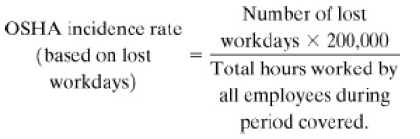
OSHA incidence rate:
Number of occupational injuries and illnesses and the total number of employee hours worked during the applicable period
An incidence rate can also be based on lost workdays instead of injuries and illnesses

Slide 20
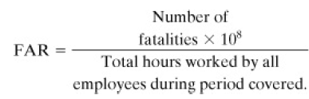
FAR
Mostly used by the British chemical industry
Reports the number of fatalities based on 1000 employees working their entire lifetime
Employees are assumed to work a total of 50 years
Based on 10⁸ working hours

Slide 21
Fatality rate
or deaths per person per year
Independent of the number of hours actually worked
Report only the number of fatalities expected per person per year
Useful for performing calculations on the general population where number of exposed hours is poorly defined

Slide 22
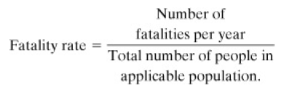
Fatality rate
Both the OSHA incidence rate and the FAR depend on the number of exposed hours
An employee working a ten-hour shift is at greater total risk than one working an eight-hour shift
FAR can be converted to a fatality rate (or vice versa) if the number of exposed hours is known
OSHA incidence rate cannot be readily converted to a FAR or fatality rate

Slide 23
Example
A process has a reported FAR of 2. If an employee works a standard 8-hr shift 300 days per year, compute the deaths per person per year.
Solution
Deaths per person per year
= (8 hr/day) x (300 days/yr) x (2 deaths/10⁸ hr)
= 4.8 x 10-5.

Slide 24
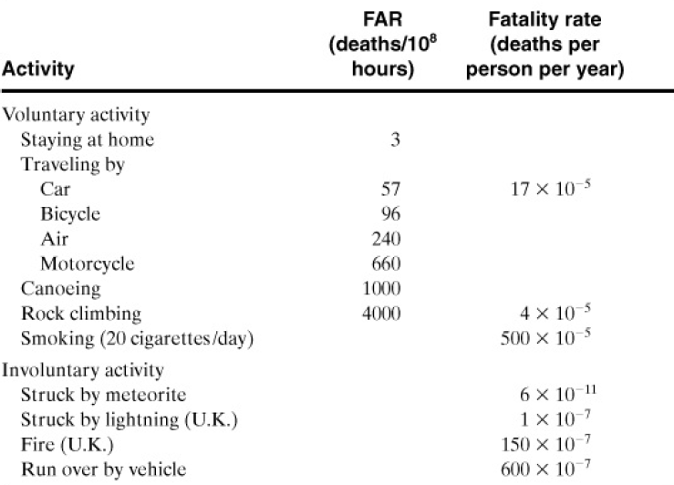
Fatality Statistics for Common Nonindustrial Activities

Slide 25
Example 1-2.
If twice as many people used motorcycles for the same average amount of time each, what will happen to (a) the OSHA incidence rate, (b) the FAR, (c) the fatality rate, and (d) the total number of fatalities?
Solution
a. The OSHA incidence rate will remain the same. The number of injuries and deaths will double, but the total number of hours exposed will double as well.
b. The FAR will remain unchanged for the same reason as in part a.
c. The fatality rate, or deaths per person per year, will double. The fatality rate does not depend on exposed hours.
d. The total number of fatalities will double.

Slide 26
Accident statistics
Accident statistics do not include information on the total number of deaths from a single incident
Example
consider two separate chemical plants. Both plants have a probability of explosion and complete devastation once every 1000 years.
The first plant employs a single operator. When the plant explodes, the operator is the sole fatality.
The second plant employs 10 operators.
In both cases the FAR and OSHA incidence rate are the same.
correspondingly larger number of exposed hours.

Slide 27
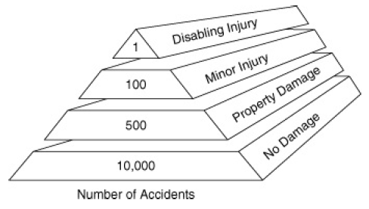
Accident pyramid
Property damage and loss of production must also be considered in loss prevention.
These losses can be substantial. Accidents of this type are much more common than fatalities.
“No Damage” accidents are called “near misses”
provide a good opportunity for determine that a
problem exists

Slide 28
Accident pyramid
Each company needs to determine an appropriate level for safety expenditures.
This is part of risk management
Engineers need to also consider other alternatives when designing safety improvements otherwise may make the system unduly complex
It is also important to recognize the causes of accidental deaths,
Most company safety programs are directed toward preventing injuries to employees, the programs should include off-the-job safety
Although the emphasis of chemical-related accidents
include training to prevent injuries resulting from transportation, assaults, mechanical and chemical exposures, and fires and explosions.

Slide 29
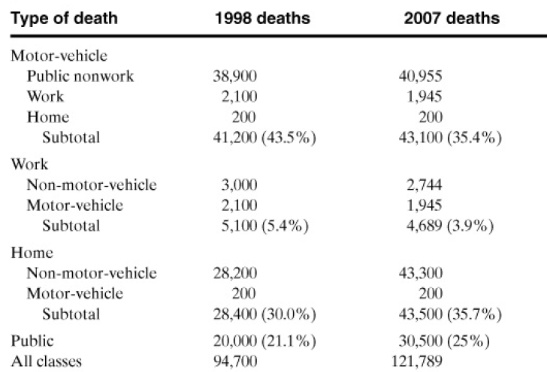
Accident pyramid
Organizations focus on the root causes of worker injuries

Slide 30
Acceptable Risk
Every chemical process has a certain amount of risk
associated with it
Engineers must make every effort to minimize risks within the economic constraints of the process.
No engineer should ever design a process that he or she knows will result in certain human loss or injury
Public Perceptions
Acceptable risk are assuming that these risks are satisfactory to the civilians living near the plant
The results of a public opinion survey on the hazards of chemicals

Slide 31
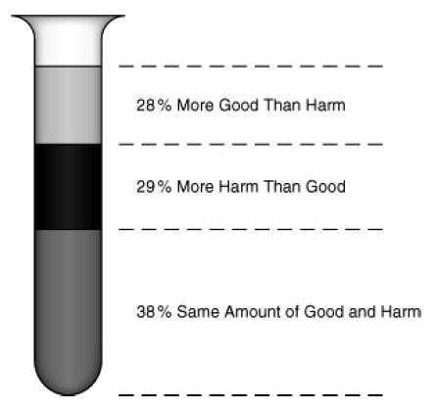
Results from a public opinion survey
The results show an almost even three-way split,
with a small margin who considered the good and harm to be equal.

Slide 32
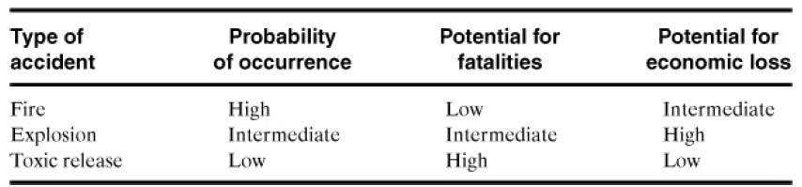
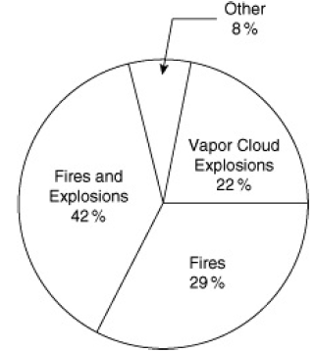
Nature of the Accident Process
Three Types of Chemical Plant Accidents
Economic loss consistently high explosions
most damaging type of vapor cloud explosion

Slide 33
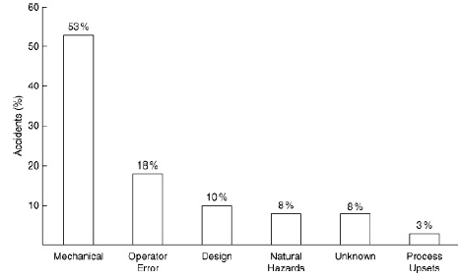
Causes of losses for largest hydrocarbon-chemical plant accidents
By far the most mechanical failures, such as pipe failures due to corrosion, erosion, and high pressures, and seal/
gasket failures.
Operator error example,
valves are not opened or
closed in the proper
sequence or reactants are
not charged to a reactor in
the correct order

Slide 34
OSHA published its final rule “Process Safety Management of Highly Hazardous Chemicals (PSM)
Most accidents follow a three-step sequence:
• Initiation (the event that starts the accident)
• Propagation (the event or events that maintain or expand the accident), and
• Termination (the event or events that stop the accident or diminish it in size)

Slide 35
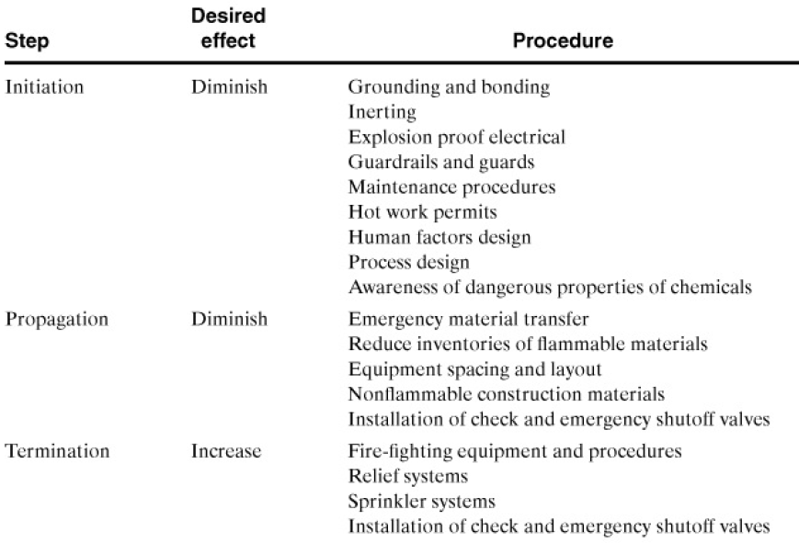
Defeating the Accident Process

Slide 36
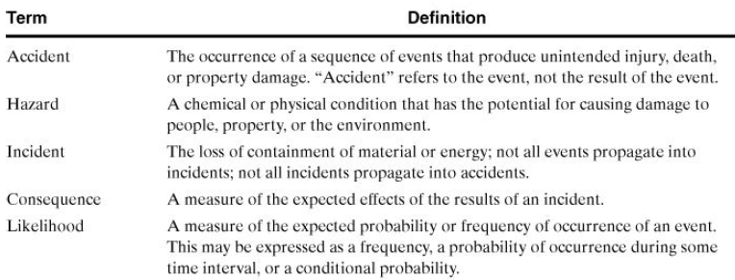
Definitions for Case Histories by
Center for Chemical Process Safety (CCPS), Guidelines for Consequence Analysis

Slide 37
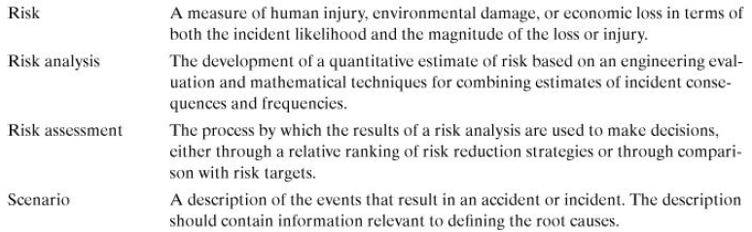
Definitions for Case Histories by
Center for Chemical Process Safety (CCPS),
Guidelines for Consequence Analysis

Slide 38
21/8/2020
END of The Lecture
Thanks

Slide 39
Inherent Safety
A process that does not require complex safety interlocks and elaborate procedures is simpler, easier to operate, and more reliable.
Smaller equipment, operated at less severe temperatures and pressures, has lower capital and operating costs.
Safety of a process relies on multiple layers of protection. The first layer of protection
  process design features.
  Subsequent layers include control systems, interlocks, safety shutdown systems, protective systems, alarms, and emergency response plans.
  Inherent safety is a part of all layers of protection
  best approach to prevent accidents
  Add process design features to prevent hazardous situations.
  An inherently safer plant is more tolerant of operator errors and abnormal conditions.

Slide 40
Inherent Safety
At these early stages process engineers and chemists have the maximum degree of freedom in the plant and process specifications
Free to consider basic process alternatives, such as changes to the fundamental chemistry and technology
The following four words are recommended to describe inherent safety:
• Minimize (intensification)
• Substitute (substitution)
• Moderate (attenuation and limitation of effects)
• Simplify (simplification and error tolerance)

Slide 41
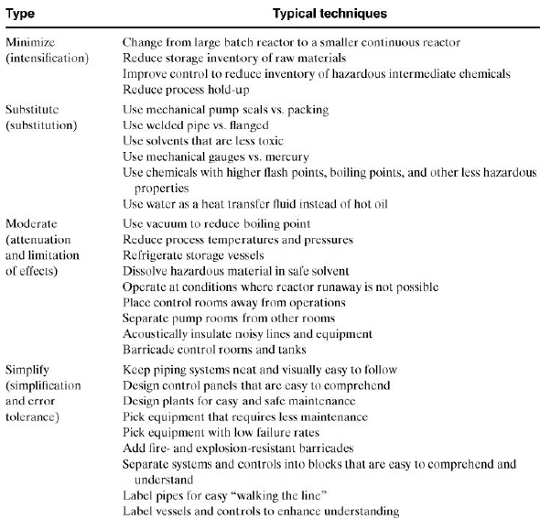
Inherent Safety Techniques

Slide 42
Inherent Safety
Minimizing entails reducing the hazards by using smaller quantities of hazardous substances in the reactors, distillation columns, storage vessels, and pipelines.
Possible, hazardous materials should be produced and consumed in situ.
Minimizes the storage and transportation of hazardous raw materials and intermediates.
Toxic materials will not accumulate around leaking tanks. Smaller tanks also reduce the hazards of a release.

Slide 43
Inherent Safety
Substitutions should also be considered as an alternative, safer materials should be used in place of hazardous ones.
Using a hazardous material under less hazardous conditions
Reduce the release concentration
Refrigerating to lower the vapor pressure
Handling larger particle size solids to minimize dust
Processing under less severe temperature or pressure conditions

Slide 44
Seven Significant Disasters
Seven most cited accidents
Flixborough, England;
Bhopal, India;
Seveso, Italy;
Pasadena, Texas;
Texas City, Texas;
Jacksonville, Florida;
Port Wentworth, Georgia
Flixborough accident is perhaps the most documented chemical plant disaster

Slide 45
Thanks
25/8/20

