Slide 1
CLASSIFICATION OF MUSCLES
BY:
DR. DIGVIJAY SHARMA
DIRECTOR
SCHOOL OF HEALTH SCIENCES, CSJMU

Slide 2
CLASSIFICATION OF MUSCLES
When muscles are categorised on the basis of action, such as muscle causes flexion at a joint are categorised as flexors, while one causes extension or rotation are referred to as extensors or rotators
When muscles are classified according to role, the individual muscle or muscle groups are named depending upon the role that the muscle play during action
These are:
Agonist or Prime movers
Antagonists
Synergists

Slide 3
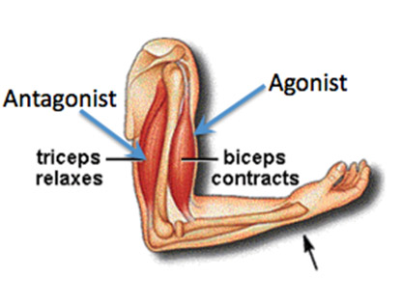
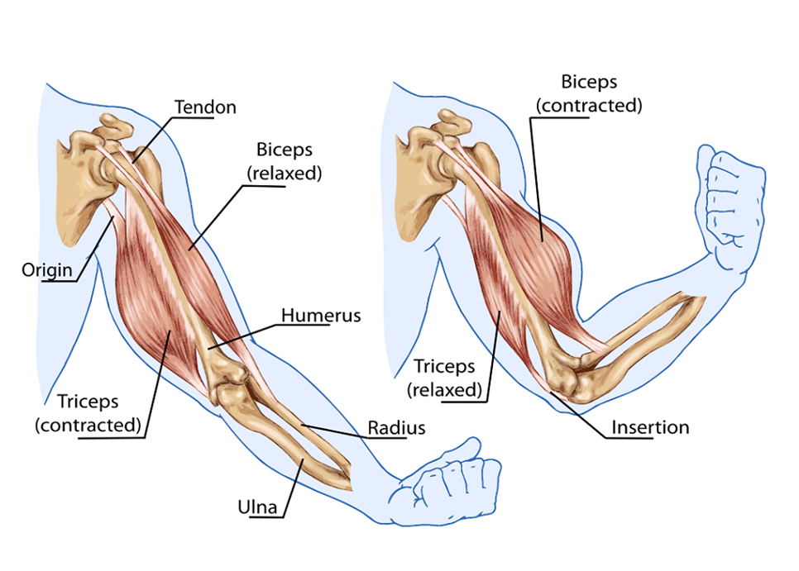
agonists
The term is used to designate a muscle whose role is to produce a desired motion at a joint
For example: if flexion is the desired action, the flexor muscle are the prime movers

Slide 4
antagonists
The muscles that are directly opposite to the desired motion are called the antagonists
The desired motion is not opposed by the antagonists, but these muscles have the potential to oppose the action
For example: if flexion is the desired motion the extensors are antagonists
Ordinarily when an agonist is called on to perform desired motion, the antagonist is inhibited which is called reciprocal inhibition
If the agonist and the potential antagonist constant simultaneously then co-contraction occurs
This provides stability for the joint and represents a form of synergy that may be necessary in some conditions
Co-contraction of muscle with opposing functions can be undesirable when a desired motion is prevented by involuntary co-contraction such as occurs in disorders affecting the control of muscle function

Slide 5
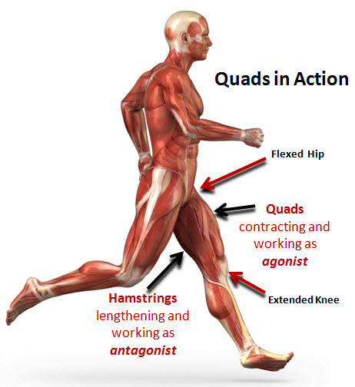
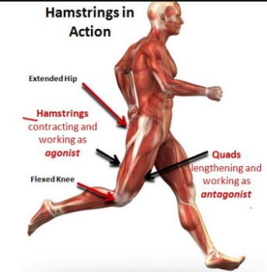

Slide 6
synergists
Muscles that help the agonist to perform a desired action are called synergists
Synergists may help agonist directly by helping to perform the desired action such as if the wrist flexion is desired action, the flexor carpii radialis and ulnaris are agonist or prime movers while the finger flexors such as digitorum is synergists while wrist extensors are the potential antagonists
Synergists may assist the agonist indirectly by stabilizing a part or by preventing an undesired action such as in case of clenching of fist
The long flexors cannot function effectively if they flex wrist and finger simultaneously
Therefore, the wrist extensors are used synergistically to stabilize the wrist and to prevent wrist flexion
Sometimes the synergistic action of two muscles are necessary to produce a palne motion such as radial deviation by flexor carpii radialis and extensor carpii radialis, wrist flexion, radial deviation by radial flexor, flexor carpii radialis, etc

Slide 7
