Slide 1
COMMUNITY BASED REHABILITATION

Slide 2
Contents
Introduction
History of CBR
Principles of CBR
Goals of CBR
Aims of CBR
Procedure of CBR
CBR matrix
Aspects CBR
Members of a CBR team
Uses of CBR
Role of physiotherapist in CBR

Slide 3
Introduction to CBR
“ It is a strategy within the community for the rehabilitation, equalization of opportunities and social integration of people with disabilities.”
Includes all the members of the community- disabled people, their families, friends, local health and socio-vocational health services.
Helps achieve self independence among disabled group of individuals.
Assessing good health or illness must be multifaceted and community-based.
CBR is a community based development for enhancement of rehabilitation services for disabled people.
Aids in social upliftment of disabled people with the help of society.
Addresses the needs of people with disabilities.
Focuses on overall enhancement of quality of life of patients with disability.
S. Sunder; Textbook of Rehabilitation; Jaypee; 3rd edition
Louise S. Madsen, Charlotte Handberg, Charlotte M. Jensen, Claus V. Nielsen. (2021) Community-based rehabilitation approaches in outdoor settings: a systematic review of people with disabilities’ and professionals’ experiences and perceptions; Disability & Society 36:7, pages 1073-1098.
Charlotte Handberg, Ole Mygind, Jan Sau Johansen. (2019) Lessons learnt on the meaning of involvement and co-creation in developing community-based rehabilitation; Disability and Rehabilitation 41:25, pages 3052-3060.

Slide 4
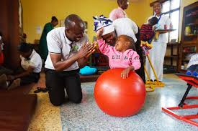
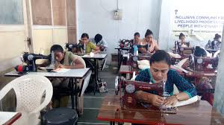
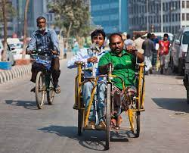
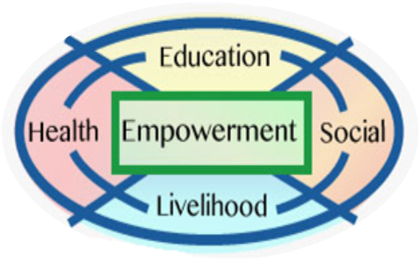
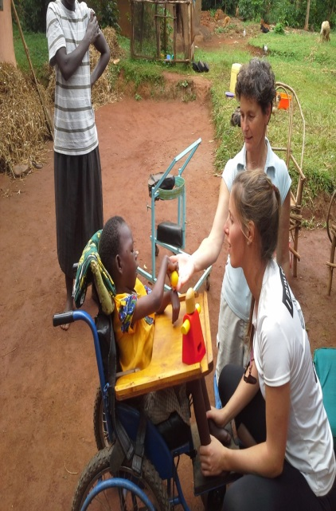
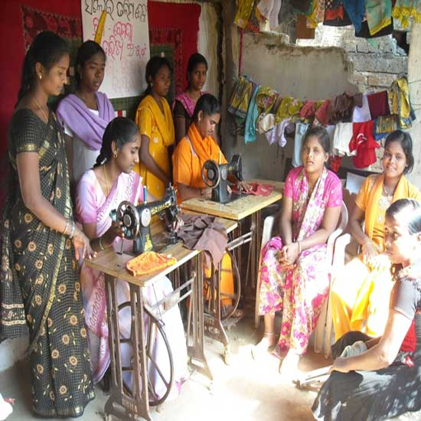
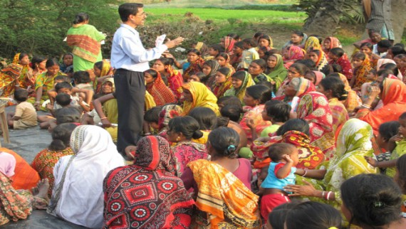
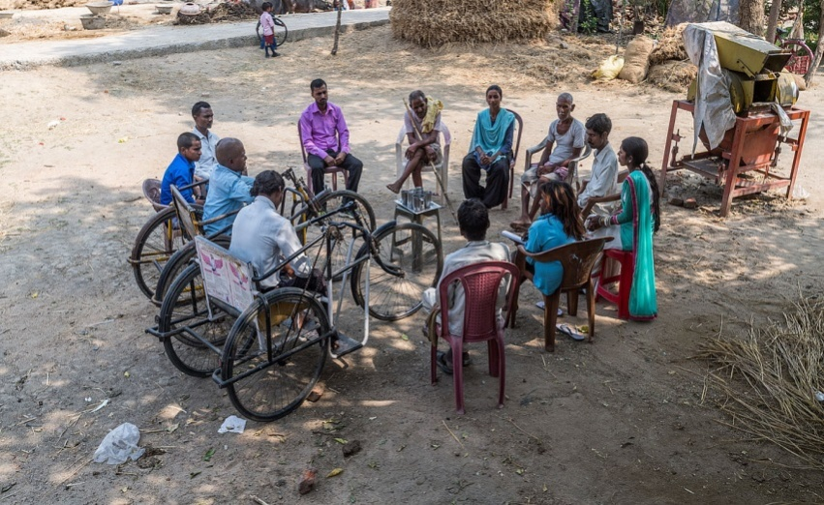
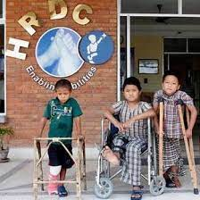

Slide 5
History of CBR
Started as an extension of primary health care in 1978.
In 1980, WHO started strategy of service delivery to overcome deficits in models of rehabilitation.
CBR evolved out of the concept issued by WHO entitled as “ Training in the community for people with disabilities”
Conceptualized for training and upliftment of people with disabilities so that they can have a social and vocational livelihood and decrease dependency on people.
From 1993-2002, several UN agencies worked in collaboration to generalize concept of CBR internationally.
1993-2002 is considered as the Asian and Pacific decade for the disabled by the ESCAP (Economic and Social Commission for Asia and Pacific)
S. Sunder; Textbook of Rehabilitation; Jaypee; 3rd edition
Louise S. Madsen, Charlotte Handberg, Charlotte M. Jensen, Claus V. Nielsen. (2021) Community-based rehabilitation approaches in outdoor settings: a systematic review of people with disabilities’ and professionals’ experiences and perceptions; Disability & Society 36:7, pages 1073-1098.
Charlotte Handberg, Ole Mygind, Jan Sau Johansen. (2019) Lessons learnt on the meaning of involvement and co-creation in developing community-based rehabilitation; Disability and Rehabilitation 41:25, pages 3052-3060.

Slide 6
Principles of CBR
Inclusion
Including people with disabilities in mainstream with normal individuals
Participation
Participation of people with disabilities in creating and working as a normal perspective with their contribution in almost fields
Sustainability
Benefits of any program must reach people with disabilities and in continuation
Equity
Equal opportunities and equal rights to people with disabilities, equal domains and equal citizenship
Self- advocacy
Empowerment
Making people with disabilities understand their rights and give them strength to fight for their rights. Choice of autonomy is to be explained.
Barrier free environment
Providing people with disabilities barrier free environment and making offices, public places accessible for such people.
Empowering people with disabilities with economical, financial, social, emotional, physical and psychological strengths to uplift their quality of life.
S. Sunder; Textbook of Rehabilitation; Jaypee; 3rd edition
Louise S. Madsen, Charlotte Handberg, Charlotte M. Jensen, Claus V. Nielsen. (2021) Community-based rehabilitation approaches in outdoor settings: a systematic review of people with disabilities’ and professionals’ experiences and perceptions; Disability & Society 36:7, pages 1073-1098.
Charlotte Handberg, Ole Mygind, Jan Sau Johansen. (2019) Lessons learnt on the meaning of involvement and co-creation in developing community-based rehabilitation; Disability and Rehabilitation 41:25, pages 3052-3060.

Slide 7
Goals of CBR
Supporting people with disabilities
Help them access regular services and opportunities
Protect rights of such people
Empowering PwDs and their families
Make them active contributors of community and society
S. Sunder; Textbook of Rehabilitation; Jaypee; 3rd edition
Louise S. Madsen, Charlotte Handberg, Charlotte M. Jensen, Claus V. Nielsen. (2021) Community-based rehabilitation approaches in outdoor settings: a systematic review of people with disabilities’ and professionals’ experiences and perceptions; Disability & Society 36:7, pages 1073-1098.
Charlotte Handberg, Ole Mygind, Jan Sau Johansen. (2019) Lessons learnt on the meaning of involvement and co-creation in developing community-based rehabilitation; Disability and Rehabilitation 41:25, pages 3052-3060.

Slide 8
Aims of CBR
Prevention of disabilities
Identification of risk individuals
Integrated schooling for children
Early detection of disability and its management strategies
Assessment of needs of people with disabilities
Home based programs
Organizations for and by people with disabilities.
S. Sunder; Textbook of Rehabilitation; Jaypee; 3rd edition
Louise S. Madsen, Charlotte Handberg, Charlotte M. Jensen, Claus V. Nielsen. (2021) Community-based rehabilitation approaches in outdoor settings: a systematic review of people with disabilities’ and professionals’ experiences and perceptions; Disability & Society 36:7, pages 1073-1098.
Charlotte Handberg, Ole Mygind, Jan Sau Johansen. (2019) Lessons learnt on the meaning of involvement and co-creation in developing community-based rehabilitation; Disability and Rehabilitation 41:25, pages 3052-3060.

Slide 9
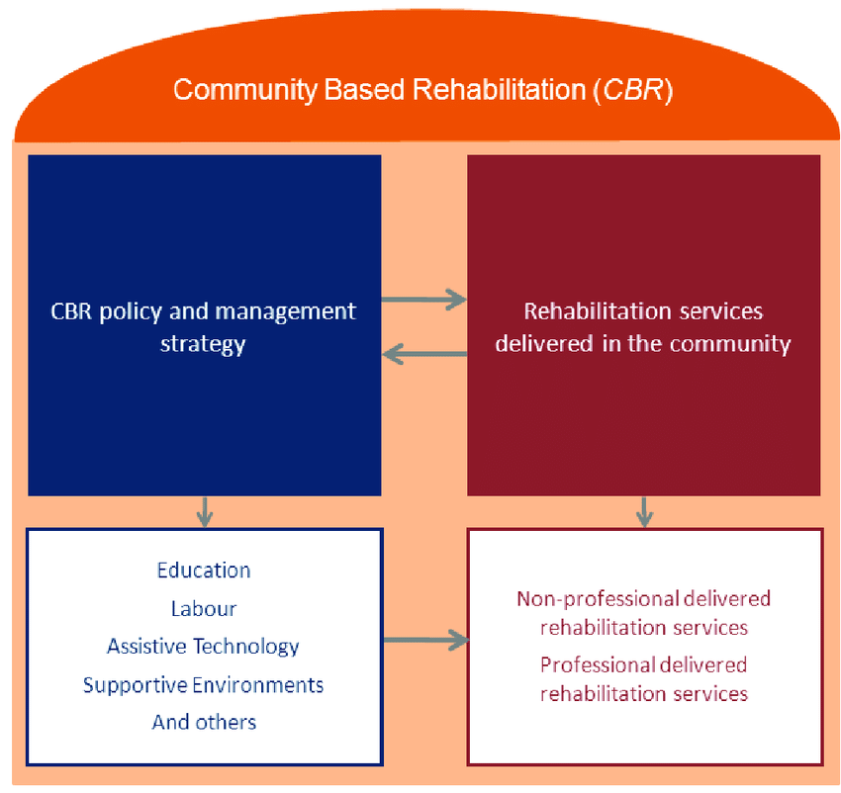
Procedure of CBR implementation
Awareness and concern among community
Planning from the community
Resources from the community
Implementation by the community
Evaluation by the community
Modification by the community
Benefits to and from the community
S. Sunder; Textbook of Rehabilitation; Jaypee; 3rd edition
Louise S. Madsen, Charlotte Handberg, Charlotte M. Jensen, Claus V. Nielsen. (2021) Community-based rehabilitation approaches in outdoor settings: a systematic review of people with disabilities’ and professionals’ experiences and perceptions; Disability & Society 36:7, pages 1073-1098.
Charlotte Handberg, Ole Mygind, Jan Sau Johansen. (2019) Lessons learnt on the meaning of involvement and co-creation in developing community-based rehabilitation; Disability and Rehabilitation 41:25, pages 3052-3060.

Slide 10
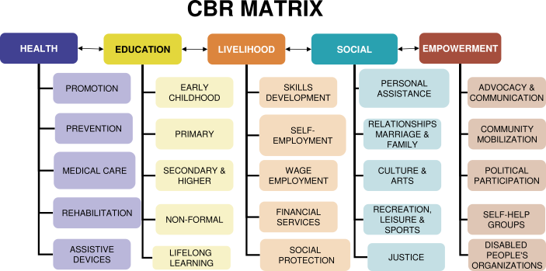

Slide 11
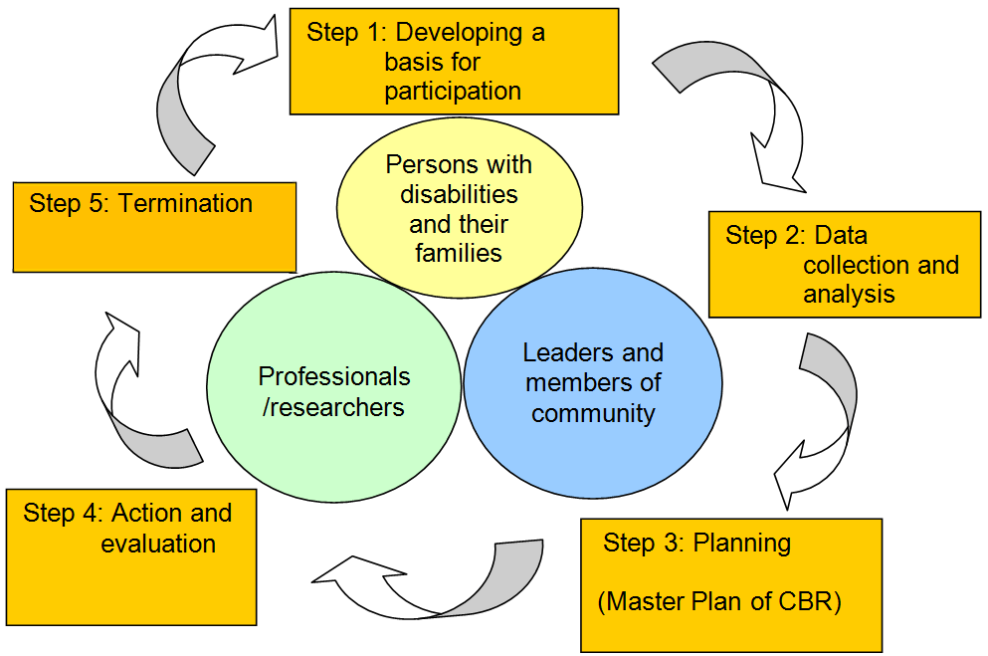

Slide 12
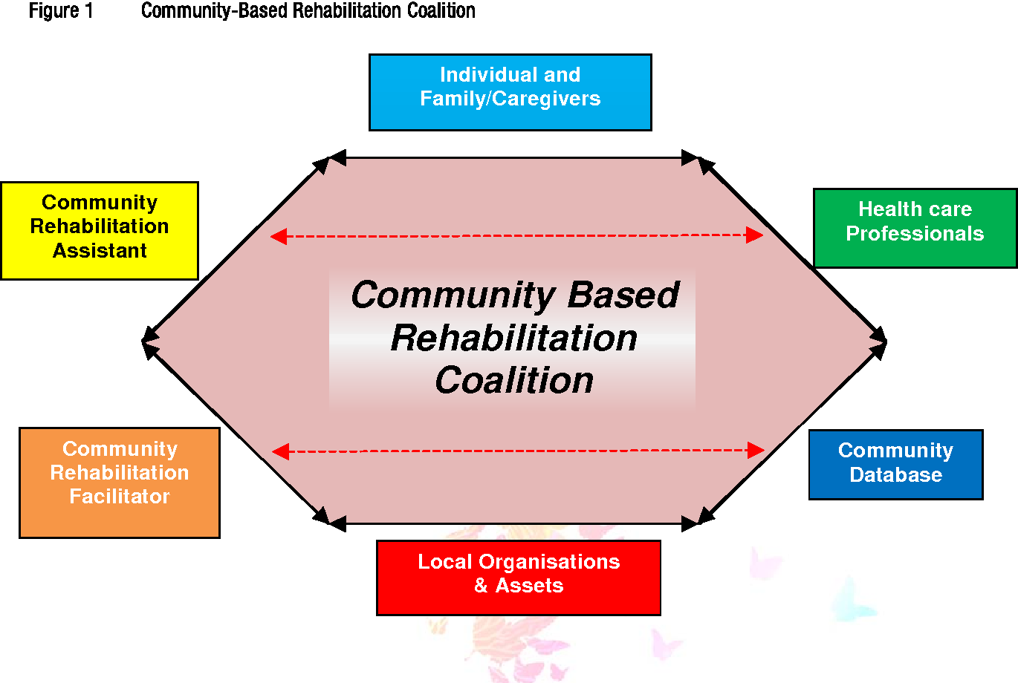
S. Sunder; Textbook of Rehabilitation; Jaypee; 3rd edition
Louise S. Madsen, Charlotte Handberg, Charlotte M. Jensen, Claus V. Nielsen. (2021) Community-based rehabilitation approaches in outdoor settings: a systematic review of people with disabilities’ and professionals’ experiences and perceptions; Disability & Society 36:7, pages 1073-1098.
Charlotte Handberg, Ole Mygind, Jan Sau Johansen. (2019) Lessons learnt on the meaning of involvement and co-creation in developing community-based rehabilitation; Disability and Rehabilitation 41:25, pages 3052-3060.

Slide 13
Aspects of CBR
It has four main aspects which are: Medical, Educational, Economical and Social.
Evaluation of disability by professionals is dealt within medical aspect.
Training for skills is dealt by vocational educators and therapists for assigning work to people with disabilities.
Economical aspect is handled by NGOs and government offices by allotment of funds and support to such people in terms of reforms and laws.
Societal aspect is very crucial and is considered to be of utmost importance, success of any CBR plan depends upon societal acceptance.
S. Sunder; Textbook of Rehabilitation; Jaypee; 3rd edition
Louise S. Madsen, Charlotte Handberg, Charlotte M. Jensen, Claus V. Nielsen. (2021) Community-based rehabilitation approaches in outdoor settings: a systematic review of people with disabilities’ and professionals’ experiences and perceptions; Disability & Society 36:7, pages 1073-1098.
Charlotte Handberg, Ole Mygind, Jan Sau Johansen. (2019) Lessons learnt on the meaning of involvement and co-creation in developing community-based rehabilitation; Disability and Rehabilitation 41:25, pages 3052-3060.

Slide 14
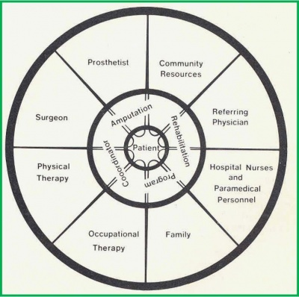
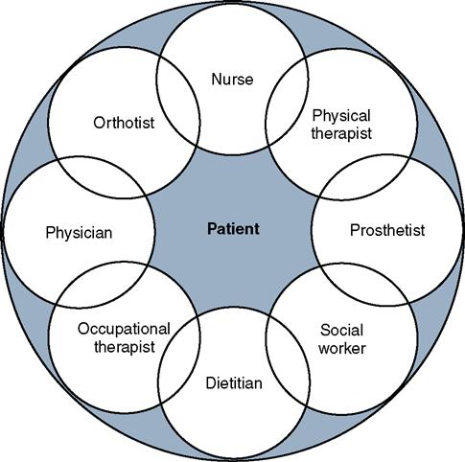
Members of a CBR team
S. Sunder; Textbook of Rehabilitation; Jaypee; 3rd edition
Louise S. Madsen, Charlotte Handberg, Charlotte M. Jensen, Claus V. Nielsen. (2021) Community-based rehabilitation approaches in outdoor settings: a systematic review of people with disabilities’ and professionals’ experiences and perceptions; Disability & Society 36:7, pages 1073-1098.
Charlotte Handberg, Ole Mygind, Jan Sau Johansen. (2019) Lessons learnt on the meaning of involvement and co-creation in developing community-based rehabilitation; Disability and Rehabilitation 41:25, pages 3052-3060.

Slide 15
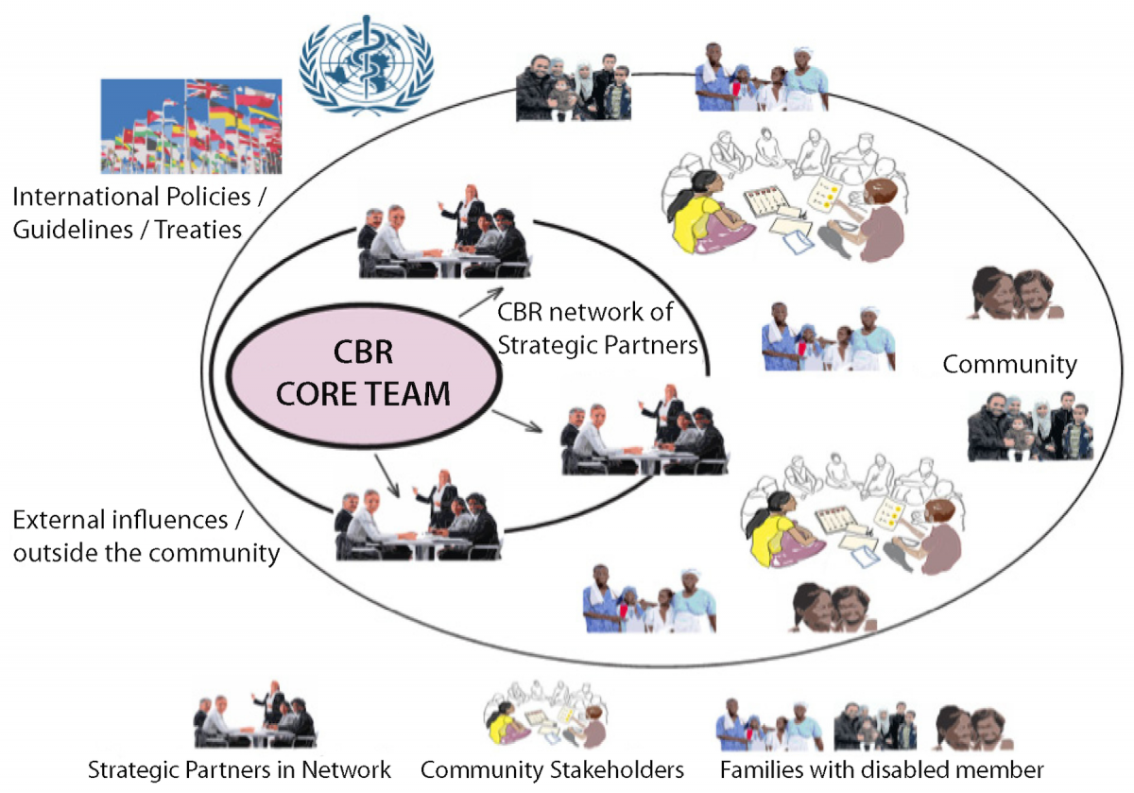

Slide 16
Uses of CBR
It aims at giving multidisciplinary treatment approach to the needy.
Appropriate for rural population with availability of resources at doorsteps.
Involvement of local people enhances a sense of sensitivity and attachment towards people with disabilities.
Prevention of secondary complications if rendered at time.
Maximal restoration of work and financial condition of patients suffering or their family.
Successful in implementing government laws and benefits issued by government to ground level to patients.
S. Sunder; Textbook of Rehabilitation; Jaypee; 3rd edition
Louise S. Madsen, Charlotte Handberg, Charlotte M. Jensen, Claus V. Nielsen. (2021) Community-based rehabilitation approaches in outdoor settings: a systematic review of people with disabilities’ and professionals’ experiences and perceptions; Disability & Society 36:7, pages 1073-1098.
Charlotte Handberg, Ole Mygind, Jan Sau Johansen. (2019) Lessons learnt on the meaning of involvement and co-creation in developing community-based rehabilitation; Disability and Rehabilitation 41:25, pages 3052-3060.

Slide 17
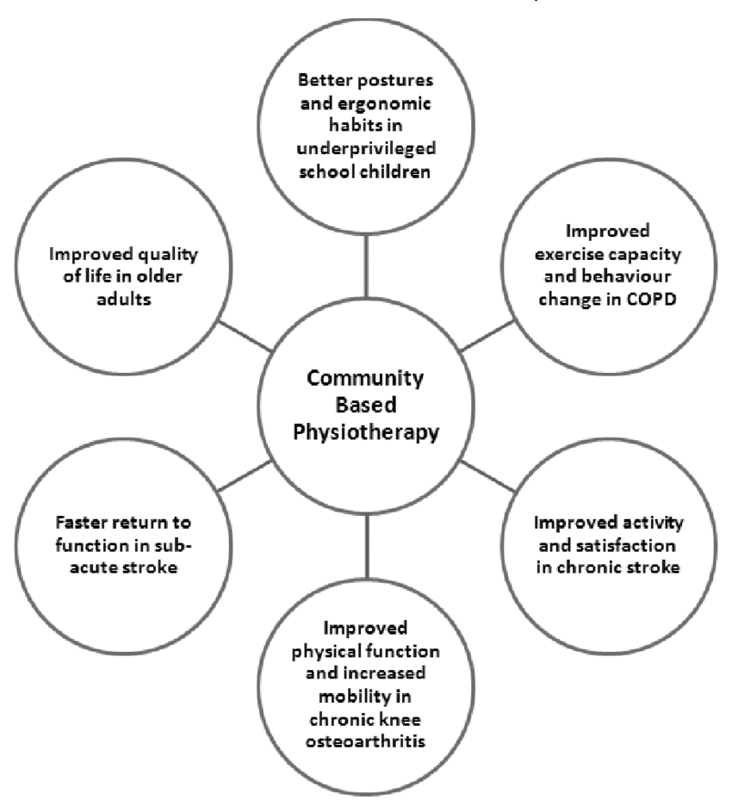
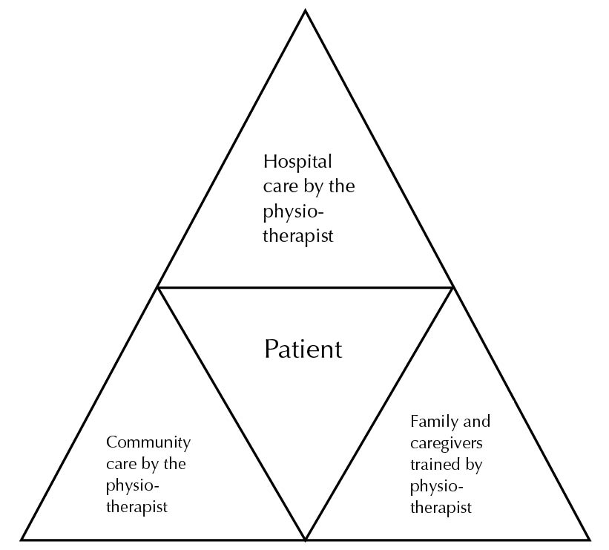
Role of physiotherapist in CBR
S. Sunder; Textbook of Rehabilitation; Jaypee; 3rd edition
Louise S. Madsen, Charlotte Handberg, Charlotte M. Jensen, Claus V. Nielsen. (2021) Community-based rehabilitation approaches in outdoor settings: a systematic review of people with disabilities’ and professionals’ experiences and perceptions; Disability & Society 36:7, pages 1073-1098.
Charlotte Handberg, Ole Mygind, Jan Sau Johansen. (2019) Lessons learnt on the meaning of involvement and co-creation in developing community-based rehabilitation; Disability and Rehabilitation 41:25, pages 3052-3060.

Slide 18
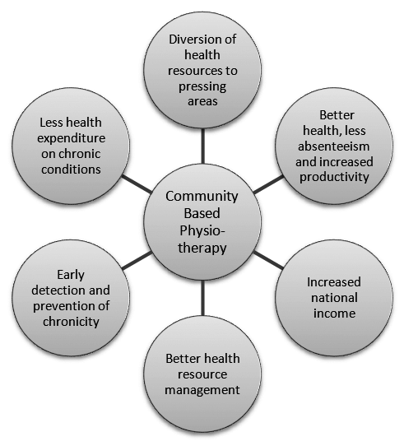
S. Sunder; Textbook of Rehabilitation; Jaypee; 3rd edition
Louise S. Madsen, Charlotte Handberg, Charlotte M. Jensen, Claus V. Nielsen. (2021) Community-based rehabilitation approaches in outdoor settings: a systematic review of people with disabilities’ and professionals’ experiences and perceptions; Disability & Society 36:7, pages 1073-1098.
Charlotte Handberg, Ole Mygind, Jan Sau Johansen. (2019) Lessons learnt on the meaning of involvement and co-creation in developing community-based rehabilitation; Disability and Rehabilitation 41:25, pages 3052-3060.

