Slide 1
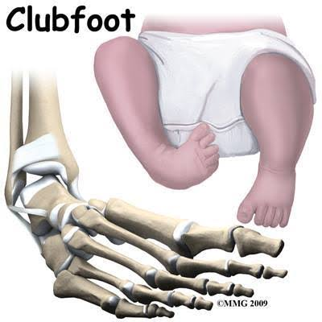
CTEV congenital talipes equino varus

Slide 2
INTRODUCTION
It is the commonest type of acquired foot deformity following muscular imbalance.
It is produced either due to the weakness or paralysis of the dorsiflexors or spasticity in the planter flexion.
The deformity is at the ankle joint while the midtarsal joint is normal.
There is exaggeration of the longitudinal arch and broadening of the heads of the metatarsal due to the constant pressure of body weight on the forefoot as the heel is off the ground.

Slide 3
Club Foot

Slide 4
PATHOLOGY
There is stretching of the ligaments on the dorsum of the foot,with shortening of the inferior-calcaneo-navicular or spring ligament,plantar fascia and other plantar ligaments.
There is the lengthening of the anterior tibial group of muscles with shortening of the long toe flexors,peroneus longus and especially tendoachilles.

Slide 5
Deformity

Slide 6
Treatment
Conservative treatment:-
Relaxed full range passive movement worked up to get maximum dorsiflexion and its passive maintenance is important.
Whenever possible efforts should be made to get active contractions in the anterior tibial group of muscles to strengthen them.
Gait training should be initiated with toe-pickup orthosis or Bkorthosis.
Assisted standing on the affected foot stretches the tight plantar flexors with body weight.

Slide 7
Surgical Treatment:-
Severe cases of fixed equinus deformity need surgical intervention. The surgical procedures performed are as follows:-
Tendon release
Triple arthrodesis

Slide 8
Physiotherapy management:-
During immobilization,The joints free from immobilization are exercised vigorously.
Toe movement are encouraged with the operated leg in elevation.
Non-weight bearing crutch walking could be begun immediately.
After removal of the plaster,maximum emphasis has to be placed on controlled passive,active assisted and eventually active dorsiflexion of the foot with toe extension.
When weight bearing is allowed,weight transfers,balance and gait training and other modes of ambulation are taught.

