Slide 1
CEREBELLUM- STRUCTURE & FUNCTION
COMPILED BY PROF SUDHIR KUMAR AWASTHI DEPT OF LIFE SCIENCES CSJMU

Slide 2
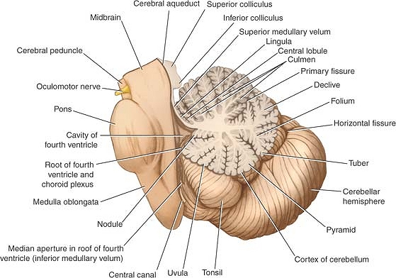
Cerebellum
Situated in the posterior cranial fossa and is covered superiorly by the tentorium cerebelli.
It is the largest part of the hindbrain (10% of total weight) and lies posterior to the fourth ventricle, the pons, and the medulla oblongata.
It consists of two cerebellar hemispheres joined by a narrow median vermis.

Slide 3
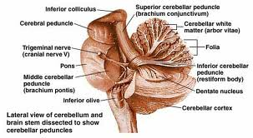
Cerebellum
Three symmetrical bundles of nerve fibers called the superior, middle, and inferior cerebellar peduncles.
Superior peduncle enters mid brain
Middle peduncule consist of transverse fibres of pons
Inferior peduncle connect with medulla

Slide 4
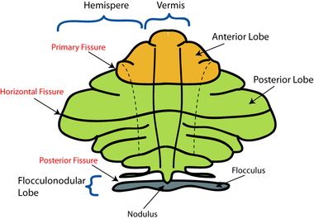
Cerebellum
The cerebellum is divided into three main lobes: the anterior lobe, the middle lobe, and the flocculonodular lobe.
The anterior lobe may be seen on the superior surface.
It is separated from the middle lobe by a wide V-shaped fissure called the primary fissure.
The middle lobe (sometimes called the posterior lobe), which is the largest part of the cerebellum, is situated between the primary and uvulonodular fissures.
The flocculonodular lobe is situated posterior to the uvulonodular fissure.

Slide 5
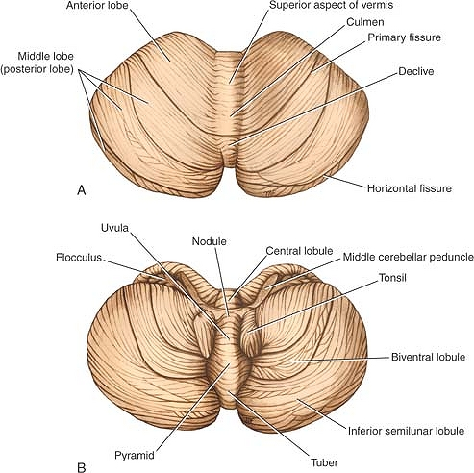
Cerebellum
Sup part of vermis
Lingula
Culmen
Declive
Folium
Inferior part of vermis
Tuber
Pyramid
Uvula
Nodule

Slide 6
Vermis

Slide 7
Cerebellum connections
Functionally cerebellum divided in corpus cerebelli and flocculonodular lobe
Corpus cerebelli:
afferent from spinal cord and trigeminal nuclei
Inputs from pontine nucleus
Flocculonodular lobe
Connections with vestibular nucleus

Slide 8
Cerebellum connections
Anterior lobe and pyramid mainly receive spinal and trigeminal afferents
Corticopontine connections are relayed to posterior lobe, tuber, vermis and uvula

Slide 9
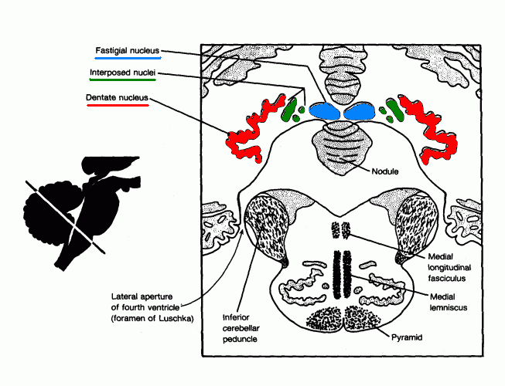
Cerebellar nuclei
Histologically made up of three layers
Embedded in white matter are four paired nuclei
Dentate is largest
Main connection is cerebropontocerebellar
Efferent fibres pass to contralateral red nucleus, thalamus, and cerebral cortex.

Slide 10
Cerebellar peduncles
Superior cerebellar peduncle
Efferent of dentate nucleus
Afferent: anterior spinocerebellar tract, Tectocerebellar from mid brain.
Middle cerebellar peduncle
Afferent fibres from pontine nucleus.
Inferior cerebellar peduncle
Efferent: cerebellovestibular tarct
Afferent: vestibulocerebellar tract, post spinocerebellar, cuneocerebellar, oivocerebellar

Slide 11
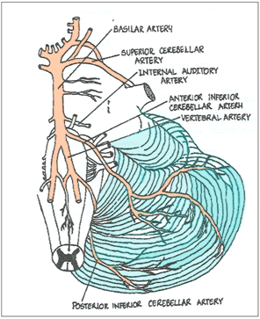
Blood supply
Posterior inferior cerebellar artery
Anterior inferior cerebellar artery
Branch of basilar artery
Superior cerebellar artery

Slide 12
Clinical application
Lesion of floccolonodular lobe leads to disequilibrium.
Lesion of cerebropontine connections leads to hypotonia, diminished muscle jerk, intention tremor, clumsy movements
Isolated lesions of the vermis are produced in children by medulloblastomas in the roof of the fourth ventricle

Slide 13
Clinical application
Anterior lobe lesions leads to ataxia
Dysdiadochokinesia: inability to perform alternating movements regularly and rapidly
Dysarthria occurs in cerebellar disease because of ataxia of the muscles of the larynx

Slide 14
FUNCTIONS OF CEREBELLUM
cerebellum is a central brain structure deeply integrated into major loops with the cerebral cortex, brainstem, and spinal cord.
The cerebellum shows a complex regional organization consisting of modules with sagittal orientation.
The cerebellum takes part in motor control and its lesions cause a movement incoordination syndrome called ataxia.
Recent observations also imply involvement of the cerebellum in cognition and executive control, with an impact on pathologies like dyslexia and autism.
The cerebellum operates as a forward controller learning to predict the precise timing of correlated events.
The physiologic mechanisms of cerebellar functioning are still the object of intense research.
Coordination derives from the precise regulation of timing and gain in the different cerebellar modules.
The investigation of cerebellar dynamics using advanced physiologic recordings and computational models is now providing new clues on how the cerebellar network performs its internal computations.

Slide 15
The signals entering the cerebellum through the mossy fibers are processed in the granular layer and transmitted to Purkinje cells, while a collateral pathway activates the deep cerebellar nuclei (DCN).
Purkinje cells in turn inhibit DCN, so that the cerebellar cortex operates as a side loop controlling the DCN.
Learning is now known to occur through synaptic plasticity at multiple synapses in the granular layer, molecular layer, and DCN, extending the original concept of the Motor Learning Theory that predicted a single form of plasticity at the synapse between parallel fibers and Purkinje cells under the supervision of climbing fiber deriving from the inferior olive.

Slide 16
REFERENCES
Principles of Neurobiology by Liqun Luo (2018)
Principles of Neural Science by Eric Kandel, James H. Schwartz, Thomas Jessell (2016)
Fundamentals of Neuroscience by L.R. Squire, Darwin Berg , F.E. Bloom, Anirvan Ghosh (2019)

