Slide 1
Column Chromatography Adsorption and partition column Chromatography Methodology, advantages, disadvantages and applications

Slide 2
Column Chromatography
Introduction: It is classified under adsorption chromatography
M.S. Tsvet 1906- used for separation of plant pigments
Rate of adsorption varies with given adsorbent
Involves principle of selective adsorption
Component with ↑ adsorbing power → adsorbs on upper part & with ↓ adsorbs on lower portion

Slide 3
Column Chromatography
Initial separation is improved by original or suitable solvent when passed thru column
Banded column or chromatogram is obtained
Portion of column occupied by particular substance → ZONE
To separate or to estimate various constituents
Column of adsorbent is pushed, various zones are cut at boundaries, extracted by elution
Column washed by more solvent (eluent)→ collecting each component

Slide 4
Column Chromatography
Principle involved
3 way equilibrium- sample, solvent, adsorbent
Intermolecular forces (intermolecular, vander waal forces, ) vary in strength according to their types & cause organic molecule to bind to stationary phase
Strong is the inter mol. force, stronger is the binding to stationary phase. Longer the compound takes to go through the column

Slide 5
Mechanism:
Consider adsorbent silica, Silica is silanol with Si—OH
Consider molecule 1, 2 , 3 in a mixture
Molecules 1,2,3 bind with adsorbent as per their affinity to adsorbent (Si—OH ) due to various interactive forces
Pass the mobile phase, the molecules 1, 2, 3 leave the surface of adsorbent as per their affinity, the one with least affinity leaves first and gets separated from mixture
Molecules have Different affinity for adsorbent
Si—OH + fn grp in molecules
molecules
Passage
1
2
3
3
Interactive forces:
Vander waal
H-bonding, electrostatic int.
Mobile phase
2
1
Silanol: Si—OH
Adsorbent silica
Interaction less or more

Slide 6
METHODOLOGY
Apparatus
1. Straight glass tube, Ratio of 20:1 (L:D)
Ex. 20-30cm L, 1-2cm D
Holds 50-100g of adsorbent & several gm of adsorbate (sample) & retains several gm of adsorbate
Adsorbent- supported on cotton/glass wool/perforated disc (for wide tubes)

Slide 7
APPARATUS
Funnel
Sand
Mobile Phase Eluant
Mixture to be separated
Silica
Fritted disk to prevent adsorbent material to pass
Stop Cock
Collected Eluant

Slide 8
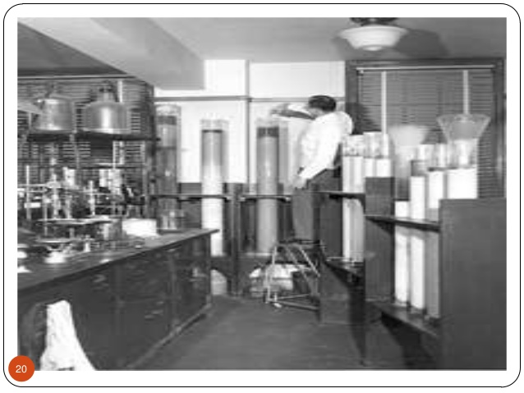
https://www.slideshare.net/krakeshguptha/column-chromatography-26966949

Slide 9
2. Adsorbents: Classification:
According to bonding strength:
Weak: Sucrose, starch, inulin, Talc, cellulose
Intermediate: CaCO₃. Ca₃(PO₄)₂
Strong: Act. Silica, Charcoal, Alumina
According to nature:
Inorganic adsorbent: Silica gel, Alumina, Keisulguhr, Mg Silicate
Organic adsorbent: Cellulose, charcoal

Slide 10
Adsorbents: Characteristics
Spherical particle, uniform size
Mechanical stability: To prevent formation of fine dust
Chemically inert : should not react with eluting solvents / sample
Inactive catalytically, neutral surface
Alumina- 150mesh provides S area- 155m²/g
Larger the mesh size smaller the adsorbent particle

Slide 11
Adsorbents
Silica- ↑ly porous, amorphous silicic acid in form of hard, opalescent particles, which is prepared by precipitation of waterglass with sulfuric acid
alumina- activated by heating at 200°-400°C in current of air / CO_{2,} Silica- 100°C 1h
Silica gel, activated charcoal, MgO, MgCO₃, CaCO₃, CaSO_{4, ,} Polyacrylamide, starch, talc
Weight of adsorbent – 20-50 times than sample wt.

Slide 12
Preparation of column
Dry packing: Cotton plug, clamp the column, Add portions of adsorbent for uniform packing
Press with flat end glass rod, fill 2/3rd of tube
Wet packing: suitable liq. Medium, suction pump, desired ht. should remain covered with petroleum ether always

Slide 13
Role of Solvents used:
To introduce mix. To column
For dev. of zone (developers)
To remove req. content of each zone from mech. Separated parts (eluents)
Method to introduce:
Top of column- covered with cotton plug. Rate of flow of solvent maintained by suction with percolation @ 4-10cm/min. in 5cm tube

Slide 14
Solvents used:
Not be dry & shrink
Too much suction results into evaporation of solvent
Hexane<CCl4<Toulene<DCM<CHCl3<EtOAc<Acetone<Propanol<EtOH<MeOH<CH₃COOH<H₂O

Slide 15
Analysis
Two methods :
1. Adsorbent is pushed with wooden pestle/ plunger, separate the zones by dropping each zone
Immediately add eluent to get suspension, filter by sintered glass funnel

Slide 16
Analysis
2. Column of adsorbent is not removed, Elution tech. (Isocratic or gradient)
Chromatogram is developed with single eluent /successive solvents in ↑ing power of eluent efficiency
Different portions are washed collected in different receivers

Slide 17
PROCESS
Sample loaded
Mobile phase
Strong interaction
Sample separation
Stationary phase
Weaker interaction
Fraction collection
Eluted molecules

Slide 18
Detection
If colored compd. separation- visual monitoring
If colorless compds. : withdrawing small fractions in between the eluation and then testing by TLC every time

Slide 19
Factors affecting column efficiency
Nature of solvents: Solvent of ↓η used for ↑ efficiency separation, because rate of flow is inversely proportional to η
E α 1/ η
Should be compatible with matrix used
2. Dimensions of column: By ↑ing L/W ratio for preparative separations sample/column packing ratio → 1:20, 1:100
Increasing L- improved separation
50 mm ID, 30cm L

Slide 20
Factors affecting column efficiency
3. Conduction of adsorbent: If deactivation takes place- separation ↓
4. Temp. of column: Difficult soluble samples are generally separated at ↑ Temp. RT is best, ↓Temp. to ↓ efficiency
5. Particle size of column packing:
By ↓ing particle size of adsorbent ↑se separation

Slide 21
Advantages
Wide choice of solvents
Wide variety of mixture can be separated
Small to large qty. of samples can be handled
Disadvantages
Time consuming
Amount of solvents req. is more, so expensive

Slide 22
Applications
For analytical uses: capillary – 0.05-2mm (id) & 1-20m (L)
Separation of geometrical isomers
Isomers of carotenoids on CaCO₃, Al₂O₃
Isomers of carboxylic acids- charcoal, silica gel
Separation of tautomer mix,
Keto & enol forms of p-hydroxylphenyl pyruvic acid & indolyl pyruvic acid, separated in weakly acidic med. Enol appears before ketoform in eluate

Slide 23
Applications
To determine no. of components in a mix.
To separate & purify substantial qty’s of those components for subsequent analysis
Purification of natural compounds obtained from plants
Separation of end products in organic synthesis
Removal of impurities

Slide 24
References
Jeffry G.H., J. Mendham et al. Vogel’s Text book of Quantitative Chemical Analysis, 5th Edition, 1989, Longman Scientific & Technical, Bath Press, Great Britain.
G.R. Chatwal, SK Anand. Instrumental methods of chemical analysis (Analytical Chemistry), ed. 1995, Himalaya Publishing House, Bombay.
A.H. Beckett & J.B. Stenlake. Practical Pharmaceutcal Chemistry, Part Two, ed. 4th, 1997, (reprint 2003) CBS Publishers & Distributors, New Delhi.

