Slide 1
CSE S302
DESIGN and ANALYSIS OF ALGORITHMS
UIET CSJMUNIVERSITY KANPUR
Dr. RAVINDRA NATH

Slide 2
Analysis and Design of Algorithms
An algorithm is a method of solving problem (on a computer)
Problem example:
given a set of points on the plane
find the closest pair
Algorithm:
find distance between all pairs
Can we do it faster?

Slide 3
Course Overview
General algorithmic methods
divide and conquer, greedy algorithms, dynamic programming
Data structures
hashing, priority queues, binary search trees, binomial heaps
Combinatorial problems
MST, TSP, Vertex/Set Cover, Matrix
Computational Complexity
NP-completeness, reducibility, approximation
Cormen-Leiserson-Rivest
Introduction to Algorithms

Slide 4
How it works
Insertion-Sort
for j = 2 to n do
current = A[j] next current
i = j - 1 go left
while i > 0 A[i] & A[i] > current do find place for current
A[i + 1] = A[i] shift sorted right
i = i - 1 go left
A[i + 1] = current put current in place

Slide 5
Running Time
Depends on
input size
input quality (partially ordered)
Kinds of analysis
Worst case (standard)
Average case (sometimes)
Best case (never)

Slide 6
Asymptotic Analysis
Ignore machine dependent constants
Look at growth of T(n) while n → ∞
O - notation
O(n^3)>O(n^2)

Slide 7
Insertion Sort Analysis
Worst Case O(n^2)
Average Case O(n^2)
Can we do better?
New paradigms

Slide 10
Why?
t_{j} is the number of times the while loop test in line 5 is executed
for that value of j.
T(n) = c₁n + c₂(n-1) + c₄(n-1) + c₅ ∑_{j=2..n} t_{j} + c₆ ∑_{j=2..n} (t_{j}-1)
+ c₇ ∑_{j=2..n} (t_{j}-1) + c₈(n-1)
Ques: What are the best and worst-case running times of
INSERTION-SORT?
How about average-case?

Slide 11
MERGE
MERGE(A, p, q, r) merges subarrays A[p..q] and A[q+1..r],
assuming that they are each already sorted.

Slide 12
MERGE() requires extra space
– arrays L and R – of the size
of the input + 2.
Ques: What is the time
complexity of MERGE? (Linear)
Ques: Could the merging be
done in-place ? I.e., just using
the input space (plus maybe a
constant amount of extra space).
E.g., like INSERTION-SORT.
What is the run time of your
algorithm?
Ques: Ok, how about in-place
and in linear time?!

Slide 13
Divide-and-Conquer: MERGE-SORT
Label1:
Labe12:
Label3:

Slide 15
Calculating the Factorial: Use of the Stack in Recursion
Consider computing the factorial recursively:
int Fact(int n)
{ if (n < 1) return 1;
Label1: else return n*Fact(n-1);
}
How is the stack used?
For a MIPS assembly language implementation of this routine see factorialRecursive.asm in http://www.cs.ait.ac.th/~guha/COA/Spim/ -> Examples Very useful !! Shows how recursion is actually implemented during run-time!
What is the run time of Fact()?
Can recursion be avoided? Replaced with iteration ? What’s the advantage/disadvantage?
How is the stack used in MERGE-SORT ?

Slide 16
The recurrence for the worst-case
running time T(n) of MERGE-SORT:
T(n) = Θ(1) if n = 1
2T(n/2) + Θ(n) if n > 1
equivalently
T(n) = c₁ if n = 1
2T(n/2) + c₂n if n > 1
Ques: Solve this recurrence by
(1) using the recursion tree of
Fig. 2.5
(2) iteratively expansion

Slide 17
Run BUBBLESORT on sample input.
Is the algorithm correct? Why? Explain by saying what it accomplishes
after each iteration of the for loop?
What is the worst-case running time of BUBBLESORT?

Slide 18
Growth of Functions

Slide 20
Recurrences

Slide 21
Solving a Recurrence by Iterative Expansion
Solve T(n) = 2T(n/2) + n.
Assume n = 2^{k} (so k = log n).
T(n) = 2T(n/2) + n
= 2( 2T(n/2²) + n/2 ) + n T(n/2) = 2T(n/2²) + n/2
= 2²T(n/2²) + 2n
= 2² ( 2T(n/2³) + n/2² ) + 2n T(n/2²) = 2T(n/2³) + n/2²
= 2³T(n/2³) + 3n
= …
= 2^{k}T(n/2^{k}) + kn
= nT(1) + nlog n
= Θ(nlog n)

Slide 22
Recursion-Tree = Diagrammatic Way of Doing Iterative Expansion
Solve T(n) = 3T(n/4) + cn² by iterative expansion.
Assume n = 4^{k}.

Slide 25
Probabilistic Analysis and Randomized Algorithms

Slide 26
Probability Practice
If the reward for rolling a dice is the number of dollars that the face up shows, what is the expected reward?
What does this mean? E.g., if this were an actual game how much would you be willing to pay to play?
If a coin is tossed 5 times, what is the probability of 0 heads, 1 head, 2 heads, …?
If a coin is tossed 5 times what is expected number of heads?
What does this mean?
How do we calculate it? Two ways:
(a) Let X be the random variable whose value is the number of heads
E(X) = ∑_{x=0..5} x * Pr(X=x)
(b) Let X_{i} = I{coin i is heads} Note: I(event) = 1, if event occurs; 0, if it doesn’t
Then X = X₁ + X₂ + X₃ + X₄ + X₅
Therefore, E(X) = E(X₁) + E(X₂) + E(X₃) + E(X₄) + E(X₅)
indicator variable

Slide 28
Guarantee randomness, no matter what the input!

Slide 29
Randomly Permuting the Input Array
Assuming all priorities P[i ] are distinct, prove that the procedure produces
a uniform random permutation.
Prove that the procedure produces a uniform random permutation.

Slide 30
Heapsort

Slide 31
Parent(i)
return floor(i/2)
Left(i)
return 2i
Right(i)
return 2i+1

Slide 32
Assumed that the binary trees
rooted at LEFT(i ) and RIGHT(i )
are already max-heaps.
Tail recursion!

Slide 33
Item percolates down to
its correct position.
Running time of MAX-HEAPIFY on a node at height h is Θ(h).

Slide 34
Converts an unorganized array A into a max-heap.

Slide 35
The running time of
BUILD-MAX-HEAP is
linear, i.e., O(n). Why?
Observe that MAX-HEAPIFY
is called on each node of
height ≥ 1.
How many nodes are
there of height 1, of
height 2, …?

Slide 37
Running HEAPSORT on
an in initial array A =
[9, 1, 3, 14, 10, 2, 8, 16, 7, 4]
Show the array after
BUILD-MAX-HEAP and
successive iterations
of the HEAPSORT
procedure.
The running time of
HEAPSORT is Θ(nlog n).
Why?

Slide 41
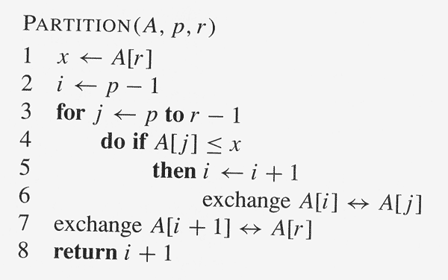
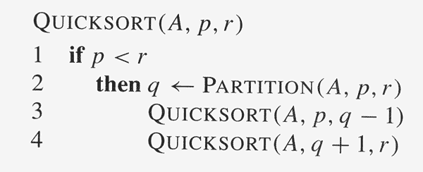
Expected Running Time of RANDOMIZED-QUICKSORT
Lemma 7.1: Let X be the number of comparisons performed in line 4 of PARTITION over the entire execution of QUICKSORT (or RANDOMIZED-QUICKSORT) on an n-element array. Then the running time of QUICKSORT (or RANDOMIZED-QUICKSORT) is O(n +X).
Proof: There are at most n calls to PARTITION (Why? Because the pivot is dropped from future recursive calls.). Each call to PARTITION does constant work and executes the for loop some number of iterations. Therefore, the total work done is O(n) + the total number of iterations of the for loop over the entire execution of QUICKSORT.
However, each iteration of the for loop performs the comparison of line 4 exactly once. Conclusion follows.

Slide 42
Hoare’s Original Partitioning Strategy
Do Prob. 7-1a

Slide 43
Sorting in Linear Time

Slide 44
Theorem 8.1: Any comparison sort algorithm requires Ω(n log n) comparisons in the
worst case.
Proof: The decision tree must have n! leaves, one corresponding to each possible
output. Moreover, the branching-factor of the tree is two, i.e., the tree is binary,
because each comparison gives one of two results.
The height of the decision tree is the number of comparisons made in the worst case.
Therefore, the minimum possible height of a binary tree with n! leaves is the number of
comparisons in the worst case.
Min. possible ht. = log (n!) = Θ(n logn) (using Stirling’s approximation).

Slide 45
COUNTING-SORT assumes that each of the input elements is an integer
in the range 0 to k, inclusive.
A [1..n] is the input array, B [1..n] is the output array, C [0..k] is a
temporary working array.

Slide 46
The running time of COUNTING-SORT is Θ(k+n) (why?), which is Θ(n) if k ≤ n.
Intuitively, explain why COUNTING-SORT can beat the lower bound of Ω(n logn)
for comparison sorts. Doesn’t it do comparisons as well…!?

Slide 47
A stable sort is one where items with the same value appear in the
same order in the output as they appeared in the input.
Lemma 8.3: Given n d-digit numbers in which each digit can take up to k possible
values, RADIX-SORT correctly sorts these numbers in Θ(d (n +k)) time.
Proof: COUNTING-SORT on each column * no. of columns
Is COUNTING-SORT stable?!!

Slide 48
BUCKET-SORT assumes each input element
A [i ] lies in 0 ≤ A [i ] < 1 (i.e., normalized).
A [1..n] is the input array, B [0..n-1] is an
auxiliary array of linked lists (=buckets).

Slide 49
Analysis of BUCKET-SORT
The running time is
T(n) = Θ(n) + ∑_{i=0..n-1} O(n_{i}²)
where n_{i} is the random variable representing the number of
elements in bucket B[i], because insertion sort is quadratic-time.
Therefore,
E[T(n)] = E[ Θ(n) + ∑_{i=0..n-1} O(n_{i}²) ] = Θ(n) + ∑_{i=0..n-1} E[O(n_{i}²)]
= Θ(n) + ∑_{i=0..n-1} O(E[n_{i}²])
Claim : E[n_{i}²] = 2 – 1/n
If the claim is proved:
E[T(n)] = Θ(n) + ∑_{i=0..n-1} O(2 – 1/n)
= Θ(n) + n * O(2 – 1/n)
= Θ(n)

Slide 50
To prove the claim E[n_{i}²] = 2 – 1/n, let the indicator variable
X_{ij} = I{A[j] falls in bucket i}
for i = 0, …, n-1 and j = 1, 2, …, n.
Therefore, n_{i} = ∑_{j=1..n} X_{ij} and
E[n_{i}²] = E[ (∑_{j=1..n} X_{ij})² ]
= ∑_{j=1..n} E[X_{ij}²] + ∑_{j=1..n} ∑_{k=1..n & k≠j} E[X_{ij} X_{ik}]
Now, X_{ij} is 1 with probability 1/n and 0 with probability 1 – 1/n.
Therefore,
E[X_{ij}²] = 1² * 1/n + 0² * (1 – 1/n) = 1/n
When k ≠ j, X_{ij} and X_{ik} and independent, so
E[X_{ij} X_{ik}] = E[X_{ij}] * E[X_{ik}] = 1/n * 1/n = 1/n²
Substituting above:
E[n_{i}²] = ∑_{j=1..n} 1/n + ∑_{j=1..n} ∑_{k=1..n & k≠j} 1/n²
= n * 1/n + n(n-1) 1/n²
= 1 + (n-1)/n = 2 – 1/n

Slide 51
Median and Order Statistics

Slide 52
Exactly n-1 comparisons are made by MINIMUM.
Is this best possible? Can the minimum element be
found with fewer than n-1 comparisons? Why?
How to find both the maximum and minimum of n
elements? Can one do better than separately
finding the maximum and minimum, which requires
2n-2 comparisons?

Slide 53
Selection in Worst-Case Linear Time
SELECT
Divide the n elements into floor(n/5) groups of 5 elements each and at most one more group of the remaining n mod 5 elements.
Find the median of each of the ceil(n/5) groups simply by sorting (e.g., insertion sort) and picking the middle element.
Use SELECT recursively to find the median x of the ceil(n/5) medians found in Step 2.
Partition the input array using the median-of-medians x as pivot. Let k be one more than the number of elements on the low side of the partition, so that x is the k th smallest element and there are n-k elements on the high side of the partition.
If i = k, return x. Otherwise, use SELECT recursively to find the i th smallest element on the low side if i < k, or the i-k th smallest element on the high side if i > k.

Slide 55
Hash Tables

Slide 56
Implementing a dictionary with a direct-address table
Size of table T = size of universe U !!
DIRECT-ADDRESS-SEARCH(T, k) return T[k]
DIRECT-ADDRESS-INSERT(T, x) T[ key[x] ] ← x
DIRECT-ADDRESS-DELETE(T, x) T[ key[x] ] ← NIL

Slide 57
Reducing the size of the table using a hash function to map keys to a hash table
collision!
h : U -> [0, 1, …, m-1]
Hash Table

Slide 58
Collision resolution by chaining
Load factor α = # elements in table n / # slots in table m
= average # elements in a chain
CHAINED-HASH-INSERT(T, x) insert x at the head of the list T[ h( key[x] ) ]
CHAINED-HASH-SEARCH(T, k) search for an element with key k in list T[ h(k) ]
CHAINED-HASH-DELETE(T, x) delete x from the list T[ h( key[x] ) ]
What are worst-case times?!

Slide 59
Simple uniform hashing means each element is equally likely to hash to any of the
m slots, independently of where any other element has hashed to.
Th. 11.1: In a hash table in which collisions are resolved by chaining, an
unsuccessful search takes expected time Θ(1+α), under the assumption of
simple uniform hashing.
Proof: For j = 0, 1, …, m-1, denote the length of the list T[j] by n_{j}.
Therefore, n = n₀ + n₁ + … + n_{m-1}.
Expected search time = time to compute h(k) + time to search to end of list
of expected length E[ n_{h(k)} ]
= Θ(1) + Θ(α)
= Θ(1+α)

Slide 60
Developing a Hash Function
Division method:
Key k goes to slot h(k) = k mod m
Avoid choosing m as power of 2, otherwise h(k) is just lower order bits of k (in binary representation), which may not be random
A good choice is a prime number not close to a power of 2. E.g., if n = 2000, and a load factor α about 3 is acceptable, then m = 701 is ok.

Slide 61
Multiplication method:
Fix a constant A in 0 < A < 1.
Then, h(k) = ⎣ m (kA mod 1) ) ⎦, i.e.,
I.e., multiply k by A, take the fractional part of k*A, then multiply m by this fractional part and take the floor
kA mod 1 =
fractional part of kA =
kA - ⎣kA⎦
In fact, m can be chosen arbitrarily in the multiplication method without randomness
being an issue. Efficient implementation is possible if m is a power of 2, say m = 2^{p},
and A = s/2^{w}, where w is the word size and 0 < s < 2^{w}. See Figure 11.4.
Book example: k = 123456, p =14, m = 2¹⁴ = 16384, w = 32, A = 2654435769/2³²,
(following Knuth’s suggestion of choosing A close to (√5 – 1)/2 = 0.6180339887… )
So, k*s = 327706022297664 = 76300*232 + 17612864, which means r₁ = 76300
and r₀ = 17612864. The 14 most significant bits of r₀ give h(k) = 67.

Slide 62
Red-Black Trees

Slide 63
Quick review of binary search trees (Ch. 12).
A red-black tree is a binary search tree with one extra bit of storage per node, the color, which can be RED or BLACK.
An RB tree, therefore, contains 5 fields per node: color, key and the left, right and parent pointers. NIL’s represent missing child or parent nodes.
NIL’s are considered leaves, other key-containing nodes are considered internal. Therefore, every internal node has 2 children.
A red-black tree must satisfy the following conditions:
Every node is either red or black.
The root is black.
Every leaf (NIL) is black.
If a node is red, then its children are black.
For each node, all paths from the node to descendant leaves contain the same number of black nodes.

Slide 64
Draw some binary search trees and
then try to color the nodes to make the tree RB.
Observe that the RB properties force
the tree to be nearly balanced.
Sentinel NIL node
The black-height of a node x, denoted
bh(x), is the number of black nodes,
not counting x itself, on a path from x
down to a leaf.
This is a valid defn. because of
Property 5.
The black-height of an RB tree is the
black-height of its root.

Slide 65
Lemma 13.1: An RB tree with n nodes has height at most 2log(n+1), in
particular, its height is O(log n).
Note: By an RB tree we mean the original tree minus NIL leaves. To calculate the black height of a node, however, we must count the contribution of black NIL ptrs.
Proof: We first prove by induction on height the following claim: the subtree
rooted at any node x contains at least 2^{bh(x)} – 1 nodes.
To start induction, observe that if ht(x) = 0 then x is a leaf, so bh(x) = 1.
And, indeed, the subtree rooted at x contains 2^{bh(x)} – 1 = 2¹ – 1 = 1 node.
For the inductive step, consider a node x with ht(x) > 0. Each child of x has
black-height either bh(x) or bh(x) – 1 (why?). Applying the inductive hypothesis,
the subtree rooted at each child of x has at least 2^{bh(x) – 1} – 1 nodes.
Therefore, the subtree rooted at x contains at least
(2^{bh(x) – 1} – 1) + (2^{bh(x) – 1} – 1) + 1 = 2^{bh(x)} – 1
nodes, proving the claim.
Next, let h be the height of the tree. According to Property 4 at least half the
nodes on a path from the root to the leaf, not including the root, must be black.
Therefore, bh(root) ≥ h/2. Using the claim proved above, the number of
nodes of the tree itself is
n ≥ 2^{bh(root)} – 1 ≥ 2^{h/2} – 1 ⇒ h ≤ 2log(n+1) ⇒ h = O(log n)
Therefore, TREE-SEARCH, TREE-MINIMUM, etc., operations that don’t modify the
structure of a binary search tree, take O(log n) time on an RB tree.
Exs. 13.1-1, 13.1-2

Slide 66
if left(y) ≠ nil(T) then

Slide 68
Ordinary binary search tree insert
Extra
lines of
code
+
NIL has
been
replaced
by nil(T)

Slide 70
Case 1: z has red uncle y.

Slide 71
Left rotation at A
Right rotation at C
y δ
y δ
y δ
Case 2: z has black uncle y, z is inside child.
Case 3: z has black uncle y, z is outside child.
Ques: What is the running time of RB-INSERT?
Ques: What is the maximum number of rotations that RB-INSERT can perform?

Slide 72
Ex. 13.3-2
Try inserting other
sequences of keys!

Slide 73
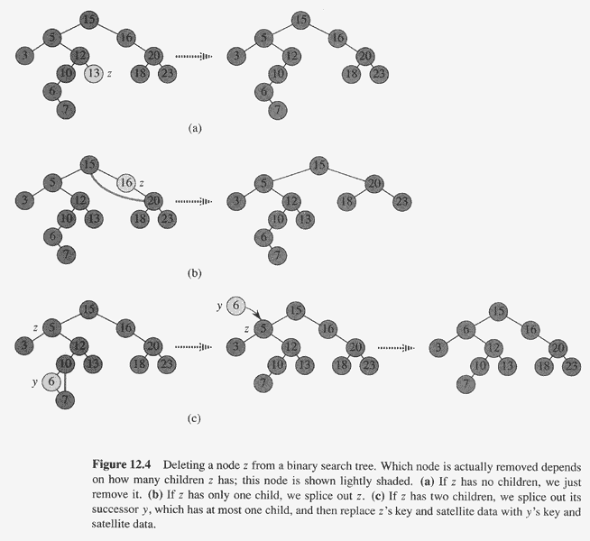
Ordinary binary search
tree delete

Slide 74
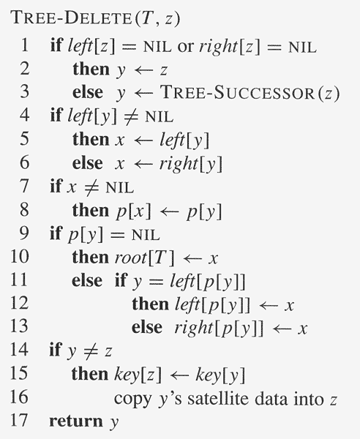
Ordinary binary search tree delete code

Slide 75
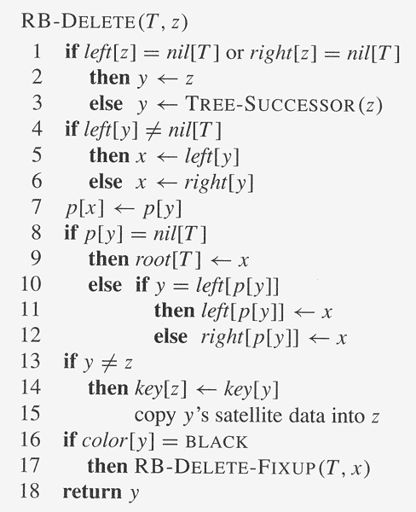
// change: no test if x ≠ nil[T ]!
// change!

Slide 76
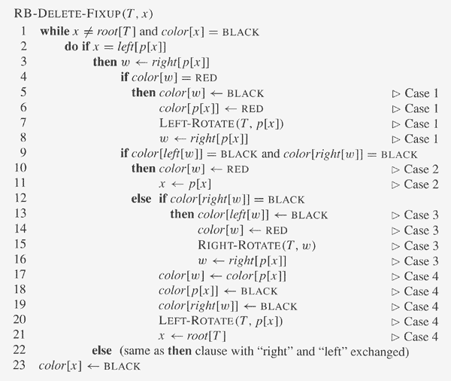

Slide 77
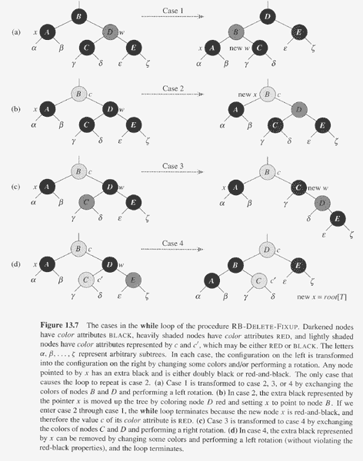

Slide 78
Ex. 15.2-1

Slide 79
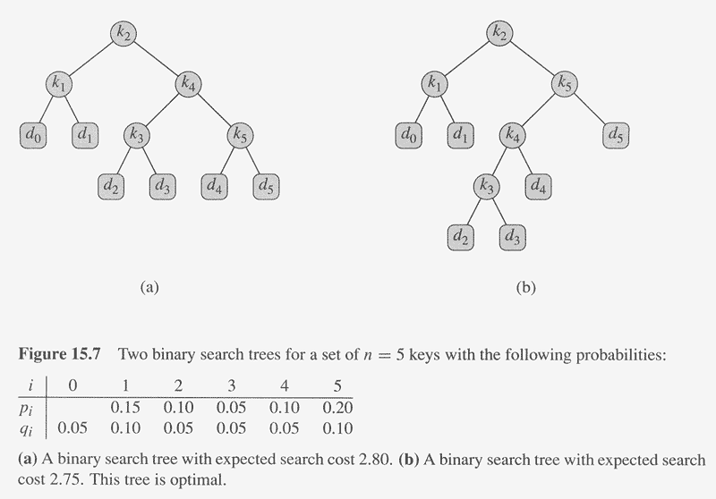
Optimal Binary Search Trees
0.1x1
0.15x2
0.1x2
0.05x3
0.2x3
0.05x3
0.1x3
0.05x4
0.05x4
0.05x4
0.1x4
Cost of node in red: total cost 2.80
k_{i} are keys, d_{i} are dummy values
representing “space between” keys k_{-i} and k_{i+1}.
Check the expected
search cost of the
two trees!
←probability of k_{i}
←probability of d_{i}

Slide 80
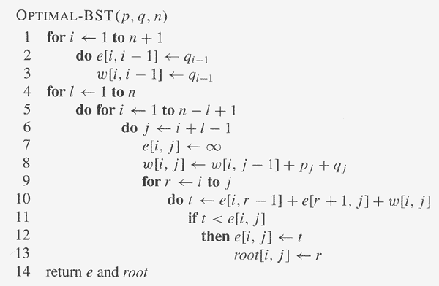

Slide 81
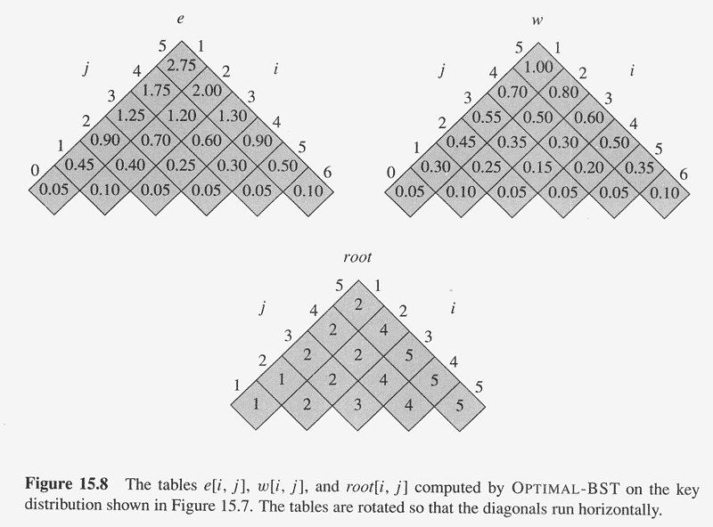

Slide 82
B-Trees

Slide 84
Disc rotation speed: 7200 RPM, typical
Arm movement: few ms.
Total access time for data on disc: 3-9 ms., typical
Versus access time in RAM: < 100 ns.
B-tree objective: to optimize disc access by using the full amount of
information retrieved per disc access, i.e., one page. So:
Size of 1 node of the B-tree = 1 page

Slide 86
Definition of B-trees
A B-tree T is a rooted tree (root = root[T]) have the properties.
Every node x has the following fields
n[x], the number of keys currently stored in node x.
The n[x] keys themselves, stored in non-decreasing order so that key₁[x] ≤ key₂[x]≤ … ≤ key_{n[x]}[x]
leaf[x], a boolean that is TRUE if x is a leaf and FALSE otherwise.
Each internal (=non-leaf) node contains n[x]+1 pointers c₁[x], c₂[x], …, c_{n[x]+1}[x] to children. Leaf nodes have no such ptrs.
The keys key_{i}[x] separate the ranges of keys stored in each subtree: if k_{i} is any key stored in the subtree with root c_{i}[x] then k₁ ≤ key₁[x] ≤ k₂ ≤ key₂[x] ≤ … ≤ key_{n[x]}[x] ≤ k_{n[x]+1}
All leaves have the same depth, which is the tree’s height h.
A fixed integer t ≥ 2 is called the minimum degree of the B-tree:
Every node other than the root must have at least t-1 keys. So, every internal node other than the root has at least t children. If the tree is non-empty the root must have at least one key.
Every node can contain at most 2t-1 keys. Therefore, an internal node can have at most 2t children. A node is said to be full if it contains 2t-1 keys.

Slide 87
Th. 18.1: If n ≥ 1, then for any n-key B-tree of height h and min degree
t ≥ 2, h ≤ log_{t} (n+1)/2.
Proof: At least 2 nodes at depth 1, at least 2t at depth 2, 2t² at depth 3,
…, 2t^{h-1} at depth h. Therefore,
n ≥ 1 + (t-1) ∑_{i=1..h} 2t^{i-1} = 1 + 2(t-1)(t^{h} -1)/(t-1) = 2t^{h} – 1 ⇒ h ≤ log_{t} (n+1)/2

Slide 88
Searching a B-tree

Slide 89
Creating an empty B-tree

Slide 90
Splitting a Full Node
Assumption is that parent is not full.
Will be justified!

Slide 91
Inserting into a B-tree

Slide 92
Always want to insert
into a leaf to avoid
having to create new
children for an internal
node (remember
no. of children = 1 +
no. of keys).

Slide 94
Deletion Strategy
Deletion strategy is a mirror-image of insertion.
Recall in insertion that before the new key k moves to the next node (in a downward pass starting just before the root), it checks to see if that node is full; if it is full, then the node is first split to make it non-full. This guarantees that when k finally reaches the target leaf node n, then it can be simply inserted because n will not be full.
For deletion, as we move downward searching for the key k to be deleted starting at the root, we check if the next node is minimal (= opposite of full = has t – 1 keys). If it is minimal, then the node is first made non-minimal:
If there is a non-minimal sibling then take a key and child ptr. from that sibling. (Case 3a)
x α x x
1. Move α down from the parent of c_{i}[x] to c_{i}[x].
2. Move β from the non-minimal sibling of c_{i}[x]
up to the parent to take the place of α.
3. Move the child ptr. next to β over to c_{i}[x].
Case 3a
x x x
β x x x
c_{i}[x] is minimal
Non-minimal sibling
Many child ptrs. not drawn to avoid clutter.

Slide 95
Deletion Strategy, cont.
If each sibling is minimal, then the node is merged with one sibling together with the separating key from the parent. (Case 3b)
x x α x x
Case 3b
x x x
x x x
x x x
Left sibling minimal
c_{i}[x] is minimal
Right sibling minimal
Merge
Many child ptrs. not drawn to avoid clutter.
1. Copy data (keys/ptrs) from one sibling (doesn’t matter which) to c_{i}[x].
2. Move the separating key α from the parent down to the median position in c_{i}[x] and
delete the pointer to the chosen sibling.
3. Delete the chosen sibling.
The above merges c_{i}[x] with its sibling and α.

Slide 96
Deletion Strategy, cont.
When we reach the node x which actually contains the key k to be deleted there are two possibilities:
x is a leaf: simply delete k . By previous step x is guaranteed to be non-minimal so k can indeed be deleted. (Case 1)
x is an internal node: we can’t simply delete k even if x is not minimal – we have to replace k with another key to separate the child of x before k and the child after k:
If the child y that precedes k is non-minimal, then the replacement k’ of k is chosen from the subtree rooted at y. Particularly, k’ is the greatest element of the subtree rooted at y. This replacement k’ is recursively deleted from its original location and put in place of k. (Case 2a)
x k x x
1. Delete k’ from its original position.
2. Replace k with k’.
Case 2a
x
x x x x
Non-minimal y
Subtree
rooted
at y
k’
= largest in subtree

Slide 97
Deletion Strategy, cont.
Otherwise, if the child z that follows k is non-minimal, then the replacement k’ of k is chosen from the subtree rooted at z. Particularly, k’ is the smallest element of the subtree rooted at z. This replacement k’ is recursively deleted from its original location and put in place of k. (Case 2b, symmetric to 2a)
x k x x
1. Delete k’ from its original position.
2. Replace k with k’.
x
Case 2b
x x x x
Non-minimal z
Subtree
rooted
at z
k’
= smallest in subtree

Slide 98
Deletion Strategy, cont.
Otherwise, if both the child y before k and the child z after k are minimal then merge them with k into one node, so that x loses a child, and then recursively delete k from the new non-minimal node. (Case 2c)
x x k x x
Case 2c
x
x x x
x x x
y is minimal
z is minimal
Merge
Many child ptrs. not drawn to avoid clutter.
1. Copy data (keys/ptrs) from z to y.
2. Move k from the parent down to the median position in y and delete the pointer to z.
3. Delete z.
The above merges y with z and k.
4. Delete k from the new y.

Slide 99
3

Slide 100
Single-Source Shortest Paths

Slide 101
The shortest-path weight from s to v is denoted δ(s,v)

Slide 102
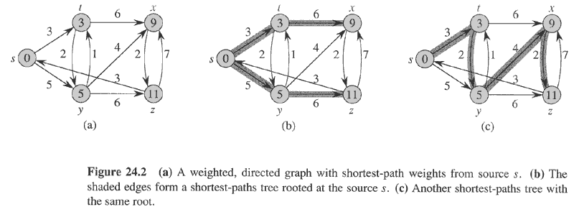

Slide 103
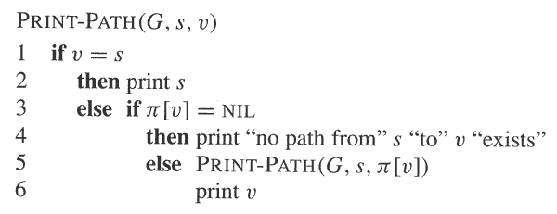
Π(v) is the predecessor of v in the shortest path to v
= parent in the shortest-paths tree

Slide 104
d [v] is the shortest path estimate to v. In fact, d [v] will
always be at least as long as the actual shortest path.

Slide 105
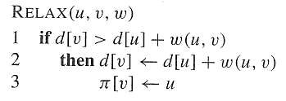

Slide 106
If there is no negative edge
weight cycle reachable from s
then Bellman-Ford returns TRUE
and d[v] = δ(s,v) for every vertex
v.
If there is a negative edge
weight cycle reachable from s
then Bellman-Ford returns
FALSE.
Running time: Θ(|V||E|)

Slide 108
Maximum Flow

Slide 109
A flow network G = (V, E) is a directed graph in which each edge (u,v) ∈ E
has a capacity c(u,v) ≥ 0. If (u,v) ∉ E, set c(u,v) = 0. Moreover, there are
two distinguished vertices, a source s and sink t, and we assume that every
vertex v lies on some path from s to t.
A flow in G is a real-valued function f : V x V → R satisfying:
Capacity constraint : For all u, v ∈V, f(u,v) ≤ c(u,v).
Skew symmetry : For all u, v ∈V, f(u,v) = – f(v,u).
Flow conservation : For all u ∈ V – {s, t}, ∑_{v∈V} f(u,v) = 0.
The value of the flow f is defined to be |f| = ∑_{v∈V} f(s,v).
The maximum flow problem is to find the flow of maximum value.

Slide 110
Let f be a flow in a flow network G = (V, E) with source s and sink t. The amount of additional flow we can push from a vertex u to a vertex v before exceeding the capacity c(u,v) is the residual capacity of (u, v) given by
c_{f}(u, v) = c(u, v) – f(u, v)
Given a flow f in flow network G = (V, E), the residual network of G induced by f is G_{f} = (V, E_{f}), where
E_{f} = {(u, v) ∈ V x V : c_{f}(u, v) > 0}
Each edge of the residual network is called a residual edge.

Slide 111
Given a flow f in a flow network G = (V, E), an augmenting path p is a simple path from source s to sink t in the residual network G_{f}.
The maximum amount by which we increase the flow on each edge in an augmenting path p is the residual capacity of p, given by
c_{f}(p) = min{c_{f}(u, v) : (u, v) is on p}

Slide 112
Lemma 26.3: Let G = (V, E) be a flow network, let f be a flow in G,
and let p be an augmenting path in G_{f}. Define a function
f_{p} : V x V → R by
c_{f}(p), if (u, v) is on p,
f_{p}(u, v) = –c_{f}(p), if (v, u) is on p,
0, otherwise.
Then f_{p} is a flow in G_{f} with value |f_{p}| = c_{f}(p) > 0.
Corollary 26.4: Let G = (V, E) be a flow network, let f be a flow in
G, and let p be an augmenting path in G_{f}. Let f_{p} be defined as
above. Define a function f’ : V x V → R by f’ = f + f_{p}. Then f’ is a
flow in G with value |f’| = |f| + |f_{p}| > |f|.
Proofs: Routine.

Slide 113
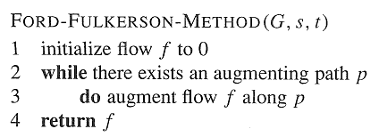

Slide 114
Ford-Fulkerson

Slide 116
Analysis of Ford-Fulkerson: Assume the capacities of all edges are integers. Then, a
straightforward implementation of Ford-Fulkerson takes O(E|f*|) time, where f* is the
maximum flow found by the algorithm:
Lines 1-3 take Ө(E) time.
The while loop of lines 4-8 is executed at most |f*| times since the value of the flow increases
by at least 1 at each iteration. Moreover, each iteration of the while loop takes O(E) time if
either depth-first or breadth-first search is used to find a path in the residual network.
Therefore, total time = O(E + E|f*|) = O(E|f*|).

Slide 117
Edmonds-Karp
Edmonds-Karp = Ford-Fulkerson using breadth-first search in
line 4 to find an augmenting path,
i.e., the augmenting path found is shortest in terms of the
number of edges.
Edmonds-Karp runs in O(VE²) time…

Slide 118
String Matching

Slide 119
Text is an array T[1..n] of length n of elements from a finite alphabet Σ.
Pattern P is an array P[1..m] of length m ≤ n of elements from Σ.
Pattern P occurs with shift s in text T if T[s+1..s+m] = P[1..m].
If P occurs with shift s in T, then s is a valid shift.
String matching problem : find all valid shifts.
Note: Valid shifts must be in the range 0 ≤ s ≤ n-m, so there are
n-m+1 possible different values of valid shifts.

Slide 120
Terminology:
The set of all finite-length strings using characters from an alphabet Σ is
denoted Σ*.
The length of a string x is denoted |x|.
The zero-length empty string is denoted ε.
The concatenation of two strings x and y is denoted xy.
A string w is a prefix of a string x, denoted † w ↓ x if x = wy, for some string
y ∈ Σ*.
A string w is a suffix of a string x, denoted † w ↑ x if x = yw, for some string
y ∈ Σ*.
Denote the k-character prefix P[1..k] of a string P[1..m] by P_{k}.
†Notation different from text.

Slide 121
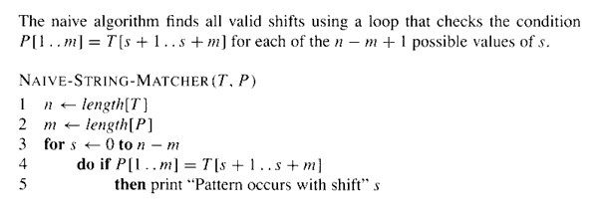
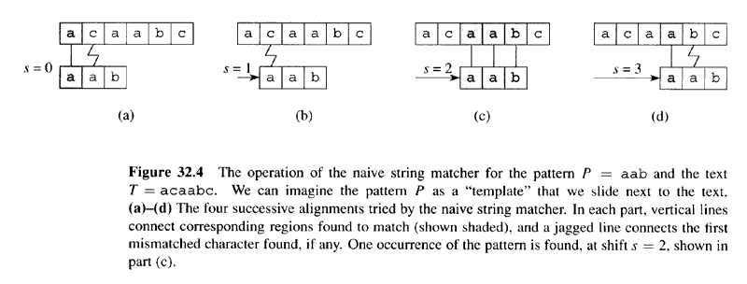
Time complexity: O( (n – m + 1)m )

Slide 122
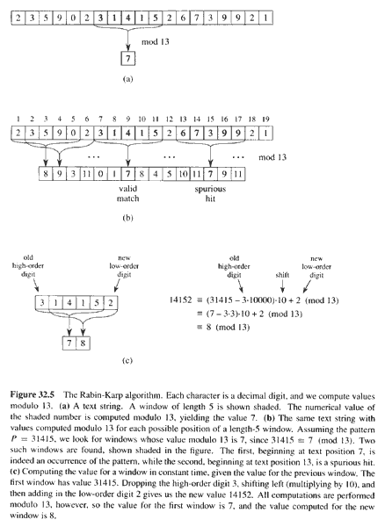
Text T =
Pattern P = 31415
31415 = 7 mod 13

Slide 123
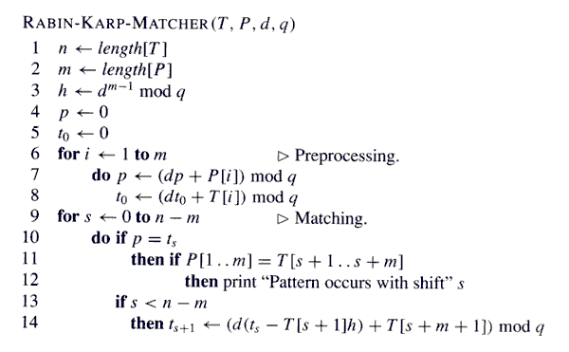
Horner’s method

Slide 124
Finite Automaton Review
A finite automaton M is a 5-tuple (Q, q₀, A, Σ, δ), where
Q is a finite set of states.
q₀ ∈ Q is the start state.
A ⊆ Q is a distinguished set of accepting states.
Σ is a finite input alphabet.
δ is a function from Q × Σ into Q called the transition function of M.
If M reads input character a when in state q, then it changes to state δ(q, a).
If its currents state q is in A, then M is said to accept the string read so far.
M induces a function ϕ: Σ* → Q, called the final-state function, such that ϕ(w) is the state of M after reading the string w. ϕ can be defined recursively as follows:
ϕ(ε) = q₀
ϕ(wa) = δ(ϕ(w), a)
Therefore, M accepts w if and only if ϕ(w) ∈ A.

Slide 125
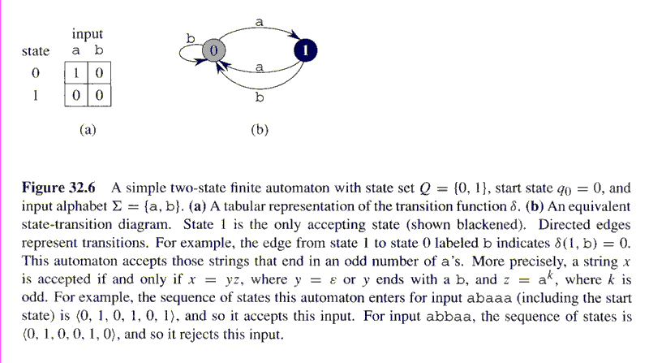

Slide 126
String Matching with Finite Automata
Strategy: Design a finite automaton that reads the text string character by character, going to an accept state only if the pattern P has just been seen. In other word, the automaton accepts strings with suffix P.
E.g., if the text is “abbbabcca” and the pattern “ab” we want the automaton to consume a, b, b , b, a, b, c, c, a and entering into an accept state only at the red b’s.
Exercise: Design an automaton as required by the strategy for the particular example above.

Slide 127
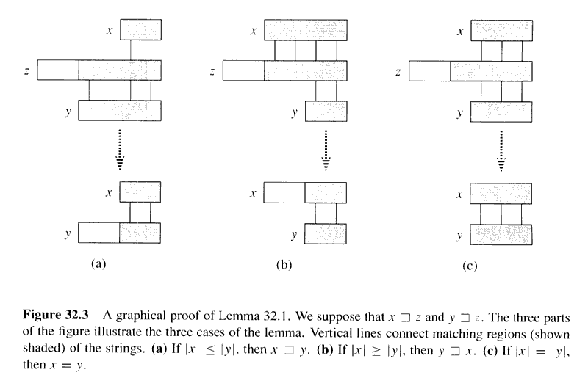
Lemma 32.1 (Overlapping Suffix Lemma)
Suppose that x, y and z are strings s.t. x ↑ z and y ↑ z. If |x| ≤ |y|,
then x ↑ y. If |x| ≥ |y|, then y ↑ x. If |x| = |y|, then x = y.
Proof: …

Slide 128
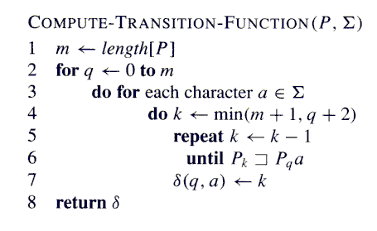
// O(m) time
// O(|Σ|) time
// O(m) time
// test O(m) time
Running time = preprocessing time for the
FA-matcher: O(m³|Σ|)
(this can be improved to O(m|Σ|))

Slide 129
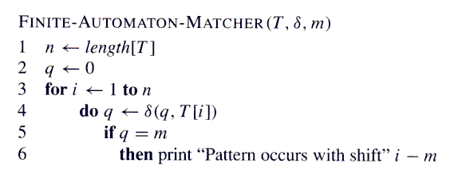
Running time (excluding preprocessing time to compute δ): Θ(n)

Slide 130
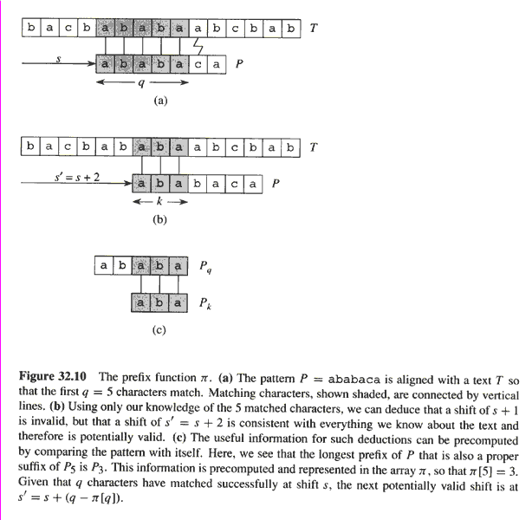
π(5) = 3 indicates that a shift of
+1 to the right cannot be valid;
however, +2 is potentially valid.

Slide 131
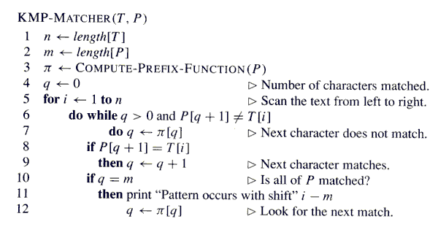
equivalent
Correctness follows from the fact that the KMP-MATCHER simulates
the FINITE-AUTOMATON-MATCHER.
Running time: Θ(n) (again by amortized analysis)

Slide 132
String Matching

Slide 133
Text is an array T[1..n] of length n of elements from a finite alphabet Σ.
Pattern P is an array P[1..m] of length m ≤ n of elements from Σ.
Pattern P occurs with shift s in text T if T[s+1..s+m] = P[1..m].
If P occurs with shift s in T, then s is a valid shift.
String matching problem : find all valid shifts.
Note: Valid shifts must be in the range 0 ≤ s ≤ n-m, so there are
n-m+1 possible different values of valid shifts.

Slide 134
Terminology:
The set of all finite-length strings using characters from an alphabet Σ is
denoted Σ*.
The length of a string x is denoted |x|.
The zero-length empty string is denoted ε.
The concatenation of two strings x and y is denoted xy.
A string w is a prefix of a string x, denoted † w ↓ x if x = wy, for some string
y ∈ Σ*.
A string w is a suffix of a string x, denoted † w ↑ x if x = yw, for some string
y ∈ Σ*.
Denote the k-character prefix P[1..k] of a string P[1..m] by P_{k}.
†Notation different from text.

Slide 135
Time complexity: O( (n – m + 1)m )

Slide 136
Rabin-Karp Strategy
Choose a hash function H:Σ* → integers.
Compute H( P[1..m] ).
For each successive s, from 0 to n-m:
Compute H( T[s+1..s+m] )
Compare H( T[s+1..s+m] ) with H( P[1..m] ).
If H( T[s+1..s+m] ) ≠ H( P[1..m] ), then T[s+1..s+m] ≠ P[1..m], so that there is no match.
If H( T[s+1..s+m] ) = H( P[1..m] ), then there is possibly a match (remember that the hash values of two different elements may collide!). In this case, explicitly check for a match T[s+1..s+m] = P[1..m] by comparing character by character as in the naïve matcher.
If H( T[s+1..s+m] ) = H( P[1..m] ) but T[s+1..s+m] ≠ P[1..m], then we are said to have a spurious hit.
Design goals for the hash function H:
It should be possible to compute H( T[s+2..s+m+1] ) from H( T[s+1..s+m] ) efficiently. I.e., starting from H( T[1..m] ) it should be possible to efficiently calculate the successive hash values H( T[2..m+1] ), H( T[3..m+2] ), …, each with the help of the previous one.
It should be possible to efficiently compare H( T[s+1..s+m] ) with
H( P[1..m] ) .

Slide 137
Example: Suppose Σ = {0, 1, …, 9}, the set of decimal digits. Define the hash function H:Σ* → integers by H(w) = decimal number represented by w.
E.g., if w = 23903, then H(w) = 23,903; if w = 02858, then H(w) = 2,858 (note that a decimal character string is simply a representation of an integer, but they are not the same thing).
Given a pattern P[1..m], the value H( P[1..m] ), call it p, can be computed via Horner’s rule:
p = P[m] + 10( P[m-1] + 10( P[m-2] + … + 10( P[2] + 10P[1] ) … ))
Let t_{s} denote the value H( T[s+1..s+m] ). Then, t₀ can be computed using Horner’s rule (as p above). Moreover, t_{s+1} can be computed from t_{s} using the recurrence:
t_{s+1} = 10(t_{s} – 10^{m-1}T[s+1]) + T[s+m+1] (32.1)
Efficiency: If the constant 10^{m-1} is pre-computed, and if 10^{m-1}, p and t_{s}, for all s, can each be contained in a single computer word, then each execution of the above equation takes a constant number of arithmetic operations and comparing p and t_{s} is a single word comparison operation as well.
Therefore, total time: Θ(n-m+1).
Question: Do we have to worry about spurious hits in this example?!

Slide 138
The assumption that 10^{m-1}, p and t_{s} fit into a single computer word is not always feasible.
Instead, computation is done mod a prime number q. The prime q is usually chosen so that 10q fits into a single word, in which case the operations involved in the modified recurrence (32.1)
t_{s+1} = ( 10(t_{s} – 10^{m-1}T[s+1]) + T[s+m+1] ) mod q
can each be executed as a one single-precision arithmetic operation.
However, spurious hits are now an issue and the worst case running time is Θ( n-m+1)m ), like the naïve matcher, because every valid shift has to be checked character by character, and there are potentially n-m+1 valid shifts.
In practice, though, we expect only a few (possibly constant number) of valid shifts, and only a few spurious hits (which also have to be verified character by character), in which case performance is much better than the worst case.

Slide 139
In general, if the alphabet Σ is of size d, then it is interpreted as
Σ = {0, 1, …, d-1} and a string in Σ* interpreted as a radix-d integer.
Correspondingly, (32.1) which was modified earlier to
t_{s+1} = ( 10(t_{s} – 10^{m-1}T[s+1]) + T[s+m+1] ) mod q
is modified now to:
t_{s+1} = ( d(t_{s} – T[s+1]h) + T[s+m+1] ) mod q (32.2)
(where h = d^{m-1} mod q)

Slide 140
Text T =
Pattern P = 31415
31415 = 7 mod 13

Slide 141
Horner’s method

Slide 142
Finite Automaton Review
A finite automaton M is a 5-tuple (Q, q₀, A, Σ, δ), where
Q is a finite set of states.
q₀ ∈ Q is the start state.
A ⊆ Q is a distinguished set of accepting states.
Σ is a finite input alphabet.
δ is a function from Q × Σ into Q called the transition function of M.
If M reads input character a when in state q, then it changes to state δ(q, a).
If its currents state q is in A, then M is said to accept the string read so far.
M induces a function ϕ: Σ* → Q, called the final-state function, such that ϕ(w) is the state of M after reading the string w. ϕ can be defined recursively as follows:
ϕ(ε) = q₀
ϕ(wa) = δ(ϕ(w), a)
Therefore, M accepts w if and only if ϕ(w) ∈ A.

Slide 144
String Matching with Finite Automata
Strategy: Design a finite automaton that reads the text string character by character, going to an accept state only if the pattern P has just been seen. In other word, the automaton accepts strings with suffix P.
E.g., if the text is “abbbabcca” and the pattern “ab” we want the automaton to consume a, b, b , b, a, b, c, c, a and entering into an accept state only at the red b’s.
Exercise: Design an automaton as required by the strategy for the particular example above.

Slide 145
Implementing the Strategy
For a pattern P[1..m] define a function σ: Σ* → {0, 1, …, m}, called the suffix function for P, such that σ(x) is the length of the longest prefix of P that is a suffix of x. I.e.,
σ(x) = max{k: P_{k} ↑ x}
Example: If the pattern is P = aba, then σ(ε) = 0, σ(abab) = 2, σ(abbaba) = 3. How about σ(ababb) and σ(bbba)?
For a pattern P[1..m] of length m, σ(x) = m if and only if P ↑ x, i.e., if and only if the pattern is at the end of x.
This leads to defining the string-matching automaton M corresponding to P[1..m] as follows:
State set Q = {0, 1, …, m}.
Start state q₀ is 0.
The only accepting state is m.
The transition function is defined by δ(q, a) = σ(P_{q}a).
Intuition: As M reads the string T =T[1]T[2]…T[n] character by character, it goes to state σ(T[1]T[2]…T[i]) after reading T[i] (Why? To be proved!). Therefore, if it is in the accepting state m after reading T[i], then the pattern P has just been seen.

Slide 146
The Floyd-Warshall Algorithm

Slide 147
All-Pairs Shortest Path Problem
Suppose we are given a directed graph G=(V,E) and a weight function w: E->R.
We assume that G does not contain cycles of weight 0 or less.
The All-Pairs Shortest Path Problem asks to find the length of the shortest path between any pair of vertices in G.

Slide 148
Quick Solutions
If the weight function is nonnegative for all edges, then we can use Dijkstra’s single source shortest path algorithm for all vertices to solve the problem.
This yields an O(n³) algorithm on graphs with n vertices (on dense graphs and with a simple implementation).

Slide 149
Quick Solution
For arbitrary weight functions, we can use the Bellman-Ford algorithm applied to all vertices. This yields an O(n⁴) algorithm for graphs with n vertices.

Slide 150
Floyd-Warshall
We will now investigate a dynamic programming solution that solved the problem in O(n³) time for a graph with n vertices.
This algorithm is known as the Floyd-Warshall algorithm, but it was apparently described earlier by Roy.

Slide 151
Representation of the Input
We assume that the input is represented by a weight matrix W= (w_{ij})_{i,j in E} that is defined by
w_{ij}= 0 if i=j
w_{ij}= w(i,j) if i≠j and (i,j) in E
w_{ij}= ∞ if i≠j and (i,j) not in E

Slide 152
Format of the Output
If the graph has n vertices, we return a distance matrix (d_{ij}), where d_{ij} the length of the path from i to j.

Slide 153
Intermediate Vertices
Without loss of generality, we will assume that V={1,2,…,n}, i.e., that the vertices of the graph are numbered from 1 to n.
Given a path p=(v₁, v₂,…, v_{m}) in the graph, we will call the vertices v_{k} with index k in {2,…,m-1} the intermediate vertices of p.

Slide 154
Key Definition
The key to the Floyd-Warshall algorithm is the following definition:
Let d_{ij}^{(k)} denote the length of the shortest path from i to j such that all intermediate vertices are contained in the set {1,…,k}.

Slide 155
Remark 2
Consider a shortest path p from i to j such that the intermediate vertices are from the set {1,…,k}.
If the vertex k is not an intermediate vertex on p, then d_{ij}^{(k)} = d_{ij}^{(k-1)}
If the vertex k is an intermediate vertex on p, then d_{ij}^{(k)} = d_{ik}^{(k-1)} + d_{kj}^{(k-1)}
Interestingly, in either case, the subpaths contain merely nodes from {1,…,k-1}.

Slide 156
Remark 2
Therefore, we can conclude that
d_{ij}^{(k)} = min{d_{ij}^{(k-1)} , d_{ik}^{(k-1)} + d_{kj}^{(k-1)}}

Slide 157
Recursive Formulation
If we do not use intermediate nodes, i.e., when k=0, then
d_{ij}⁽⁰⁾ = w_{ij}
If k>0, then
d_{ij}^{(k)} = min{d_{ij}^{(k-1)} , d_{ik}^{(k-1)} + d_{kj}^{(k-1)}}

Slide 158
The Floyd-Warshall Algorithm
Floyd-Warshall(W)
n = # of rows of W;
D⁽⁰⁾ = W;
for k = 1 to n do
for i = 1 to n do
for j = 1 to n do
d_{ij}^{(k)} = min{d_{ij}^{(k-1)} , d_{ik}^{(k-1)} + d_{kj}^{(k-1)}};
od;
od;
od;
return D^{(n)};

Slide 159
Reference: Introduction to Algorithm: By cormen PHI Publication
Algorithms_3rd Introduction to Algorithms, Third Edition
https://web.iiit.ac.in ›

