Slide 1
Diazotization
titration
(Nitrite Titration)
Dr Nisha Sharma

Slide 2
INTRODCTION
▪
The process of forming diazonium compounds or salts is
called diazotation, diazoniation, or diazotization
▪
Diazonium compounds or diazonium salts are a group
of organic compounds sharing a common functional group
with the characteristic structure of R-N2⁺
X⁻
where R can be
any organic residue such alkyl or aryl and X is an inorganic
or organic anion such as a halogen.

Slide 3
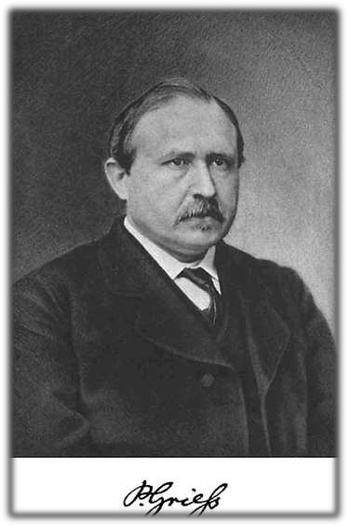
▪
The reaction was discovered by
Peter
Griess
in
1858,
who
subsequently discovered several
reactions of the new compound. This method is first used in the determination of dyes.

Slide 4

Diazonium
salts
have
been
developed
as important
intermediates in the organic synthesis of dyes

Diazotization
titrations
are
carried
out
for
the
estimation of drugs containing primary aromatic amino
group.

Several
drugs contain
either
primary
aromatic
amino
group or they can be converted to have such groups by
simple reaction like hydrolysis or reduction.

Slide 5
▪
An
primary
aromatic
amine
reacts
with
nitrous
acid
produced by the reaction of sodium nitrite in acidic medium
to form diazonium salt.
▪
The reaction is quantitative under the controlled conditions
of temp. (approx 15⁰C) and the end point can be detected
when a small quantity of excess nitrous acid present at
the
by
end
point
gives colour change
with
indicator
or
electromerically.
▪
It uses the titrant- Sodium Nitrite hence method is
Soduim Nitrite Titration / Nitrite Titration

Slide 6
CONDITION FOR DIAZOTIZATION
➢ RATE OF TITRATION

Different
amino
compound
react with
HONO
at
different rates
NaNO₂ added from the burette

needs time to react with
amino group accumulating
in the solution

Amines
are classified
as
rate
rapidly,
slowly
diazotisable
depending
compounds.
on
the
of
conversion
into
azo

Slide 7
▪
Slow diazotisable compounds include compounds that contain
sulpha
groups,
nitrous oxide
group,
or
carboxylic
group
in
aromatic ring or besides aromatic ring
▪
Eg: isomeric nitro aniline, sulphanilic acid and anthranilic acid
▪
Fast diazotisable compounds do not contain any substituent
group
other
than
amino
group but some
times
they
may
contain –CH3 or –OH group along with NH2 group.
Eg : aniline, toluidine and aminophenol
▪
▪
Adding KBr to the solution can increase the rate of titration.

Slide 8
➢
TEMPERATURE

The diazonium compounds formed are unstable and readily
decompose at elevated temperature

This can lead to side reaction and give wrong result .

To eliminate this problem, this titration is carried out at low
temperature (0-5⁰ C).

Optimum temperature for most amine is 10-15⁰ C, when they
form relatively stable diazo compounds.

Slide 9
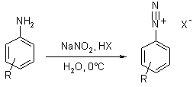
PRINCIPLE
 The first involved is addition of sodium nitrite to hydrochloric acid
cause formation of nitrous acid
^{NaNO}2 ^{+ HCl}
HONO + NaCl
 This nitrous acid diazotises the aromatic amino group
^{R − NH}2 ^{+ NaNO}2 ^{+ HCl}
R −
N⁺
≡ N − Cl⁻ + NaCl + ..

Slide 10
cont….
After the end point , excess nitrous acid formed is shown
▪
by
instant formation
KI + HCl
NaNO2 + HCl
2HI +2HONO
of
blue
colour with starch iodide paper.
HI+ KCl
HNO2 + NaCl
I₂↑ +2NO +2H₂O
▪
Starch iodide paper
is prepared by immersing a
filter paper
in starch mucilage and potassium iodide solution
▪
The iodine formed reacts with starch mucilage
blue colour.
to give the
I2 + Starch
blue color (end point)
▪
The end point can also be determined by dead stop end point
and potentiometric technique.

Slide 11

IMPORTANT NOTE
It is important to check the acidity at the end
of
in
the
the
titration.
solution,
If
there
is
no excess of
acid
present
detect
starch–iodide
paper
will
not
excess
HNO2 and so will not indicate the end point.

Slide 12
Method:
 Weigh accurately 0.5 g sulphonamide add to it 20 ml of
hydrochloric acid and 50 ml water, stirr, dissolve and cool to 15⁰c. Immerse the electrode in the solution and apply the voltage of about 50 mV.
 Place burette tip just below the solution to eliminate oxidation of
sodium nitrite. Stirr it gently & maintain the temp below 15⁰c.

Slide 13
• This
method is
suitable
for
most of the pharmacopoeial
sulphonamides
&
its
preparations
as
well
as
the
drugs
which
contains primary aromatic amines.
The reaction with sulphonamide can be shown as,
•

Slide 14
APPLICATIONS
 The first use of diazonium salts was to produce water-fast dyed fabrics.
 A more common process uses a paper coated with diazo.
 It is also applicable in nano technology.
 It is also used in the preparation of hydrocarbons, aryl halide, aryl
cyanide and aryl hydrazines.
 It is used in the assay of sulpha drugs like dapsone, sulphonamides,
sulphacetamide sodium, sulphadiazine, sulphamethazole, sulphadoxine, sulphamethoxazole & sulphaphenazone etc.
 It is also used in the assay of various drugs like benzocaine,
procainamide, procaine, suramin, sodium amino salicylate, primaquine sulphate etc.

