Slide 1
THE GIBBS-DONNAN EFFECT
By
Prof. Sudhir Kumar Awasthi
Dept. Of Life Sciences
CSJMU

Slide 2
Some ionic species can pass through the barrier while others cannot.
Solutions may be gels or colloids as well as solutions of electrolytes, and as such the phase boundary between gels, or a gel and a liquid, can also act as a selective barrier.
Electric potential arising between two such solutions is called the Donnan potential.
Effect named after the American physicist Josiah Willard Gibbs and the British chemist Frederick
G. Donnan.
Donnan effect is extra attributable to cations (Na⁺ dissolved plasma proteins.
osmotic pressure and K⁺) attached to

Slide 3
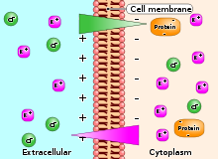

Slide 4
Presence of
a charged impermeant ion (for
example, a protein) on one side of a membrane will result in an asymmetric distribution of permeant charged ions.
Gibbs–Donnan equation at equilibrium (assuming permeant ions are Na⁺ and Cl⁻):
[Na_{Side 1}] × [Cl_{Side 1}] = [Na_{Side 2}] × [Cl_{Side 2}]
states
Start
Side 1: 9 Na, 9 Cl
Side 2: 9 Na, 9 Protein
Equilibrium
Side 1: 6 Na, 6 Cl
Side 2: 12 Na, 3 Cl, 9 Protein

Slide 5
Facilitated Diffusion
Also known as facilitated transport or passive- mediated transport.
It is the spontaneous passage of molecules or ions across a biological membrane passing through specific transmembrane integral proteins (as opposed to active transport).
May occur either across biological membranes or through aqueous compartments of an organism.
Polar molecules and charged ions are dissolved in water but they cannot diffuse freely across the plasma membrane due to the hydrophobic nature of the fatty acid tails of phospholipids that make up the lipid bilayers.

Slide 6
Only small
as oxygen can
nonpolar
molecules, such easily across the
diffuse
membrane.
All | polar molecules | are | transported
across | membranes by | proteins | that form
transmembrane channels.
These channels are gated so they can open and close, thus regulating the flow of ions or small polar molecules.
Larger molecules are transmembrane carrier
transported by proteins, such
as permeases that change their conformation as the molecules are carried through, for example glucose or amino acids.

Slide 7
Non-polar molecules, such as retinol or lipids are poorly soluble in water.
They are transported compartments of cells or
through aqueous through extracellular
space by water-soluble carriers as retinol binding protein.
Metabolites are not changed because no energy is required for facilitated diffusion.
Only permease changes its shape in order to transport the metabolites.
Form of transport through cell membrane which modifies its metabolites is the group translocation transportation.

Slide 8
examples of molecules and ions that must efficiently get across the plasma membrane but to which the lipid bilayer of the membrane is virtually impermeable.
Glucose, sodium ions and chloride ions are some
Various attempts have been made by engineers to mimic the process of facilitated transport in synthetic (i.e., non-biological) membranes for use in industrial-scale gas and liquid separations, but these have met with limited success to date, most often for reasons related to poor carrier stability and/or loss of carrier from the membrane.

Slide 9
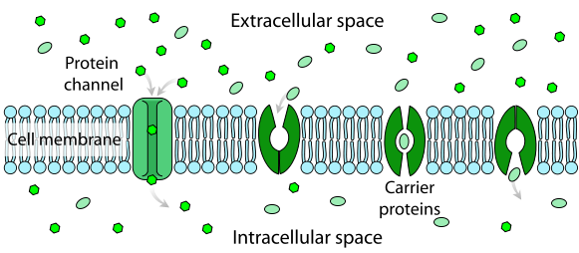

Slide 10
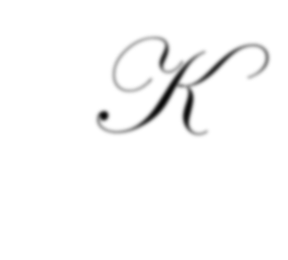
Kinetics of Diffusion
Fick's first law relates diffusive flux to the concentration under steady state conditions.
It postulates that the flux goes from regions of
high concentration concentration, with
to regions a magnitude
of low that is
proportional to the concentration gradient (spatial derivative).
In one (spatial) dimension, the law is:
J = - D ∂ϕ
∂x

Slide 11
Where:
J is the "diffusion flux" [(amount of substance) per unit area per unit time], example . J measures the amount of substance that will flow through a small area during a small time interval.
D is the diffusion coefficient or diffusivity in dimensions of [length² time⁻¹] or m²/s.
Φ (phi) (for ideal mixtures) is the concentration in dimensions of [amount of substance per unit volume] or mol/m³
x is the position [length] or m

Slide 12
D is proportional to the squared velocity of the diffusing particles, which depends on the temperature, viscosity of the fluid and the size of the particles according to the Stokes-Einstein relation.
In dilute aqueous solutions the diffusion coefficients of most ions are similar and have values that at room temperature are in the range
of 0.6x10⁻⁹ to 2x10⁻⁹ m²/s. For molecules the diffusion coefficients range from 10⁻¹¹ to 10⁻¹⁰ m²/s.
biological normally

Slide 13
In two or more dimensions we must use , the del or gradient operator, which generalises the first derivative, obtaining
J = - D ϕ
The driving force for the one-dimensional diffusion is the quantity - ∂ϕ
∂x
which for ideal mixtures is the concentration gradient.
In chemical systems other than ideal solutions or mixtures, the driving force for diffusion of each species is the gradient of chemical potential of this species.

Slide 14
J_{i} = Dc_{i} ∂µ_{i}
RT ∂x
Then Fick's first law (one-dimensional case) can be written as:
where the index i denotes the ith species, c is the concentration (mol/m³), R is the universal gas constant (J/(K mol)), T is the absolute temperature (K), and μ is the chemical potential (J/mol).

Slide 15
Fick's second law predicts how diffusion causes the concentration to change with time:
(delta) ∂ϕ = D ∂² ϕ
∂t ∂ x
where
ϕ is the concentration in dimensions of [(amount of substance) length⁻³], example mole/m³
t is time [s]
D is the diffusion coefficient in dimensions of [length² time⁻¹], example m²/s
x is the position [length], example m

Slide 16
Electrochemical gradient
A gradient of electrochemical potential, usually for an ion that can move across a membrane.
Gradient consist of two parts:
First, an electrical component caused by a charge difference across the lipid membrane.
Second, a chemical component caused by a difference in the chemical concentration across a membrane.
A combination of these two factors determines the thermodynamically favourable direction for an ion's movement across a membrane.

Slide 17
Difference of electrochemical potentials can be interpreted as a type of potential energy available for work in a cell.
An electrochemical gradient is analogous to the water pressure across a hydroelectric dam.
Membrane transport proteins such as the sodium-potassium pump within the membrane are equivalent to turbines that convert the water's potential energy to other forms of physical or chemical energy and the ions that pass through the membrane are equivalent to water that ends up at the bottom of the dam.

Slide 18
Also, energy can be used to pump water up into the lake above the dam.
In similar manner, chemical energy in cells can be used to create electrochemical gradients.
Einstein has shown that the relation between molecular movement and diffusion in a liquid may be expressed by the following equation, when the particles move independently of each other.
D = ∆²/ 2t …………. 1
‘D’ being the diffusion coefficient and ‘∆^{2’} the mean square of the deviation in a given direction in time ‘t’.

Slide 19
Further it is assumed that the particles possess the same kinetic energy as gas molecules at the same temperature, the following equation holds
∆² = 2RT . t ……….. 2
N C
where R is the universal gas constant, N is the Avagadro number, T is the absolute temperature and C is a constant which is called the frictional resistance of the molecule.
Hence, D = RT . 1 …………. 3
N C

Slide 20
Equations 2 and dissolved molecules
3 hold
equally good for
and particles of greater
dimensions.
For spherical molecules moving in a medium of
proportionately small molecules Stokes
has holds
shown that a hydrodynamic equation namely,
C = 6 πZr
where r is the radius of a diffusing particle and Z is the viscocity of the diffusion medium. By substituting in (3) we obtain for D the following relation.

Slide 21
D = RT . 1
N 6πZr
This is known as the Stokes-Einstein equation and is valid only when the aforesaid conditions are fulfilled.

Slide 22
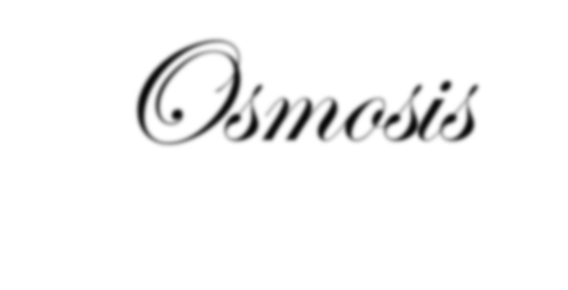
Osmosis
Net movement of solvent molecules through a partially permeable membrane into a region of higher solute concentration, in order to equalize the solute concentrations on the two sides.
or
A physical process in which any solvent moves, without input of energy, across a semipermeable membrane (permeable to the solvent, but not the solute) separating two solutions of different concentrations.

Slide 23
Net movement of
solvent is from the less
concentrated (hypotonic) to the more concentrated (hypertonic) solution, which tends to reduce the difference in concentrations.
This effect can be countered by increasing the pressure of the hypertonic solution, with respect to the hypotonic.
Osmotic pressure is defined as the pressure required to maintain an equilibrium, with no net movement of solvent.
Osmotic pressure is a colligative property, meaning that the osmotic pressure depends on the molar concentration of the solute but not on its identity.

Slide 24
Osmosis is essential in biological systems, as biological membranes are semipermeable.
In general, cell membranes are impermeable to large and polar molecules, such as ions, proteins, and polysaccharides, while being permeable to non-polar and/or hydrophobic molecules like lipids as well as to small molecules like oxygen, carbon dioxide, nitrogen, nitric oxide, etc.
Permeability depends on solubility, charge, or chemistry, as well as solute size.

Slide 25
Water molecules
travel
through the plasma
membrane, tonoplast
membrane (vacuole) or
protoplast by diffusing across the phospholipid bilayer via aquaporins (small transmembrane proteins similar to those in facilitated diffusion and in creating ion channels).
Osmosis provides the primary means by which water is transported into and out of cells.
The turgor maintained membrane,
pressure
of
a
cell
is largely
by osmosis, across between the cell interior
the cell and its
relatively hypotonic environment.

Slide 26
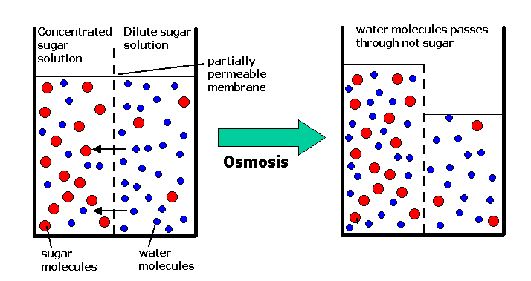

Slide 27
REFERENCES
Donnan membrane Principle ; Opportunities for sustainable engineered processes & materials by S. Sarkar, A.K. Singh Gupta (2016)
Biochemistry by Lubert Stryer (2015)
Biochemistry by Voet & Voet (2015)

