Slide 1
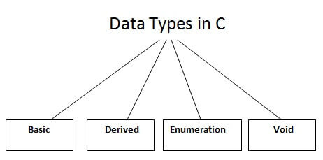
Data Types in C
A data type specifies the type of data that a variable can store such as integer, floating, character, etc.

Slide 2
There are the following data types in C language.
Types | Data Types
Basic Data Type | int, char, float, double
Derived Data Type | array, pointer, structure, union
Enumeration Data Type | enum
Void Data Type | void

Slide 3
Basic Data Types
The basic data types are integer-based and floating-point based. C language supports both signed and unsigned literals.
The memory size of the basic data types may change according to 32 or 64-bit operating system.
Let's see the basic data types. Its size is given according to 32-bit architecture.

Slide 4
Data Types | Memory Size | Range
char | 1 byte | −128 to 127
signed char | 1 byte | −128 to 127
unsigned char | 1 byte | 0 to 255
short | 2 byte | −32,768 to 32,767
signed short | 2 byte | −32,768 to 32,767
unsigned short | 2 byte | 0 to 65,535
int | 2 byte | −32,768 to 32,767
signed int | 2 byte | −32,768 to 32,767
unsigned int | 2 byte | 0 to 65,535

Slide 5
short int | 2 byte | −32,768 to 32,767
signed short int | 2 byte | −32,768 to 32,767
unsigned short int | 2 byte | 0 to 65,535
long int | 4 byte | -2,147,483,648 to 2,147,483,647
signed long int | 4 byte | -2,147,483,648 to 2,147,483,647
unsigned long int | 4 byte | 0 to 4,294,967,295
float | 4 byte
double | 8 byte
long double | 10 byte

Slide 6
Keywords in C
A keyword is a reserved word. You cannot use it as a variable name, constant name, etc. There are only 32 reserved words (keywords) in the C language.
A list of 32 keywords in the c language is given below:
auto | break | case | char | const | continue | default | do
double | else | enum | extern | float | for | goto | if
int | long | register | return | short | signed | sizeof | static
struct | switch | typedef | union | unsigned | void | volatile | while

Slide 7
C Identifiers
C identifiers represent the name in the C program, for example, variables, functions, arrays, structures, unions, labels, etc.
An identifier can be composed of letters such as uppercase, lowercase letters, underscore, digits, but the starting letter should be either an alphabet or an underscore. If the identifier is not used in the external linkage, then it is called as an internal identifier.
If the identifier is used in the external linkage, then it is called as an external identifier.
We can say that an identifier is a collection of alphanumeric characters that begins either with an alphabetical character or an underscore, which are used to represent various programming elements such as variables, functions, arrays, structures, unions, labels, etc. There are 52 alphabetical characters (uppercase and lowercase), underscore character, and ten numerical digits (0-9) that represent the identifiers. There is a total of 63 alphanumerical characters that represent the identifiers.

Slide 8
Rules for constructing C identifiers
The first character of an identifier should be either an alphabet or an underscore, and then it can be followed by any of the character, digit, or underscore.
It should not begin with any numerical digit.
In identifiers, both uppercase and lowercase letters are distinct. Therefore, we can say that identifiers are case sensitive.
Commas or blank spaces cannot be specified within an identifier.
Keywords cannot be represented as an identifier.
The length of the identifiers should not be more than 31 characters.
Identifiers should be written in such a way that it is meaningful, short, and easy to read.

