Slide 1
DESCRIPTIVE RESEARCH

Slide 2
INTRODUCTION

Slide 6
General Principles of surveys

Slide 7
Design of survey

Slide 8
Prospective designs

Slide 9
Retrospective design

Slide 10
TYPES OF ITEMS

Slide 11
OPEN FORMAT ITEMS

Slide 12
CLOSED FORMAT ITEMS

Slide 13
Multiple choice

Slide 14
Likert- type

Slide 15
Semantic differential

Slide 16
Q-sort

Slide 18
Implementation overview

Slide 19
Mailed questionnaires

Slide 20
Access to a sampling frame

Slide 21
Questionnaire development

Slide 22
Drafting

Slide 25
Expert review

Slide 26
First revision

Slide 27
Pilot test

Slide 28
Final revision

Slide 29
Motivating prospect to respond

Slide 30
Implementation details

Slide 31
Interviews

Slide 32
Types of interviews

Slide 33
STRUCTURED INTERVIEW

Slide 34
SEMISTRUCTURED INTERVIEWS

Slide 35
UNSTRUCTURED INTERVIEW

Slide 36
Development of interview schedules

Slide 37
Motivating prospects to participate

Slide 38
Implementation details

Slide 39
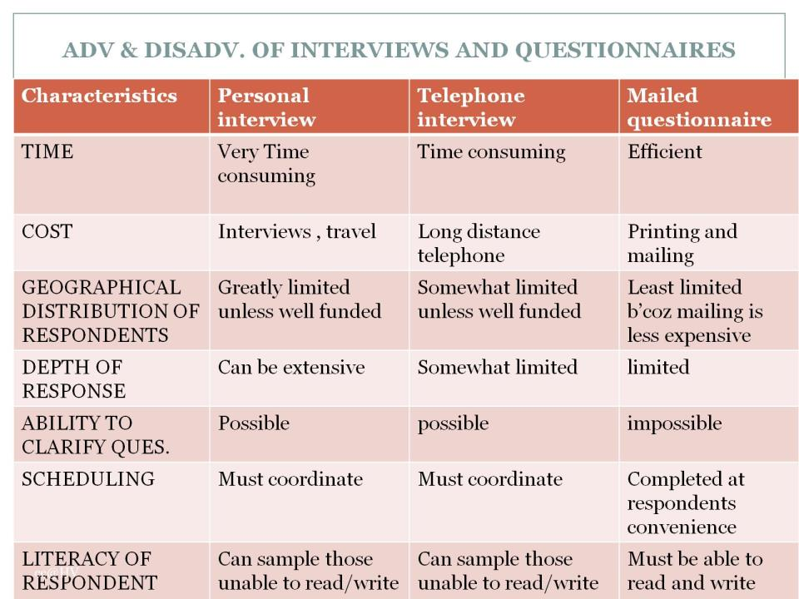
ADV & DISADV. OF INTERVIEWS AND QUESTIONNAIRES

Slide 40
References

