Slide 1
ELASTICITY & SPRINGS
BY:
DR. DIGVIJAY SHARMA
DIRECTOR
SCHOOL OF HEALTH SCIENCES, CSJMU

Slide 2
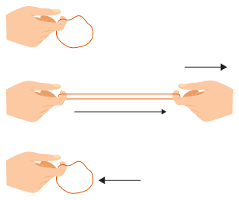
ELASTICITY
It is the property of a body which enables it to regain its original form after it has been distorted by the application of a force

Slide 3
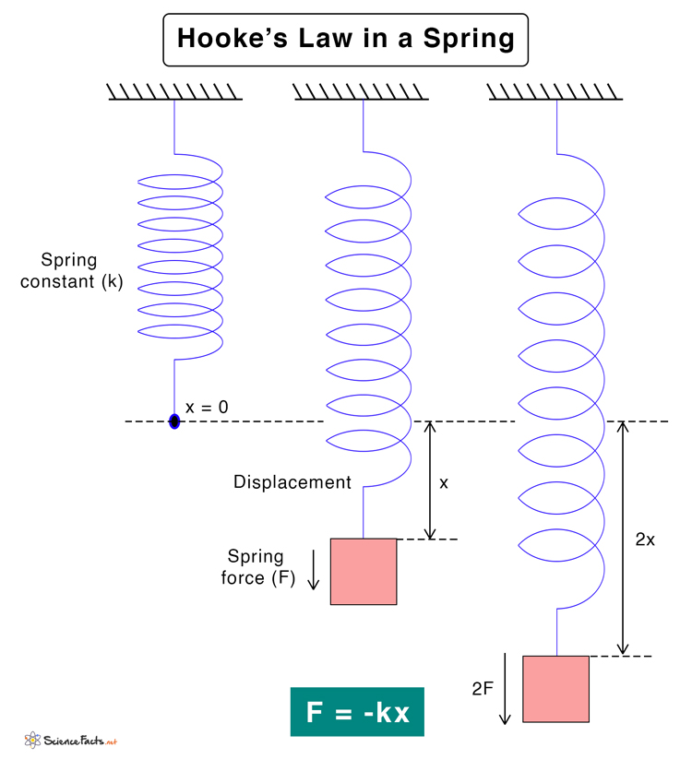
HOOKE’S LAW
Hooke’s law states that the strain is proportional to the stress producing it
Springs, rubber, elastic and sorbo rubber all posses the property of elasticity and are commonly used in physiotherapy

Slide 4
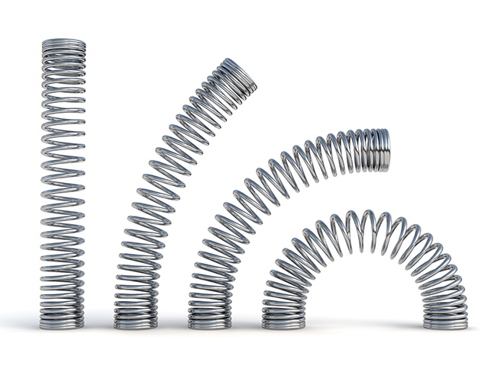
SPRINGS
It consists of uniform coil of wire which is extensible
Springs are used to resist or assist the muscle contraction or to produce passive movement of joints

Slide 5
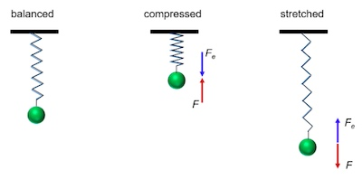
EXTENSIBILITY
A spring can be elongated by a force applied at one end while the other end is fixed
Increase in the length of spring is directly proportional to the applied force

Slide 6
WEIGHT
Standard springs which are used are still graded in pounds such as 50 lbs, 40lbs, 20lbs, etc. which is determined by material and thickness of wire from which it is made and the average diameter of its coils

Slide 7
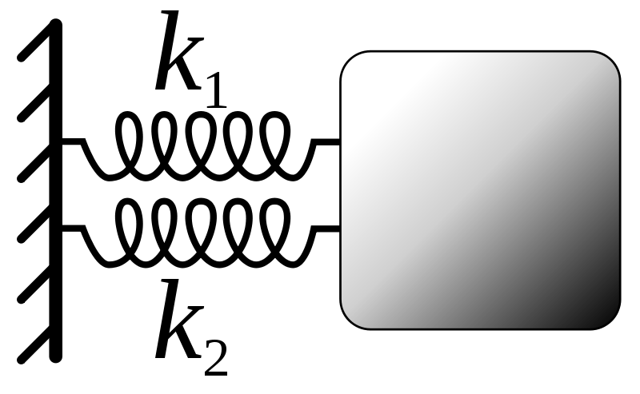
SPRINGS IN PARALLEL
When two springs are arranged side by side attached to the same point in parallel, the weight of the resistance will be the same of the two
Example: two 40 lbs springs arranged in parallel are equal to single 80 lbs spring

Slide 8
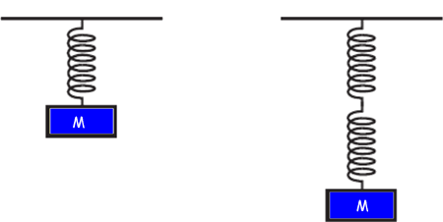
SPRINGS IN SERIES
When two springs are joined end to end as in series, is the same as that of single spring but the amount by which they must be in order to reach the limit of extension is double that required for a single spring
Example: If two 10 lbs springs are attached end to end the resistance offered will be 10 lbs only

Slide 9
RUBBER ELASTIC
Rubber elastic of different thickness may be used in Physiotherapy for providing right assistance or resistance

Slide 10
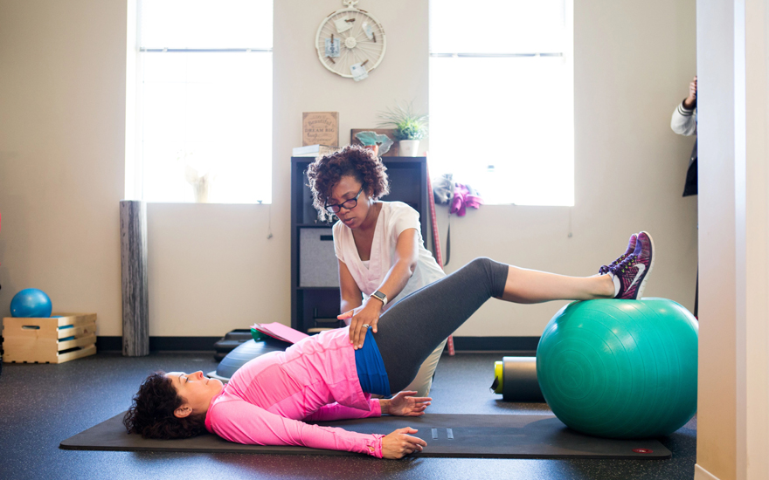
SORBO RUBBER
This material is both compressible and extensible and is useful for providing right resistance for gripping movements of the hand

