Slide 1
ELECTROSTATIC-II Gauss’s law and its application
Er.Somesh Kr Malhotra
Assistant Professor
ECE Department,UIET

Slide 2
Electric flux density
Electric flux density is a measure of the strength of an electric field generated by a free electric charge, corresponding to the number of electric lines of force passing through a given area. Electric flux density is the amount of flux passing through a defined area that is perpendicular to the direction of the flux.
Mathematically

Slide 3
Electric Flux
Electric flux is the rate of flow of the electric field through a given area Electric flux is proportional to the number of electric field lines going through a virtual surface.
Mathematically

Slide 4
Example

Slide 5
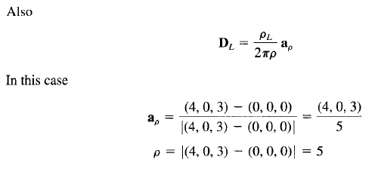
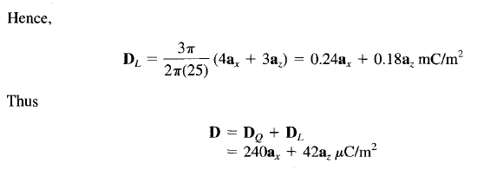
Example

Slide 6
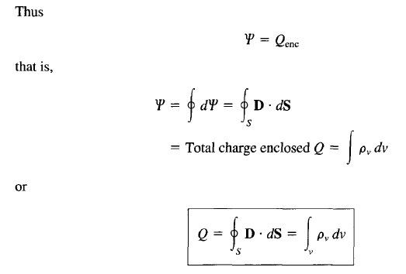
Gauss’s Law

Slide 7
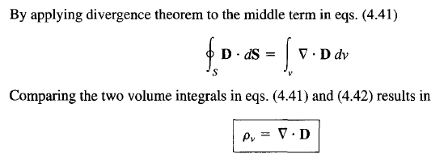
Gauss’s Law

Slide 8
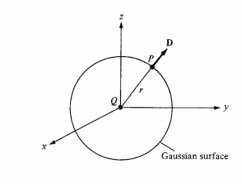
Application of Gauss Law
Point Charge
Suppose a point charge Q is located at the origin. To determine D at a point P, it is easy to see that choosing a spherical Gaussian surface containing P will satisfy symmetry conditions as shown in fig.

Slide 9
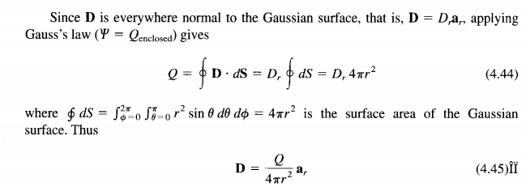
Point Charge

Slide 10
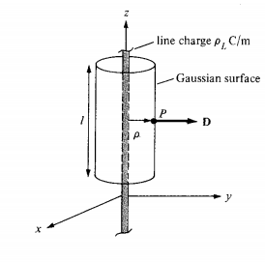
INFINITE Line Charge
Suppose the infinite line of uniform charge pL C/m lies along the z-axis. To determine D at a point P, we choose a cylindrical Gaussian surface containing P to satisfy symmetry condition as shown in Figure . D is constant on and normal to the cylindrical Gaussian surface

Slide 11
Infinite Line Charge

Slide 12
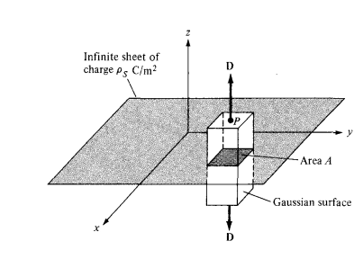
INFINITE Sheet Charge

Slide 13
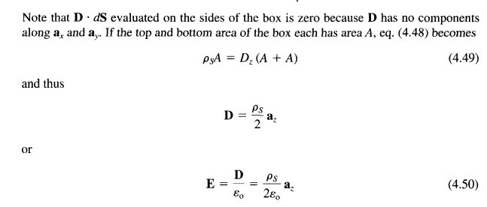
INFINITE Sheet Charge
Above eq. become

