Slide 1
ELECTROSTATIC-III Gauss’s law and its application
Er.Somesh Kr Malhotra
Assistant Professor
ECE Department,UIET

Slide 2
Electric flux density
Electric flux density is a measure of the strength of an electric field generated by a free electric charge, corresponding to the number of electric lines of force passing through a given area. Electric flux density is the amount of flux passing through a defined area that is perpendicular to the direction of the flux.
Mathematically

Slide 3
Electric Flux
Electric flux is the rate of flow of the electric field through a given area Electric flux is proportional to the number of electric field lines going through a virtual surface.
Mathematically

Slide 4
Example

Slide 5
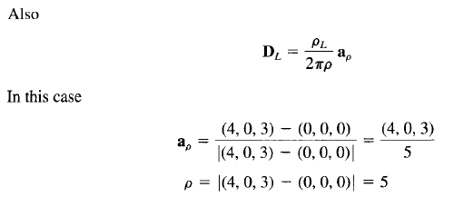
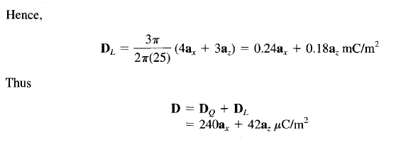
Example

Slide 6
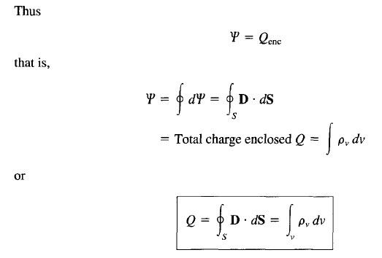
Gauss’s Law

Slide 7
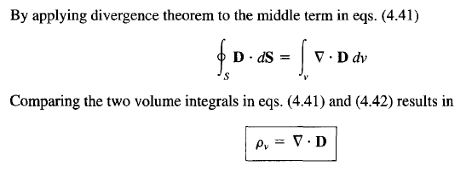
Gauss’s Law

Slide 8
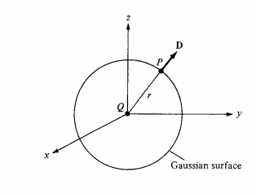
Application of Gauss Law
Point Charge
Suppose a point charge Q is located at the origin. To determine D at a point P, it is easy to see that choosing a spherical Gaussian surface containing P will satisfy symmetry conditions as shown in fig.

Slide 9
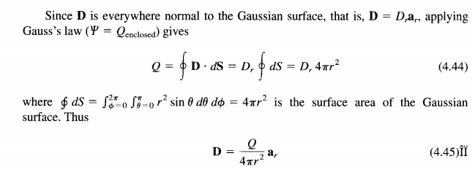
Point Charge

Slide 10
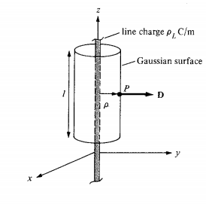
INFINITE Line Charge
Suppose the infinite line of uniform charge pL C/m lies along the z-axis. To determine D at a point P, we choose a cylindrical Gaussian surface containing P to satisfy symmetry condition as shown in Figure . D is constant on and normal to the cylindrical Gaussian surface

Slide 11
Infinite Line Charge

Slide 12
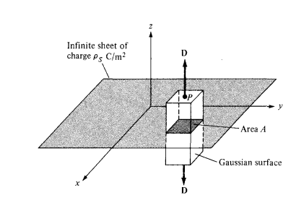
INFINITE Sheet Charge

Slide 13
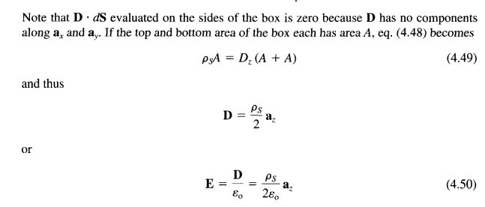
INFINITE Sheet Charge
Above eq. become

Slide 14
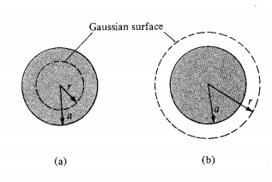
Uniformly charged sphere
Consider a sphere of radius a with a uniform charge
To determine D everywhere, we construct Gaussian surfaces for eases r < a and r > a separately.
Since the charge has spherical symmetry, it is obvious that a spherical surface is an appropriate Gaussian surface

Slide 15
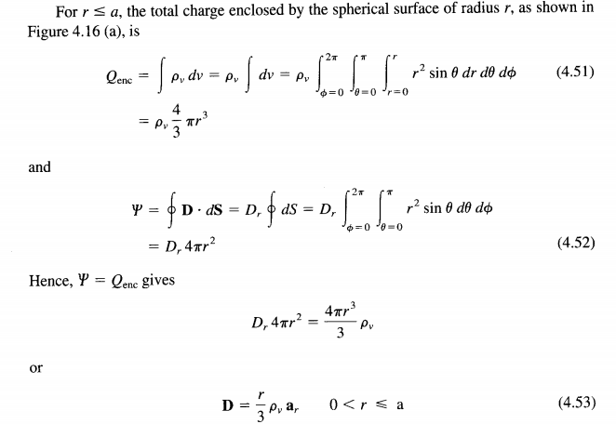
Uniformly charged sphere

Slide 16
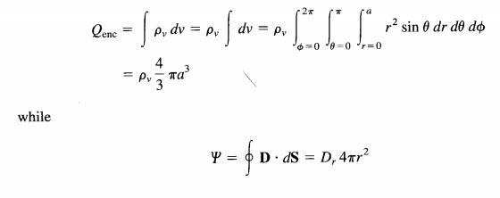
Uniformly charged sphere
For r > a, the Gaussian surface is shown in Figure(b). The charge enclosed by the surface is the entire charge in this case, that is,

Slide 17
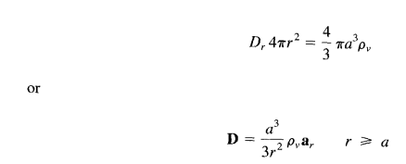
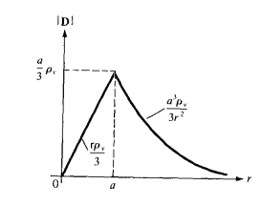
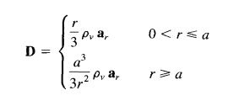
Uniformly charged sphere

Slide 18
Example 1

Slide 19
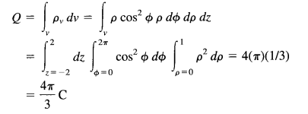
Example 1

Slide 20
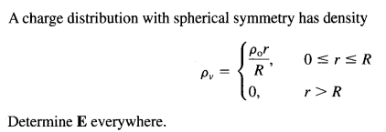
Example 2
Solution: By gauss’s Law

Slide 21
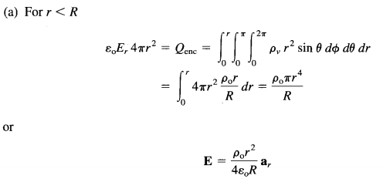
Example 2

Slide 22
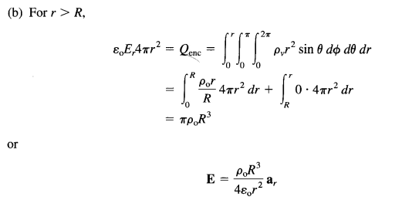
Example 2

Slide 23
Electric potential
Suppose we wish to move a point charge Q from point A to point B in an electric field E
. From Coulomb's law, the force on Q is F = QE so that the work done in displacing the charge by d\ is
The negative sign indicates that the work is being done by an external agent. Thus the total work done, or the potential energy required, in moving Q from A to B is

Slide 24
Electric potential
Dividing W by Q gives the potential energy per unit charge. This quantity, denoted by VAB, is known as the potential difference between points A and B. Thus
Note that
In determining VAB, A is the initial point while B is the final point.
If VAB is negative, there is a loss in potential energy in moving Q from A to B; this implies that the work is being done by the field. However, if VAB is positive, there is a gain in potential energy in the movement; an external agent performs the work.

Slide 25
Electric potential
VAB is independent of the path taken
VAB is measured in joules per coulomb, commonly referred to as volts (V).

Slide 26
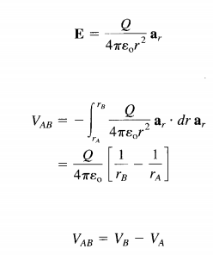
Electric potential for point charge
E field due to a point charge Q located at the origin, then
Potential difference of two points due to this point charge will be

Slide 27
Superposition principle
The superposition principle, which we applied to electric fields, applies to potentials. For n point charges Q1 Q2,. • • ,Qn located at points with position vectors r1 b r2,. . ., rn, the potential at r is

Slide 28
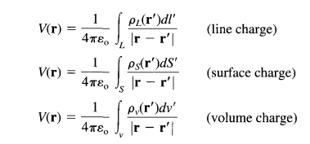
Potential for continuous charge distribution

Slide 29
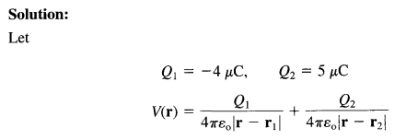
Example
Two point charges - 4 uC and 5 uC are located at ( 2 , - 1 , 3) and (0, 4, -2), respectively. Find the potential at (1, 0, 1) assuming zero potential at infinity.

Slide 30
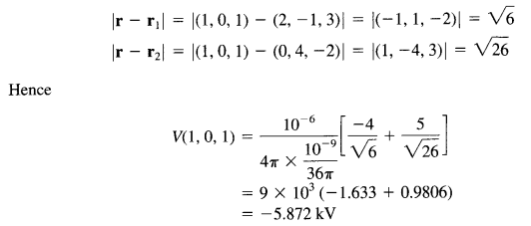
Example

Slide 31
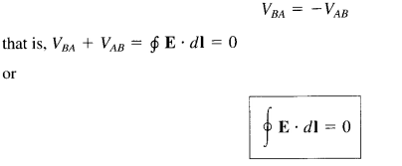
Relation between E and V
the potential difference between points A and B is independent of the path taken. Hence,

Slide 32
Relation between E and V
This shows that the line integral of E along a closed path must be zero. Physically, this implies that no net work is done in moving a charge along a closed path in an electrostatic field. Applying Stokes's theorem to eq. gives

Slide 33
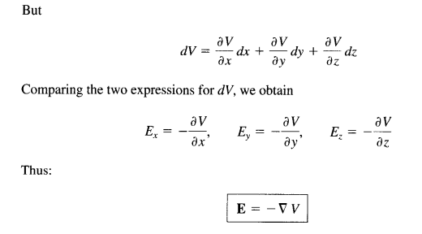
Relation between E and V

Slide 34
Relation between E and V
that is, the electric field intensity is the gradient of V. The negative sign shows that the direction of E is opposite to the direction in which V increases; E is directed from higher to lower levels of V.

Slide 35
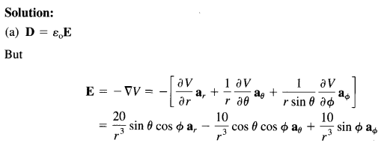
Example

Slide 36
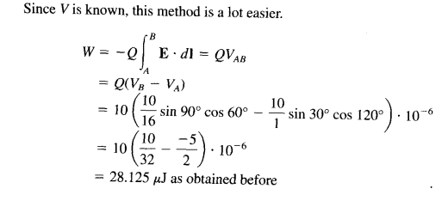
Example

