Slide 1
PHILOSOPHICAL PERSPECTIVES OF EDUCATION Mr. S.C. Patel Asst. Prof. Department of Education, C.S.J.M. University Kanpur

Slide 2
Power Point Presentation
On
EDUCATION : MEANING, NATURE AND SCOPE OF EDUCATION

Slide 3
PHILOSOPHY
EDUCATION MEANING, NATURE AND
SCOPE OF EDUCATION

Slide 4
Meaning of Education
“Education is that process of development which consists the passage of human being from infancy to maturity, the process whereby he adapts himself gradually in various ways to his physical and spiritual environment.”
– T. Raymont

Slide 5
The word ‘Education’ has been
interpreted in various ways. The
following are the different
interpretations given to
education-

Slide 6
1. Educatum – To train, Act of teaching or training.
Educere – To lead out, To draw out
Educare – To bring up, To raise, To educate

Slide 7
The Latin word
‘Educatum’ means to train.
‘E’ means from inside and
‘Duco’ means to draw out, to Lead out or to bring up.

Slide 8
To combine the two we come to mean as to draw from within.
Each child is born with some innate tendencies , Capacities and inherent powers. Education is to draw out these powers out and develop them to full.

Slide 9
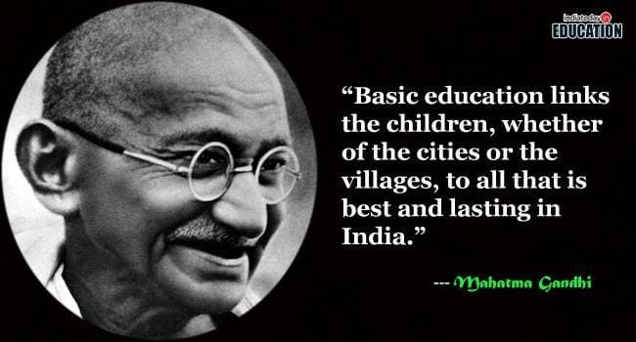
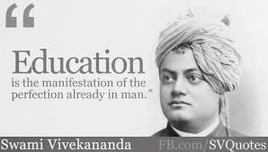
DEFINITION OF EDUCATION ACCORDING TO INDIAN PHILOSOPHERS

Slide 10
Meaning of Education according to Shankracharya
“Sa vidya ya vimuktaye”
(Education is what emancipates)
- Shankar

Slide 11
Meaning of Education according to Swami Vivekanand
“Education “Education is manifestation of perfection
already present in man.”
- Swami Vivekanand

Slide 12
Meaning of Education according to Mahatma Gandhi
“By education I mean an all-round drawing out of
the best in child and man – body, mind and spirit.”
- Mahatma Gandhi

Slide 13
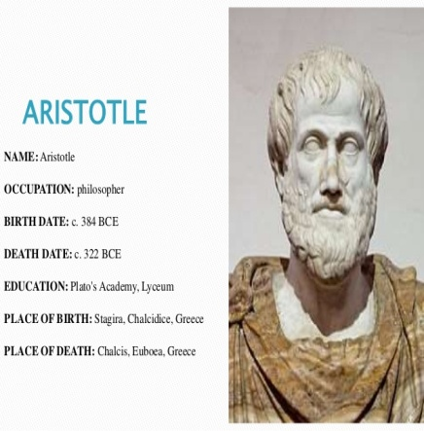
DEFINITION OF EDUCATION ACCORDING TO WESTERN PHILOSOPHERS

Slide 14
Meaning of Education according to Plato
“Education consists in giving to the body and
soul all the perfection to which they are susceptible.”
- Plato

Slide 15
Meaning of Education according to Materialistic Philosophers
“Education is what enables man to lead a happy life.”
- Materialistic philosophers

Slide 16
Meaning of Education according to Aristotle
“Education is the creation of a sound mind in a
sound body.”
- Aristotle

Slide 17
Meaning of Education according to Spencer
“Education means establishment of
coordination between the
Inherent powers and the outer life.”
- Herbert Spencer

Slide 18
Meaning of Education according to John Dewey
“Education is the development of all those capacities in the individual which will enable him to control his environment and fulfill his possibilities.”
- John Dewey

Slide 19
Narrower and Wider Education
Narrower Education | Wider Education
“In narrow sense, education may be taken to mean any consciously directed effort to develop and cultivate our powers.” - S.S. Mackenzi | “In the wider sense, it is a process that goes on throughout life, and is promoted by almost every experience in life.” - S.S. Mackenzi

Slide 20
Narrower Education | Wider Education
“Education is a process in which and by which knowledge, character and behaviour of the young are shaped and moulded .” - Prof. Drever | “By education , I mean the all round drawing out of the best in child and man – body, mind and soul .” – M.K. Gandhi

Slide 21
Narrower Education | Wider Education
“The influence of the environment on the individual with a view to producing a permanent change in his habits of behaviour, of thought and attitude .” – G.H. Thompson | “Education in its widest sense includes all the influences which act upon an individual during his passage from cradle to the grave.” - Dumvile

Slide 22
Analytical Meaning of Education
Not limited to knowledge imparted in school
Education as the development of child’s innate power
Education as a dynamic process

Slide 23
Analytical meaning of Education
4. Education as a bipolar process-Adams
(book- “Evolution of Educational Theory”) Education Student Teacher
5. Education as a tripolar process- Ryburn Student
Teacher Curriculum
Education

Slide 24
Comparison Between Old Concept of Education and Modern Concept of Education

Slide 25
Sl.No. | Aspect of education | Old concept of education | Modern concept of education
1. | Meaning | Instruction | Development
2. | Aims | Knowledge | Development of Total Personality, Social Efficiency
3. | Curriculum | Subject Centred | Activity-Centered, Social Efficiency

Slide 26
4. | Methods | Rote Memorization | Learning by Doing, Project etc
5. | Discipline | Rigid Repressionistic | Self Discipline
6. | Examination | Essay Type Tests | Objective type Tests

Slide 27
7. | Agencies | Formal (School) | Formal and Informal both
8. | Teacher | Instructor | Friend, Philosopher and Guide
9. | Child | Passive Recipient | Active, Dynamic
10. | School | Teaching Shops | Miniature of Society

Slide 28
Nature of education
Education is social process
Education is life long process
Education is purposeful process
Education is development of individual and the society

Slide 29
Nature of Education
Education is modification of behaviour
Education is Training
Education is instruction and direction

Slide 30
Scope of Education
Educational Philosophy
Educational Psychology
Educational Sociology
History of Education
Economics of Education

Slide 31
Scope Of Education
Method of Teaching
Educational Administration and Supervision
Problem of Education
Population Education
Environmental Education

Slide 32
Conclusion
In this way we can conclude that
“Education is an ever-lasting and purposeful social process in a society through which the development of the innate powers of man , progress in his knowledge and art –skills and behaviour changes , and thus he is made a decent , cultured and capable citizen . Through this , both the individual and society continuously develop .”

