Slide 1
Electronics Circuits
ECE-S 301

Slide 2
UNIT-1
Multistage Amplifiers

Slide 3
Definition
An amplifier formed by connecting several amplifiers in cascaded arrangement such that output of one amplifier becomes the input of other whose output becomes input of next and so on .
The overall voltage gain of multistage amplifier is product of voltage gain of individual amplifier

Slide 4
Why do we need multistage amplifier?
The advantages of the multistage amplifier are flexibility within input & output impedance and higher gain.
The multistage amplifier applications are, it can be used to increase extremely weak signals to utilizable levels. The distortion can be reduced by changing the signal within stages.

Slide 5
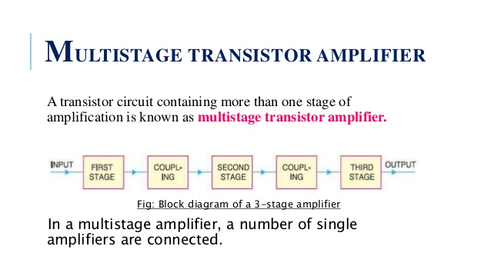
Block Diagrams

Slide 6
Block diagrams

Slide 8
MULTISTAGE TRANSISTOR AMPLIFIER
A transistor circuit containing more than one stage of amplification is known as multistage transistor amplifier.
Block diagram of a 3-stage amplifier In a multistage amplifier, a number of single amplifiers are connected.

Slide 9
What is the difference between Cascade and cascode amplifier?
From a transistor perspective, a cascade is typically when the amplifier load(s) are connected in a left-to right horizontal chain configuration,
whereas a cascode has the load(s) stacked vertically. .
Cascode: An amplifier consisting of a common emitter input stage that drives a common base output stage.

Slide 10
cascade amplifier
A cascade amplifier is any two-port network constructed from a series of amplifiers, where each amplifier sends its output to the input of the next amplifier in a daisy chain. The complication in calculating the gain of cascaded stages is the non-ideal coupling between stages due to loading.

Slide 11
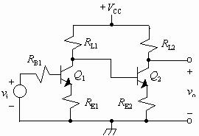
Circuit of cascade amplifier

Slide 12
In an amplifier chain when the individual amplifiers are cascaded it means the output of the first amplifying device is connected to the input of the next and so on. Cascading is a general term for objects connected serially that start a chain reaction.
A cascode on the other hand is an amplifying device that has a CE input stage driving a CB output stage.

Slide 13
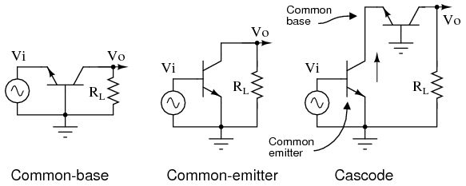
Circuit of cascode amplifier
Such cascade and cas code connection is also possible with FET amplifiers

Slide 14
Types OF MULTISTAGE TRANSISTOR AMPLIFIER
R-C coupled amplifier
b) Transformer coupled amplifier
c) Direct coupled amplifier

Slide 15
R.C.Coupling
In RC coupling, a capacitor is used as the coupling device. The capacitor connects the output of one stage to the input of the next stage in order to pass the a.c. signal on while blocking the d.c. bias voltages.

Slide 16
Transformer coupling
In transformer coupling, transformer is used as the coupling device.
The transformer coupling provides the same two functions but permits in addition impedance matching.

Slide 17
Direct coupling
In direct coupling or d.c. coupling,
The individual amplifier stage bias conditions are so designed that the two stages may be directly connected without the necessity for d.c. isolation.

Slide 18
Effect of Coupling and Bypass Capacitors
Coupling capacitors (or dc blocking capacitors) are use to decouple ac and dc signals so as not to disturb the quiescent point of the circuit when ac signals are injected at the input. Bypass capacitors are used to force signal currents around elements by providing a low impedance path at the frequency.

Slide 19
A coupling capacitor is a capacitor which is used to couple or link together only the AC signal from one circuit element to another. The capacitor blocks the DC signal from entering the second element and, thus, only passes the AC signal.

Slide 20
Bypass Capacitor
A Bypass Capacitor is usually applied between the VCC and GND pins of an integrated circuit.
The Bypass Capacitor eliminates the effect of voltage spikes on the power supply and also reduce the power supply noise.
The name Bypass Capacitor is used as it bypasses the high frequency components of power supply

Slide 21
Coupling and Bypass Capacitors Coupling capacitors (or dc blocking capacitors) are use to decouple ac and dc signals so as not to disturb the quiescent point of the circuit when ac signals are injected at the input.
Bypass capacitors are used to force signal currents around elements by providing a low impedance path at the frequency.

Slide 22
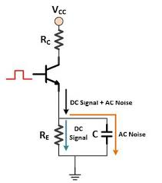
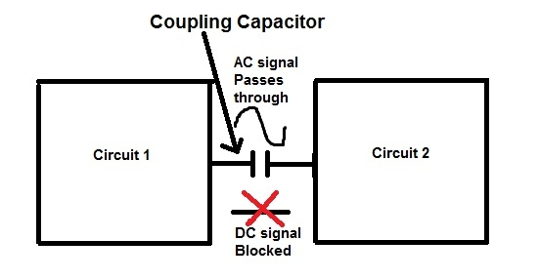
Coupling and Bypass Capacitors

