Slide 1
Electrophoresis
Part –II
Dr. Shalini Verma
BBT-201
Department of Biotechnology
IBSBT, CSJM, University, Kanpur

Slide 2
Polyacrylamide Gel Electrophoresis
cross-linked gels formed by the polymerization of acrylamide with a cross-linking agent, usually N,N’-methylenebisacrylamide.
free radical polymerization
ammonium persulfate as the initiator and N,N,N’,N’-tetramethylethylendiamine (TEMED) as the catalyst.
widely used in biochemistry, forensic chemistry, genetics, molecular biology and biotechnology to separate biological macromolecules, usually proteins or nucleic acids, according to their electrophoretic mobility.
commonly used form of polyacrylamide gel electrophoresis is the Sodium dodecyl suplhate Polyacrylamide gel electrophoresis (SDS- PAGE)

Slide 3
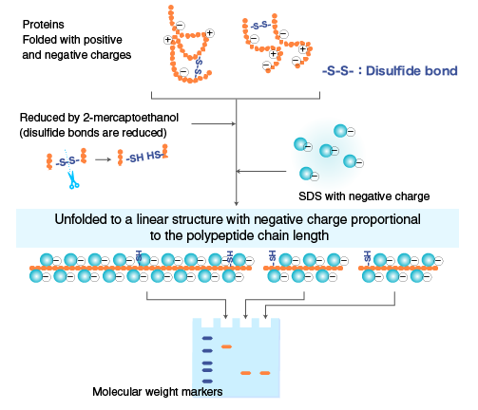
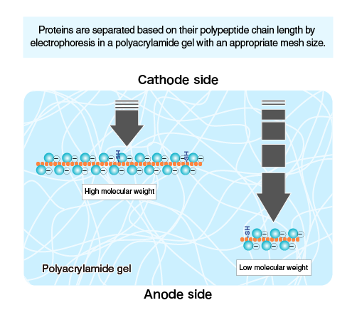
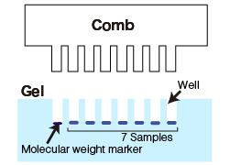
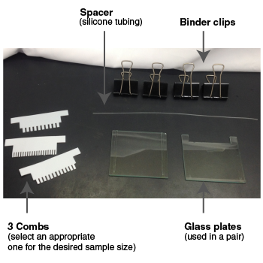
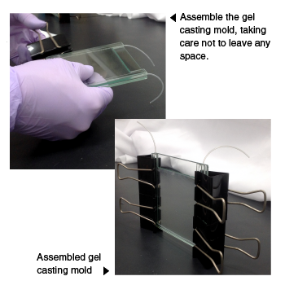
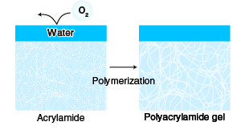
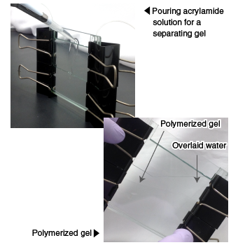
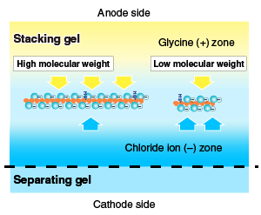
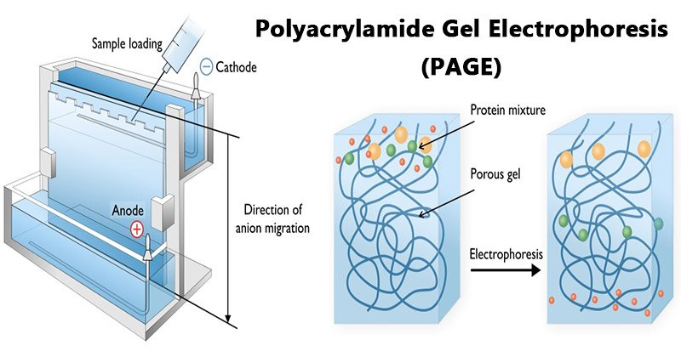
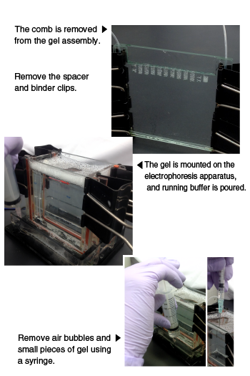
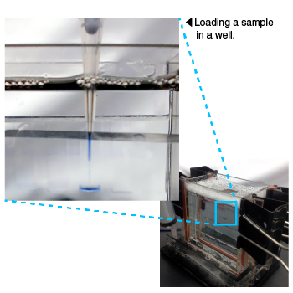
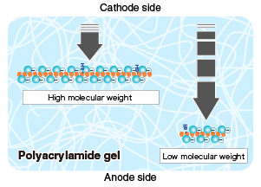
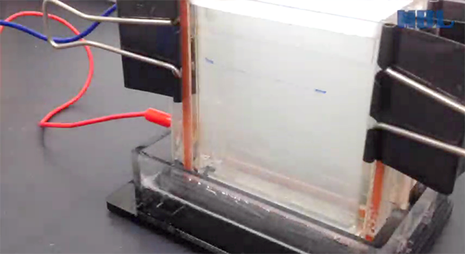
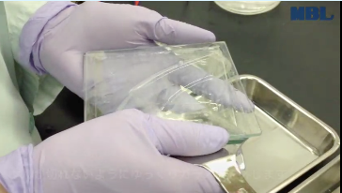
PAGE

Slide 4
Requirements for Polyacrylamide Gel Electrophoresis (PAGE)
Acrylamide solutions (for resolving & stacking gels).
Isopropanol / distilled water.
Gel loading buffer.
Running buffer.
Staining, destaining solutions.
Protein samples
Molecular weight markers.
The equipment and supplies necessary for conducting SDS-PAGE includes:
An electrophoresis chamber and power supply.
Glass plates (a short and a top plate).
Casting frame
Casting stand
comb

Slide 5
Steps Involved in Polyacrylamide Gel Electrophoresis (PAGE)
1. Sample Preparation

Slide 6
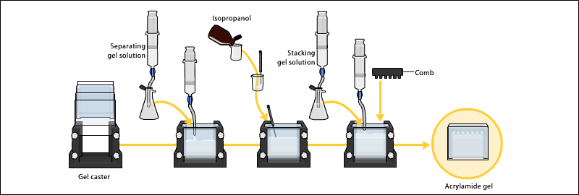
2. Preparation of Polyacrylamide gel

Slide 7
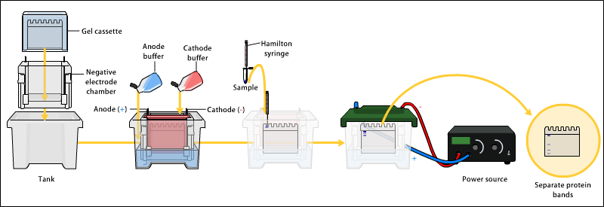
3. Electrophoresis

Slide 8
Applications of Polyacrylamide Gel Electrophoresis (PAGE)
Measuring molecular weight.
Peptide mapping.
Estimation of protein size.
Determination of protein subunits or aggregation structures.
Estimation of protein purity.
Protein quantitation.
Monitoring protein integrity.
Comparison of the polypeptide composition of different samples.
Analysis of the number and size of polypeptide subunits.
Post-electrophoresis applications, such as Western blotting.
Staining of Proteins in Gels with Coomassie G-250 without Organic Solvent and Acetic Acid.
Pouring and Running a Protein Gel by reusing Commercial Cassettes.
Selective Labelling of Cell-surface Proteins using CyDye DIGE Fluor Minimal Dyes.
Detection of Protein Ubiquitination.

