Slide 1
FACTORS AFFECTING MUSCLE FUNCTION
BY:
DR. DIGVIJAY SHARMA
DIRECTOR
SCHOOL OF HEALTH SCIENCES, CSJMU

Slide 2
FACTORS AFFECTING MUSCLE FUNCTION
There are several factors out of which some are:
Types of joint and location of muscle attachment
Number of joints crossed by the muscle
Active insufficiency
Passive insufficiency
Sensory receptors

Slide 3
Types of joint and location of muscle attachment
It is the structure of joint that determines the type of motion that will occur such as flexion and extension and the range of motion
The location determines which motion the muscle performs
Generally, the muscles that cross the anterior aspect of the joints are flexors while muscles located on the posterior aspect of these joints are extensors
Muscles located medially and laterally are adductors and abductors and may also serve as rotators
SPURT muscle has prime function of mobility while the SHUNT muscle’s is stability.

Slide 4
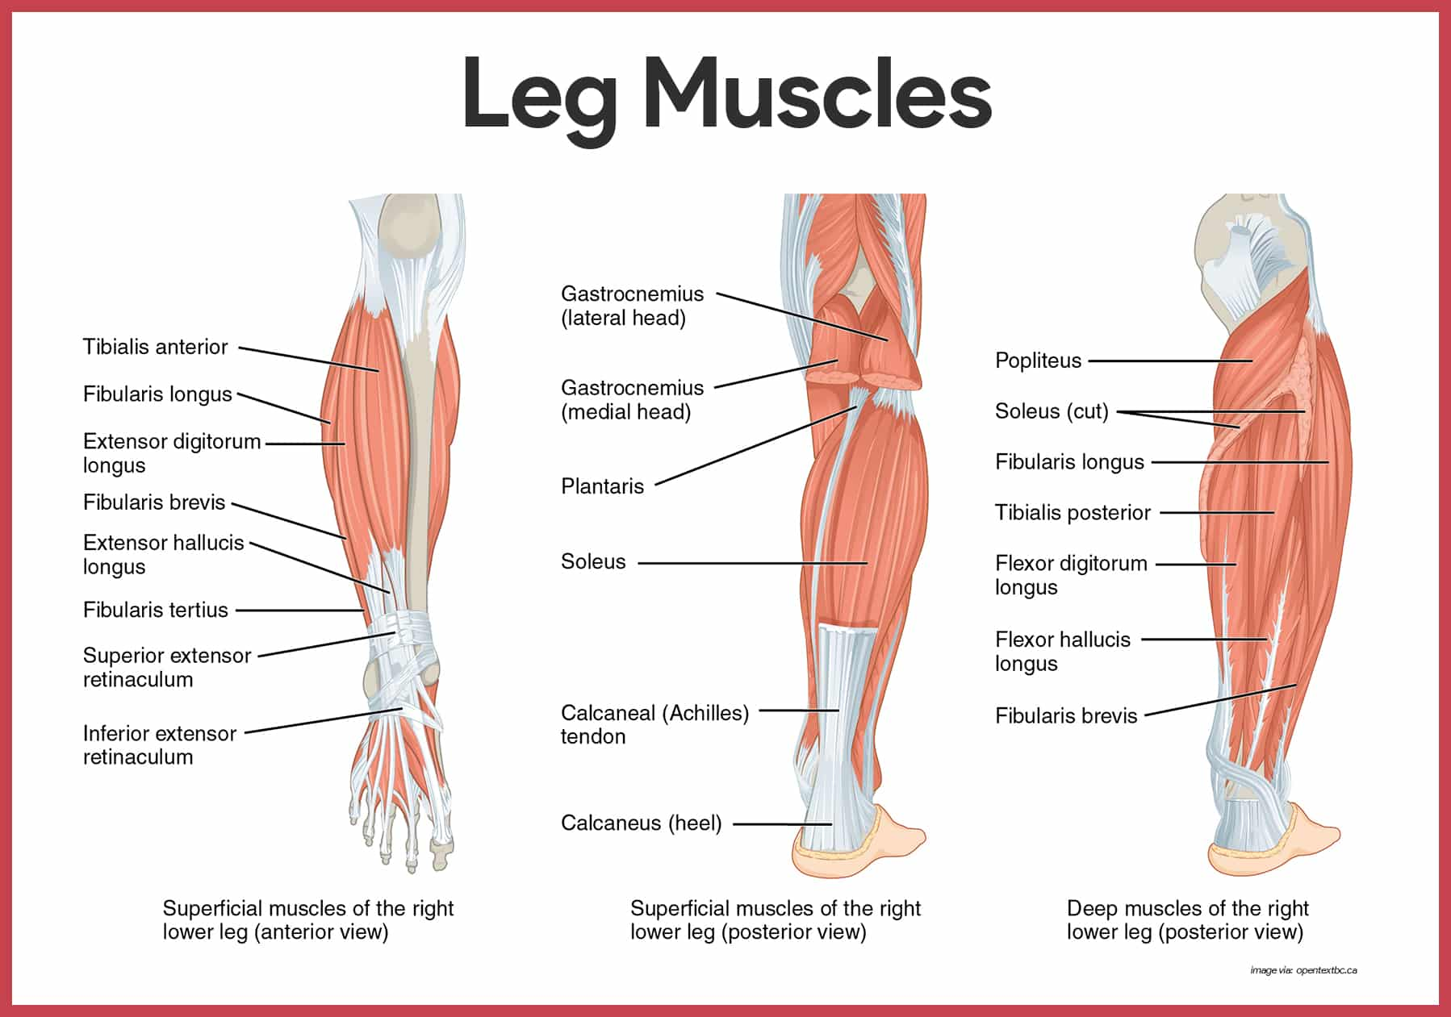

Slide 5
Number of joints crossed by the muscle
The number of joints that the muscles cross determines the muscle function in many cases
The single joint muscles tend to produce force and work primarily in concentric and isometric contraction
Multiple joint muscles on the other hand tend to control the fine regulation of torque during dynamic movements
The multiple joints gets recruited during complex motions such as elbow flexion with supination, while one joint muscle in case of simple motion such as elbow flexion

Slide 6
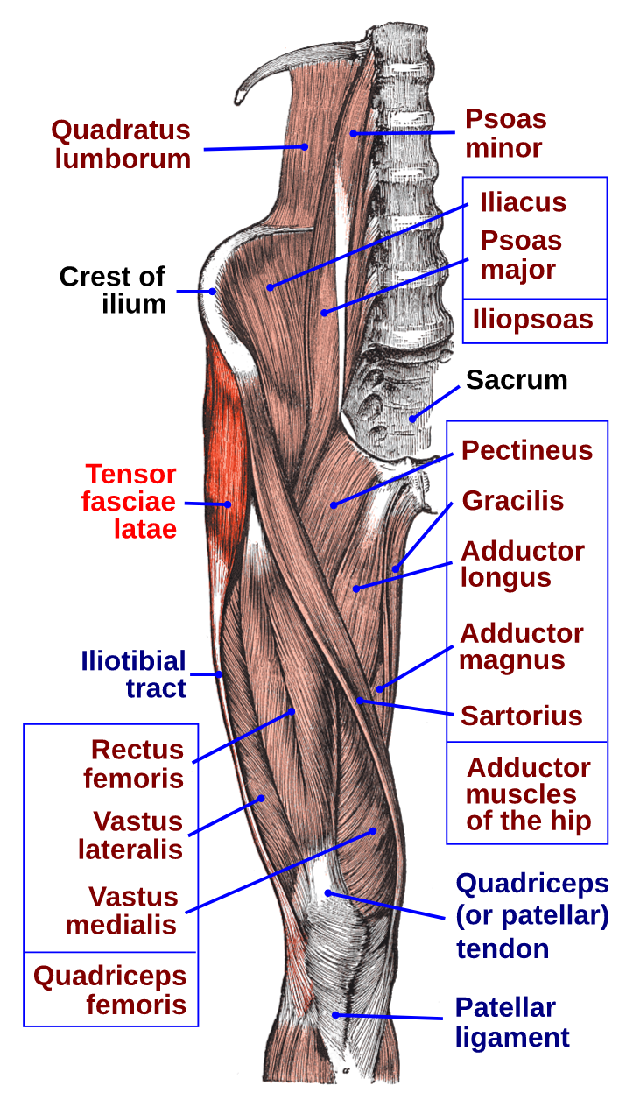
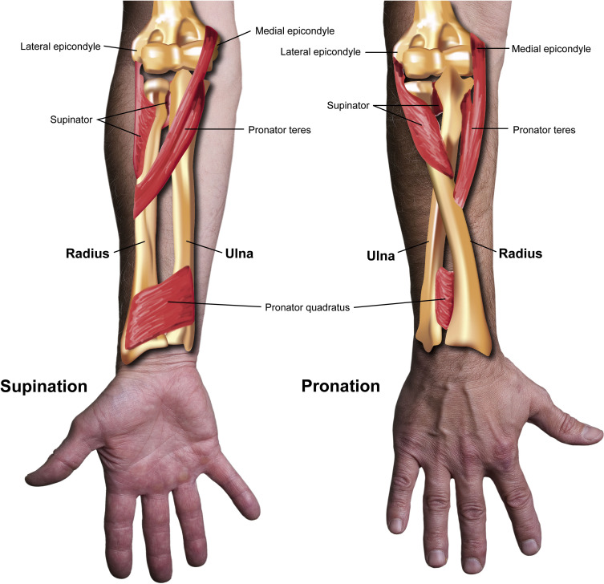

Slide 7
Active insufficiency
It is diminished activity of a muscle to produce or maintain active tension
Usually this occurs when a muscle has shorten to a point at which no further sliding of the filament can take place
Some muscles are arranged around a joint so the muscle can neither excessively elongated or shortened
Thus arrangement is effective for muscle which crosses more than one joint
Active insufficiency is encountered when full range of motion is attempted simultaneously at all joints crossed by a two or multi joint muscle

Slide 8
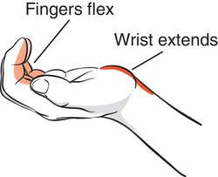
Example: the finger flexors crosses wrist, MCP and IP joints. If all joints are allowed to flex simultaneously the finger flexors will probably be shortened than the optimal length as a result it will be actively insufficient. Normally when the finger flexors contact the wrist is maintained in right extension by exterior muscles. The wrist extensors prevents the finger flexor from flexing the wrist and therefore an optimal length is maintained.

Slide 9
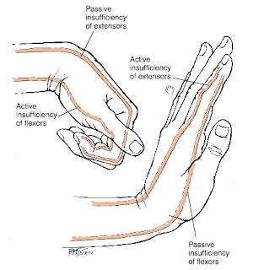
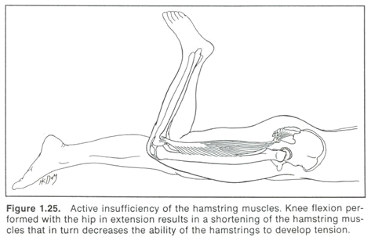

Slide 10
Passive insufficiency
It occurs when an inactive antagonistic muscle is of insufficient length to permit completion of the full ROM available at joints crossed by the passive muscle
When such a situation occurs, passive tension develops in muscle
The passive tension developed in these muscles make check further motion of the bony lever and if the tension generated is sufficient it may pull the bony lever in the direction of passive pull
When movement of the lever occurs as a result of the passive pull, it is called as tendon action or tenodesis
Under normal conditions, one joint muscle rarely If ever are of insufficient length to allow full ROM at the joint
However, the two joint or multi joint muscles are frequently insufficient length or extensibility to allow full ROM to be produced simultaneously at all joints crossed by the muscle

Slide 11
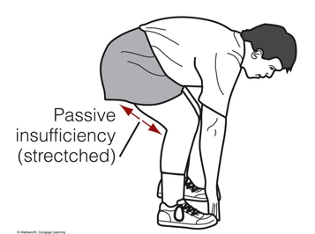
Example: if once elbow placed on the table and the hand is allowed to drop forward into wrist flexion, the fingers tend to extend. Extension of the fingers are a result of passive insufficiency of the finger extensors

Slide 13
Sensory receptors
Two important types of sensory receptors are:
Golgi tendon organ
Muscle spindle
Both these receptors help to protect the muscle from injury by monitoring change in muscle length

Slide 14
Golgi Tendon organ
It is located in the tendon at the myotendinous junction
These are sensitive to tension and may be activated either by muscle contraction or excessive stretch of the muscle
When it gets excited, they send a message to the nervous system to inhibit the muscle in whose tendon the receptor lies

Slide 15
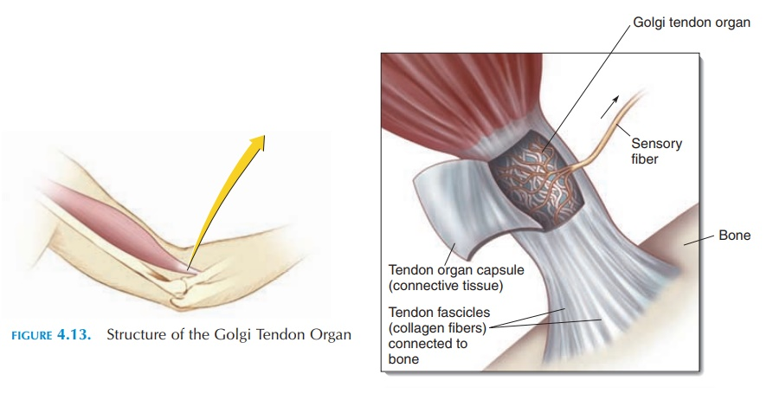
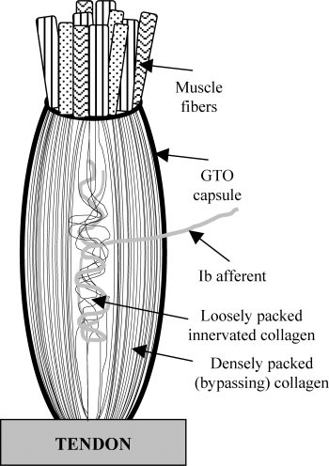
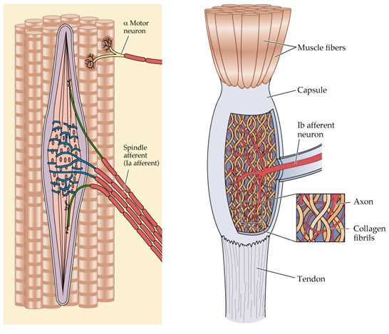

Slide 16
Muscle spindle
It consists of 2 to 10 specialized muscle fibres (intrafusal fibres) enclosed in a connective tissue sheath are inter-spread throughout the muscle
These fibres are sensitive to the length and the velocity of lengthening of muscle fibres (intrafusal fibres)
When the muscle stretches muscle spindle send messages to the brain , while stop when muscle shortens
When the signals decreases, the higher centres send impulses to intrafusal fibres in the spindle to shorten so they once again are liable to respond to the length change in the muscle

Slide 17
The muscle spindle is responsible for sending impulse to the muscle in which it lies when the tendon of muscle is tapped with hammer
The quick stretch of the muscle by tapping the tendon activates the muscle spindles and muscle respond to this sudden impulse by brief contractions
This response is called stretch reflex or deep tendon reflex (DTR) or muscle spindle reflex (MSR)

Slide 18
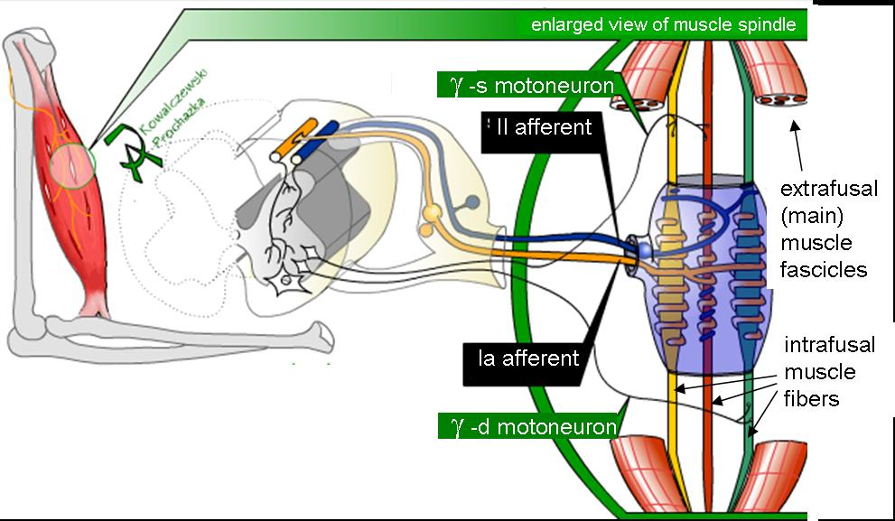
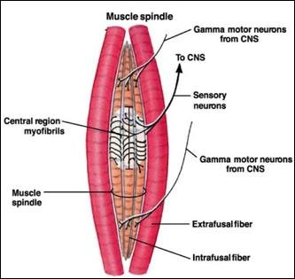
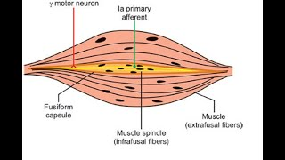

Slide 19
Muscle tone
It is defined as the state of partial contraction of muscle or response of the muscle to stretch
Normal muscle tone is due to the discharge in the gamma motor neurons whose activity is regulated by the excitatory and inhibitory reticulospinal tracts
The higher centres that are required for the maintenance of normal muscle tone are:
Cerebellum
Basal ganglia
Cerebral cortex to some extent

Slide 20
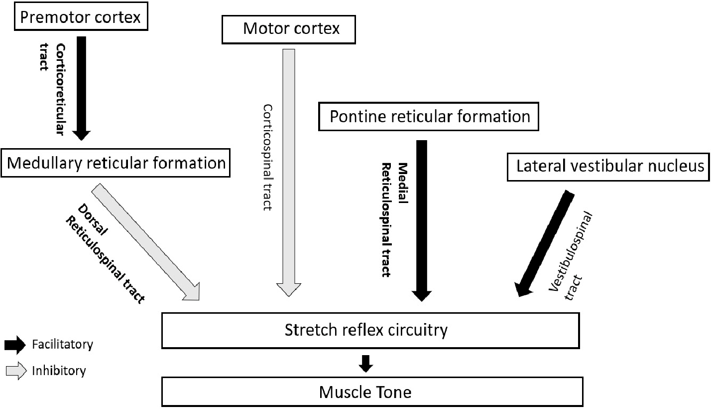

Slide 21
Abnormalities of Muscle tone
Hypotonia- Decrease in the muscle tone in Lower motor neuron lesion
Atonia- absence of muscle tone occurring due to cerebellar lesions
Hypertonia- increase in muscle tone occurring due to upper motor neuron lesion
Spasticity- occurs in upper motor neuron lesion in which extra-pyramidal fibres are damaged
Rigidity- it occurs in diseases of basal ganglia

Slide 22
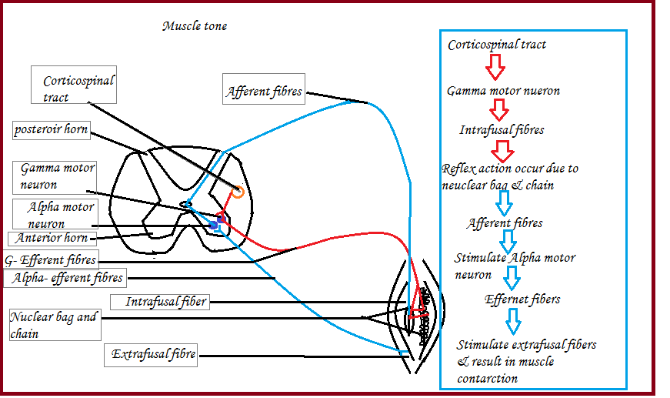
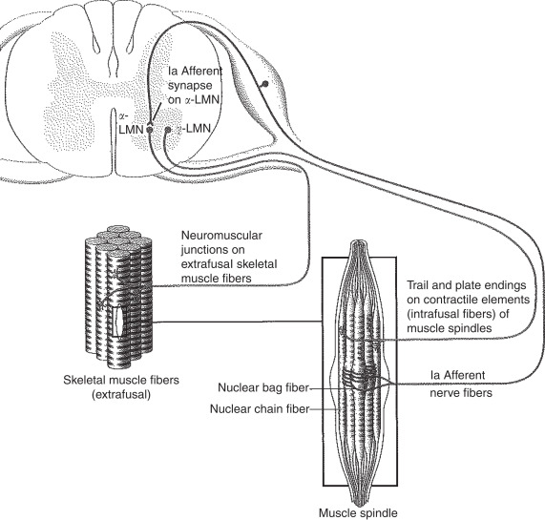

Slide 23
Proprioception & kinesthesia
Proprioception means sense of body’s position in space and kinesthesia means the sensation associated with joint movement
Proprioceptors are receptors capable of detecting the change in position. Therefore they carry conscious and unconscious kinesthetic movement such as sense of passive movement and posture

Slide 24
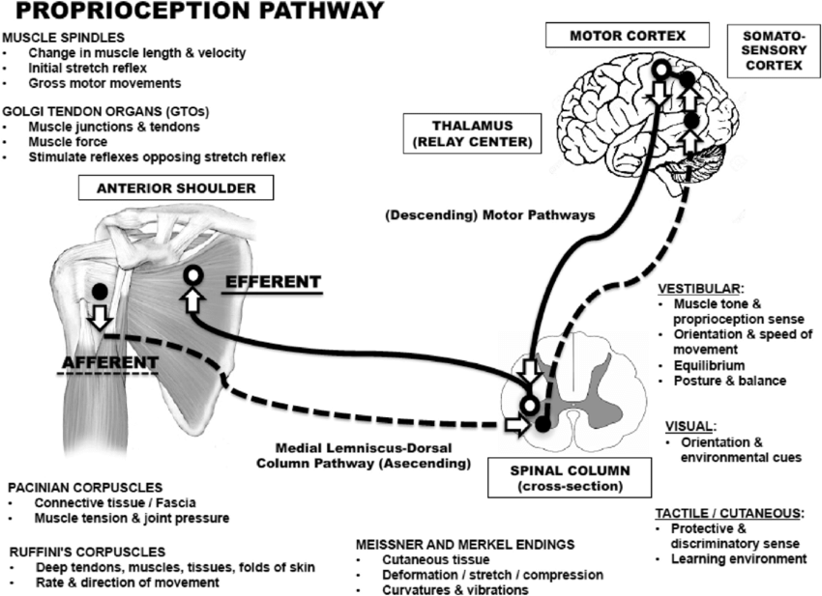

Slide 25
Neural pathway
Conscious sense of position vibration, deep pressure is carried by axons from joint receptors- Pacinian corpuscles. These entering the spinal cord via posterior route, branch and enter the dorsal column of the same side.
Unconscious sense is carried by the dorsal and ventral spino-cerebellar tract

Slide 26
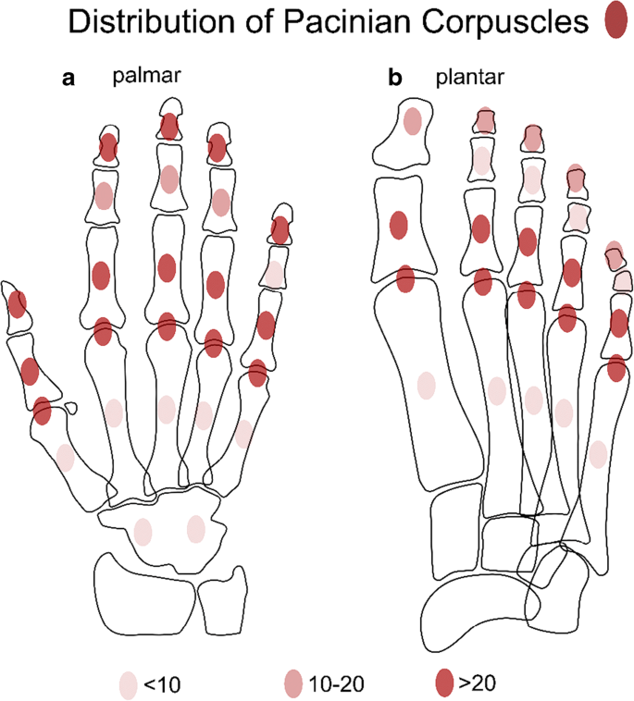
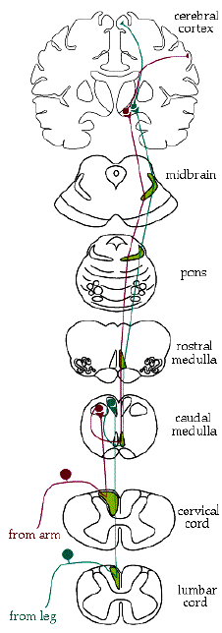

Slide 27
Types of joint receptors
NAME OF RECEPTOR | SENSITIVITY | LOCATION
Ruffini receptors | Stretch usually at extremes of extension | Fibrous layer of the joint capsule on flexion side of the joints. Periosteum, ligaments and tendons
Paccini or pacciniform | Compression or changes in hydrostatic pressure and joint movement | Throughout joint capsule mainly in deeper layer and in fat pads
Golgi tendon organ | Pressure and forceful joint movement into extremes of motions | Inner layer of joint capsule, ligament and tendons
Free nerve endings | Non-noxious and noxious mechanical stress or biomechanical stress | Around blood vessels in synovial layer or capsule, adjacent to fat pads, ligaments, tendons and periosteum
Vestibular receptors | For vestibular function | Vestibular apparatus in internal ear

Slide 28
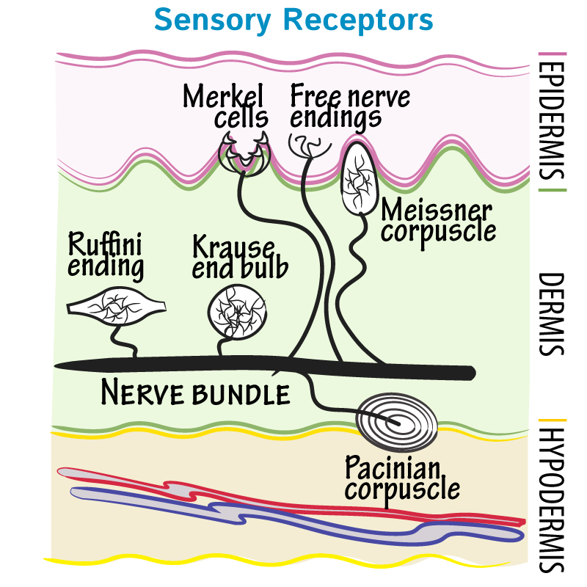
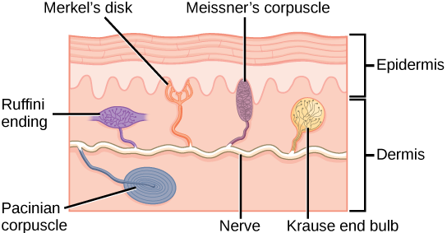
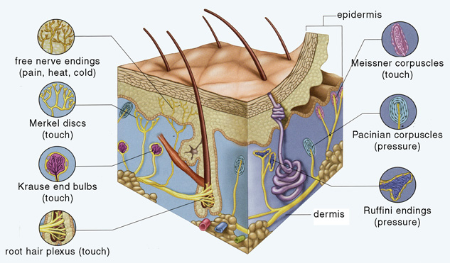

Slide 29
Applied physiology
Loss of control over the voluntary movement (muscular incoordination) is called Ataxia
A disturbance of muscular coordination due to defective sensory information usually due to disease or injury of dorsal column is called Sensory Ataxia
While due to cerebellar lesion is called cerebellar Ataxia

Slide 30
