Slide 1
FORCE & FRICTION
BY:
DR. DIGVIJAY SHARMA
DIRECTOR
SCHOOL OF HEALTH SCIENCES, CSJMU

Slide 2
CONTENTS
Definition
Types of force
Force vectors
Naming of Forces
Reaction forces
Linear force system
Concurrent force system
Composition of forces
Friction
Muscle action lines
Divergent muscle pull

Slide 3
DEFINTION
“Force is a push or pull exerted by one material, object or substance on another”

Slide 4
TYPES OF FORCES
EXTERNAL FORCES
These are pushes or pulls on the body that arise from sources outside the body. For example: Gravity, Wind, Water, etc
INTERNAL FORCES
These are the forces that act on the body arising from sources within the human body. For example: muscle pull, bones and ligaments, etc.
There are some forces such as Friction and Atmospheric pressure which can act as both External to and from within the body

Slide 5
FORCE VECTORS
All the forces despite the source or the object acted on are vector quantities and can be defined as:
a. A point of application on the object being acted on
b. An action line and direction indicating a pull towards the source or push away from the source.
c. A magnitude, that is quantity of force being exerted
Here, a vector is traditionally represented by an arrow so, a force is represented by an arrow that:
Has a base on the object being acted at Point of application
The arrowhead in the direction of force being exerted
Has a length represents the amount of force being exerted (magnitude)

Slide 6
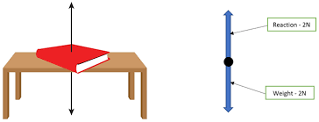
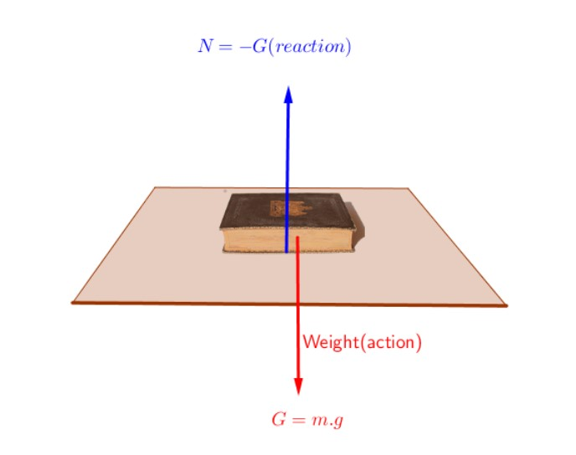
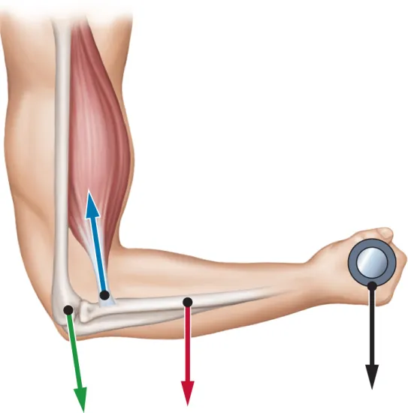
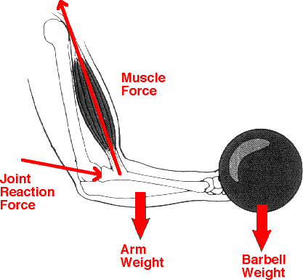
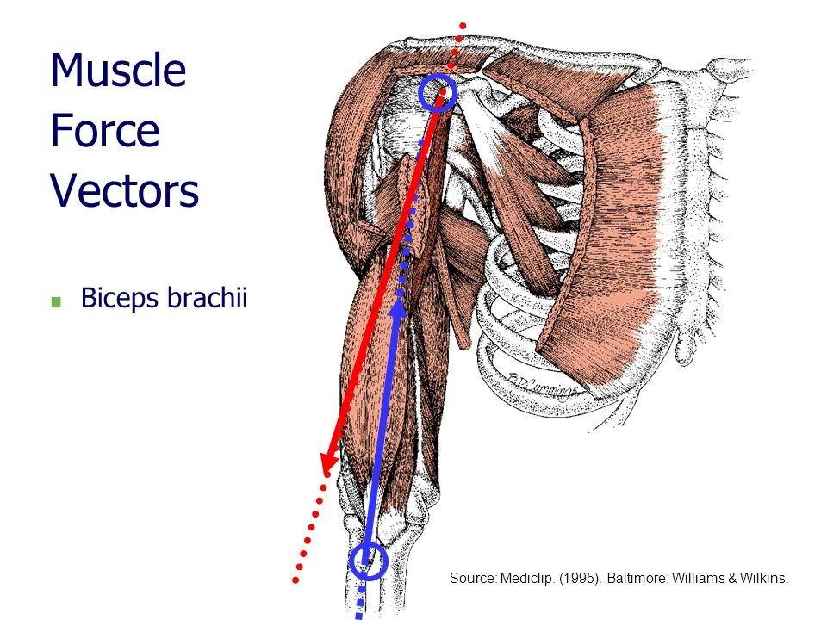

Slide 7
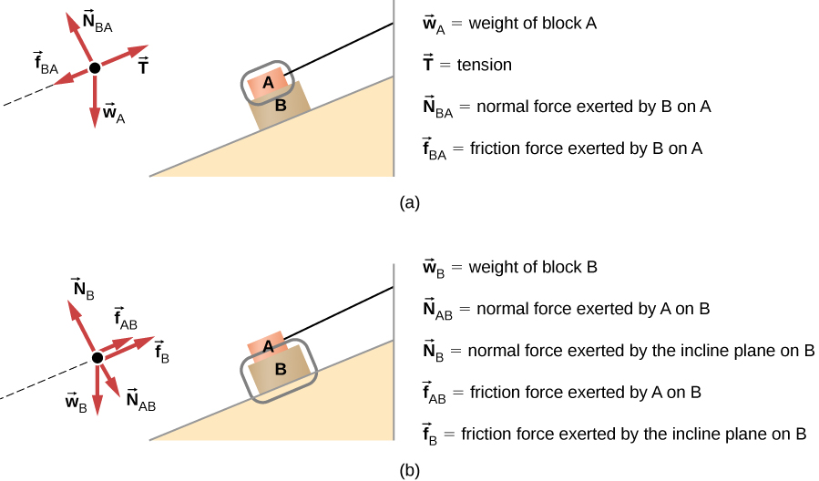
NAMING OF FORCES
Naming convention of “object on object” is used to identify forces
The first object named will always be the source of the force
The second object named will always be the object being acted on
This means that object to which the force is applied will always be the last name of the force
The action line and direction will be towards the force in case of pull and away from the source in case of push

Slide 8
REACTION FORCES
We can say according to Newton’s third law of motion, when an object applies a force to the second object, the second object must simultaneously apply a force equal in magnitude and opposite in direction to the first object
These two forces on the two contacting objects constitute an interaction pair or action- reaction forces
We can say that anything which touches an object will exert a force on the object and object on that particular thing
Newton noted this phenomena and concluded that all forces come in pairs that are equal in magnitude and opposite in direction and applied to adjacent Contacting objects.
So these action reaction forces can also be referred to as Contact forces

Slide 9
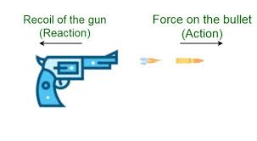
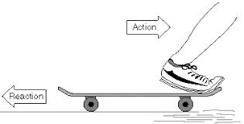
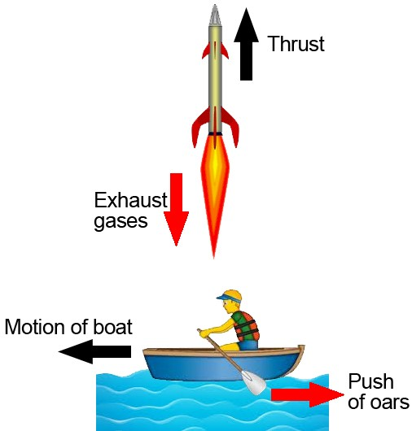
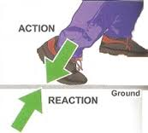
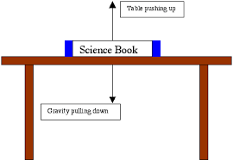

Slide 10
REACTION FORCES
It is important to note that in any interaction pair, the point of application are on different object.
The following points must be considerable in case of forces on an object:
Forces on an object are exerted by things that touch that object
Gravity counts a force on all objects is always touching an object
When two objects contact, they exert a force on each other (all forces come in pairs)

Slide 11
LINEAR FORCE SYSTEM
A linear force system exists whenever two or more forces act on the same object and in the same line
Vector in this same linear force system will overlap if lengths are extended.
Vectors that overlap but applied on different objects can not be a part of the linear force system
Since, linear force system produces translatory motion, the magnitude is given signs using the convention for translatory forces
So the forces applied up or to the right are considered positive.
When applied down on to the left are considered as negative
The resultant of linear force system is determined by finding the arithmetic sum of the magnitude of each of forces in same force system

Slide 12
CONCURRENT FORCES
Two or more forces acting at a common point of application on an object but in divergent directions are a part of a Concurrent force system
Two or more forces applied to the same object can also be a part of the same concurrent force system when the vectors have different points of application on the object as long as the vectors intersect when extended in length
The net resultant can be represented by a single new vector through the process known as Composition of forces

Slide 13
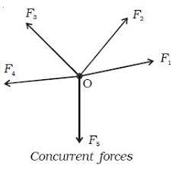
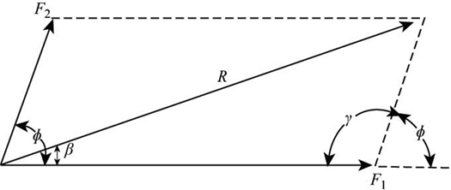

Slide 14
COMPOSITION OF FORCES
If two men pulling the block at a right angle to each other then, action lines of Man A on block and Man B on the block are in different directions
The net effect or resultant action of the two pulls will be in a line that was between the men, which can be shown by polygon method
The vectors with a common point of application maintaining a 90 degree angle between them such that the new vectors are drawn parallel to the old vectors forming a polygon.
The resultant vector so obtained is always diagonal of the polygon formed by the original two vectors

Slide 15
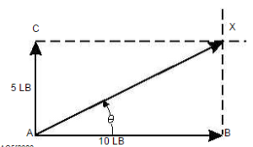
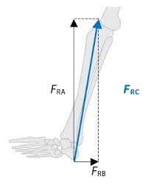
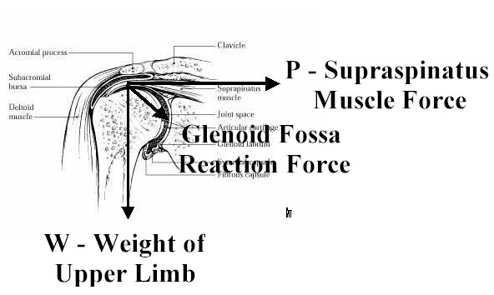
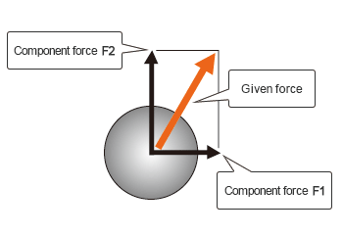
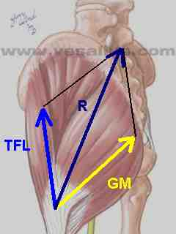

Slide 16
FRICTION
The force of Friction may exists whenever two objects contact
It has magnitude only when two conducting objects move or attempt to move on the other.
The force that moves or attempts to move one object on another is termed as Shear Force.
It is the force that is applied parallel to contacting surfaces in direction of attempted movement.
When two contacting objects are not moving, but there is a shear force applied to the object, then maximum magnitude of force of friction on that object is the product of a constant known as coefficient of static friction and the reaction or constant force exerted by the contacting object.

Slide 17
FRICTION
The coefficient of static friction is constant for given material
F_{x} ≤ µ_{s}F_{c}
µ_{s} for ice on ice = 0.05 (approx.) and for wood on wood = 0.25
As the contacting surface becomes softer and rougher µ_{s} increases
The constant force is directly proportional to weight of the contacting objects
Friction is given on a maximum potential force because it has magnitude only if an attempt is made to move one object on another.
Once the object is moving, coefficient of kinetic friction is given by:
F_{a} ≤ µ_{k}F_{c}
Where, µ_{k} is the coefficient of kinetic friction. This is always less than the maximum value of static friction for any contacting surfaces

Slide 18
MUSCLE ACTION LINE
Every muscle pulls on each of its end every time the muscle exerts a force
Therefore, every muscle exerts minimum of two force vectors one on each bone to which the muscle is attached.
Movement created by a muscle depends on net forces acting on each of its levers and not on origin or insertion
The force applied by a muscle to a bony segment is actually the resultant of the pull, because each muscle fibre can be represented as a vector.
The fibre taken together form a concurrent force system with a resultant that is total muscle force vector (Fms)
Fms has a point of application at the attachment of the muscle and an action line that is the direction of the resultant pull of the muscle’s fibre, which is towards the centre of the muscle.

Slide 19
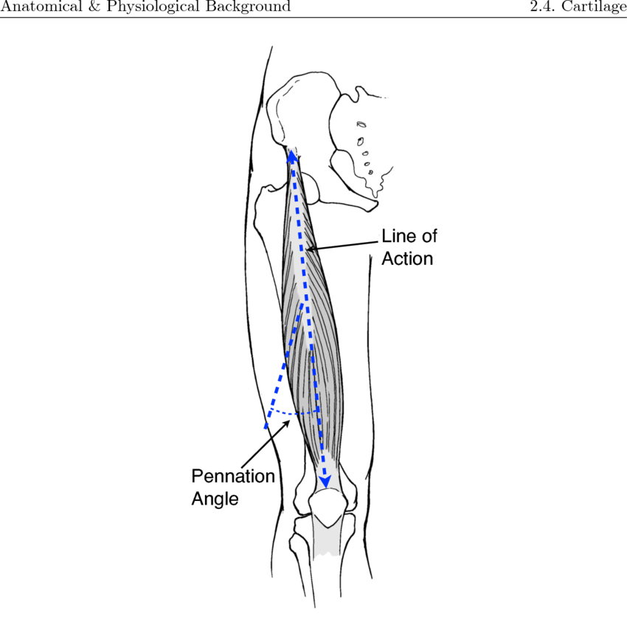
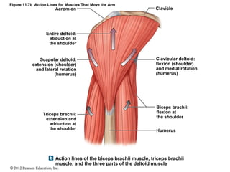
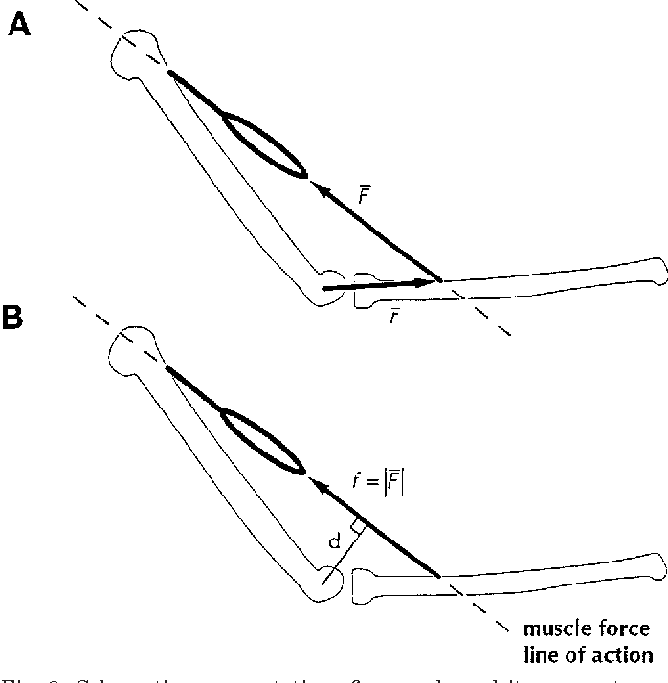
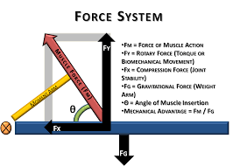
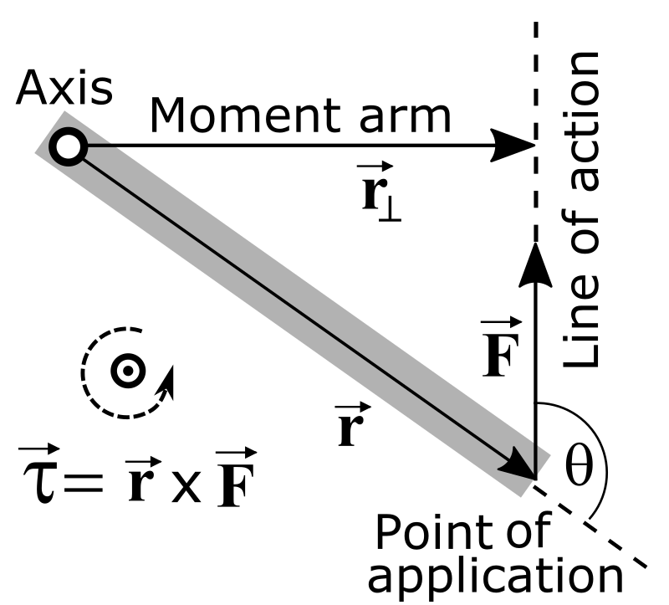

Slide 20
DIVERGENT MUSCLE PULL
The concept of concurrent force system can be used to determine the resultant of two or more segments of one muscle or two muscles when they have a common attachment
For example, Deltoid, which is having three portions, i.e., anterior, posterior and middle acting on the humerus using the polygon method of composition of forces
The resultant will be the diagonal of polygon which in this case coincides with the middle fibre of Deltoid and have a common point of origin, hence they are the part of linear force system.
So the new resultant Fms will be equal in magnitude to Resultant+ Middle fibre of Deltoid and in the same segment
This vector Fms represents the total pull of all three segments of Deltoid leading to abduction of the arm.

Slide 21
