Slide 1
Factors affecting Drug Permeation
(Dr.) Pranati Srivastava
Asst. Professor
School of Pharmaceutical Sciences, CSJMU, Kanpur

Slide 2
Physicochemical factors
Biological factors
Formulation factors
10/20/2012
vikramjit singh
12

Slide 3
◻ Physicochemical factors of penetrant/drug
Partition coefficient
Solubility
Ionization / p^{Ka}
Molecular size and weight
Stability or half-life

Slide 4
◻ Biological factors
P^{H} of the environment
Area of application
Age, Sex, Race
Condition of the skin
Integrity and Thickness of stratum corneum
Pathological conditions of skin
Hydration
Metabolism
Temperature

Slide 5
◻ Formulation factors
Vehicle-solubility of the drug
Lipophilicity of the solvent
P^{H} of the vehicle
Composition of drug delivery system
Surfactants

Slide 6
Dose deliverable :
Aqueous solubility :
≤ 10mg/day
>1mg/ml
Lipophilicity :
Molecular size Melting point :
log P (1-3)
: < 500 Daltons
< 200°C
Drug should not be an irritant to skin.
The drug should not stimulate an immune reaction in the skin.
Along with these properties the drug should be potent, having short half life

Slide 7
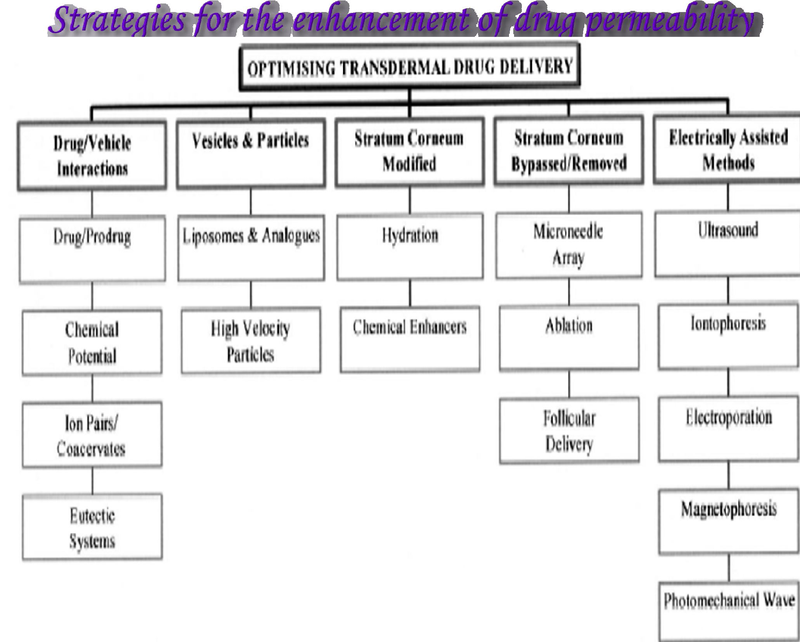

Slide 8
◻ Drug vehicle interactions
◻ 1.Prodrugs
The prodrug approach has been investigated to enhance transdermal delivery of drugs with unfavourable partition coefficients.
The prodrug design strategy generally involves addition of a pro-moiety to increase partition coefficient and solubility to increase the transport of the drug in the stratum corneum.
Upon reaching the viable epidermis, esterases release the active drug by hydrolysis thereby optimizing concentration in the epidermis.

Slide 9
◻ 2.Ion-pairs
Charged drug molecules do not readily partition into or permeate through human skin. Formation of lipophilic ionpairs has been investigated to increase stratum corneum penetration of charged species.
This strategy involves adding an oppositely charged species to the charged drug, forming an ion-pair in which the charges are neutralized so that the complex can partition into and permeate through the stratum corneum.
The ion-pair then dissociates in the aqueous viable epidermis releasing the parent charged drug that can diffuse within the epidermal and dermal tissues.

