Slide 1
Feedback Amplifiers

Slide 2
Outline
Introduction
The general feedback structure
Some properties of negative feedback
The four basic feedback topologies
The series-shunt feedback amplifier
The series-series feedback amplifier
The shunt-shunt and shunt-series feedback amplifier

Slide 3
The stability problem
Stability study using bode plot
Frequency compensation

Slide 4
Introduction
It’s impossible to think of electronic circuits without some forms of feedback.
Negative feedback
Desensitize the gain
Reduce nonlinear distortion
Reduce the effect of noise
Control the input and output impedance
Extend the bandwidth of the amplifier

Slide 5
The basic idea of negative feedback is to trade off gain for other desirable properties.
Positive feedback will cause the amplifier oscillation.

Slide 6
The General Feedback Structure
This is a signal-flow diagram, and the quantities x represent either voltage or current signals.

Slide 7
The General Feedback Equation
Closed loop and open loop
Closed loop gain
Feedback factor β
Loop gain Aβ
Amount of feedback (1+ Aβ)

Slide 8
Some Properties of Negative Feedback
Gain desensitivity
Bandwidth extension
Noise reduction
Reduction in nonlinear distortion

Slide 9
The Four Basic Feedback Topologies
Voltage amplifier---series-shunt feedback
voltage mixing and voltage sampling
Current amplifier---shunt-series feedback
Current mixing and current sampling

Slide 10
Transconducatnce amplifier---series-series feedback
Voltage mixing and current sampling
Transresistance amplifier---shunt-shunt feedback
Current mixing and voltage sampling

Slide 11
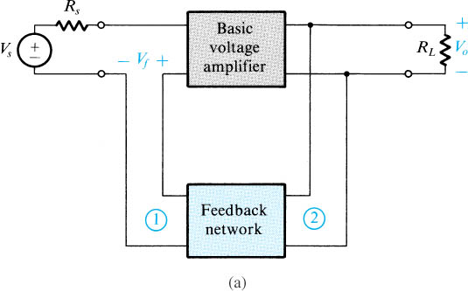
The Series-Shunt Feedback Topologies
voltage-mixing voltage-sampling (series–shunt) topology

Slide 12
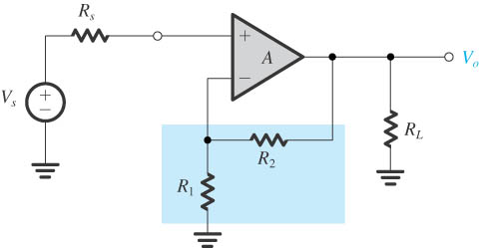
The Amplifier with Series-Shunt Feedback
voltage-mixing voltage-sampling (series–shunt) topology

Slide 13
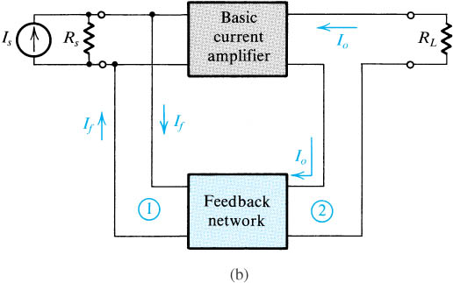
The Shunt-Series Feedback Topologies
current-mixing current-sampling (shunt–series) topology

Slide 14
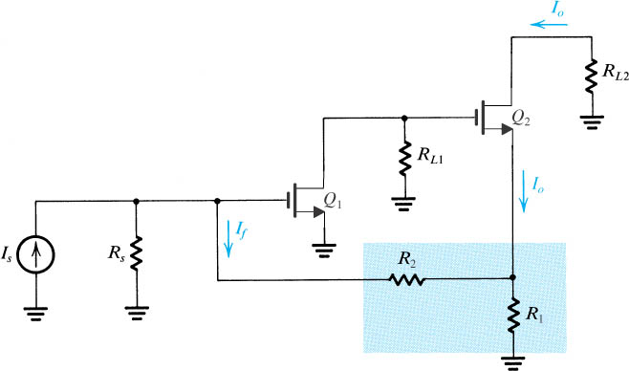
The Amplifier with Shunt-Series Feedback
current-mixing current-sampling (shunt–series) topology

Slide 15
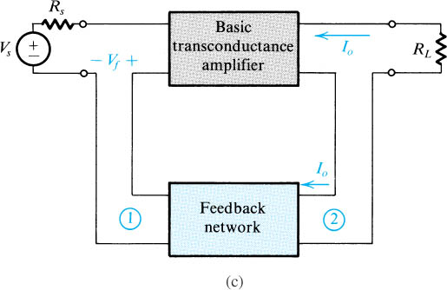
The Series-Series Feedback Topologies
voltage-mixing current-sampling (series–series) topology

Slide 16
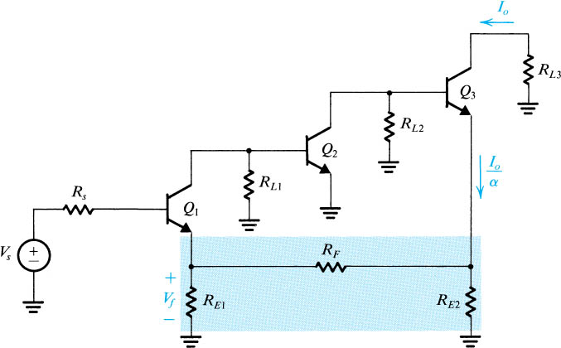
The Amplifier with Series-Series Feedback
voltage-mixing current-sampling (series–series) topology

Slide 17
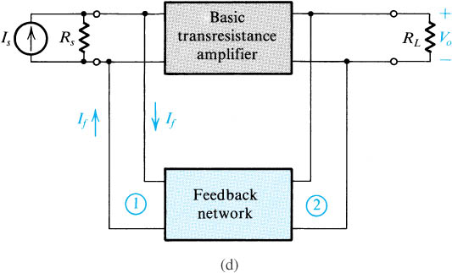
The Shunt-Shunt Feedback Topologies
current-mixing voltage-sampling (shunt–shunt) topology

Slide 18
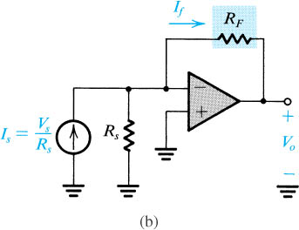
The OP Amplifier with Shunt-Shunt Feedback
current-mixing voltage-sampling (shunt–shunt) topology

Slide 19
The Series-Shunt Feedback Amplifier
The ideal situation
The practical situation
summary

Slide 20
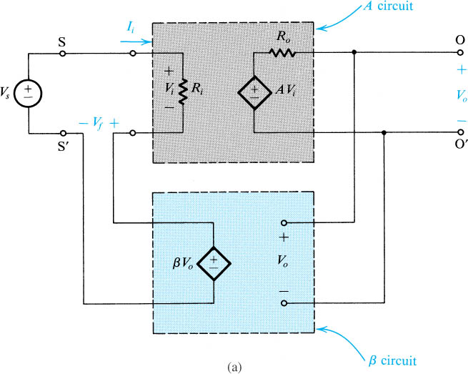
The Ideal Situation

Slide 21
A unilateral open-loop amplifier (A circuit).
An ideal voltage mixing voltage sampling feedback network (β circuit).
Assumption that the source and load resistance have been included inside the A circuit.

Slide 22
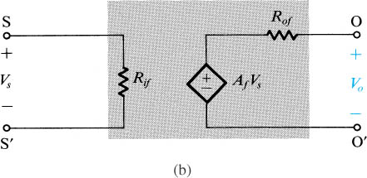
The Ideal Situation
Equivalent circuit.
R_{if} and R_{of} denote the input and output resistance with feedback.

Slide 23
Input and Output Resistance with Feedback
Input resistance
In this case, the negative feedback increases the input resistance by a factor equal to the amount of feedback.

Slide 24
Output resistance
In this case, the negative feedback reduces the output resistance by a factor equal to the amount of feedback.

Slide 25
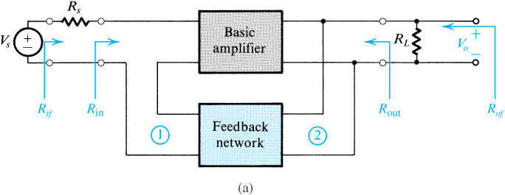
The Practical Situation
Block diagram of a practical series–shunt feedback amplifier.
Feedback network is not ideal and load the basic amplifier thus affect the values of gain, input resistance and output resistance.

Slide 26
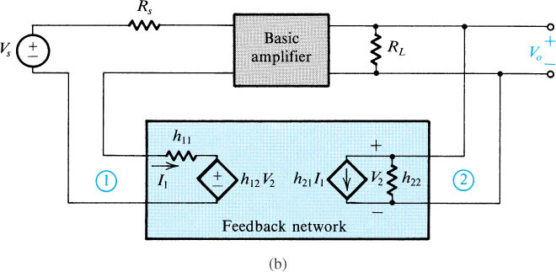
The Practical Situation
The circuit in (a) with the feedback network represented by its h parameters.

Slide 27
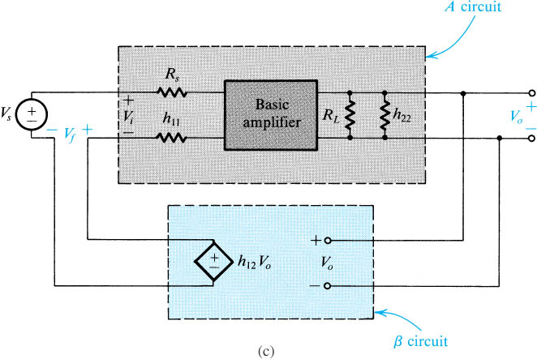
The Practical Situation
The circuit in (b) with h₂₁ neglected.

Slide 28
The Practical Situation
The load effect of the feedback network on the basic amplifier is represented by the components h₁₁ and h_{22.}
The loading effect is found by looking into the appropriate port of the feedback network while the port is open-circuit or short-circuit so as to destroy the feedback.

Slide 29
If the connection is a shunt one, short-circuit the port.
If the connection is a series one, open-circuit the port.
Determine the β.

Slide 30
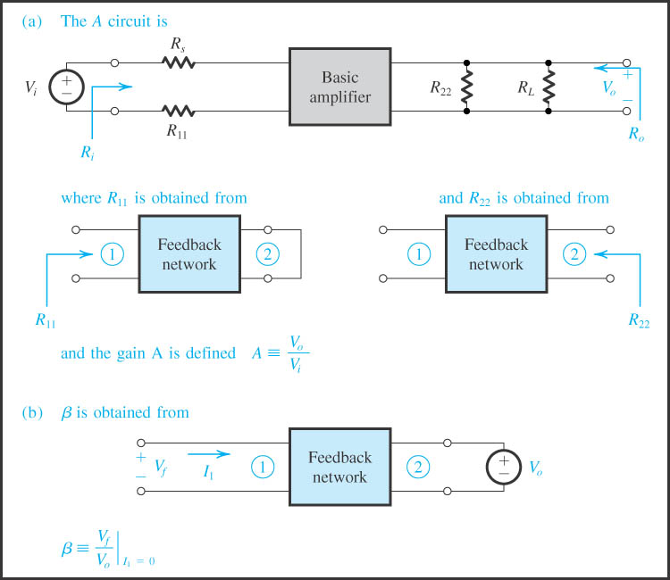

Slide 31
Summary
R_{i} and R_{o} are the input and output resistances, respectively, of the A circuit.
R_{if} and R_{of} are the input and output resistances, respectively, of the feedback amplifier, including R_{s} and R_{L}.
The actual input and output resistances exclude R_{s} and R_{L}.

Slide 32
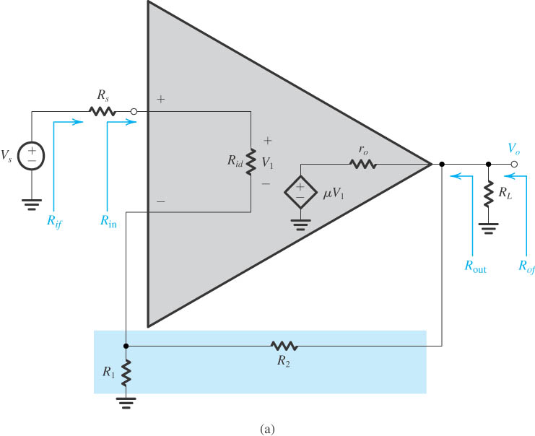
Example of Series-Shunt Feedback Amplifier

Slide 33
Example of Series-Shunt Feedback Amplifier
Op amplifier connected in noninverting configuration with the open-loop gain μ, R_{id} and r_{o}
Find expression for A, β, the closed-loop gain V_{o}/V_{i} , the input resistance R_{in} and the output resistance R_{out}
Find numerical values

Slide 34
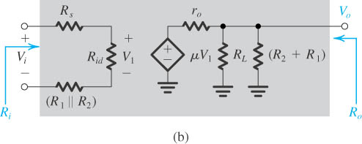
Example of Series-Shunt Feedback Amplifier

Slide 35
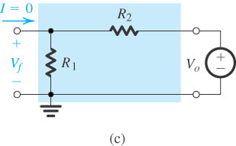
Example of Series-Shunt Feedback Amplifier

Slide 36
The Series-Series Feedback Amplifier
The ideal situation
The practical situation
summary

Slide 37
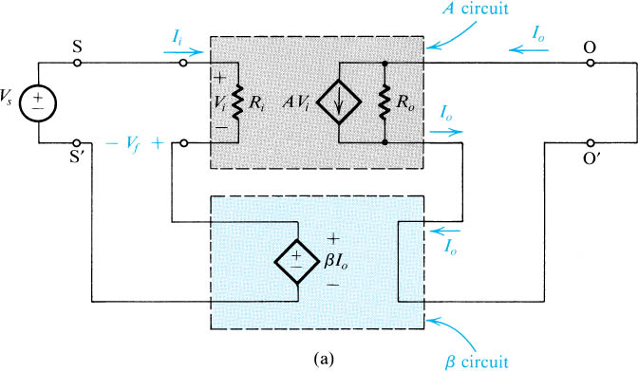
The Ideal Situation
Trans conductance gain

Slide 38
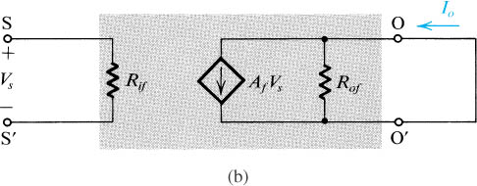
The Ideal Situation
Tranresistance feedback factor

Slide 39
Input and Output Resistance with Feedback
Input resistance
In this case, the negative feedback increases the input resistance by a factor equal to the amount of feedback.

Slide 40
Output resistance
In this case, the negative feedback increases the output resistance by a factor equal to the amount of feedback.

Slide 41
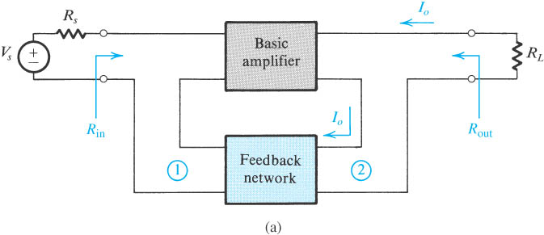
The Practical Situation
Block diagram of a practical series–series feedback amplifier.

Slide 42
Feedback network is not ideal and load the basic amplifier thus affect the values of gain, input resistance and output resistance.

Slide 43
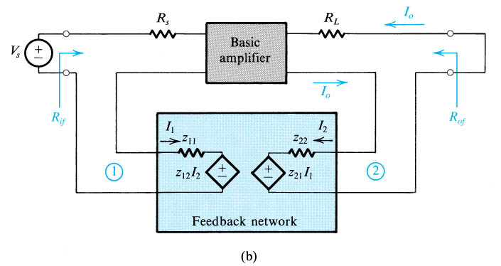
The Practical Situation
The circuit of (a) with the feedback network represented by its z parameters.

Slide 44
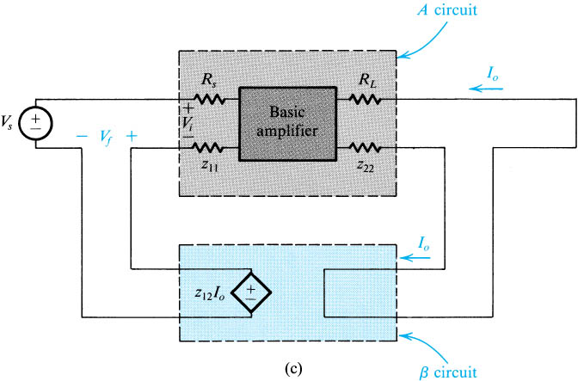
The Practical Situation
A redrawing of the circuit in (b) with z₂₁ neglected.

Slide 45
The Practical Situation
The load effect of the feedback network on the basic amplifier is represented by the components Z₁₁ and Z_{22.}
Z₁₁ is the impedance looking into port 1 of the feedback network with port 2 open-circuited.

Slide 46
Z₂₂ is the impedance looking into port 2 of the feedback network with port 1 open-circuited.
Determine the β.

Slide 47
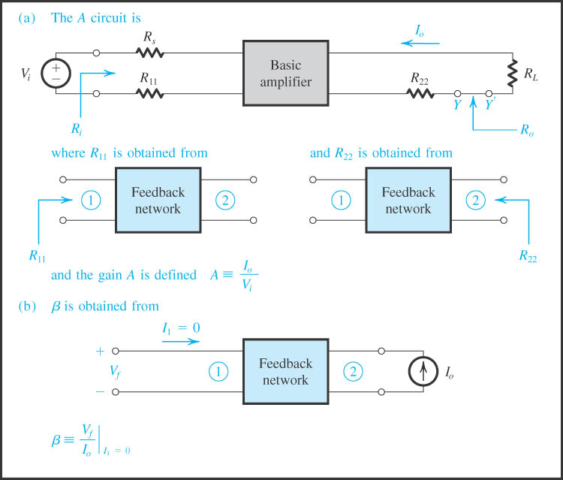

Slide 48
Summary
R_{i} and R_{o} are the input and output resistances, respectively, of the A circuit.
R_{if} and R_{of} are the input and output resistances, respectively, of the feedback amplifier, including R_{s} and R_{L}.

Slide 49
The actual input and output resistances exclude R_{s} and R_{L}.

Slide 50
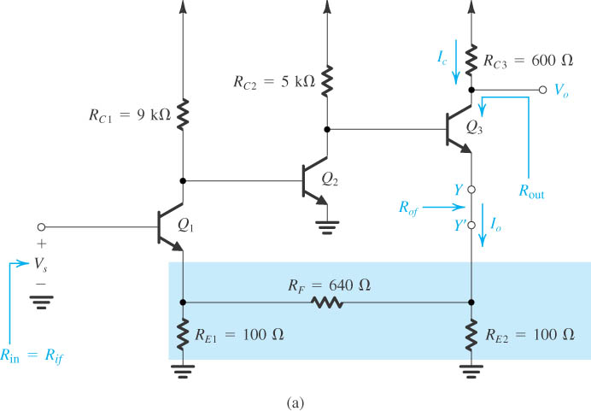
Example of Series-Series Feedback Amplifier

Slide 51
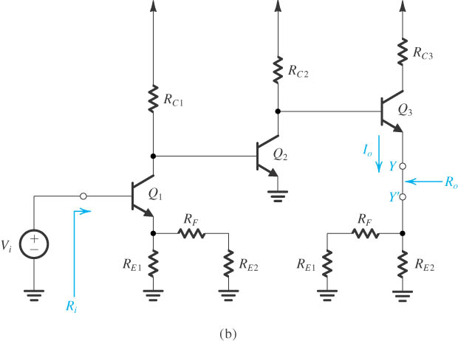
Example of Series-Series Feedback Amplifier

Slide 52
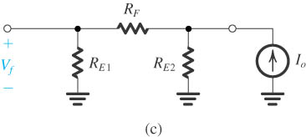
Example of Series-Series Feedback Amplifier

Slide 53
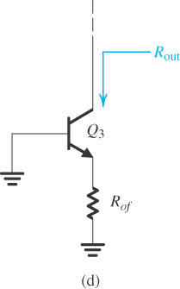
Example of Series-Series Feedback Amplifier

Slide 54
The Shunt-Shunt and Shunt-Series Feedback Amplifiers
Study by yourselves
Important notes:
Closed-loop gain
Feedback factor
Load effect
Summary
example

Slide 55
The Stability Problem
Closed-loop transfer function is similar to the one of the middle band gain.
The condition for negative feedback to oscillate

Slide 56
Any right-half-plane poles results in instability.
Amplifier with a single-pole is unconditionally stable.
Amplifier with two-pole is also unconditionally stable.
Amplifier with more than two poles has the possibility to be unstable.
Stability study using bode plot

Slide 57
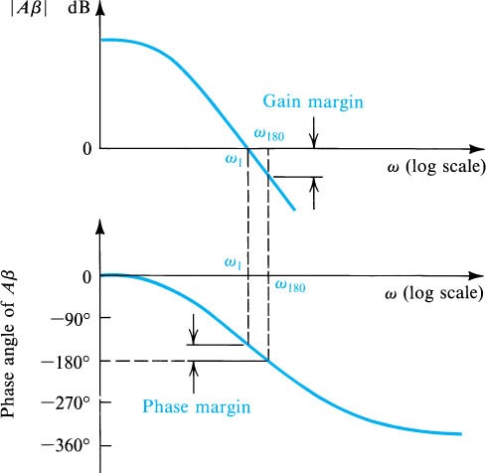
The Definitions of the Gain and Phase margins

Slide 58
Gain margin represents the amount by which the loop gain can be increased while stability is maintained.
Unstable and oscillatory
Stable and non-oscillatory
Only when the phase margin exceed 45º or gain margin exceed 6dB, can the amplifier be stable.

Slide 59
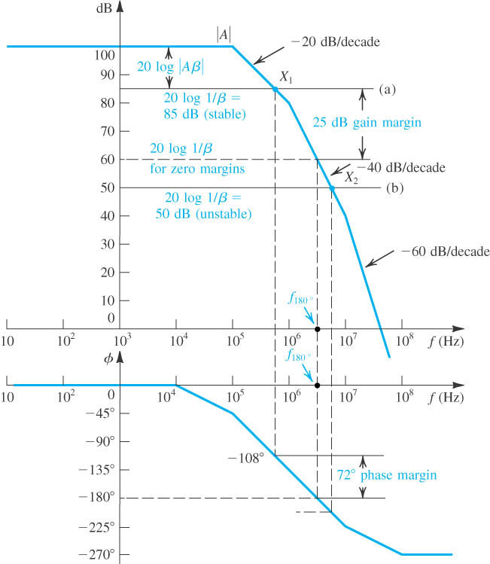
Stability analysis using Bode plot of |A|

Slide 60
Stability Analysis Using Bode Plot of |A|
Gain margin and phase margin
The horizontal line of inverse of feedback factor in dB.
A rule of thumb:
The closed-loop amplifier will be stable if the 20log(1/β) line intersects the 20log|A| curve at a point on the –20dB/decade segment.

Slide 61
The general rule states:
At the intersection of 20log[1/ | β (jω)| ] and 20log |A(jω)| the difference of slopes should not exceed 20dB/decade.

Slide 62
Frequency Compensation
The purpose is to modifying the open-loop transfer function of an amplifier having three or more poles so that the closed-loop amplifier is stable for any desired value of closed-loop gain.
Theory of frequency compensation is the enlarge the –20dB/decade line.

Slide 63
Implementation
Capacitance C_{c} added
Miller compensation and pole splitting

Slide 64
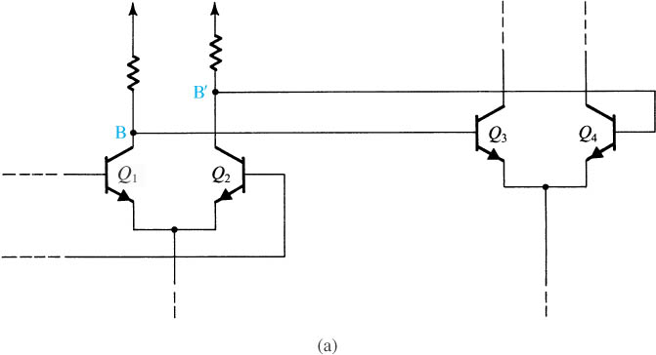
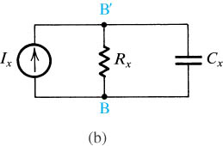
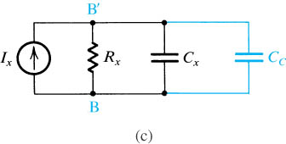
Frequency Compensation

Slide 65
Two cascaded gain stages of a multistage amplifier.
Equivalent circuit for the interface between the two stages in (a).
Same circuit as in (b) but with a compensating capacitor C_{C} added.

Slide 66
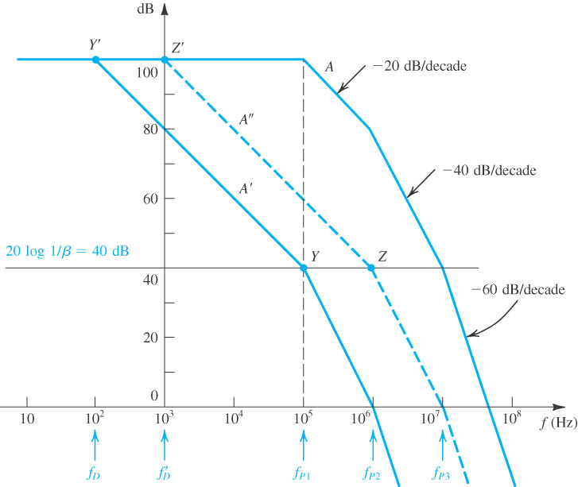

Slide 67
Frequency compensation for β = 10⁻². The response labeled A′ is obtained by introducing an additional pole at f_{D}. The A″ response is obtained by moving the original low-frequency pole to f ′_{D}.

Slide 68
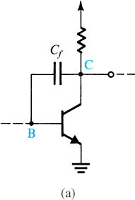
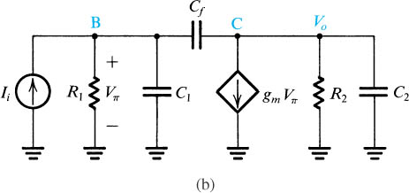
Frequency Compensation
A gain stage in a multistage amplifier with a compensating capacitor connected in the feedback path
An equivalent circuit.

