Slide 1
FUNCTIONAL OUTCOME SCALES

Slide 2
An outcome measure is a tool used to assess a patient’s current status. Outcome measures may provide a score, an interpretation of results and at times a risk categorization of the patient.
Prior to providing any intervention, an outcome measure provides baseline data. The initial results may help determine the course of treatment intervention.
Once treatment has commenced, the same tool may be used in serial assessments to determine whether the patient has demonstrated change.

Slide 3
With the move towards Evidence Based Practice (EBP) in health care, outcome measures provide credible and reliable justification for treatment on an individual patient level.
The results from outcome measures may also be grouped for aggregated analysis focused on determining quality of care.
When outcome measures are used in an aggregated data situation to compare results, a risk adjustment process is required to fairly compare results.

Slide 4
Functional outcome measures (FOM) should be the other obvious essential component of physical therapy, along with research. FOM are objective tests that have established reliability and validity, for that reason, it seems intuitive that FOM should be utilized and incorporated into any research study, thereby providing a greater degree of confidence in the validity of the study results. In this way, research can provide the evidence needed by utilizing measures that can be readily implemented by clinicians. FOM have been utilized in research studies to examine the effects of interventions in many varied patient populations.

Slide 5
A physical therapy examination should include several FOM to assess baseline function, establish goals, develop the Plan of care (POC), and demonstrate progress especially to the patient.
When FOM are not assessed for a patient, significant, quantifiable evidence of the patient’s status is overlooked and unreported. Information from FOM is not only useful to clinicians and insurance companies, but also to patients who become increasingly motivated and knowledgeable about their health status from an understanding of the FOM and interpretation of their score.

Slide 6
CLASSIFICATION
Outcome measures that we use in clinical practice are divided into four categories:
Self-report measures
Performance-based measures
Observer-reported measures
Clinician-reported measures

Slide 7
Self-report measures are typically captured in the form of a questionnaire. The questionnaires are scored by applying a predetermined point system to the patient's responses. Although self-report measures seem subjective in nature, self-report measures objectify a patient's perception.
Performance-based measures require the patient to perform a set of movements or tasks. Scores for performance-based measures can be based on either an objective measurement (e.g., time to complete a task) or a qualitative assessment that is assigned a score (e.g., normal or abnormal mechanics for a given task).

Slide 8
Observer-reported measures are measurements completed by a parent, caregiver or someone who regularly observes the patient on a daily basis.
Clinician-reported measures are measurements that are completed by a health care professional. The professional uses clinical judgement and reports on patient behaviors or signs that are observed by the professional.

Slide 9
Common functional outcome measurement tools used by physical therapist
The timed up and go test3﻿
The Tinetti balance and gait evaluation.
The Berg balance scale.
The six minute walk test4﻿
The functional reach test.
The Oswestry low back pain disability questionnaire.
The functional independent measure.

Slide 10
Objectives
Describe the need for outcomes planning
Describe the benefits and challenges with using outcome measures in clinical practice
Identify strategies to facilitate the use of outcome measures in clinical practice.
Identify strategies to overcome challenges to implementing outcome measurement in clinical practice.
Effectively sustain outcome measurement use across his or her practice, and across practice sites or programs.
2

Slide 11
Benefits of Outcome Measures: Clinicians and Patients
Recommended for use in various clinical guidelines, and implementation leads to improved patient outcomes and satisfaction
Identifies and quantifies impairment, activity limitations, participation restrictions and personal factors
Assists in clinical-decision making
Helps determine whether treatment plan is appropriate
Identifies whether patient is making meaningful progress
Determines whether patient is at risk for falls, impairment levels, prognosis, etc
Diagnosis and referrals
Enhances communication between clinicians, referral sources and insurance companies
Engages and motivates patients
(Bekkering et al, 2005; Duncan et al, 2002; Reker et al, 2002, 3
Swinkels 2011, Jette 2009, Finch 2002, Kay 2001)

Slide 12
Benefits of Outcome Measures: Organizations
Increases accountability
– Provides mechanism to compare clinician outcomes
Improves efficiency of clinicians
Improves care and outcomes of clinical care
(Swinkels 2011, Jette 2009, Finch 2002, Kay 2001)
4

Slide 13
The need for outcomes planning
Policy
Centers for Medicare & Medicaid Services
Commission on the Accreditation of Rehabilitation Facilities (CARF)
Affordable Care Act of 2010
5

Slide 14
Client/patient: Feedback on progress identified by standardized measures improves outcomes
Individuals that received daily reinforcement of speed had greater walking speed
at discharge than those that didn’t receive reinforcement (Dobkin et al, 2010)
Individuals who received enhanced medical rehabilitation showed higher intensity therapy, more engagement in therapy sessions, improved gait speed, and 6 min walk distance when compared to those who received standard rehabilitation (Lenze et al , 2012)

Slide 15
Clinical Utilization of Standardized Instruments
52% of Physical Therapists reported not using standardized measurements, 49% of these indicated no future plans to use standardized assessments
Mental health practitioners utilize their own intuition more than standardized measures to monitor progress
Oncologists rely more on their own impressions and informal assessments to make decisions
Nurses rely on clinical judgment to manage patients
(Jette et al, 2009; Garland et al, 2003; Taylor et al, 1996; Meadow et al, 1998)
6

Slide 16
Common Facilitators
Individual
Positive attitude: to measurement and change, convinced of benefits
Flexibility: room for personal considerations
Practicality: immediacy, negotiate with insurers, quality improvement
(Swinkels 2011, Jette 2009, Finch 2002, Kay 2001)
16

Slide 17
External
Access to resources: range of measures, guide to selection
Provide summaries of research written in an understandable manner (Bury, 1996)
Concisely summarized research (Jette et al, 2003)
Free online resources that are available at the point of care (Jette et al, 2003)
Support: from colleagues (opinion leaders) and organization
Guidance in selection, administration, scoring, and interpretation
(Swinkels 2011, Jette 2009, Finch 2002, Kay 2001

Slide 18
Common Challenges
Individual
Time: to search, administer, score, interpret
Knowledge: to select, interpret
Resources too few available, too many to choose, difficult to set up,
equipment required, unclear instructions, difficult to interpret
Competence: education, routine, experience
Attitude: resist change/set in ways, skeptical, overwhelmed, confidence
Opinion leader (vs. champion)
(Swinkels 2011, Jette 2009, Finch 2002, Kay 2001)
18

Slide 19
Organizational
Time and Cost: investment required, no compensation
Policy: no policy, poor adherence/compliance
Culture: congruence/conflict at micro and macro levels

Slide 20
Discuss Solutions to Clinical Challenges
Documentation
Advocate for clinical useful, important measures to be a part of your electronic medical records at your institution.
Available test packets
Create “cheat sheets” with meaningful change scores
Equipment
Designated testing areas for testing
Testing kits for common instruments
Have clinical students make testing kits

Slide 21
Time to administer
Instrument checklists for each patient
Integrate clinically useful assessments into the treatment process (for example, the kitchen test of the EFPT)

Slide 22
Discuss Solutions to Clinical Barriers
Training & Service Delivery
Develop in-services about potential measures that will address the needs of the populations you serve at your facility
Have staff share assessments that they’ve learned about at workshops that could benefit the team
Look for public domain instruments that can be used without cost
Share outcome measure data at team meetings

Slide 23
Read articles about different measures and what they could contribute to practice strategies
Start a journal club or brown bag outcome meeting
Work with your quality assurance staffing to relate your data back to those being reported by the entire facility or for accreditation purposes.
Share data between disciplines so there is not unnecessary duplication of
testing, and that outcome results can be used across the team

Slide 24
Databases and Resources

Slide 25
Outcome Measurement Resources
Rehabilitation Measures Database:
www.rehabmeasures.org
~200 instrument summaries of psychometric properties and clinical utility
Includes a link to the testing document whenever possible

Slide 26
Outcome Measurement Resources
APTA Neurology Section EDGE recommendations
www.neuropt.org/professional-resources/neurology-section-outcome-measures- recommendations
Review of instruments used in physical therapy that assess patients with Stroke,
MS, TBI, SCI (PD and vestibular to come this year)
Recommendations instruments to be used in clinical practice

Slide 27
Outcome Measurement Resources
Stroke Engine Assess
strokengine.ca/assess/
Psychometrics and clinical utility information about instruments that can be used
with individuals with stroke
Provides instrument whenever possible

Slide 28
Outcome Measurement Resources
Center for Outcome Measurement in Brain Injury
www.tbims.org/combi/
~30 instrument reviews of psychometrics and clinical utility
Specific to measuring individuals with brain injury
Links to instrument whenever possible

Slide 29
Outcome Measurement Resources
Acquired Brain Injury Evidence Based Review
www.abiebr.com
Educational modules and case studies on evidence-based practice in brain injury
Includes chapter on psychometrics and clinical utility of instruments
Specific to individuals with brain injury

Slide 30
Outcome Measurement Resources
Evidence-based Review of Stroke Rehabilitation
www.ebrsr.com
Educational modules and case studies on evidence-based practice in stroke
Includes chapter on psychometrics and clinical utility of instruments
Specific to individuals with stroke

Slide 31
Outcome Measurement Resources
Orthopedic Scores
http://www.orthopaedicscore.com/
Measures that assess musculoskeletal conditions
No psychometric information, Minimal information about score interpretatio
Can score directly on test forms on website, website scores and produces completed test document
15

Slide 32
Outcome Measurement Resources
Physiopedia
http://www.physio-pedia.com/Outcome_Measures
Measures that assess musculoskeletal, neuro and common geriatric conditions
Psychometrics, clinical utility
Some videos to demonstrate test administration
15

Slide 33
Outcome Measurement Resources
Spinal Cord Injury Rehabilitation Evidence
www.scireproject.com
Educational modules and case studies on evidence-based practice in stroke
Includes chapter on psychometrics and clinical utility of instruments
Specific to individuals with spinal cord injury

Slide 34
Outcome Measurement Resources
Other website descriptions with links available at the Rehabilitation Measures Database at www.rehabmeasures.org/rehabweb/links.aspx

Slide 35
Classroom Activities

Slide 36
Overview of Classroom Activities
Discussion of need for standardized instruments
Develop a presentation on measurement
Adapting an evidence-based summary to meet your clinical needs
Develop a resource binder
Discuss responses to common reaction to measurement utilization.

Slide 37
Classroom Activity (1)
Activity: Discuss the need for outcomes at each of these levels:
Patient
Improvement in outcomes across ICF levels (body structure & function, activity, participation)
Length of stay
Satisfaction
Other?
Clinician
Changes in decision-making
Efficiency and Effectiveness
Satisfaction
Other?
Organizational or process level
Overall patient outcomes
Reimbursement
Planning Discharge
Other?
19

Slide 38
Classroom Activity (2)
Activity: Develop a presentation with your classmates that you could share at your clinical site or with your clinical instructor
How to use an outcome measure
The fundamentals of measurement – reliability, validity, indices of change, etc
A case description in which measurement was used
Include a list of resources that you could share at your clinical site.

Slide 39
Classroom Activity (3)
Activity: Adapt a summary from a free online website to meet your needs
Download content from the website
Adapt with clinically relevant information (examples in next few slides)
Save to share examples on your clinical

Slide 40
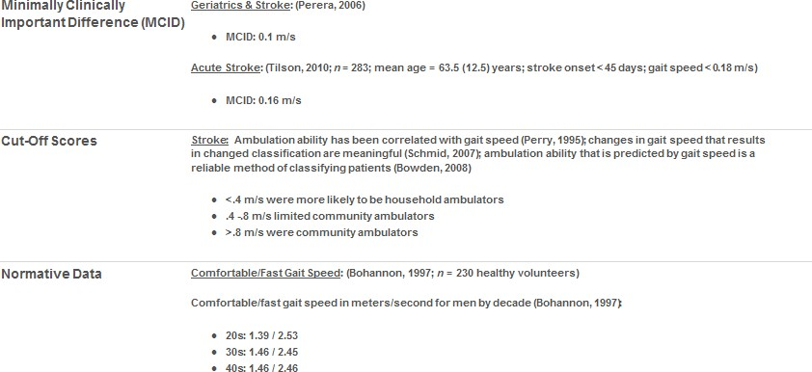

Slide 41
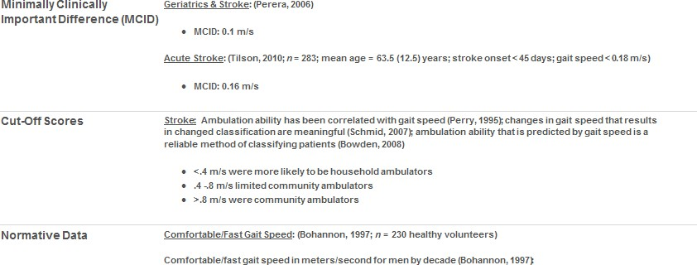
Include information relevant to your clinic:
Similar patient populations
Brief review of psychometrics
Indices of change
Considerations for use at your clinics (recommended in Outpatient vs. inpatient, etc)

Slide 42
Add site specific information:
Where is the equipment kept?
Specific area “marked” for 10 meter walk
When and how often will the measure be taken?
Recommendations for using in goals
Where and how is the instrument documented in the POC?
How are the results transferred to the next level of care?

Slide 43
Classroom Activity (4)
Activity: Develop resource binders
Copies of relevant outcome measures
Scoring sheets
List of website resources
One-page summaries of most pertinent information
Indications for use
Administration and scoring procedures
Interpretation information/data
Normative data
Responsiveness values

Slide 44
Describe how you would respond to the following comments
We don’t have time to collect outcome measures!
Nobody requires us to collect this information!
Measurement is unnecessary!
I want to spend my time treating patients, not measuring patients.
I already know how to bill using G codes.

Slide 45
Overall Discussion
What is the value of using the ICF to organize your clinical measures?
Why is it critical to use a client-centered approach?
Why should you use valid and reliable measures?
How can you interpret change and know that the patient has made a meaningful improvement?
What strategies could you use to introduce measures into your practice?
What can you do to overcome barriers you will find in developing an outcome measurement plan in your clinical site?

Slide 46
Questions and Discussion

Slide 47
References
Bekkering GE, van Tulder MW, Hendriks EJ, Koopmanschap MA, Knol DL, Bouter LM, Oostendorp RA. Implementation of clinical guidelines on physical therapy for patients with low back pain: randomized trial comparing patient outcomes after a standard and active implementation strategy. Phys Ther 2005; 85(6):544-555.
Duncan PW, Horner RD, Reker DM, Samsa GP, Hoenig H, Hamilton B, LaClair BJ, Dudley TK. Adherence to postacute rehabilitation guidelines is associated with functional recovery in stroke. Stroke 2002; 33(1):167-177.
Reker DM, Duncan PW, Horner RD, Hoenig H, Samsa GP, Hamilton BB, Dudley TK. Postacute stroke guideline compliance is associated with greater patient satisfaction. Arch Phys Med Rehabil 2002; 83(6):750-756.

Slide 48
References
Swinkels RA, van Peppen RP, Wittink H, Custers JW, Beurskens AJ. Current use and barriers and facilitators for implementation of standardized measures in physical therapy in the Netherlands. BMC Musculoskelet Disord 2011 May; 22; 12:106.
Jette DU, Halbert J, Iverson C, Miceli E, Shah P. Use of standardized outcome measures in physical therapist practice: perceptions and applications. Phys Ther 2009; 89:125-135.
Finch E, Brooks D, Stratford P, Mayo N. Physical rehabilitation outcome measures. 2nd ed. Hamilton: BC Decker; 2002.
Kay T, Myers A, Huijbregts M. How far have we come since 1992? A comparative survey of physiotherapists' use of outcome measures. Physiother Can 2001; 53(4):268-275.

Slide 49
References
Dobkin BH, Plummer-D’Amato P, Elashoff R, Lee J & SIRROWS Group. International randomized clinical trial, stroke inpatient rehabilitation with reinforcement of walking speed (SIRROWS), improves outcomes. Neurorehabilitation and Neural Repair 2010; 24:235.
Lenze EJ, Host JJ, Hildebrand MW, Morrow-Howell N, Carpenter B, Freedland KE, Baum CA, Dixon D, Core P, Wendleton L, & Binder EF. Enhanced medical rehabilitation increases therapy intensity and engagement and improves functional outcomes in postacute rehabilitation of older adults: A randomized-controlled trial. JAMDA 2012; 13:708-712.

Slide 50
References
Garland AF, Kruse M, Aarons GA. Clinicians and outcome measurement: what's the use? J Behav Health Serv Res 2003 Oct-Dec; 30(4):393-405.
Taylor KM, Macdonald KG, Bezjak A, Ng P, DePetrillo AD. Physicians' perspective on quality of life: an exploratory study of oncologists. Qual Life Res 1996 Feb; 5(1):5-14.
Meadows KA, Rogers D, Greene T. Attitudes to the use of health outcome questionnaires in the routine care of patients with diabetes: a survey of general practitioners and practice nurses. Br J Gen Pract 1998 September; 48(434):1555–1559.

Slide 51
Copyright Information
© 2013 by the Rehabilitation Institute of Chicago.

Slide 52
THANK YOU

