Slide 1
GENU RECURVATUM

Slide 2
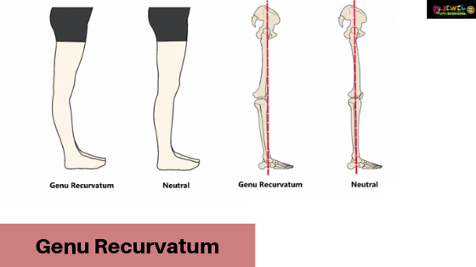
DEFINITION
Genu recurvatum is a deformity in the knee joint, so that the knee bends backwards. In this deformity, excessive extension occurs in the tibiofemoral joint.
Genu recurvatum is also called knee hyperextension and back knee. This deformity is more common in women and people with familial ligamentous laxity.

Slide 3
TYPES
Hyperextension of the knee may be :
mild,
moderate or
severe.

Slide 4
CAUSES
Bone growth disorder
An inherited problem or birth defect
Joints of the knee are not stable due to ligaments laxity
Femur and tibia is not properly aligned
Postural habits
Some medical diseases like multiple sclerosis, CP or muscular dystrophy
LLD
Unusual position of the ankle and foot when walking

Slide 5
SYMPTOMS
Pain on the outer back part of the knee referred to as the posterolateral ligamentous
An aching pain in the medial tibiofemoral joint
Knee moves in hyperextension in midstance phase
A nipping feeling in the front part of the knee

Slide 6
TREATMENT
Treatment generally includes the following:
Sometimes pharmacologic therapy for initial disease treatment
Physical therapy: physiotherapy will be beneficial in patient with complaint of pain, discomfort.
Use of appropriate assistive devices such as orthoses (KAFO, AFO, KO)
Surgical treatment

