Slide 1
GENU VALGUM

Slide 2
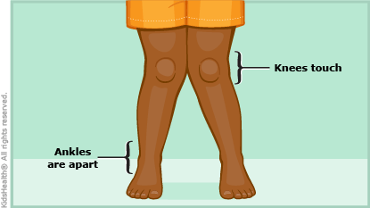
DEFINITION
Inward or medial angulation of leg over thigh at the knee joint is termed as genu valgum or knock knee.
In this, condition, a line drawn from the head of the femur to the middle of the ankle joint passes lateral to the knee joint instead of passing through the center of the knee.

Slide 3
CAUSES
It could be because of:
Rickets, producing curvatures in the femur or tibia.
Growth imbalance between the medial and lateral femoral condyles. Rapid overgrowth of medial condyle leads to knock knee.
Muscular or ligamentous weakness at adolescent stage.
Muscular paralysis of semimembranosus, semitendinosus.
Fracture and injuries involving the knee joint.
Secondary to coxa vara, flat foot, OA knees or spinal curvatures.
Obesity
Deficiency of vitamin D and calcium

Slide 4
CLINICAL FEATURES
Symptoms of genu valgum include an obvious visual separation of the ankles when the knees are together. The individual’s gait is also likely to be affected as they compensate for the lack of gap between their knees.
The altered gait may cause additional symptoms, such as;
knee pain
a limp when walking
pain in feet, hips, and ankles
stiff joints
lack of balance when standing

Slide 5
DIAGNOSIS
The diagnosis is done through:
Physical examination of knee : The knee is evaluated for the degree of deformity in the weight bearing position. Intramalleolar distance is noted which could vary from 2 inches to 20 inches. The angle of genu valgum is measured with a goniometer or using weight bearing X-Rays.
X-Ray
MRI

Slide 6
TREATMENT
The treatment is directed towards the causative factor. Specially designed orthosis with lateral uprights and a broad knee strap to pull the knee joint laterally is given. The patients are treated by corrective osteotomy.
PHYSIOTHERAPEUTIC MANAGEMENT
Cases treated conservatively: Correct method of applying orthosis, weight transfers and proper ambulation is taught.
Following surgery
Graded knee mobilization constitutes the major part of physiotherapy. Knee mobilization should be initiated in a small range as relaxed free movement, progressing gradually.
Thermotherapy adjunct should be used as a pain controlling measure.
Strengthening exercises for the quadriceps, hamstrings and glutei should be instituted.

