Slide 1
Gastro retentive Drug Delivery Systems

Slide 2
Gastro retentive Drug Delivery Systems
Gastro retentive systems can remain in the gastric region for several hours and hence significantly prolong the gastric residence time of drugs.
Prolonged gastric retention
improves bioavailability
reduces drug waste and
improves solubility

Slide 3
It has applications also for local drug delivery to the stomach and proximal small intestines.
Gastro retention helps to provide better availability of new products with new therapeutic possibilities and substantial benefits for patients.

Slide 4
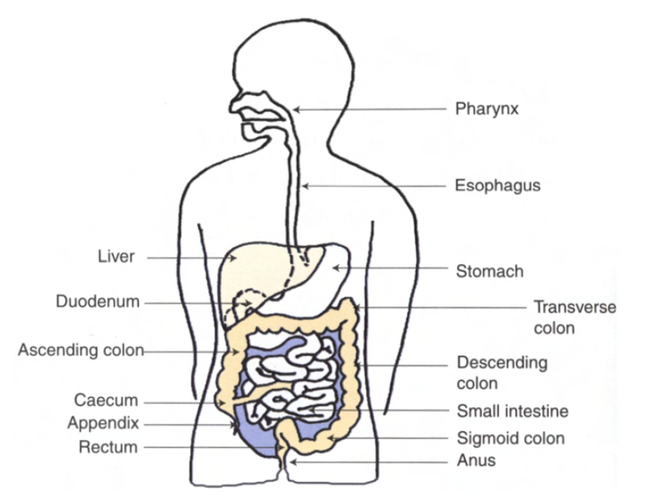
Fig. Anatomy of GI Tract:

Slide 5
The role of digestive system is to break down complex molecules, derived from ingested food, into simple ones for absorption into the blood or the lymph.
This process occurs in five main phases, within defined regions of the gastrointestinal system-
• ingestion (mouth);
• fragmentation (mouth and stomach);
• digestion (stomach and small intestine);
• absorption (small and large intestine);
• elimination of waste products (large intestine).

Slide 6
Basic Gastrointestinal Tract Physiology
Anatomically the stomach is divided into 3 regions:
Fundus
Body and
Antrum (pylorus)
The proximal part made of fundus and body acts as a reservoir for
undigested material, whereas the antrum is the main site for mixing motions and act as a pump for gastric emptying by propelling actions.

Slide 7
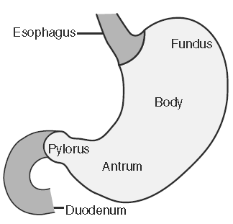

Slide 8
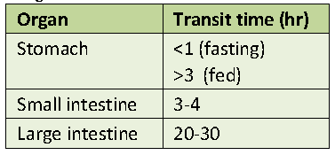
Table: Transit time of various parts of GIT

Slide 9
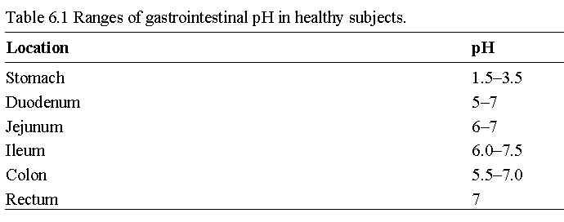
Table: pH environment in different parts of GIT

Slide 10
FACTORS CONTROLLING GASTRIC RETENTION OF DOSAGE
FORMS
Density of dosage form
Dosage forms having a density lower than that of gastric fluid experience floating behaviour and hence gastric retention.
A density of <1.0 gm/ml is required to exhibit floating property.
However, the floating tendency of the dosage form usually decreases as a function of time, as the dosage form gets immersed into the fluid, as a result of the development of hydrodynamic equilibrium.

Slide 11
2. Shape and size of the dosage form
The mean gastric residence times of non-floating dosage forms are highly variable and greatly dependent on their size, which may be large, medium and small units.
In most cases, the larger the dosage form the greater will be the gastric retention time (GRT) due to the larger size of the dosage form would not allow this to quickly pass through the pyloric antrum into the intestine.
Ring-shaped and tetrahedron-shaped devices have a better gastric residence time as compared with other shapes.

Slide 12
3. Food intake and nature of food
Food intake, the nature of the food, caloric content, and frequency of feeding have a profound effect on the gastric retention of dosage forms.
The presence or absence of food in the stomach influences the GRT of the dosage form.
Usually, the presence of food increases the GRT of the dosage form and increases drug absorption by allowing it to stay at the absorption site for a longer time.

Slide 13
4. Effect of gender, posture and age
Generally females have slower gastric emptying rates than male.
The effect of posture does not have any significant difference in the mean gastric retention time (GRT) for individuals in upright, ambulatory and supine state.
In case of elderly persons, gastric emptying is slowed down.

Slide 14
POTENTIAL DRUG CANDIDATES FOR GASTRORETENTIVE
DRUG DELIVERY SYSTEMS
1. Drugs those are locally active in the stomach
e.g. misroprostol, antacids etc.
2. Drugs that have narrow absorption window GIT
e.g. L-DOPA, para aminobenzoic acid, furosemide, riboflavin etc.
3. Drugs those are unstable in the intestinal or colonic environment
e.g. captopril, ranitidine HCl, metronidazole.
4. Drugs that disturb normal colonic microbes
e.g. antibiotics against Helicobacter pylori.
5. Drugs that exhibit low solubility at high pH values
e.g. diazepam, chlordiazepoxide, verapamil HCl

Slide 16
DRUGS THOSE ARE UNSUITABLE FOR GASTRORETENTIVE
DRUG DELIVERY SYSTEMS
1. Drugs that have very limited acid solubility
e.g. phenytoin etc.
2. Drugs that suffer instability in the gastric environment
e.g. erythromycin etc.
3. Drugs intended for selective release in the colon
e.g. 5- amino salicylic acid and corticosteroids etc.

Slide 17
ADVANTAGES OF GASTRORETENTIVE DRUG DELIVERY
SYSTEMS
Enhanced bioavailability
The bioavailability of riboflavin GRDF is significantly enhanced in comparison to the administration of non-GRDF polymeric formulations.
There are several different processes, related to absorption and transit of the drug in the gastrointestinal tract, that act concomitantly to influence the magnitude of drug absorption.

Slide 18
2. Sustained drug delivery/Reduced frequency of dosing
For drugs with relatively short biological half life, sustained and slow input from GRDF may result in improved pharmacokinetics and reduced dosing frequency.
This feature is associated with improved patient compliance and thereby improves therapy.

Slide 19
3. Targeted therapy for local ailments in the upper GIT
The prolonged and sustained administration of the drug from GRDF to the stomach may be advantageous for local therapy in the stomach and small intestine.
By this mode of administration, therapeutic drug concentrations may be attained locally while systemic concentrations, following drug absorption and distribution, are minimal.

Slide 20
4. Reduced fluctuations of drug concentration
Continuous input of the drug following GRDF administration produces blood drug concentrations within a narrower range compared to the immediate release dosage forms.
Thus, fluctuations in drug effects are minimized and concentration dependent adverse effects that are associated with peak concentrations can be prevented.
This feature is of special importance for drugs with a narrow therapeutic index.

Slide 21
5. Site specific drug delivery
A floating dosage form is a feasible approach especially for drugs which have limited absorption sites in upper small intestine.
The controlled, slow delivery of drug to the stomach provides sufficient local therapeutic levels and limits the systemic exposure to the drug.
This reduces side effects that are caused by the drug in the blood circulation.
In addition, the prolonged gastric availability from a site directed delivery system may also reduce the dosing frequency.

Slide 22
TYPES OF GASTRORETENTIVE DOSAGE FORMS
Floating drug delivery systems
Floating drug delivery systems (FDDS) have a bulk density less than gastric fluids and so remain buoyant in the stomach without affecting gastric emptying rate for a prolonged period of time.
While the system is floating on the gastric contents, the drug is released slowly at the desired rate from the system.
After release of drug, the residual system is emptied from the stomach.
This results in an increased GRT and a better control of the fluctuations in plasma drug concentration.

Slide 23
FDDS can be divided into Non-effervescent and effervescent system
(a) Non-effervescent systems
This type of system, after swallowing, swells unrestrained via imbibition of gastric fluid to an extent that it prevents their exit from the stomach.
One of the formulation methods of such dosage forms involves the mixing of the drug with a gel, which swells in contact with gastric fluid after oral administration.

Slide 24
The air trapped by the swollen polymer confers buoyancy to these dosage forms.
Excipients used most commonly in these systems include
Hydroxypropyl methyl cellulose (HPMC)
Polyacrylate polymers
Polyvinyl acetate
Carbopol
Agar
Sodium alginate
Calcium chloride
Polyethylene oxide
Polycarbonates

Slide 25
Colloidal gel barrier system
On coming in contact with gastric fluid, the hydrocolloid in the system hydrates and forms a colloid gel barrier around its surface.
This prolongs GRT and maximizes the amount of drug that reaches its absorption sites in the solution form for ready absorption.
This system incorporates a high level of one or more gel-forming highly soluble cellulose type hydrocolloid.
e.g., Hydroxypropyl cellulose, Hydoxyethyl cellulose, Hydroxypropyl methyl cellulose (HPMC), Polysacharides and Matrix-forming polymer such as Polycarbophil, Polyacrylate and Polystyrene.

Slide 26
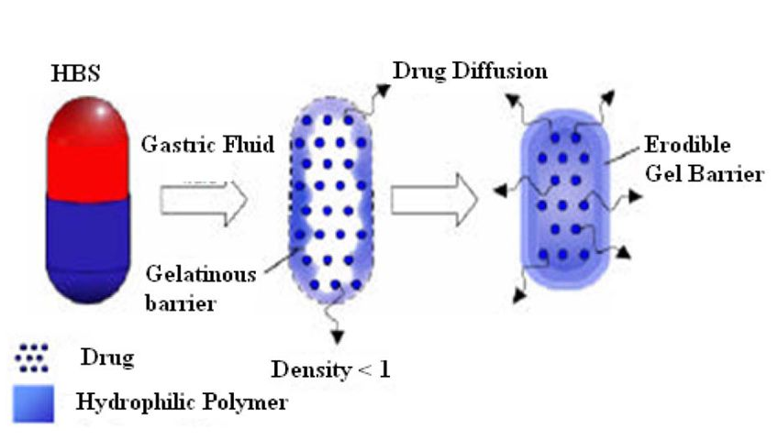
Fig. Colloidal gel barrier system

Slide 27
(b) Gas-generating (Effervescent) systems
These buoyant systems utilize matrices prepared with
swellable polymers such as methocel, polysaccharides (e.g., chitosan)
effervescent components (e.g., sodium bicarbonate, citric acid or tartaric acid)
The system is so prepared that upon arrival in the stomach, carbon dioxide is released, causing the formulation to float in the stomach.

Slide 28
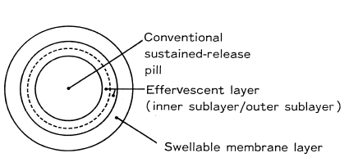
Fig. A typical effervescent system

Slide 29
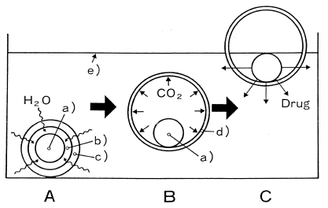
Fig. Mechanism of drug release in an effervescent system

Slide 30
Evaluation of Gastro retentive Drug Delivery Systems
Floating time
The test for floating time measurement is usually performed in simulated gastric fluid or 0.1 mole.lit-1 HCl maintained at 370C.
It is determined by using USP dissolution apparatus containing 900 ml of 0.1 mole.lit-1 HCl as the dissolution medium at 370C.
The time taken by the dosage form to float is termed as floating lag time and the time for which the dosage form floats is termed as the floating or flotation time

Slide 31
2. Drug release:
Dissolution tests are performed using the dissolution apparatus.
Samples are withdrawn periodically from the dissolution medium with replacement and then analyzed for their drug content after an appropriate dilution.

Slide 32
3. Content uniformity, Hardness, Friability (Tablets)
4. Drug loading, drug entrapment efficiency, particle size analysis, surface characterization (for floating microspheres and beads), Swelling index
5. X-Ray/Gamma Scintigraphy
6. Pharmacokinetic studies

Slide 33
7. Gastroscopy
Gastroscopy is commonly used for the diagnosis and monitoring of the GI tract. This technique utilizes a fiber-optic or video system and can be easily applied for monitoring and locating GRDFs in the stomach.
However, it is too inconvenient to conduct the procedure frequently in the same experiment for one subject. In human, the procedure can be applied with or without slight anaesthesia while it requires complete anaesthesia in dogs.

