Slide 1
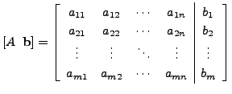
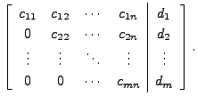
Gauss Elimination Method
DEFINITION (Forward/Gauss Elimination Method)
Gaussian elimination is a method of solving a linear system Ax=b consisting of m equations and n unknowns by bringing the augmented matrix
to an upper triangular form

Slide 2
The following examples illustrate the Gauss elimination procedure.
EXAMPLE Solve the linear system by Gauss elimination method.
y+z = 2
2x +3z =5
x+y+z = 3
Solution: In this case, the augmented matrix is
Interchange 1st row and 2nd equations (row)
Divide the Ist equation by 2

Slide 3
Continued…..

Slide 4
R3-→R3-R2

Slide 5
R3→(-2/3)R3

Slide 6
Using Back substitution method we have equation form
Last equation gives
z=1
Put z=1 in last second equation y+z=2 we have
y=1
Now put y and z in first equation x+3/2z=5/2, we have
x= 1
Hence solution of the system is (x,y,z)=(1,1,1)

Slide 7
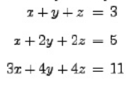
Exercise:
Solve the following system of linear equation by Gauss Elimination Method

