Slide 1
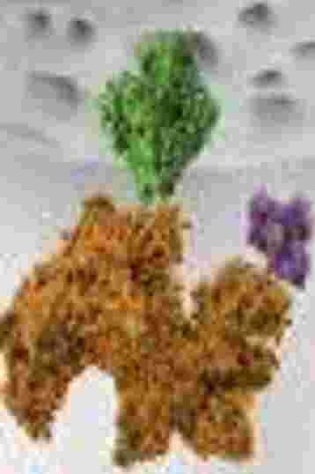
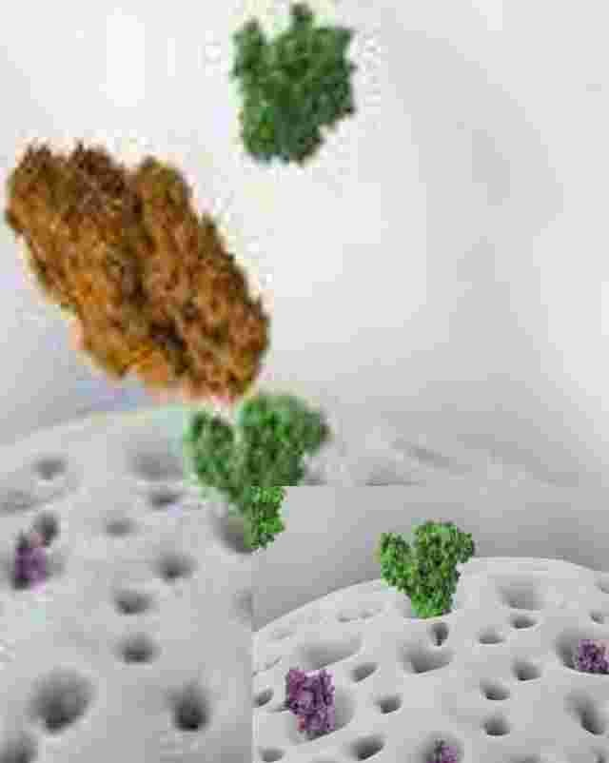
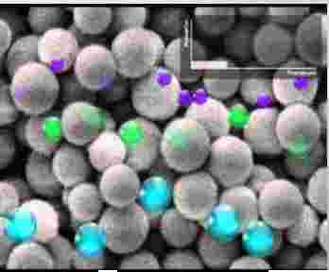
GEL PERMEATION CHROMATOGRAPHY
'

Slide 2
➢Introduction
➢Principle of separation
➢Theory of separation
➢GPC components
➢Experimental setup
➢Separation procedure
➢Advantages and disadvantages
➢Applications

Slide 3
Introduction
❖ Gel permeation chromatography
❖ Gel chromatography
❖ Size exclusion chromatography
❖ Gel filtration
❖ Molecular-sieve chromatography
Definition:
Technique : separation of components based on the difference in molecular
weight or size, and is one of the effective methods used to isolate and analyze the bio-
macromolecular substances.

Slide 4
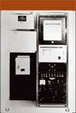
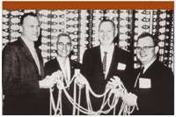
Brief background Literature
◆ 1951-1955 the SEC concept was first recognised but was not clearly formulated
◆ 1963- Jim Waters build the first commercial GPC equipment based on John Moore’s design
  1979- Yau, Kirkland and Bly published the first definitive text on SEC which contributed to the success of SEC and a complete revised edition was publish in 2009.
Model GPC-100 price $12,500
Jim Waters - John C. Moore - Prof. Fred V. -
Larry E. Maley

Slide 5
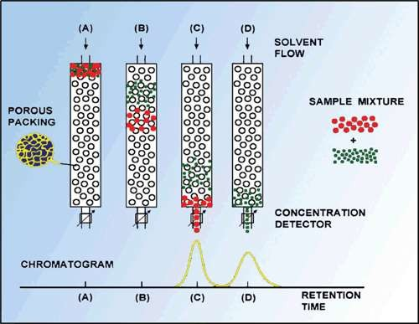
Principle of
It’s a technique that separates dissolved molecules on the basis of their size by pumping these molecules through specialized columns containing a microporous packing material(gel).
Stationary phase is a porous polymer matrix whose pores are completely filled with the solvent to be used as the mobile phase.
The pore size is highly critical, since the basis of the separation is that molecules above a certain size are totally excluded from the pores, and the interior of the pores is accessible, partly or wholly, to smaller molecules.
The flow of mobile phase will cause larger molecules to pass through the column unhindered, without penetrating the gel matrix, whereas smaller molecules will be retarded according to their penetration of the gel.
separation
➢
➢
➢
➢

Slide 6
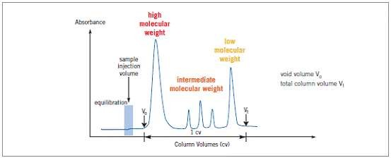
Theory of separation
A column is made up of swollen gel particles and the solvent used to swell the gel in a suitable
tubular container.
An equation is given below:
Vt = V0 + Vi + Vm
where,
Vt = the total volume of the column (which can be measured),
V0 = the volume of liquid outside the gel matrix (known also void or dead volume),
Vi = the volume of liquid inside the matrix,
Vm = the volume of the gel matrix

Slide 7
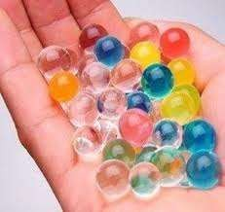
GPC
components
1.
2.
3.
4.
5.
Stationary Phase
The Mobile Phase
The Columns The Pump Detectors
1. Stationary phase:
Composed of semi-permeable, porous polymer gel beads with well defined range of pore sizes .
Properties of gel beads:
1- Chemically inert
2- Mechanically stable
3- Has ideal and homogeneous porous structure (wide pore size give low resolution).
4- Uniform particle and pore size.
5- The pore size of the gel must be carefully controlled.
Examples of gel
➢ Dextran(Sephadex) gel: An α 1-6-polymer of glucose natural gel
➢ Agarose gel: A 1,3 linked β-D-galactose and 1,4 linked 3,6-anhydro-α, L-galactose natural gel
➢ Acrylamide gel: A polymerized acrylamide, a synthetic gel

Slide 8
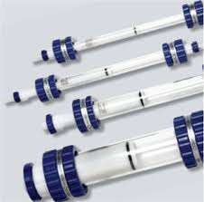
2. The Mobile Phase
Composed of a liquid used to dissolve the biomolecules to make the mobile phase
permitting high detection response and wet the packing surface.
Material Solvent
Synthetic elastomers Toluene
( polybutadiene , polyisoprene )
PS, PVC, Styrene-Butadiene Tetrahydrofuran (THF) Rubber , Epoxy resins
Polyolefins Tri- chloro -benzene
Polyurethane Di- methylformamide (DMF)
Proteins, polysaccharides Water / Buffers
3. Columns
Commercially Available Columns include
◆ Analytical column- 7.5–8mm diameters.
◆ Preparative columns-22–25mm
◆ Usual column lengths-25, 30, 50, and 60 cm.
◆ Narrow bore columns- 2–3mm diameter
have been introduced

Slide 9
4. The pump
Are either syringe pumps or reciprocating pumps with a highly constant flow rate.
5. Detectors
Concentration sensitive detectors
• Bulk Property Detectors- Refractive Index (RI) Detector
• Solute Property Detectors- Ultraviolet (UV) Absorption Detector
• Evaporative Detectors- Evaporative Light Scattering Detector (ELSD)
Molar mass sensitive detectors
1. Light Scattering Detectors
• Low Angle Light Scattering (LALS) Detectors
• Multiangle Light Scattering (MALS) detectors
2. Viscosity Detectors- Differential Viscometers

Slide 10
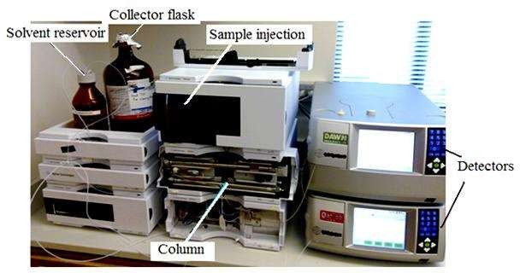
Experimental setup

Slide 11
Separation procedure
1- Preparation of column for gel filtration which involves
◆ Swelling of the gel
◆ Packing the column
◆ Washing: After packing, several column volumes of buffer solution
is passed through the column to remove any air bubbles and to test
the column homogeneity.
2- Loading the sample onto the column using a syringe
3- Eluting the sample and detection of components

Slide 12
Advantages
and
disadvantages
Advantages:
◆ Short analysis time.
◆ Well defined separation.
◆ Narrow bands and good sensitivity.
◆ There is no sample loss.
◆ Small amount of mobile phase required.
◆ The flow rate can be set.
Disadvantages:
◆ Limited number of peaks that can be resolved within the short time scale of the GPC run.
◆ Filtrations must be performed before using the instrument to prevent dust and other
particulates from ruining the columns and interfering with the detectors.
◆ The molecular masses of most of the chains will be too close for the GPC separation to show anything more than broad peaks.

Slide 13
Applications of GPC
◆ Proteins fractionation
◆ Purification
◆ Molecular weight determination.
◆ Separation of sugar, proteins, peptides, rubbers and others on the basis of their size.
◆ This technique can be use to determine the quaternary structure of purified proteins.

